Slide 1
Global COVID-19 Analysis Dashboard
AnalystLab Africa Data Analytics Internship
Week 4:Data Visualization and Dashboarding Project
Tool Used: Microsoft Power BI
Prepared by: Tinotenda Chadzingwa

Slide 2
Dataset Overview
Dataset Source:
Johns Hopkins COVID-19 Global Time Series Dataset
Datasets Used:
Confirmed Cases Dataset – contains cumulative confirmed COVID-19 cases by country and date.
Deaths Dataset – contains cumulative COVID-19 deaths by country and date.
Recovered Dataset – contains cumulative recovered cases by country and date.
Data Fields:
Country/Region
Date
Confirmed Cases
Deaths
Recovered Cases
Purpose:
> The dataset was used to analyze global COVID-19 trends, compare country-level impact, and create an interactive dashboard for data-driven insights.

Slide 3
Business Problem
The COVID-19 pandemic generated large amounts of data that required effective analysis and visualization to support understanding and decision-making.
The dashboard aims to answer:
How did global COVID-19 cases change over time?
Which countries were most affected by the pandemic?
What were the differences in confirmed cases, deaths, and recoveries across countries?
What were the recovery and death rates?
Objective:
> To develop an interactive dashboard that transforms COVID-19 data into meaningful insights through data visualization and KPI analysis.

Slide 4
Key Performance Indicators
The dashboard uses key metrics to summarize the impact of COVID-19 globally and by country.
KPIs:
1. Total Confirmed Cases
Shows the total number of reported COVID-19 cases.
2. Total Deaths
Shows the total number of reported deaths related to COVID-19.
3. Total Recoveries
Shows the number of reported recovered cases.
4. Recovery Rate
Measures the percentage of confirmed cases that recovered.
Formula: Recovery Rate = (Recovered Cases ÷ Confirmed Cases) × 100
5. Death Rate
Measures the percentage of confirmed cases that resulted in deaths.
Formula: Death Rate = (Deaths ÷ Confirmed Cases) × 100

Slide 5
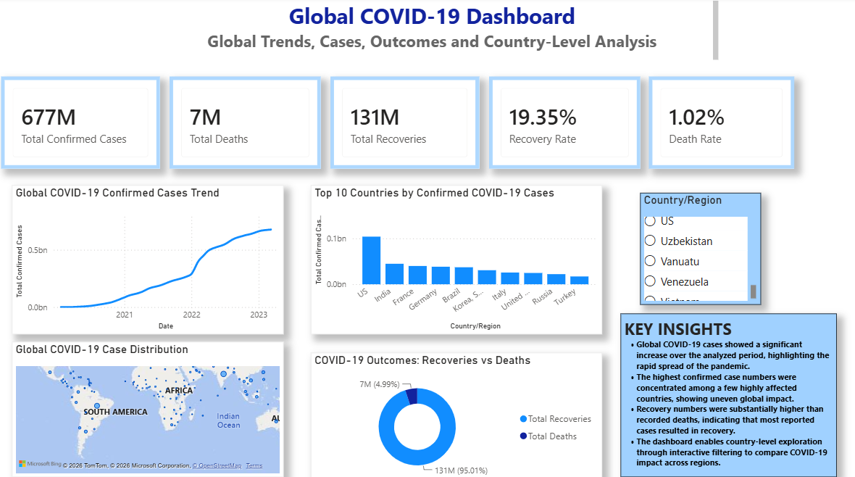
COVID-19 Analysis Dashboard

Slide 6
Key Insights
1. Global Case Trends
Confirmed COVID-19 cases increased significantly over the analyzed period, showing the progression of the pandemic globally.
2. Country-Level Impact
The impact of COVID-19 varied across countries, with differences in confirmed cases, deaths, and recoveries.
3. Recovery and Death Outcomes
Recovery and death rates provided insights into the outcomes of reported COVID-19 cases across different regions.
4. Interactive Analysis
The dashboard enables users to explore global and country-level trends through interactive filtering.

Slide 7
Recommendations
Based on the dashboard analysis, the following recommendations are suggested:
1. Data-Driven Monitoring
Use interactive dashboards to continuously monitor health trends and support timely decision-making.
2. Improve Data Quality
Encourage consistent and accurate reporting of health data across regions.
3. Resource Planning
Use insights from data analysis to support planning and allocation of healthcare resources.
4. Future Analysis
Combine COVID-19 data with additional health and demographic information for deeper insights.

Slide 8
Challenges Faced
During the project, the following challenges were encountered:
Cleaning and preparing multiple COVID-19 datasets.
Creating relationships between separate tables in Power BI.
Developing accurate DAX measures for KPIs and rates.
Ensuring all visuals responded correctly to slicer selections.
Designing a dashboard that was both interactive and easy to understand.

Slide 9
Conclusion
This project successfully transformed COVID-19 data into an interactive Power BI dashboard. The dashboard provides clear visualizations of confirmed cases, deaths, recoveries, and key performance indicators, enabling users to explore trends and gain meaningful insights through interactive filtering.
Closing Statement:
The project demonstrates how data visualization can support informed decision-making by presenting complex health data in a clear, interactive, and easy-to-understand format.

