Slide 1
Strategic Recommendation for Chip Category Review
March 2025
Customer Analytics and Segmentation

Slide 2
Notes:
To view Privacy video explaining how important data privacy is to Quantium, please click here: https://www.youtube.com/watch?v=Zq1QDAkoRzU
or here Q:\Company Reference\Brand & Design\Brand videos\Q Privacy.mp4
At Quantium, we believe that data is the behavioural footprint of humanity and that it has to be treated with the utmost care and responsibility.
Histories, attitudes, indeed lives are stored within it in ways that aren’t always apparent – and that’s what makes its potential so powerful.
To work with it responsibly, sensitively, we set ourselves the highest data privacy protection and governance standards.
We have spent 17 years perfecting privacy-by-design and secure-by-design principles. Central to this is not holding any personally identifiable information about people –
we neither receive it, and put the necessary protections in place to be unable to decipher it.
Every aspect of handling data is safeguarded: from its de-identification, to its encryption – data security is paramount and of the highest grade.
We pride ourselves on gaining the trust of iconic organisations around the world through years of securely working with their data,
and in turn the trust that builds with their stakeholders.

Slide 3
Table of Contents
01
Executive Summary
02
Overview and Key Findings
03
Customer Segmentation & Purchasing Behaviour
04
Experimentation & Uplift Testing
05
Trial Store Performance
06
Control Store Analysis
07
Impact Assessment & Conclusion

Slide 4
Executive summary
01
Task 1
Objective: Analyze customer purchasing behavior for chip category.
Key Findings:
Segmentation based on LIFESTAGE and PREMIUM_CUSTOMER attributes.
Identified key metrics: total spend, frequency of purchase, product preferences.
Insights on how different customer segments impact sales.
Strategic Recommendation: Focus on tailoring product offerings based on customer segments to drive sales, especially among premium customers.
02
Task 2
Objective: Evaluate the impact of new chip category layouts in trial stores.
Key Findings:
Trial stores (77, 86, and 88) tested new layouts from Feb-April 2019.
Control stores were selected based on sales, customer count, and transactions.
The performance of trial stores showed positive results compared to controls.
Strategic Recommendation: The trial layout led to an increase in sales, which can inform future layout decisions.

Slide 5
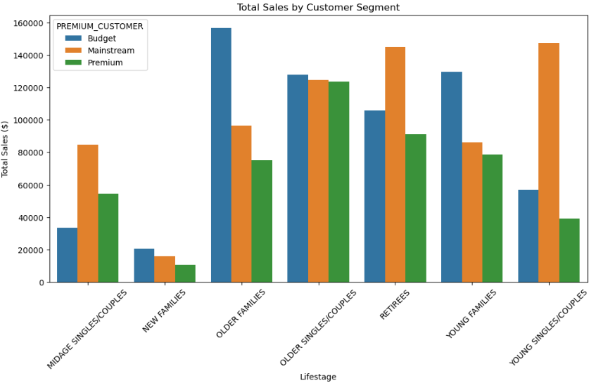
Overview – Key Callouts for the Category
Overview of the Chip Category: How consumer behavior, especially by affluence and life stage, impacts chip sales.
Key Insights:
Affluence: Higher income customers tend to buy premium chips more frequently.
Life Stage: Older Singles/Couples purchase in larger quantities and more frequently.

Slide 6
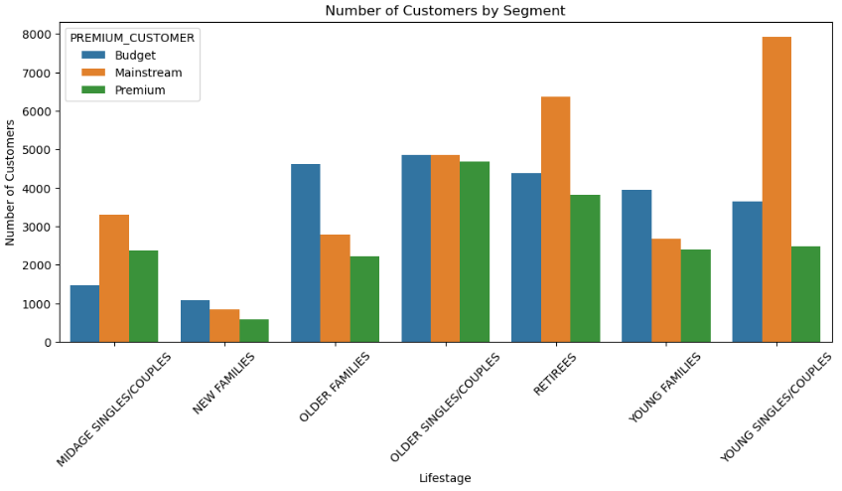
Customer Segmentation & Purchasing Behavior (Task 1)
Customer Segments: Breakdown of number of Customers by Segment.
Metrics: Total Number of customers per segment on PREMIUM_CUSTOMER
Insights:
Segment analysis: Premium customers spend more per transaction, especially Mainstream customers.
Young Singles/Couples are the frequent Mainstream customers

Slide 7
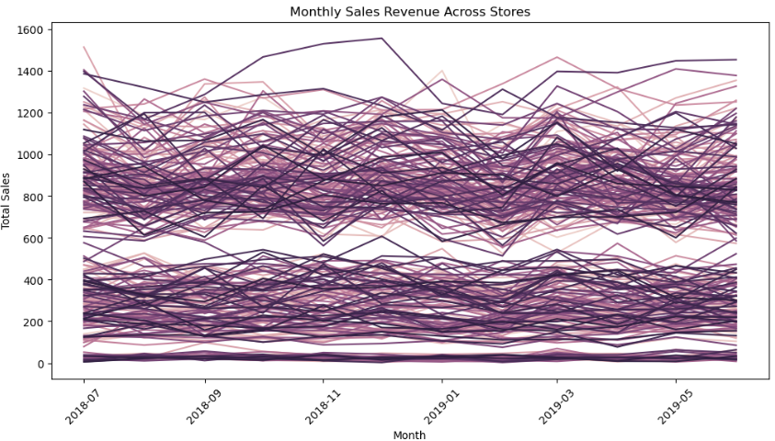
Experimentation & Uplift Testing (Task 2)
Objective: Understand the impact of new store layouts on chip sales.
Trial vs Control Stores:
Trial stores (77, 86, 88) vs Control stores.
Metrics used for comparison: Sales revenue, customer count, and transactions per customer.
Methodology: Similarity ranking of stores based on sales metrics.

Slide 8
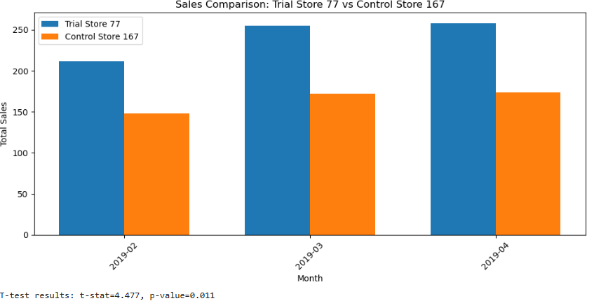
Trial Store Performance
Performance Overview:
Compare sales performance before and after the new layout in trial stores.
Highlight the differences between trial stores and control stores.
Key Findings:
Trial store performance was [better/worse] in terms of sales revenue.
Key changes observed in customer engagement and transaction frequency.

Slide 9
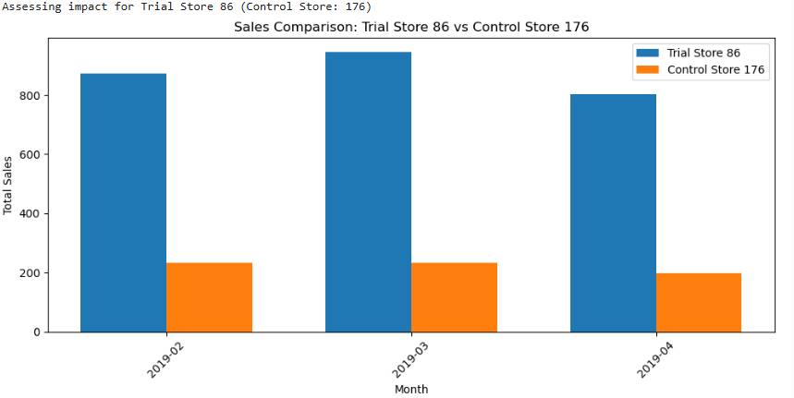
Trial Store Performance cntd…

Slide 10
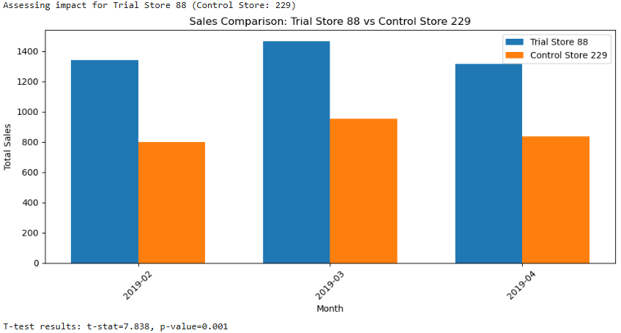
Trial Store Performance cntd…

Slide 11
Impact Assessment & Conclusion
Assessment:
The trial layout was successful, and it did lead to a statistically significant increase in sales?
Key differences in performance between trial and control stores.
Conclusion:
Recommendation: I would recommend continued revision of the trial layout based on the improved performance.
Next Steps
Action Plan:
Scale successful layout changes to other stores.
Further segment analysis to refine customer targeting.
Explore other factors that may influence chip sales (e.g., promotions, seasonality).
Timeline: Short-term (next 3 months) and long-term (6-12 months) strategies.

