Slide 1
Signal chain
hil_drv
hil_adas
DM scenario default
Partner ECU (arbitration
hil_vehicle
FMU
hil_adas
controller
Carmaker
DM/VC overwrite
DM scenario default
Only for lateral control Driver passive/active
Car Vhcl
hil_hvm
hil_hvm
bus signal
bus signal

Slide 2
Signal behavior and arbitration. Gear, Long example
hil_drv
P
Classe VM
D
No req
P
D
No req
P
hil_adas
D
No req
Arbitration FMU
hil_vehicle
P
D
P
CM
Def scenario
D
Cm_in
hil_hvm
P
D

Slide 3
Signal behavior and arbitration. Gear example
P
D
hil_drv
P
No req
D
No req
P
hil_adas
D
No req
hil_vehicle
P
D
scenario
P
D
hil_hvm
P
D

Slide 4
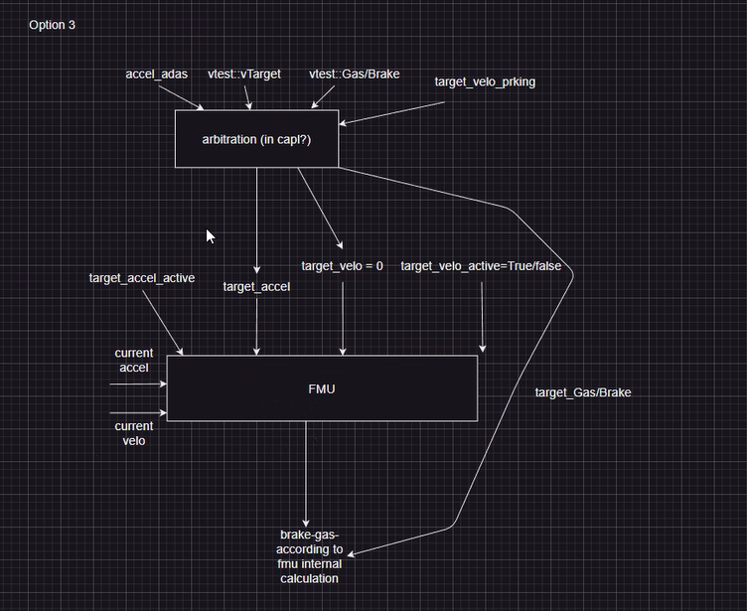
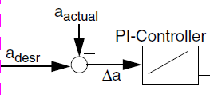
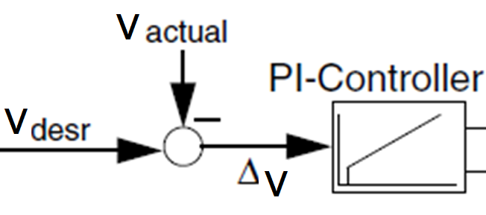
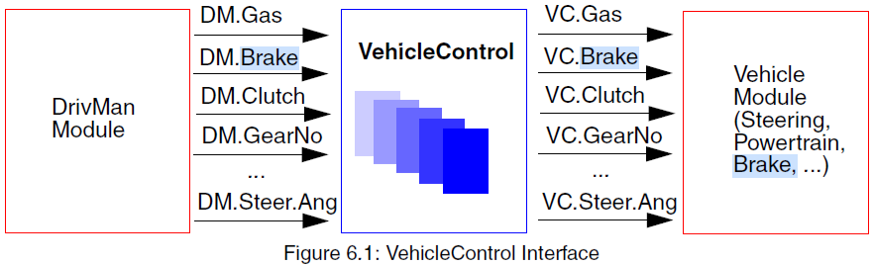
Hvm ax
Longitudinal Controller (FMU)
ax Driver
Partner ECU sim (FMU)
ax ADAS
If axd == axa
Driver\ ADAS | + | - | 0
+ | Choose biggest | Choose smallest | Choose biggest
- | Choose smallest | Choose smallest | Choose smallest
0 | Choose biggest | Choose smallest | 0
Hvm ax
yes
ax req
PID
ax req = truth table
ax req = axa
time
Vehicle ax req
no
Driver\ ADAS | + | - | 0
+ | Choose biggest | Choose smallest | Choose biggest
- | Choose smallest | Choose smallest | Choose smallest
0 | Choose biggest | Choose smallest | 0
If ax req == 0 && target V flag == 1
DM/VC.Brake
If geard == geara
gear Driver
DM/VC.Gas
DM/VC.SelectorCtrl
gear ADAS
yes
gear req = truth table
yes
gear req = geara
Vehicle gear req
Hvm v
Hvm gear
PID
Hvm v
target velocity
time
target velocity flag

Slide 5
Hvm WheelAng
Lateral Controller (FMU)
Wheel ang Driver
Partner ECU sim (FMU)
Wheel ang ADAS
If axd == axa
Driver\ ADAS | + | - | 0
+ | Choose biggest | Choose smallest | Choose biggest
- | Choose smallest | Choose smallest | Choose smallest
0 | Choose biggest | Choose smallest | 0
IPGDriver_Passive.pdf (ipg-automotive.com)
Hvm ax
yes
ax req
FR = Susp_Ext.Kin_tExt[1][5]
PID
ax req = truth table
FL = Susp_Ext.Kin_tExt[0][5]
ax req = axa
time
Hvm ax req
no
Driver\ ADAS | + | - | 0
+ | Choose biggest | Choose smallest | Choose biggest
- | Choose smallest | Choose smallest | Choose smallest
0 | Choose biggest | Choose smallest | 0
If ax req == 0 && target V flag == 1
VC.Steering.Ang
If geard == geara
VC.Steering.AngAcc
VC.Steering.AngVel
yes
VC.Steering.Trq
gear req = truth table
yes
gear req = geara
Hvm gear req
Hvm v
Hvm gear
PID
Hvm v
target velocity
time
target velocity flag

