Slide 1
System Design Lane simulation

Slide 2
Table of contents
  Panel design
  Panel design and data flow
  Concept
  Curvature (arc)
  Curvature calculation (for point-based representation; arc)
  Curvature calculation (for point-based representation; clothoid)
  Lane departure simulation (TBD)
  Road scenarios (TBD)

Slide 3
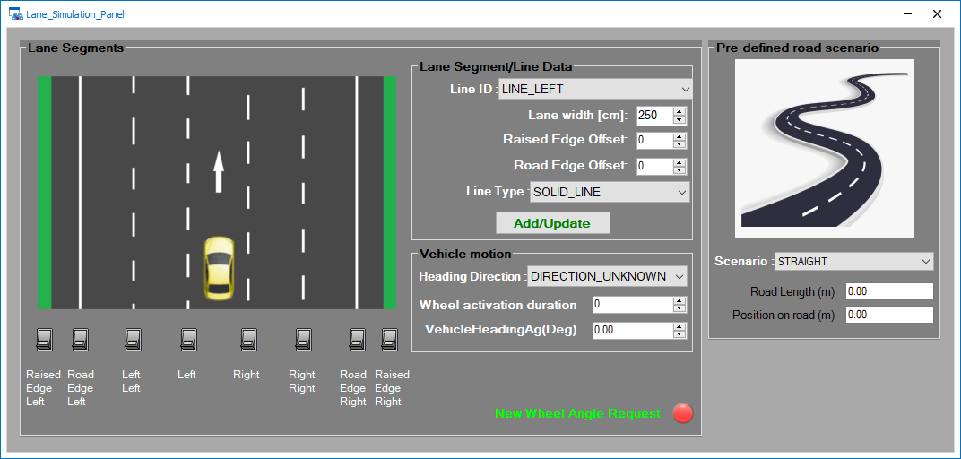
Panel design

Slide 4
Panel design and data flow
Customer / Bosch COM protocols
Lane Panel
User
Lane segment
Segment/Line ID
Lane width
Road edge offset
Raised edge offset
Line type
Activaton (using switches) of segments (L, R, LL, RR, etc.)
Road secnarios
list of pre-defined road scenarios:
  straight (default)
  curve 1 (simple curvature without curvature change, r1)
  curve 2 (simple curvature without curvature change, r2)
  curve 3 (curvature with curvature change)
Length of road (read only)
Position on road (read only)
Representation =
Curvature-based
OR
Point-based
CLOE :: Lines
- via FDX protocol
- simulation source: video
Vehicle motion
Heading direction (Left, Right)
Heading angle (deg)
Wheel activation duration
Internal data structure to store simulated Lane segments
(max 8 segments)
- Segment/Line ID [1 .. 8]
- Line type
- Line Relation (right, left, etc…)
- Line Distance y
- Line Curvature (1/m)
- Line Curvature Change (1/m*m)
- Line Distance x Start
- Line Distance x End
Vehicle Model data structure

Slide 5

Concept
Dy
Lane width
Heading angle
Line Left
Road curvature
Heading angle
Line Right
NOTE:
Curvature of Line segments is derived from Road curvature
Line position (Dy) is calculated from Vehicle Head position (based on Lane width)

Slide 6
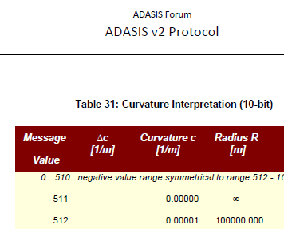
Curvature (arc)
1 rad (in degree) | 57,29577951
radian (rad) | 1 | 1 | 1 | 1
radius (m) | 1 | 500 | 100 | 100000
curv (rad/m) | 1 | 0,002 | 0,01 | 0,00001
rad to degree | 57,29577951 | 0,114591559 | 0,572958 | 0,000573
α
R
R
R
α = 1 rad
Example in ADASIS v2 protocol description

Slide 7
Curvature calculation (for point-based representation; arc)
Where:
β = (α / resolution) / 2
a = 2 * R * sinβ
tan : tangent at joints
α
R
tan
Point calculation:
P1 (x1, y1)
y1 = sinβ * a
x1 = cosβ * a
P2 (x2, y2)
y2 = sin(2*β) * a + y1
x2 = cos(2*β) * a + x1
P2 (x3, y3)
y3 = sin(3*β) * a + y2
x3 = cos(3*β) * a + x2
R
P3
a
β
R
tan
P2
a
90°
β
a
P1
α
β
tan

Slide 8
Curvature calculation (for point-based representation; clothoid)
Where:
β = (α / resolution) / 2
γ = curvature change / resolution
tan : tangent at joints
TBD
Point calculation:
TBD
R2
β + γ
a
tan
β
R1
P2
R0
a
β + γ
90°
a
tan
P1
β + γ

Slide 9
Lane departure simulation
Lane width
Heading angle
Line Left
Road curvature
Dy < DyMin
Line Right
NOTE:
DyMin is the distance the vehicle needs to move back towards lane center
The vehicle shall follow the lane direction after returning the center of the lane
In case of straight road scenarios, lane departure has to be started by user
In case of curvature road scenarios, the vehicle shall adapt automatically to the road conditions (no additional lane departure activation is needed by the user)

Slide 10
Distance to lane border
VehLength
DistToLeftBorder
DyLeft
TBD
α
VehWidth
α
DistToRightBorder
DyRight

Slide 11
Road scenarios
Straight Road:
  This road scenario is iterative, simulated continuously
Curvature (arc):
  This road scenario is simulated only once. When the vehicle passed this road section, Straight Road is started to simulate

