Slide 1
System Design objects

Slide 2
Table of contents
  Naming conventions
  Definition of Coordinate Systems
  RoadObj FMU
  Fradar signal calculations
  Fvideo signal calculations
  Field of View
  RoadObj architecture
  Object shifting and validity sending
  Reading object data when sending ByteArray directly from the RoadObj DLL via CanTP

Slide 3
1. Naming conventions

Slide 4
dx_front_left
dy_front_left
dx_front
dy_front
dx_front_right
dy_front_right
RCS
ACCS
dx_left
dy_left
dx_right
dy_right
RCA
dx_rear_left
dy_rear_left
dx_rear
dy_rear
dx_rear_right
dy_rear_right

Slide 5
height
Edge_top
Edge_mid
Edge_left
Reference Side
Edge_right
Edge_bottom
width

Slide 6
2. Coordinate Systems

Slide 7
Rear Center Axle Coordinate System (RCA)
X
Sensors sending in this Coordinate System | Example Signals
Front Video | Distances
Radar Front Left | Distances
Radar Front Right | Distances
Radar Rear Left | Distances
Radar Rear Right | Distances
Y
Rear Center Axle
Reference Point

Slide 8
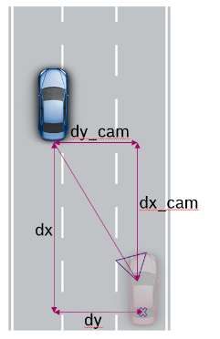
Aligned Camera Coordinate System (ACCS)
X
Sensors sending in this Coordinate System | Example Signals
Front Video | Edges Normalized velocities
Aligned Coordinate System | dx_cam
 | dy_cam
RCA Coordinate System | dx
 | dy
Y
Mounting position of the camera
Reference Point

Slide 9
Radar Coordinate System (RCS)
X
Sensors sending in this Coordinate System | Example Signals
Front Center Radar | Distances Angles
Y
Mounting position of the radar
Reference Point

Slide 10
3. CAPL dll

Slide 11
Simulator
Classe/CM/…
RoadObj.can
CAPL
Rotate/Shift
Rotation C++ dll
Raw target data
Call of rotation functions
Center of Coordinates
Classe: RCA; CM: Sensor
Target Reference Point
Rear Bumper/…
Center of Coordinates
RCA or Sensor position
Target Reference Point
Rear Bumper/…
Inputs
Center of Coordinates
RCA or Sensor position
Target Reference Point
Rear Bumper
Rotated object data
Outputs
Center of Coordinates
RCA and Sensor position
Target Reference Point
Mid of geometry
Rotated/Shifted object data
Obj data
Loc data
Rotated/Shifted object data
Object calcs
object_calc.dll
Loc calcs
StarModel C++ dll
Center of Coordinates
RCA and Sensor position
Target Reference Point
Mid of object
Center of Coordinates
Sensor position
Target Reference Point
Mid of object

Slide 12
3.1 rotation dll

Slide 13
Example Input
Output
CM gives the distance from Sensor position towards the rear center bumper
The Input could also be from RCA on the ego
RCA to middle of target geometry
Sensor position to middle of target geometry

Slide 14
3.2 Object calc dll

Slide 15
DLL Input
X
First part of the DLL input..
From the Ego Rear Center Axle
Towards the Target Mid of Geometry
Second part of the DLL input..
From the Sensors position
Towards the Target Mid of Geometry
Y
Ego Sensor Position
Ego Rear Center Axle
Target Mid of Geometry

Slide 16
Input
Output
RCA to middle of target geometry
Sensor position to middle of target geometry
RCA to reference point
Sensor position to reference point
Reference side which middle point is the calculated reference point

Slide 17
Calculating the position of the reference side
The position of the reference side is the distance we want to inject onto the BUS/via XCP.
To calculate this, the DLL first gets the position of the middle of the target geometry as an input.
Using this aswell as the given length, width and heading angle of the target, the DLL calculates a rectangle around the target and by this the middle points of each side aswell as the edge points.
The reference side is being found by comparing all 4 middle points on each side of the target and taking the smallest one.
Using this reference point together with the heading angle the visible view on the target can be calculated.
On the following slides this procedure is being displayed…

Slide 18
Example: DLL working chain Radar Front Center (locations)
CAPL
Input: Sensor data RFC
DLL
calculate_RCA
dx_rca
dy_rca
heading_angle_rca
dx_sensor
dy_sensor
heading_angle_sensor
height
length
width
offset_dx
offset_dy
dx_rear_center_axle
dy_rear_center_axle
height
length
width
heading_angle
Calculated rectangle around target in the Rear Center Axle coordinate System
calculate_radial_distance, …
dx_ref_pnt
dy_ref_pnt
Calculated data needed from the perspective of the RFC position
Output : Target data RFC
get_dx_ref_pnt
get_dy_ref_pnt

Slide 19
X
Width/2
=W/2
$$dx=Hypo∗\cos\left(angle_{res}\right)$$
Referencepoint
Rear | Front | Left | Right
$$\left(\begin{matrix}ⅆx \\ ⅆy\end{matrix}\right)$$ | $$\left(\begin{matrix}dx+ⅆx_{front} \\ ⅆy+dy_{front}\end{matrix}\right)$$ | $$\left(\begin{matrix}dx+ⅆx_{left} \\ ⅆy+dy_{left}\end{matrix}\right)$$ | $$\left(\begin{matrix}dx+ⅆx_{right} \\ ⅆy+dy_{right}\end{matrix}\right)$$
Mid front
bumper
Mid left side
Length/2
=L/2
$$\left(\frac{L}{2}\right)$$
$$\left(\frac{W}{2}\right)$$
$$dx_{left}=\left(\frac{W}{2}\right)∗\cos\left(α+90°\right)$$
$$dy_{left}=\left(\frac{W}{2}\right)∗sin⁡\left(α+90°\right)$$
$$Given$$
$$Coordinate$$
$$dx_{right}=\left(\frac{W}{2}\right)∗\cos\left(α−90°\right)$$
$$\left(\frac{L}{2}\right)$$
$$\left(\frac{W}{2}\right)$$
$$dy_{right}=\left(\frac{W}{2}\right)∗sin⁡\left(α−90°\right)$$
$$dx_{front}=\left(\frac{L}{2}\right)∗\cos\left(α\right)$$
Mid left side
Mid rear bumper
$$dy_{front}=\left(\frac{L}{2}\right)∗sin⁡\left(α\right)$$
$$dx_{rear}=\left(\frac{L}{2}\right)∗\cos\left(α−180°\right)$$
$$heading angle$$
$$=α$$
$$dy_{rear}=\left(\frac{L}{2}\right)∗sin⁡\left(α−180°\right)$$
Y

Slide 20






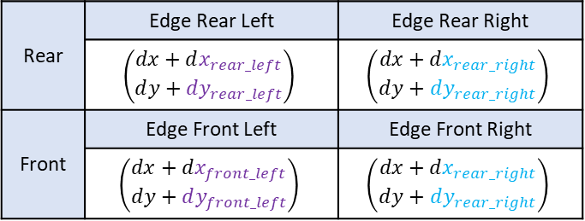














X
Width/2
=W/2
$$dx=Hypo∗\cos\left(angle_{res}\right)$$
Rear | Edge Rear Left | Edge Rear Right
 | $$\left(\begin{matrix}dx+ⅆx_{rear_left} \\ ⅆy+dy_{rear_left}\end{matrix}\right)$$ | $$\left(\begin{matrix}dx+ⅆx_{rear_right} \\ ⅆy+dy_{rear_right}\end{matrix}\right)$$
Front | Edge Front Left | Edge Front Right
 | $$\left(\begin{matrix}dx+ⅆx_{front_left} \\ ⅆy+dy_{front_left}\end{matrix}\right)$$ | $$\left(\begin{matrix}dx+ⅆx_{rear_right} \\ ⅆy+dy_{rear_right}\end{matrix}\right)$$
$$90°=1.5708 rad$$
$$α+arctan\left(\frac{W/2}{L}\right)$$
Length
=L
$$Hypo_{rear_left}=\frac{W}{2}$$
$$angle_{rear_left}=α+90°$$
$$dx_{rear_left}=\frac{W}{2}∗\cos\left(α+90°\right)$$
$$dy_{rear_left}=\frac{W}{2}∗sin⁡\left(α+90°\right)$$
Hypo_front
$$\arctan\left(\frac{W/2}{L}\right)$$
$$Hypo_{rear_right}=\frac{W}{2}$$
$$angle_{rear_right}=α−1.5708$$
dx_front
$$dx_{rear_right}=\frac{W}{2}∗\cos\left(α−90°\right)$$
$$dy_{rear_right}=\frac{W}{2}∗sin⁡\left(α−90°\right)$$
$$Hypo_{front_left}=\sqrt{L^{2}+{\left(\frac{W}{2}\right)}^{2}}$$
$$angle_{left}=α+\arctan\left(\frac{W/2}{L}\right)$$
$$Given Coordinate$$
(Mid rear bumper)
dy_front
dy_left
dx_left
$$dx_{front_left}=\sqrt{L^{2}+{\left(\frac{W}{2}\right)}^{2}}∗\cos\left(α+\arctan\left(\frac{W/2}{L}\right)\right)$$
Hypo_left
$$heading angle$$
$$=α$$
$$dy_{front_left}=\sqrt{L^{2}+{\left(\frac{W}{2}\right)}^{2}}∗sin⁡\left(α+\arctan\left(\frac{W/2}{L}\right)\right)$$
$$angle_{front_right}=α−\arctan\left(\frac{W/2}{L}\right)$$
Y
$$Hypo_{front_right}=\sqrt{L^{2}+{\left(\frac{W}{2}\right)}^{2}}$$

Slide 21
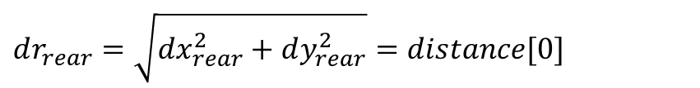
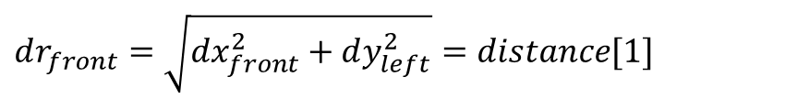
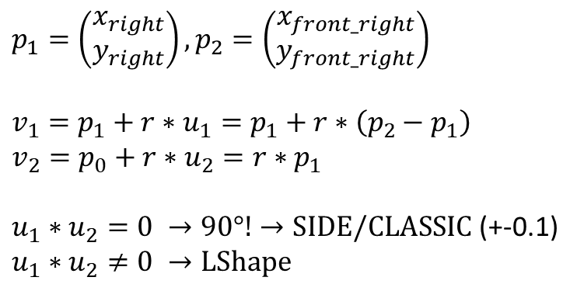
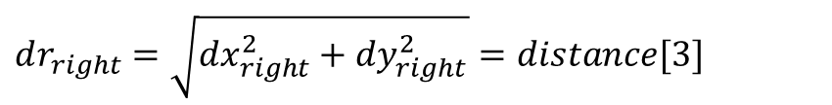
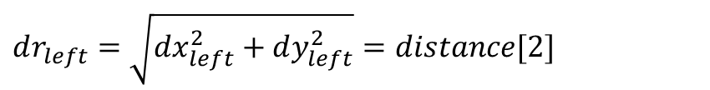
Choose reference point (and the corresponding side) by comparing radial distance. Lowest value = refPoint
$$dr_{rear}=\sqrt{dx_{rear}^{2}+dy_{rear}^{2}}=distance[0]$$
double smallestElement = 0;
int indexSmallestElement = 0;
for(int i = 0; i < 4; i++){
if(distance[i] < smallestElement){
smallestElement = distance[i];
indexSmallestElement = i;
}
}
$$dr_{front}=\sqrt{dx_{front}^{2}+dy_{left}^{2}}=distance[1]$$
$$dr_{left}=\sqrt{dx_{left}^{2}+dy_{left}^{2}}=distance[2]$$
$$dr_{right}=\sqrt{dx_{right}^{2}+dy_{right}^{2}}=distance[3]$$
Use refPoint and 1 other point of this side to define view using vector calculations
$$p_{1}=\left(\begin{aligned}x_{right} \\ y_{right}\end{aligned}\right),p_{2}=\left(\begin{aligned}x_{front_right} \\ y_{front_right}\end{aligned}\right)$$
$$v_{1}=p_{1}+r∗u_{1}=p_{1}+r∗\left(p_{2}−p_{1}\right)$$
$$v_{2}=p_{0}+r∗u_{2}=r∗p_{1}$$
$u_{1}∗u_{2}=0 →90°!→SIDE/CLASSIC$ (+-0.1)
$$u_{1}∗u_{2}≠0 →LShape$$
u2
p2
X
X
p1
u1
If Lshape: Check which edge is the farthest away
-> other 3 are building the L!

Slide 22
4. Fradar signals

Slide 23

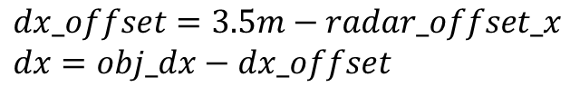

Center of coordinates for FRadar
$$dx_offset=3.5m−radar_offset_x \\ dx=obj_dx−dx_offset$$
3.5m offset
radar_offset_x
Distances between Ego and Target
dx = of the radar
obj_dx = in vehicle model
radar
dx_offset
vehicle model
$$dy=obj_dy−radar_offset_y$$
$$dz=obj_dz−radar_offset_z$$
Note: This dx, dy and dz are used in the following slides to calculate all the values for the signals

Slide 24



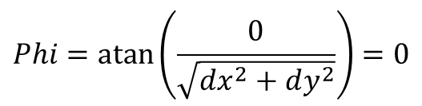

Calculation of locations for FRadar
LR RB 2022
dz
$$dz=0$$
$$Dr_2d=Dr_3d=Dr$$
dy
$$Dr=\sqrt{dx^{2}+dy^{2}}$$
Dr_3d
$$Phi=\operatorname{atan}\left(\frac{0}{\sqrt{dx^{2}+dy^{2}}}\right)=0$$
Dr_2d
dx
$Theta=atan⁡(\frac{0}{\sqrt{dx^{2}+dy^{2}}}$)
Theta
Phi
+
-
Note: Classe is 2-dimensional which is why dz is always 0
dy

Slide 25
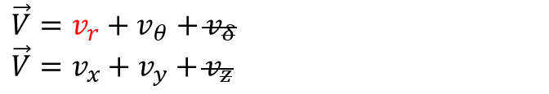

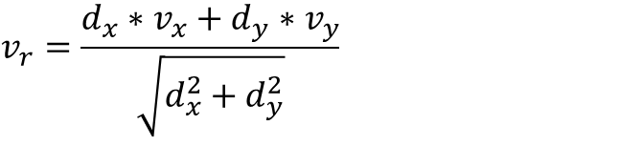





Calculation of velocities for FRadar
$$d_{y}$$
$$vz=0$$
$$v_{θ}$$
$$Vr_2d=Vr_3d=Vr$$
$$v_{r}$$
$$\vec{V}=v_{r}+v_{θ}+v_{δ}$$
$$\vec{V}=v_{x}+v_{y}+v_{z}$$
$$d_{x}$$
$$v_{r}=\frac{d_{x}∗v_{x}+d_{y}∗v_{y}}{\sqrt{d_{x}^{2}+d_{y}^{2}}}$$
+
-
Note: Classe is 2-dimensional which is why vz is always 0
vy

Slide 26
5. FVideo signals

Slide 27

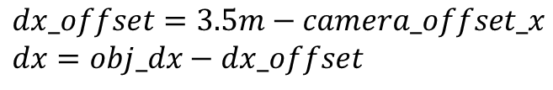

Center of coordinates for FVideo
$$dx_offset=3.5m−camera_offset_x \\ dx=obj_dx−dx_offset$$
3.5m offset
camera_offset_x
Distances between Ego and Target
dx = of the camera
obj_dx = in vehicle model
camera
dx_offset
vehicle model
$$dy=obj_dy−camera_offset_y$$
$$dz=obj_dz−camera_offset_z$$
Note: This dx, dy and dz are used in the following slides to calculate all the values for the signals

Slide 28
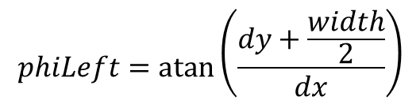

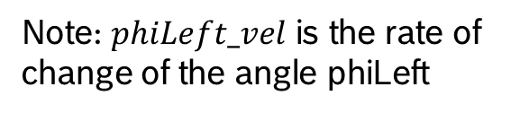
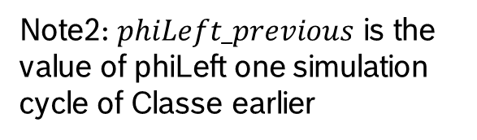
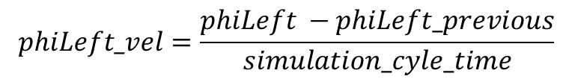
Calculation of phi for FVideo
$$phiLeft=\operatorname{atan}\left(\frac{dy+\frac{width}{2}}{dx}\right)$$
LR RB 2022
$$\frac{width}{2}$$
dy
$$phiLeft_vel=\frac{phiLeft −phiLeft_previous}{simulation_cyle_time}$$
dx
phiLeft
Note: $phiLeft_vel$ is the rate of change of the angle phiLeft
+
-
Note2: $phiLeft_previous$ is the value of phiLeft one simulation cycle of Classe earlier
dy

Slide 29
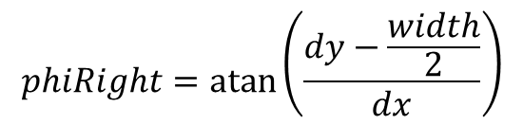

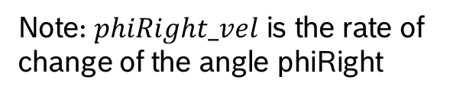
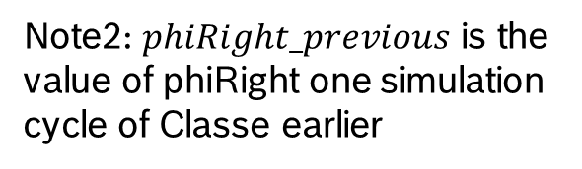
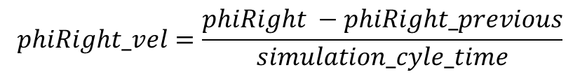
Calculation of phi for FVideo
$$phiRight=\operatorname{atan}\left(\frac{dy−\frac{width}{2}}{dx}\right)$$
LR RB 2022
$$\frac{width}{2}$$
dy
$$phiRight_vel=\frac{phiRight −phiRight_previous}{simulation_cyle_time}$$
dx
phiRight
Note: $phiRight_vel$ is the rate of change of the angle phiRight
+
-
Note2: $phiRight_previous$ is the value of phiRight one simulation cycle of Classe earlier
dy

Slide 30
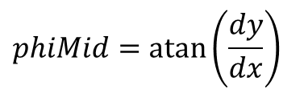
Calculation of phi for FVideo
LR RB 2022
dy
$$phiMid=\operatorname{atan}\left(\frac{dy}{dx}\right)$$
distance
dx
phiMid
+
-
dy

Slide 31
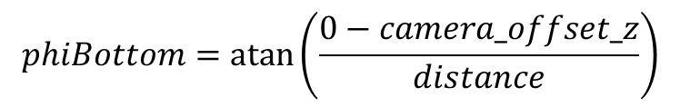

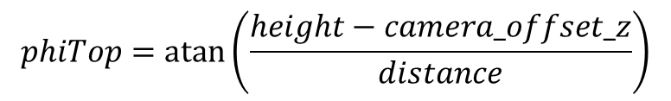
Calculation of phi for FVideo
$$height=1.5m$$
LR RB 2022
dy
$$phiTop=\operatorname{atan}\left(\frac{height−camera_offset_z}{distance}\right)$$
distance
dx
$$phiBottom=\operatorname{atan}\left(\frac{0−camera_offset_z}{distance}\right)$$
phiTop
+
-
dy

Slide 32
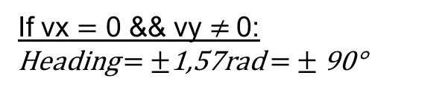
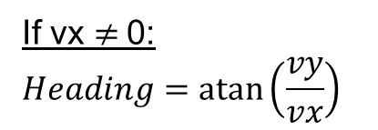
Calculation of heading angle for FVideo
LR RB 2022
vy
If vx $≠$0:
$$Heading=\operatorname{atan}\left(\frac{vy}{vx}\right)$$
velocity
If vx $=$ 0 && vy $≠$0:
Heading $=$ $±$1,57rad $=$ $±$90°
vx
Heading
+
-
Note: those velocities are the ones of the object
vy

Slide 33

Calculation of normalised velocity and
indicator signals for FVideo
LR RB 2022
$$NormVx=\frac{Vx}{Dx−MountPosX}\left[\frac{1}{s}\right]$$
vy
velocity
vx
dx
vy > 0 | vy < 0
Indicator = Left | Indicator = Right
+
-
Note: those velocities are the ones of the object
vy

Slide 34
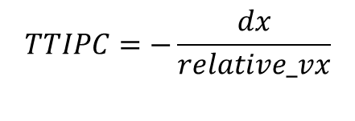
Calculation of image plane crossing
time to collision for FVideo
LR RB 2022
relative_vy
$$TTIPC=−\frac{dx}{relative_vx}$$
relative
velocity
Min | Max
TTIPC = -8s | TTIPC = 8s
relative_vx
relative
Heading
+
-
Note: those velocities are the relative velocities of the Ego to the Target vehicle
vy

Slide 35
Visible View:
Classified View:
Rear
CLASSIC
Left
SIDE
Rear
CLASSIC_LShape
Left
SIDE_LShape

Slide 36
Visible View: Side
edge_left
edge_right

Slide 37
Visible View: Side_LShape
edge_left
edge_right
edge_mid

Slide 38
6. Field of view

Slide 39
Field of View
Sensor | FoV | Mounting angle
Radar Front Center | +- 90° | 0°
Radar Front Left | +- 60° | 45°
Radar Front Right | +- 60° | -45°
Radar Rear Left | +- 60° | 135°
Radar Rear Right | +- 60° | -135°

Slide 40
7. Roadobj architecture

Slide 41
Master
RoadObj.can
RoadObj.can
Calls mapping and injection files (dependent on the chosen sensor and simulator)
1 file
Function call
Function call
Mapping Files
e.g. Map_CM.cin
Reading of the object data for each sensor from the simulator and calculating further required data, depending on the chosen sensor model. Setting of Validity flags.
1 file per Simulator
CM
Classe
RFC
VFC
…
Validity Flags
RFC
VFC
…
Validity Flags
CAPL sim Arrays
CAPL sim Arrays
1obj1loc
Starmodel
1obj1loc
Starmodel
Calculated data
Function call
and receiving data
Function call
and receiving data
Calculated data
Calculation
RoadObj_calc.cin
Generic functions globally used for calculating necessary object and location data
1 file
calculate_radial_distance
calculate_radial_velocity
…
Injection Files
e.g. Inject_RFC.cin
Injecting data of the objects and locations depending on the chosen injection method
1 file
per Sensor
Radar Front Center
Radar Front Left
Object
Location
Object
Location
Bus
XCP
Bus
XCP
Delete Target
Delete Target

Slide 42
8. Object shifting and Validity sending

Slide 43
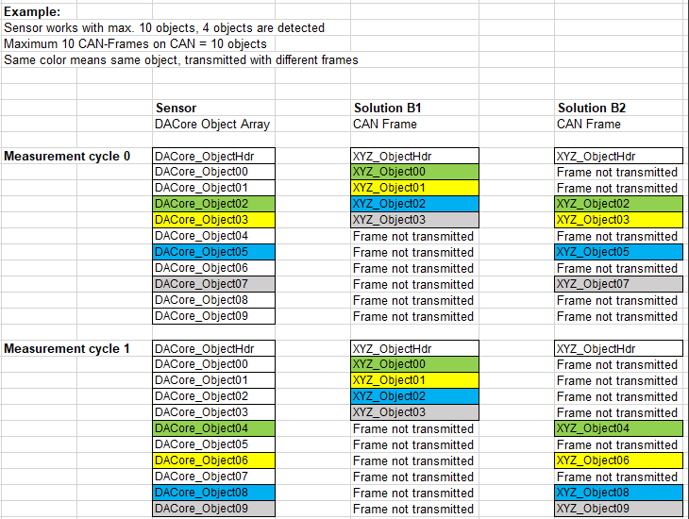
Required system behavior
OD is expecting Solution B1 which includes
Sending messages only for valid objects. The
other frames shall not be transmitted.
-> validity sending
The valid objects must be sent by means of
successive messages. No holes between objects
(as in B2) are allowed.
-> object shifting
Validity sending:
Setting of the validity flags (done in Classe cycle, 5ms)
Sending dependent of the validity flags (via extra timers)
Object shifting: (done when deleting an object)
Finding a hole
Planning which objects must be moved
Shifting of the objects
[Approved] DDD - L3 interface CAN message transfer strategy for sensor data - OneDriving - Docupedia (bosch.com)

Slide 44


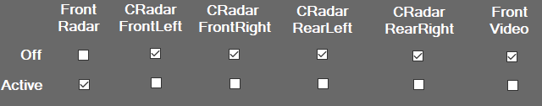
Validity sending – Setting of the validity flags (every Classe cycle)
On/Off Button is inactive | On/Off Button is active
If the button is inactive the validity flags are generally set to 1 -> All objects on all sensors are being sent DACore Object Array | If the button is active the validity flags are set depending on the chosen sensors for each object Solutions B1/B2
 | Choosing on which sensors the object shall be sent
 | Sensor is set to active for this obj OR VehicleModel is in FDX mode For each object, the validity flags are set to 1 for every chosen sensor (here: FRadar, all in FDX mode) Hdr messages are set to 1 as long as in Classe or FDX mode All messages with the ID > 8 have their validity flags set to 0 (only 0-8 objects are supported) | Sensor is set to inactive for this obj If a sensor is set to off, then the validity flag for this object on this sensor is set to 0

Slide 45
Validity sending – Sending dependent of the validity flags
Each sensor has its own validity timer
 | “on timer”-function for validity flags is called every 66ms Those 66ms are set in the SystemVariable @ValidityFlags::RoadObj::validityTimer
 | To what state is the VehicleModel set?
 | VehicleModel is set to Classe/FDX Messages are being sent according to their validity flags | VehicleModel is set to off/init No message is being sent
 | Sending is done by setting the ON_OFF SysVar of the specific message to 1 (for example VFC_Object00A_ON_OFF for the first video object) Validity flags are either set to 1 or 0 which defines if the ON_OFF is 1 (sending the message) or 0 (not sending the message) Each time the “on timer”-function is called and the ON_OFFs are set to the values of the validity flags, the ones set to 1 are being sent on the bus

Slide 46
Object shifting – Finding a hole
Loop through objects
 | ☓ Planning the shifting of objects
 | Already found a hole?
 | Yes (◢) | No
 |  | Check activated sensors for that object
 |  | All sensors deactivated hole found (●) | At least 1 sensor activated object found
 |  |  | Check if object is already planned for shifting
 |  |  | Already planned object counts as hole found (◾) | Not planned -
Example: Initial situation is [0 1 1 1]
-> ☓ see next slide
-> ◢ In either case we want to fill the first hole found with an object coming behind, which is why in case a hole is already found nothing is done
-> ● Finds the hole on the first position, but it doesn't realize the 1 on the second position is going to be shifted which will leave a hole
-> ◾ Checks for already planned objects, which are counted as a 0 -> so switching to [1 1 1 0] is possible in one cycle

Slide 47
Object shifting – Planning of shifting an object
Loop through objects using shiftCounter
 | shiftCounter++
 | Already found a hole?
 | No (◢) | Yes
 |  | Check activated sensors for that object
 |  | All sensors deactivated - | At least 1 sensor activated object found and shifting is necessary
 |  |  | Check if object is already planned for shifting
 |  |  | Already planned - (●) | Not planned Plan this object for shifting Set shiftCounter to the position after the found hole (◾)
-> ◢ Only if a hole is found we must shift an object
-> ● If the object is already planned, we can skip it
-> ◾ Setting back the shiftCounter when an object is planned is necessary in case two empty Objects build a hole. For example [1 0 0 1 1]
After the first planning it would look like this: [1 1 0 0 1] - which is why we must start the planning process again at the third position

Slide 48
Object shifting – Shifting of the objects
Check is shifting is necessary
No(◢) | Yes
 | Loop through the planned objects that must be shifted
 |  | Copy the object into the chosen hole and insert it Delete the original object (●) Remove this object from the list of planned objects
-> ◢ If no shifting is necessary, we save computation time
-> ● Setting the Classe array and all the signals of the bus messages of this object to 0
NOTE: if we have for example [0 1 1 1] the logic is doing the following steps: [0 1 1 1] -> [1 0 1 1] -> [1 1 0 1] -> [1 1 1 0]
This can lead to problems with the current VT TCs, because they are deleting objects in order. So, the first object is deleted as first.
This will trigger the shifting with a questionable outcome.

Slide 49
9. Reading object data when sending ByteArray directly from the RoadObj DLL via CanTP

Slide 50
Reading Object Data from ByteArray
CarMaker
RoadObj DLL
CAN TP
ByteArray
CANoe
To read values set these SysVars:
CAN_RadarXX_RXX_Object::TP_enable_loopback_reading = 1
RXX_Object_ObjY.Read = 1

