Slide 1
System Design Traffic Signs

Slide 2
Table of contents
  Concept
  Panel design and data flow
  Final panel design

Slide 3
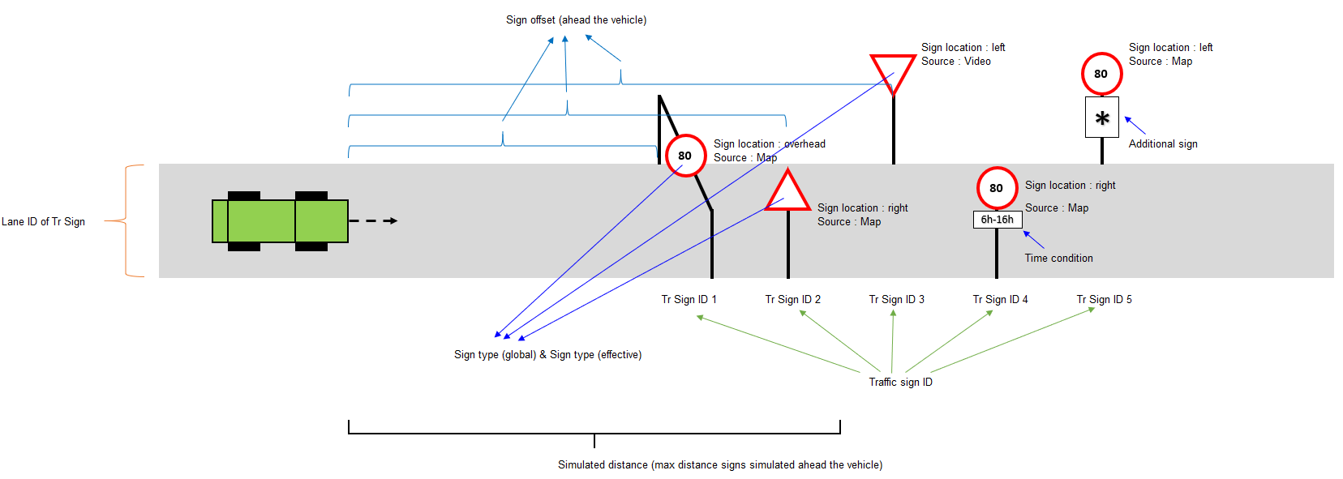
Concept

Slide 4
Panel design and data flow
Customer / Bosch COM protocols
TS Panel
User
Traffic Sign
- TS ID
- TS offset
- TS type
- SL unit
- TS location
- Addition TS
- Time condition
- Lane ID of TS
Selected traffic sign (visual representation of sign to simulate)
Simulated traffic sign
- pictures, read only information of already simulated traffic signs
- displayed content can be disabled
CLOE :: Road signs
- via FDX protocol
- simulation source: video
Internal data structure to store simulated Traffic Signs
(max 32 signs)
- TS ID [1 .. 32]
- TS static offset on road
- TS offset compared to vehicle position
- TS type
- SL unit
- TS location
- Addition TS
- Time condition
- Lane ID of TS
- simulated distance
- simulation source
Simulation settings
- simulated distance
- current time
Vehicle position
- lane of vehicle
- vehicle position
Simulation state
- simulation ON/OFF
- insert / delete TS objects
- simulation source (video / map)
Vehicle Model data structure

Slide 5
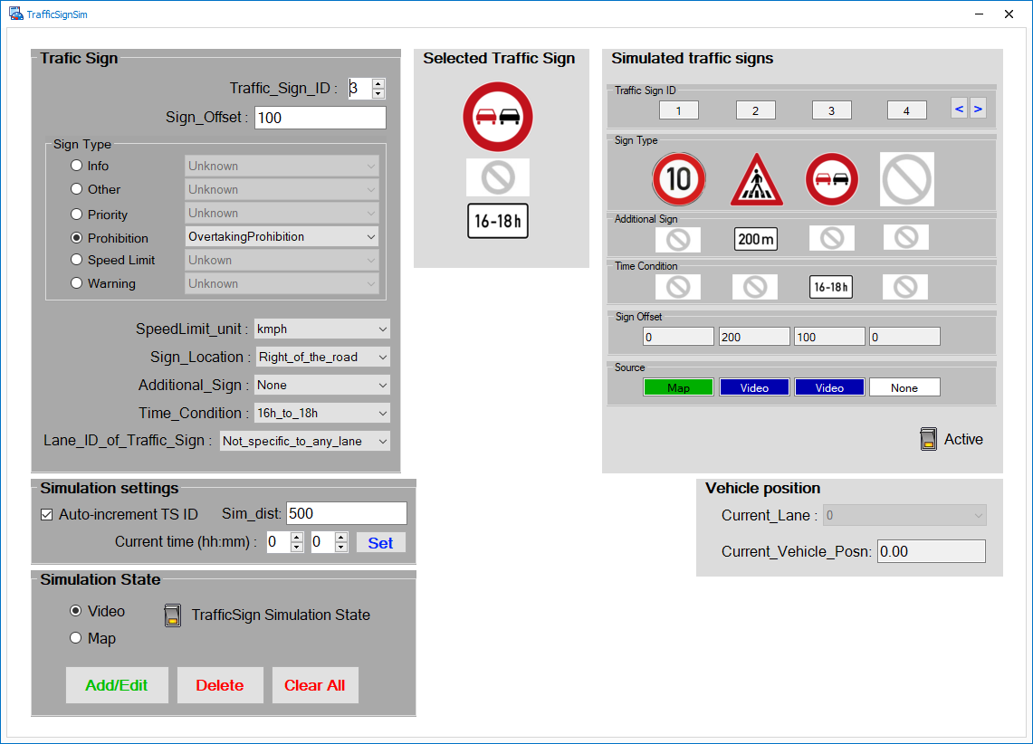
Final panel design

Slide 6
FDX data flow
Store traffic sign info from CLOE
Calculation
5ms cycle begin
Simulation = FDX or CLASSE
Input :: CLOE :: Road signs
message_FDX_in_HIL_specific_TS :: [0..31] ::
FDX_in_TS_additional_sign
FDX_in_TS_lane_id_of_traffic_sign
FDX_in_TS_sign_offset
FDX_in_TS_sign_type
FDX_in_TS_sign_location
FDX_in_TS_simulation_source
FDX_in_TS_time_condition
FDX_in_TS_traffic_sign_id
FDX
Output :: Internal data structure to store simulated Traffic Signs
(max 32 signs)
- TS ID [1 .. 32]
- TS static offset on road (not used)
- TS offset compared to vehicle position
- TS type
- SL unit
- TS location
- Addition TS
- Time condition
- Lane ID of TS
- simulated distance = defined by RBS
- simulation source
- simulation protocol = FDX
Traffic sign ID is valid
valid
0 .. 31

Slide 7
CLASSE data flow
Store traffic sign info from Panel
TS Panel
Traffic Sign
- TS ID
- TS offset
- TS type
- SL unit
- TS location
- Addition TS
- Time condition
- Lane ID of TS
Internal data structure to store simulated Traffic Signs
(max 32 signs)
- TS ID [1 .. 32]
- TS static offset on road
- TS offset compared to vehicle position (filled during 5ms cycle period)
- TS type
- SL unit
- TS location
- Addition TS
- Time condition
- Lane ID of TS
- simulated distance
- simulation source
- simulation protocol = CLASSE
Insert / Delete / Clear All
Simulation settings
- simulated distance
- current time
Simulation state
- simulation ON/OFF
- insert / delete TS objects
- simulation source (video / map)

Slide 8
CLASSE data flow
Calculate Vehicle speed and road sign offsets
Calculation
5ms cycle begin
Simulation = FDX or CLASSE
Input :: Internal data structure to store simulated Traffic Signs
(max 32 signs)
- TS ID [1 .. 32]
- TS static offset on road
Input :: Vehicle Model :: vehicle speed
CLASSE
Output :: Internal data structure to store simulated Traffic Signs
(max 32 signs)
- TS offset compared to vehicle position
Traffic sign ID is valid
valid
0 .. 31

