Slide 1
System Design Vehicle Model

Slide 2
Abbreviations
Abbr. | Meaning
ABS | Anti-lock Braking System
DRV | Driver (user)
HIL | Hardware in the loop
HMI | Human-Machine interface
HVM | Host vehicle movement
RWA | Road wheel angle
SWA | Steering wheel angle
WIC | Wheel impulse counter

Slide 3
Vehicle Model - Features
Lateral control
  Steering
  Road wheel control
  Driver steeing torque
Longitudinal control
  Acceleration
  Speed
  Pedals
  Gear
ABS/WIC simulation
  Wheel impulse counter
Steering system simulation
  SWA-based RWA control
  Link definition between SWA and RWA: ratio, rack travel
Door control
External control (keyboard)
Customer-related data control
  Motion
  HMI

Slide 4
Vehicle Model - Inputs/Outputs (CLASSE)

Slide 5
LATERAL control

Slide 6
Lateral Control
Basis data - Ego parameters to calculate vehicle motion (car dimenstions)
Basis model and calculations of turning movement
wheel angle
simplified model
delta heading angle
wheel angles calculated from front center RWA
wheel angles calculated from side RWA
wheel speeds
Max allowed RWA
Active steering (control flow)
Driver torque
User interface
Vehicle motion output information and parameters (EGO Motion panel)

Slide 7
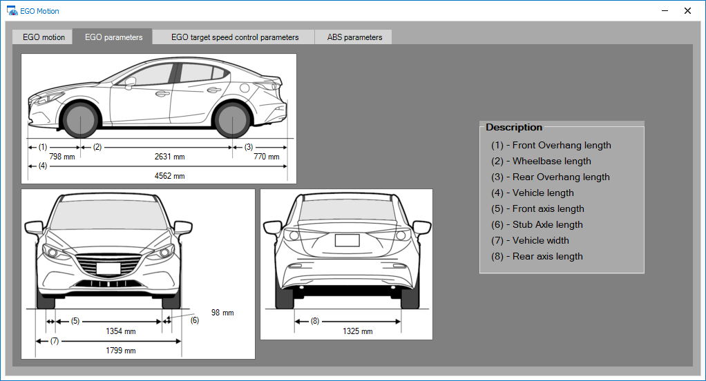
Vehicle Motion - car dimensions

Slide 8
Vehicle turning movement - wheel angle
FR Wheel
RR Wheel
Road Wheel Angle
α > 0
α < 0
FL Wheel
RL Wheel

Slide 9
Vehicle turning movement - simplified model
FR Wheel
RR Wheel
Front axis center
Stub axle length
Front axle width
Rear axle width
α
Road Wheel Angle
Rear axis center
Virtual Front Center (driven) Wheel
r FRW
r RRW
RL Wheel
FL Wheel
Wheelbase length
r RCenter
r FLW
r RLW
r FCenter
α

Slide 10
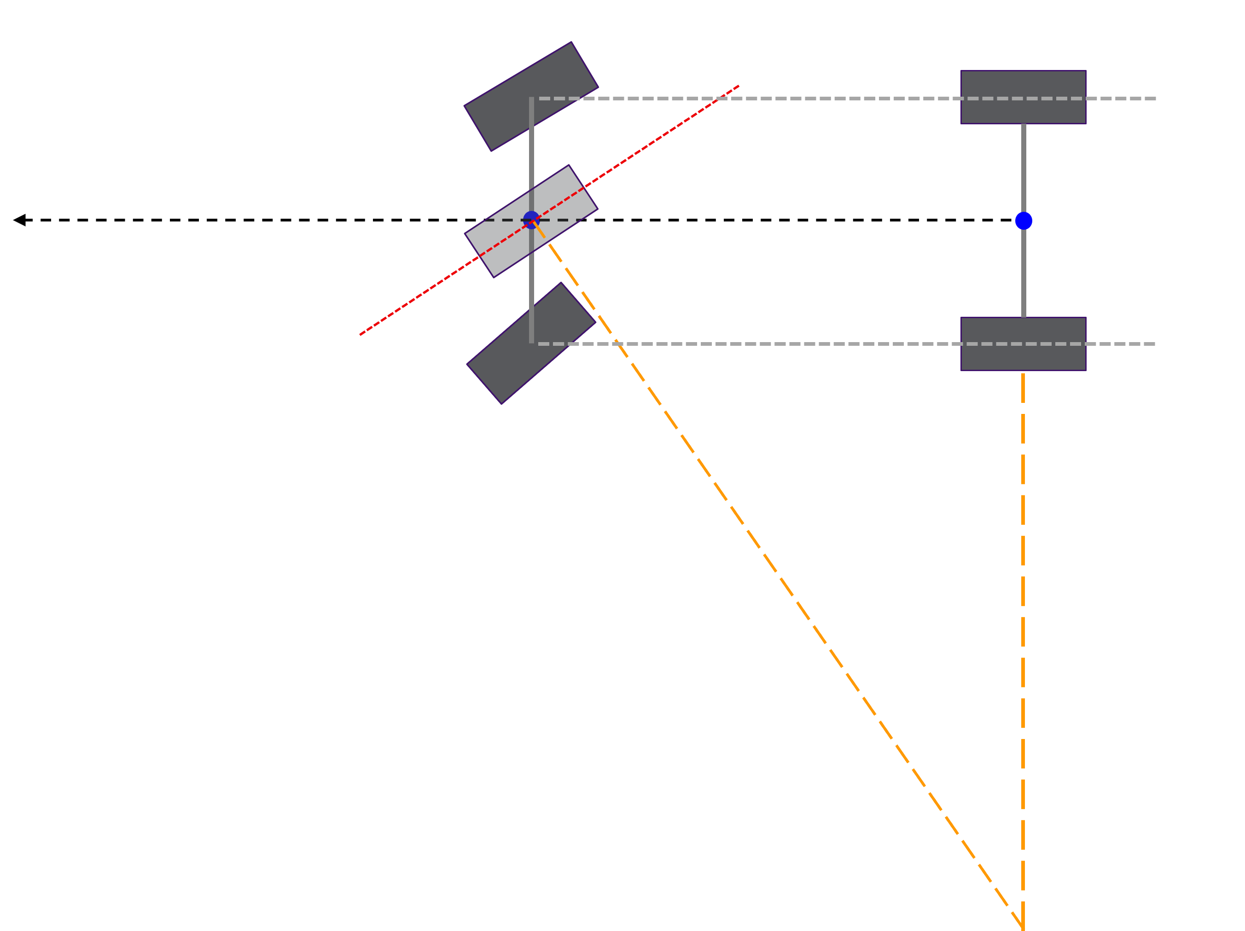
Vehicle turning movement - delta heading angle
β
β
Heading angle change after dTime and VehSpeed>0
β

Slide 11
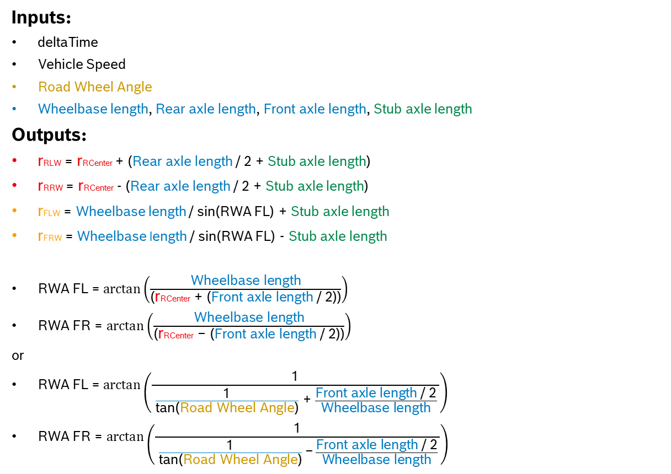
Vehicle turning movement - input/output (distances, road wheel angles)
Inputs:
deltaTime
Vehicle Speed
Road Wheel Angle
Wheelbase length, Rear axle length, Front axle length, Stub axle length
Outputs:
rRLW = rRCenter + (Rear axle length / 2 + Stub axle length)
rRRW = rRCenter - (Rear axle length / 2 + Stub axle length)
rFLW = Wheelbase length / sin(RWA FL) + Stub axle length
rFRW = Wheelbase length / sin(RWA FL) - Stub axle length
RWA FL = $arctan\left(\frac{\text{Wheelbase} \text{length}}{\text{(}\text{r}\text{RCenter} \text{+} \text{(}\text{Front} \text{axle} \text{length}\text{ / 2))}}\right)$
RWA FR = $arctan\left(\frac{\text{Wheelbase} \text{length}}{\text{(}\text{r}\text{RCenter} \text{−} \text{(}\text{Front} \text{axle} \text{length}\text{ / 2))}}\right)$
or
RWA FL = $arctan\left(\frac{\text{1}}{ \frac{\text{1}}{\text{tan}\text{(}\text{Road} \text{Wheel} \text{Angle}\text{)}} \text{+} \frac{\text{Front} \text{axle} \text{length}\text{ / 2}}{\text{Wheelbase} \text{length}} }\right)$
RWA FR = $arctan\left(\frac{\text{1}}{ \frac{\text{1}}{\text{tan}\text{(}\text{Road} \text{Wheel} \text{Angle}\text{)}} \text{−} \frac{\text{Front} \text{axle} \text{length}\text{ / 2}}{\text{Wheelbase} \text{length}} }\right)$
Where:
rFCenter = Wheelbase length / sin(Road Wheel Angle)
rRCenter = rFCenter * cos(Road Wheel Angle)
or
rRCenter = Wheelbase length / tan(Road Wheel Angle)

Slide 12
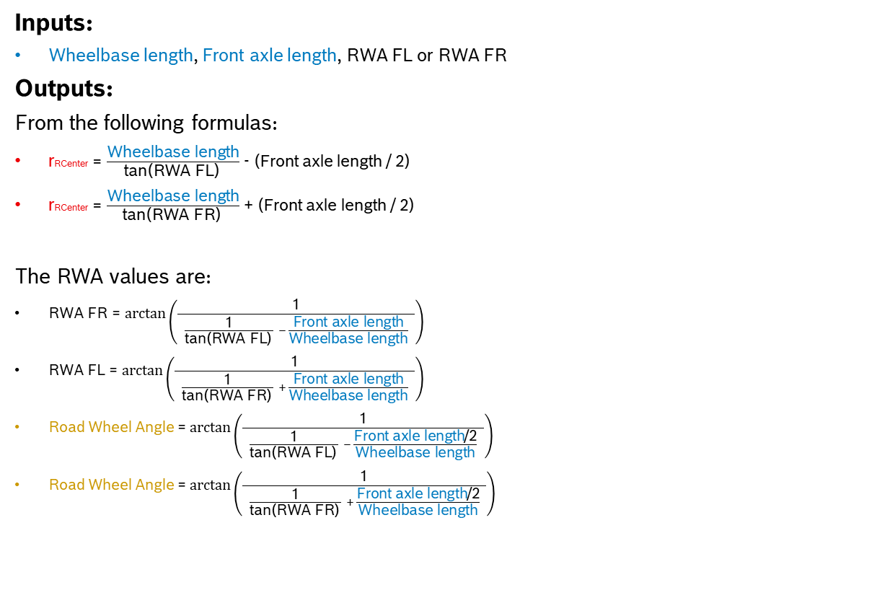
Vehicle turning movement - front side wheel angle as basis
Inputs:
Wheelbase length, Front axle length, RWA FL or RWA FR
Outputs:
From the following formulas:
$\text{r}\text{RCenter}$= $\frac{\text{Wheelbase} \text{length}}{\text{t}\text{an}\text{(}\text{RWA} \text{FL}\text{)} }$ - (Front axle length / 2)
$\text{r}\text{RCenter}$= $\frac{\text{Wheelbase} \text{length}}{\text{t}\text{an}\text{(}\text{RWA} \text{FR}\text{)} }$ + (Front axle length / 2)
The RWA values are:
RWA FR = $arctan\left(\frac{\text{1}}{ \frac{\text{1}}{\text{t}\text{an}\text{(}\text{RWA} \text{FL}\text{)} } − \frac{\text{Front} \text{axle} \text{length}}{\text{Wheelbase} \text{length}} }\right)$
RWA FL = $arctan\left(\frac{\text{1}}{ \frac{\text{1}}{\text{t}\text{an}\text{(}\text{RWA} \text{FR}\text{)} } + \frac{\text{Front} \text{axle} \text{length}}{\text{Wheelbase} \text{length}} }\right)$
Road Wheel Angle = $arctan\left(\frac{\text{1}}{ \frac{\text{1}}{\text{t}\text{an}\text{(}\text{RWA} \text{FL}\text{)} } − \frac{\text{Front} \text{axle} \text{length}\text{/2}}{\text{Wheelbase} \text{length}} }\right)$
Road Wheel Angle = $arctan\left(\frac{\text{1}}{ \frac{\text{1}}{\text{t}\text{an}\text{(}\text{RWA} \text{FR}\text{)} } + \frac{\text{Front} \text{axle} \text{length}\text{/2}}{\text{Wheelbase} \text{length}} }\right)$
Where:
rRCenter = Wheelbase length / tan(Road Wheel Angle)

Slide 13
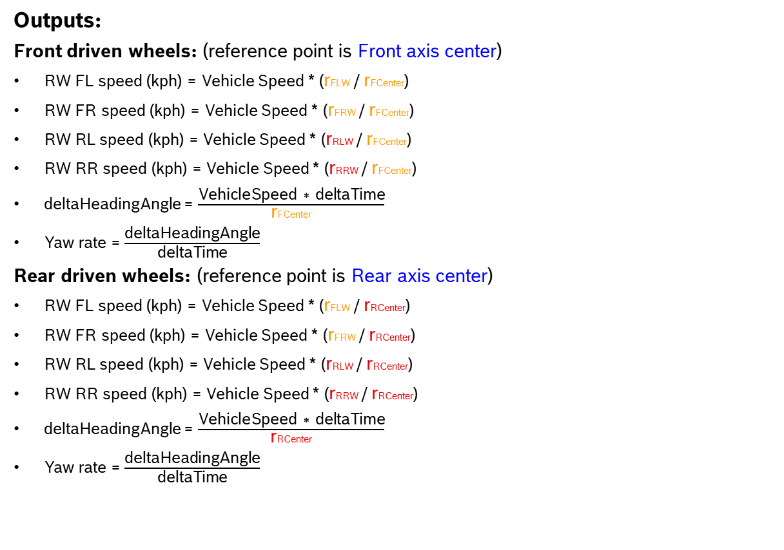
Vehicle turning movement - input/output (wheel speeds, heading angle change)
Outputs:
Front driven wheels: (reference point is Front axis center)
RW FL speed (kph) = Vehicle Speed * (rFLW / rFCenter)
RW FR speed (kph) = Vehicle Speed * (rFRW / rFCenter)
RW RL speed (kph) = Vehicle Speed * (rRLW / rFCenter)
RW RR speed (kph) = Vehicle Speed * (rRRW / rFCenter)
deltaHeadingAngle = $\frac{\text{VehicleSpeed}\text{ ∗ }\text{deltaTime}}{\text{r}\text{F}\text{Center}}$
Yaw rate = $\frac{\text{deltaHeadingAngle}}{\text{deltaTime}}$
Rear driven wheels: (reference point is Rear axis center)
RW FL speed (kph) = Vehicle Speed * (rFLW / rRCenter)
RW FR speed (kph) = Vehicle Speed * (rFRW / rRCenter)
RW RL speed (kph) = Vehicle Speed * (rRLW / rRCenter)
RW RR speed (kph) = Vehicle Speed * (rRRW / rRCenter)
deltaHeadingAngle = $\frac{\text{VehicleSpeed}\text{ ∗ }\text{deltaTime}}{\text{r}\text{RCenter}}$
Yaw rate = $\frac{\text{deltaHeadingAngle}}{\text{deltaTime}}$

Slide 14
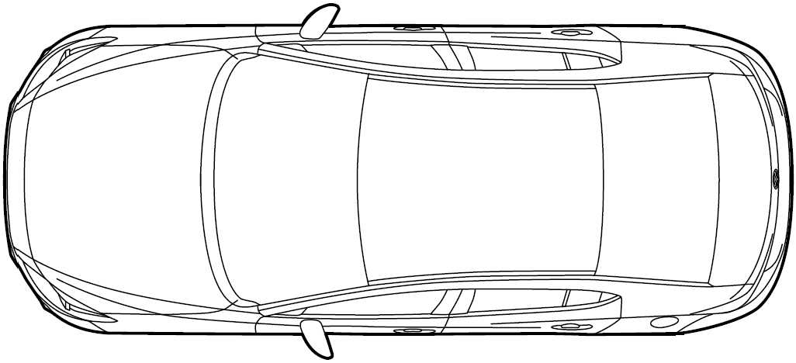
Vehicle turning movement – Max allowed RWA
FR Wheel
RR Wheel
α
Road Wheel Angle
Vehicle width
RL Wheel
FL Wheel
r min
r FCenter
Front overhang
Wheelbase length
α

Slide 15
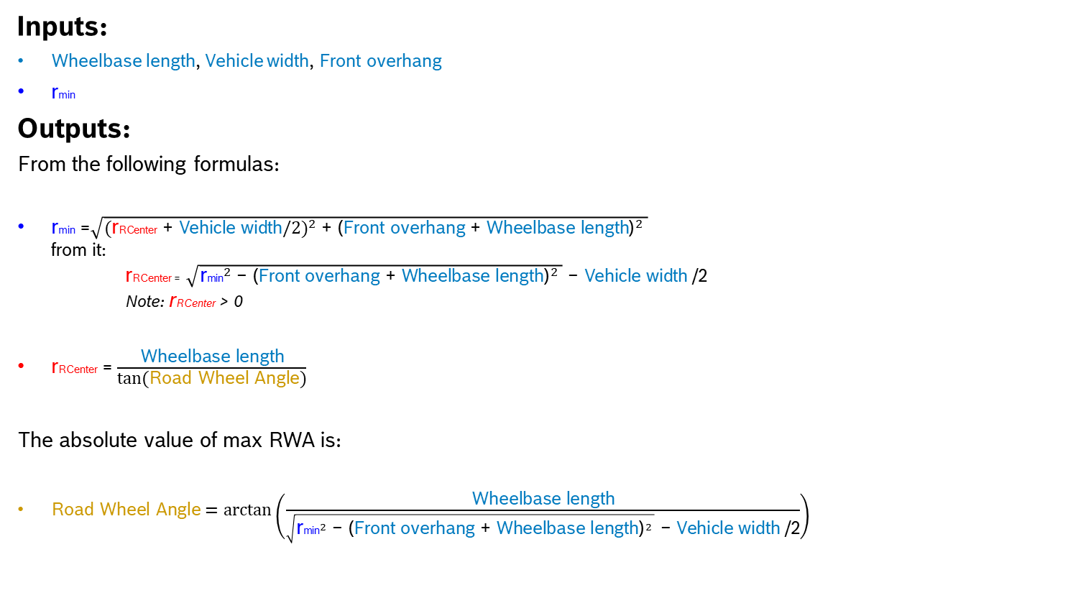
Vehicle turning movement – Max allowed RWA calculation
Inputs:
Wheelbase length, Vehicle width, $\text{Front} \text{overhang}$
rmin
Outputs:
From the following formulas:
rmin =$\sqrt{{(\text{r}\text{R}\text{Center}\text{ + }\text{Vehicle} \text{width}/2)}^{2}\text{ + }{\text{(}\text{Front} \text{overhang} \text{+ }\text{Wheelbase} \text{length}\text{)}}^{2} }$
from it:
rRCenter = $\sqrt{{\text{r}\text{min}}^{2}\text{ − }{\text{(}\text{Front} \text{overhang} \text{+ }\text{Wheelbase} \text{length}\text{)}}^{2} }\text{ − }\text{Vehicle} \text{width} \text{/2}$
Note: rRCenter > 0
rRCenter = $\frac{\text{Wheelbase} \text{length}}{\text{tan}\text{(}\text{Road} \text{Wheel} \text{Angle}\text{)}}$
The absolute value of max RWA is:
$\text{Road} \text{Wheel} \text{Angle}=\arctan\left(\frac{\text{Wheelbase} \text{length}}{\sqrt{{\text{r}\text{min}}^{2}\text{ − }{\text{(}\text{Front} \text{overhang} \text{+ }\text{Wheelbase} \text{length}\text{)}}^{2} }\text{ − }\text{Vehicle} \text{width} \text{/2}}\right)$

Slide 16
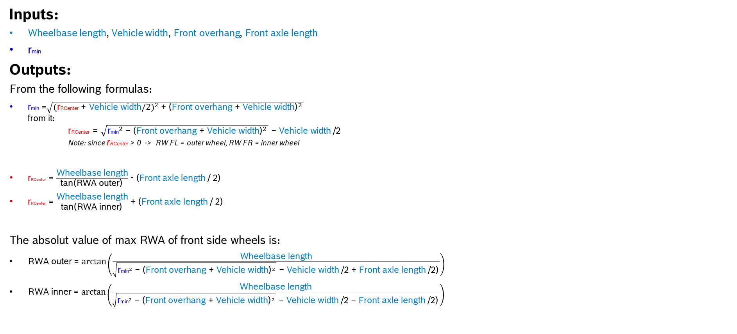
Vehicle turning movement – Max allowed RWA calculation (from side RWA)
Inputs:
Wheelbase length, Vehicle width, $\text{Front} \text{overhang}$, $\text{Front} \text{axle} \text{length}$
rmin
Outputs:
From the following formulas:
rmin =$\sqrt{{(\text{r}\text{RCenter}\text{ + }\text{Vehicle} \text{width}/2)}^{2}\text{ + }{\text{(}\text{Front} \text{overhang} \text{+ }\text{Vehicle} \text{width}\text{)}}^{2} }$
from it:
rRCenter = $\sqrt{{\text{r}\text{min}}^{2}\text{ − }{\text{(}\text{Front} \text{overhang} \text{+ }\text{Vehicle} \text{width}\text{)}}^{2} }\text{ − }\text{Vehicle} \text{width} \text{/2}$
Note: since rRCenter > 0 -> RW FL = outer wheel, RW FR = inner wheel
$\text{r}\text{RCenter}$= $\frac{\text{Wheelbase} \text{length}}{\text{tan}\text{(}\text{RWA} \text{outer}\text{)} }$ - (Front axle length / 2)
$\text{r}\text{RCenter}$= $\frac{\text{Wheelbase} \text{length}}{\text{tan}\text{(}\text{RWA} \text{inner}\text{)} }$ + (Front axle length / 2)
The absolut value of max RWA of front side wheels is:
RWA outer = $arctan\left(\frac{\text{Wheelbase} \text{length}}{\sqrt{{\text{r}\text{min}}^{2}\text{ − }{\text{(}\text{Front} \text{overhang} \text{+ }\text{Vehicle} \text{width}\text{)}}^{2} }\text{ − }\text{Vehicle} \text{width} \text{/2} \text{+ }\text{Front} \text{axle} \text{length}\text{ /2)} }\right)$
RWA inner = $arctan\left(\frac{\text{Wheelbase} \text{length}}{\sqrt{{\text{r}\text{min}}^{2}\text{ − }{\text{(}\text{Front} \text{overhang} \text{+ }\text{Vehicle} \text{width}\text{)}}^{2} }\text{ − }\text{Vehicle} \text{width}\text{ /2 }\text{− }\text{Front} \text{axle} \text{length}\text{ /2)} }\right)$

Slide 17
Lateral control – Active steering (control flow)
Cycle begin
INPUT
CLASSE
OUTPUT
[1]
wheel angle control is active
yes
SWA arbitration
[2]
ADAS RWA request is active
yes
RWA request
hil_adas::rwa_req
hil_adas::req_type
hil_hvm::swa
hil_hvm::rwa
no
PID logic on steering wheel
[3]
Driver SWA request is active or passive
hil_drv::swa_req
yes
no
SWA request
[4]
Driver RWA request is active
yes
hil_drv::rwa_req
hil_drv::max_yaw_rate
no
Move steering wheel to center position
hil_hvm::velocity != 0
yes

Slide 18
Lateral control – Active steering – CLASSE logic
[1] Wheel angle control :
If :
  Front RWA control flag has been set to „USER”
  or Rear RWA control flag has been set to „USER”
  or There is active driver/user steering (hil_drv::swa_req has been changed by user)
  or RWA is requested by driver/user (hil_drv::rwa_req has been changed by user)
  or rhere is active ADAS steering requesting
  Then :
Wheel angle control is active
  Note:
  Wheel angle control is used to enable/disable driver control of simulation tool (for ex.: CarMaker).
  It shall only be set to inactive by user.
[1]
[2]
RWA
[3]
[4]
SWA

Slide 19
Lateral control – Active steering – CLASSE logic
[2] ADAS RWA request
If :
ADAS is requesting steering (hil_adas::rwa_req != 0)
or ADAS steering request is active (hil_adas::req_type != „no request”)
  Then :
ADAS RWA request is active
Else :
ADAS RWA request is inactive
[1]
[2]
RWA
[3]
[4]
SWA

Slide 20
Lateral control – Active steering – CLASSE logic
[3] Driver SWA request
If :
Driver/user is steering (hil_drv::swa_req has been changed by user)
Then :
Driver SWA request is active
Else if :
Driver/user is no more steering actively,
and no other Driver/ADAS request has become active
Then :
Driver SWA request is passive
Else if :
other Driver/ADAS request has just become active
or Wheel angle control has become inactive
Then :
Driver SWA request is inactive
hil_drv::swa_req follows hil_hvm::swa
[1]
[2]
RWA
[3]
[4]
SWA

Slide 21
Lateral control – Active steering – CLASSE logic
[4] Driver RWA request
If :
Driver has requested RWA change (hil_drv::rwa_req != 0)
Then :
Driver RWA request is active
Else if :
other Driver/ADAS request has just become active
or Wheel angle control has become inactive
Then :
Driver RWA request is inactive
[1]
[2]
RWA
[3]
[4]
SWA

Slide 22
Lateral control – Active steering – CLASSE logic
Driver torque calculation
Driver torque = 0
Driver torque components
+
+
+
Driver SWA speed
=
Yaw rate
hil_adas::swa_req
hil_hvm::swa
hil_hvm::yaw_rate
hil_drv::swa_req
hil_drv::swa_speed
Nm
Nm
hil_drv::
steering_torque
hil_adas::swa_req != 0
no
Yaw rate
Driver SWA speed
Delta SWA (Driver - HVM)
yes
Nm
Delta SWA

Slide 23
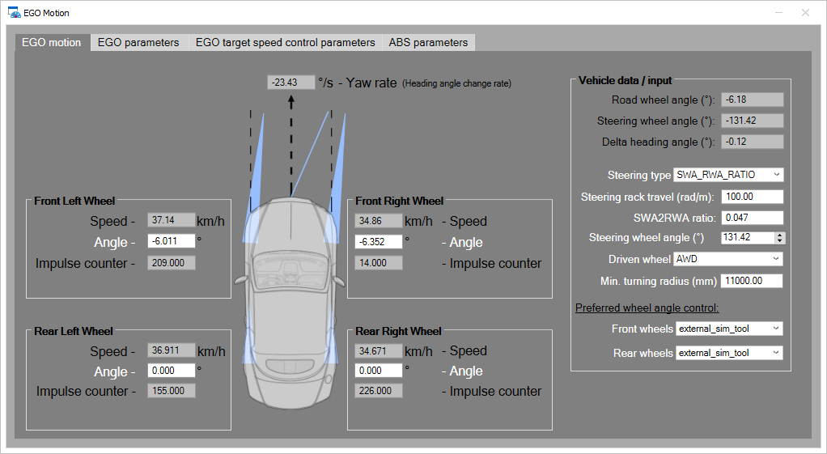
Vehicle Motion panel - Vehicle motion tab (user interface)

Slide 24
Longidutinal control

Slide 25
Longitudinal control - Speed control
INPUT
CLASSE
OUTPUT
ax arbitration
hil_adas::ax
hil_adas::ax != 0
and
hil_adas::ax_type != override
ax request
hil_adas::ax_type
yes
PID logic on pedals (based on current ax request)
hil_hvm::<pedals>
hil_hvm::ax
hil_hvm::vx
hil_drv::gas/brake pedals
Driver pedal request is active
yes
Arbitration (driver override check)
no
hil_drv::target_velocity
Driver target velocity request is active
yes
hil_drv::target_velocity_status
no
hil_drv::ax
yes
Driver ax is active
Gear control
hil_drv::gear_req

Slide 26
Longitudinal control - ax arbitration
Driver pedal position request
Ax request arbitration
PID logic on virtual pedal positions
Driver virtual pedals
Driver override check
driver
ax request
HVM gear position is in D or R
Driver brake/gas pedal position change request based on ax request
driver gas pedal > ADAS gas pedal
OR
driver brake pedal < ADAS brake pedal
OR
driver target speed has been activated
hil_hvm::<pedals>
hil_hvm::ax
AND
hil_hvm::vx
ADAS
ax request
ADAS brake/gas pedal position change request based on ax request
ADAS virtual pedals
ACC (ADAS function) is active
Override-related customer data on bus to ADAS ECU

Slide 27
ABS/WIC simulation

Slide 28
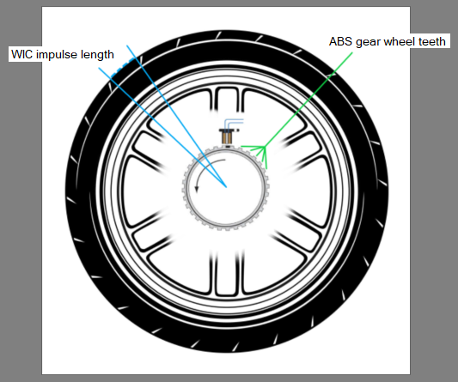
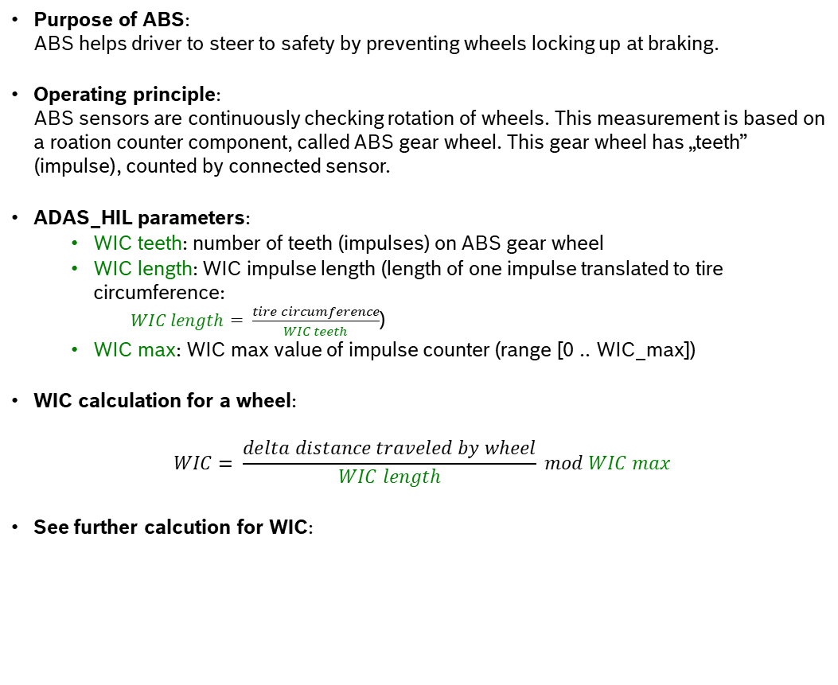
ABS/WIC calculation
Purpose of ABS:
ABS helps driver to steer to safety by preventing wheels locking up at braking.
Operating principle:
ABS sensors are continuously checking rotation of wheels. This measurement is based on a roation counter component, called ABS gear wheel. This gear wheel has „teeth” (impulse), counted by connected sensor.
ADAS_HIL parameters:
  WIC teeth: number of teeth (impulses) on ABS gear wheel
  WIC length: WIC impulse length (length of one impulse translated to tire circumference:
  $WIC length= \frac{tire circumference}{WIC teeth}$)
  WIC max: WIC max value of impulse counter (range [0 .. WIC_max])
WIC calculation for a wheel:
$$WIC= \frac{delta distance traveled by wheel}{WIC length} mod WIC max$$
See further calcution for WIC:

Slide 29
Steering system simualtion

Slide 30
Steering system model
Steering system model provides functions to simulate steering mechanism, like:
steering model types:
  SWA-RWA ratio
  rack travel
  SWA-RWA ratio table (TBD)
bi-directional conversion between SWA and RWA
confinement of SWA and RWA (based on min. turning radius of Ego vehicle)

Slide 31

Steering system types
Steering model type #1: SWA-RWA ratio
RWA = SWA * SWA_RWA_ratio
Where
  SWA_RWA_ratio is paramater
SWA
RWA
Simplified model to calculate front center virtual RWA

Slide 32

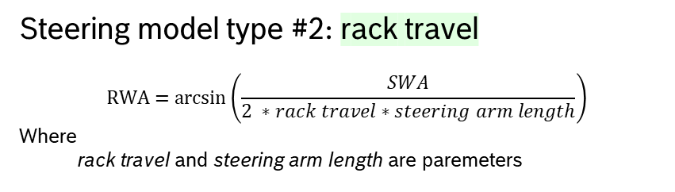
Steering system types
Steering model type #2: rack travel
$$RWA=\arcsin\left(\frac{SWA}{2 ∗rack travel∗steering arm length}\right)$$
Where
  rack travel and steering arm length are paremeters
SWA
SWA
delta rack position
steering arm
RWA
RWA
Basis concept
Simplified model to calculate front center virtual RWA

Slide 33
Door control

Slide 34
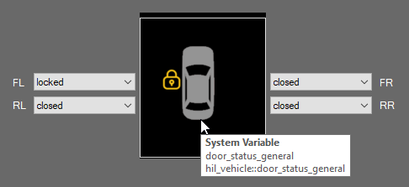
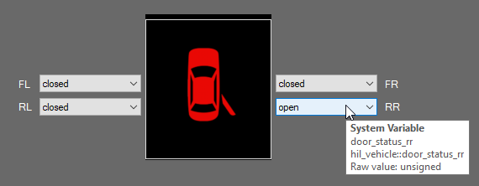
Vehicle Model - Door control
Doors control is based on a simple door opening/closing/locking input set (also based on CANoe sysvars CLASSE database)
Input(s):
- door status FL, FR, RL, RR
Output(s):
- overall door status (closed, only if none doors is open)

Slide 35
External control
(keyboard)

Slide 36
Vehicle Model - External control (keyboard)
TBD

Slide 37
Customer data flow control

Slide 38
Vehicle Model - Customer data flow control
Customer-related data control (value of bus signals) is implemented in separate module (CAPL include file) of Vehicle Model.
Data flow control has two steps within a simulation cycle:
Collecting necessary input signal values from ADAS ECU(s)
  RWA request
  Acceleration/Deceleration requests
Assign calculated values to necessary output signals sent to ADAS ECU(s) related to:
  Pedal
  Power mode
  Gear
  Driving direction
  Longitudinal motion
  Lateral motion
  ESP

