Slide 1
1objXloc Radar Model

Slide 2
01
Architecture

Slide 3
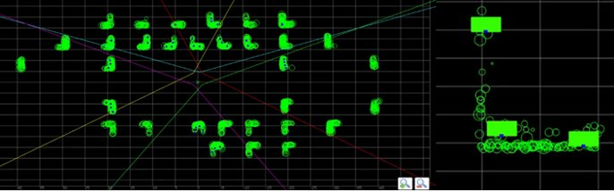
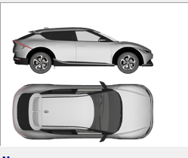
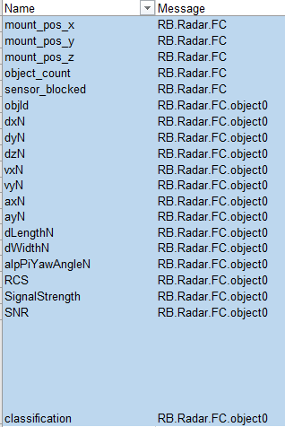
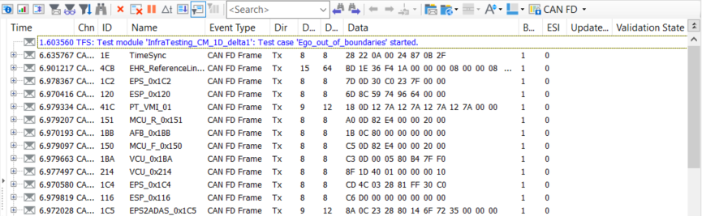
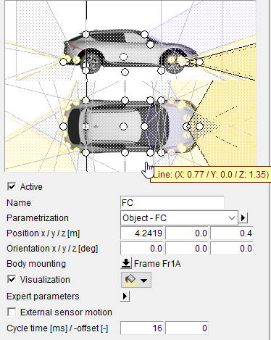
Radar Model
Architecture
Carmaker
CANoe
OEM Car file
Bosch creates custom plugin
Standard Bosch Object interface
Dynamic modulation/ alternation/ parameterization
Custom made UDP eth communication (byte array) for higher data exchange rate
Bosch CANoe node config
Creation of sysvars
Creation of UDP receiving node over C libraries dll
Mapping to radar model DLL
Bosch Radar Model
DLL library receiving object structure and generating location cloud
Tunable location number per object
Custom features for location distribution
Bosch adds/configures in OEM car file
Object Sensor
Radar HiFi sensor (freq, noise, etc)
Sensor mounting positions
Bosch Restbus simulation
Maps locations from the model to bus PDUs per arxml
Schedules the bus sending cyclic time
Loops back the request for alternating modulation

Slide 4
Deliverables
Architecture
OEM
Car file Carmaker with graphics, light model, powertrain and other plugins, sensor mounting positions
Bosch
Object structure database excel
Bosch
Radar location model 1objXloc library with parameter documentation
Bosch
Arxml radar mapping to the radar location model structure
Bosch
Car file Carmaker with ADAS sensors

Slide 5
02
Input Definitions

Slide 6
CarMaker Sensor Configuration
Input Definitions
Radar Front Left
Radar Front Right
RCS Sensor
Object Sensor
Radar Rear Left
Radar Rear Right
Rear Center Axle (RCA)

Slide 7
Coordinate System of the Input Data
Input Definitions
X
Distance from Sensor position towards the rear center bumper
Object
Ego Vehicle
Y

Slide 8
Steering inputs - appInit
Input Definitions
Function Description: Creates and initializes an instance of the DLL with the ID of the given handle.
Parameter | Type | Description
handle | uint32 | A unique identifier for the object.
Steering inputs - appInitRoadObj
Function Description: Sets global infrastructure values of the DLL.
Parameter | Type | Description
handle | uint32 | A unique identifier for the object.
simulator | int | Specifies the simulator to be used (Classe =1, CarMaker = 2).
data_transfer_protocol | int | Specifies the data transfer protocol to be used (CAN FD = 1, CAN TP = 2, Ethernet = 3).

Slide 9
Steering inputs - appInputEgoValues
Input Definitions
Function Description: Sets values of the ego vehicle.
Return Parameter: 0 = OK, -1 = No DLL instance found
Parameter | Type | Description
handle | uint32 | A unique identifier for the object.
velocity_x | double | Ego velocity in longitudinal direction (in m/s).
velocity_y | double | Ego velocity in lateral direction (in m/s).
Steering inputs - appInputSensorDefinitionsRadarXX
Function Description: Sets sensor specification parameters.
Return Parameter: 0 = OK, -1 = No DLL instance found
Parameter | Type | Description
handle | uint32 | A unique identifier for the object.
mount_dx | double | Mounting position of the sensor in longitudinal direction in reference to the RCA (m).
mount_dy | double | Mounting position of the sensor in lateral direction in reference to the RCA (m).
mount_dz | double | Mounting position of the sensor in vertical direction in reference to the RCA (m).
mount_yaw | double | Mounting position yaw angle of the sensor in x-y-plane (rad).
fov_angle | double | Field of view angle of the sensor (rad).
validity_sending_active | int | Flag to activate the validity sending (send all locations = 0, only valid locations = 1).
obj_sim_active | int | Flag to indicate that this sensor is currently being simulate (not sim = 0, sim = 1).
obj_count | int | Number of valid objects (only used as input for CarMaker usecase).

Slide 10
Steering inputs - appInputRadarDefinitionsRadarXX
Input Definitions
Function Description: Sets radar specification parameters.
Return Parameter: 0 = OK, -1 = No DLL instance found
Parameter | Type | Description
handle | uint32 | A unique identifier for the object.
loc_model | int | Flag to choose which location model to use (0 = 1objXloc).
loc_distribution_model | int | Flag to choose the distribution model to use (0 = Even, 1 = CMP, 2 = Statistical).
loc_sim | int | Flag to activate calculations of location data for this sensor (0 = off, 1 = on).
max_nr_of_loc | int | Maximum number of locations to be generated per object.
loc_separation_angle | double | Separation angle between generated locations (rad).
radar_generation | int | Indicates the generation of the radar which influences the data being calculated.

Slide 11
Steering inputs - appInputObjectDataRadarXX
Input Definitions
Function Description: Captures and processes the object data from the radar sensors at the front-left position of the vehicle.
Return Parameter: 0 = OK, -1 = No DLL instance found
Parameter | Type | Description
handle | uint32 | A unique identifier for the object.
obj_id | int | The ID of the object.
sim_on | int | Indicates whether the simulation is active (1) or not (0).
sensor_mode | Int | Sensor mode in which the object has been detected (0 = driving, 1 = parking).
dx | double | The x-coordinate of the object's position relative to the ego vehicle (m).
dy | double | The y-coordinate of the object's position relative to the ego vehicle (m).
vx | double | The x-component of the object's velocity (m/s).
vy | double | The y-component of the object's velocity (m/s).
ax | double | The x-component of the object's acceleration (m/s²).
ay | double | The y-component of the object's acceleration (m/s²).
yaw_angle | double | The yaw angle of the object (rad).
width | double | The width of the object (m).
length | double | The length of the object (m).
height | double | The height of the object (m).
type | int | The type of the object (1 = unknown, 2 = Barrier, 3 = bike, 4 = pedestrian, 5 = truck, 6 = vehicle).
rcs | double | The Radar Cross Section (RCS) value of the object.
snr | double | The Signal-to-Noise Ratio (SNR) of the radar signal.
rssi | double | The Received Signal Strength Indicator (RSSI) value of the radar signal.

Slide 12
03
Location Distribution

Slide 13
Sequence Diagram for Radar Calculations
1objXloc Radar Model
Master
DLL
appInit(handle)
Has to be called just once (more often possible)
appInitRoadObj(handle, simulator, data_transfer_protocol)
appInputEgoValues(handle, velocity_x, velocity_y)
appInputSensorDefinitionsRadarXX(handle, mount_dx, mount_dy, mount_dz, mount_yaw,double fov_angle, validity_sending_active, obj_sim_active, obj_count)
appInputRadarDefinitionsRadarXX(handle, loc_model, loc_distribution_model, loc_sim_active, max_nr_loc,double loc_separation_angle, radar_generation)
Has to be called each cycle
appInputObjectDataRadarXX(handle, obj_id, sim_on, dx, dy, vx, vy, ax, ay, yaw_angle, width, length, height, type, rcs, snr, rssi)
appCalcAllSensorTargetData(handle)
appGetRadarXXValidLocCount(handle)
Location Count

Slide 14
Static Locations
Ego Vehicle
Object
Location
1objXloc Radar Model
L-Shape detected
One Side detected
Description: Five static locations generated on the object. On the middle of the object aswell as on the three corner points and middle of the side mainly detected (indicated in orange).
Description: Four static locations generated on the object. On the middle of the object aswell as on the corner points and middle of the detected side (indicated in orange).

Slide 15
Distribution Models
Ego Vehicle
Object
Location
1objXloc Radar Model
Even Distribution Model
Crowded Middle Point (CMP) Distribution Model
Statistical Distribution Model

Slide 16
04
Output Definitions

Slide 17
Reading calculated data from DLL
Output
Method 1: Reading signal values one by one
Method 2: Reading the full ByteArray
Function | Return Type | Parameter List
appGetRadarXXValidLocCount | long | (uint32_t handle)
appGetRadarXXLocRadialDistance | double | (uint32_t handle, int loc_nr)
appGetRadarXXLocRadialVelocity | double | (uint32_t handle, int loc_nr)
appGetRadarXXLocAzimuthAngle | double | (uint32_t handle, int loc_nr)
appGetRadarXXLocElevationAngle | double | (uint32_t handle, int loc_nr)
appGetRadarXXLocRCS | double | (uint32_t handle, int loc_nr)
appGetRadarXXLocRSSI | double | (uint32_t handle, int loc_nr)
appGetRadarXXLocSNR | double | (uint32_t handle, int loc_nr)
Function | Return Type | Parameter List
appGetRadarXXByteArray | long | (uint32_t handle, , uint8_t byteArray[])
Description:
The DLL populates all the location data into a ByteArray. To read this, a ByteArray must be provided as a parameter to the function. The function then copies the data into it and returns the populated ByteArray.
The Bytes for the Header values need to be added into the ByteArray in an additional step afterwards. The DLL is not able to populate this data and therefor leaves a blankspace for those values.
Description:
Each value of each location can be read individually for every radar.

