Slide 1
Client Server architecture and design for Test benches

Slide 2
Current situation and objective of the project
Architecture
vTESTstudio projects are executed on RT rack
Necessity to call batch files, scripts, tools, … on the desktop PC from the RT rack during the test case execution
Develop a client server solution to enable the client (RT rack) to execute any batch file, script, tool on the server (desktop PC)
For security reasons restrict access to only one client and only from the known IP address of the RT rack
  in windows defender firewall
  also implemented in the Python server

Slide 3
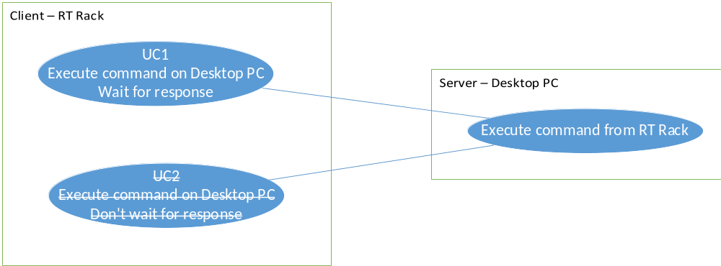
Use cases
Architecture
UC 1
Call any application and wait until finished
UC2
Call any application and return immediately, don’t wait until finished

Slide 4
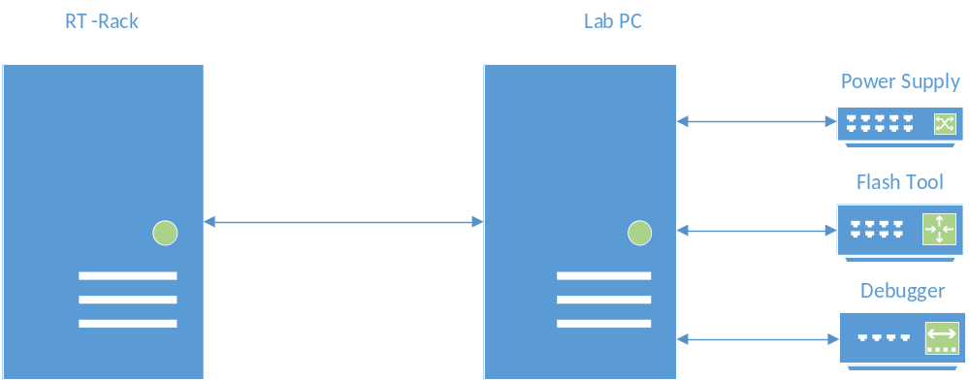
HW Case 1
Architecture
External devices are connected to the Lab PC
Test can control external devices via there own interfaces (e.g Debugger) or via the Python server running on the Lab PC (next slide)
Framework on the Lab PC can power up the ECU and flash because devices are connected to the Lab PC

Slide 5
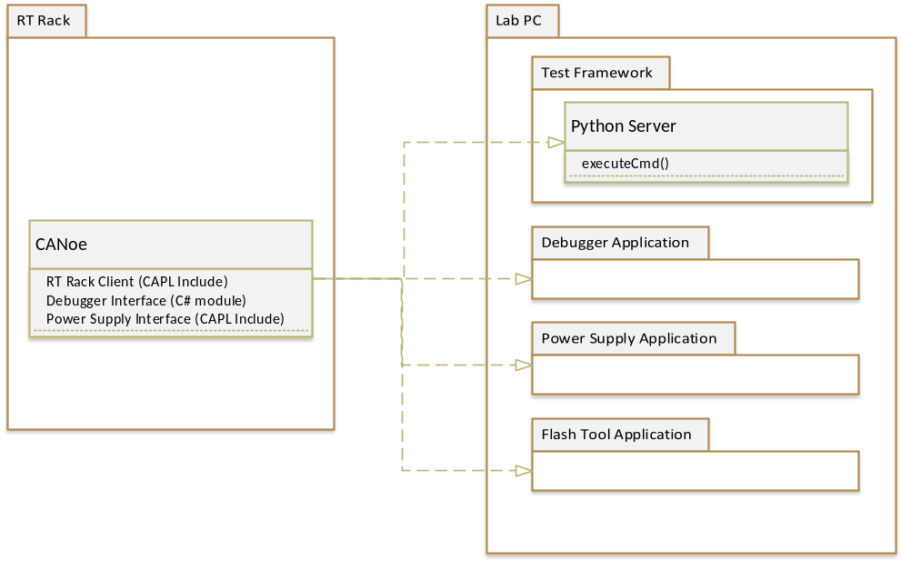
SW Case 1
Architecture
CANoe on the RT rack can send commands to the Python server on the Lab PC
Commands can be batch files, scripts, starting applications, …
Python Server is started by the Test Framework (to be implemented)
Debugger, Power Supply, Flash Tool applications can be controlled by there own interfaces
Small adaptations needed to call the applications on the remote computer
- IP address
- Port number

Slide 6
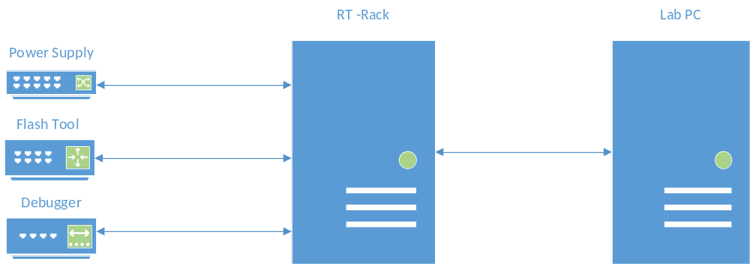
HW Case 2
Architecture
External devices are connected to the RT rack
Test has full control over the devices when executed on the RT rack
Framework on the Lab PC cannot power up the ECU and flash because devices are connected to the RT rack
- this is the only restriction to the framework
New option is needed in the framework to NOT control the power supply

Slide 7
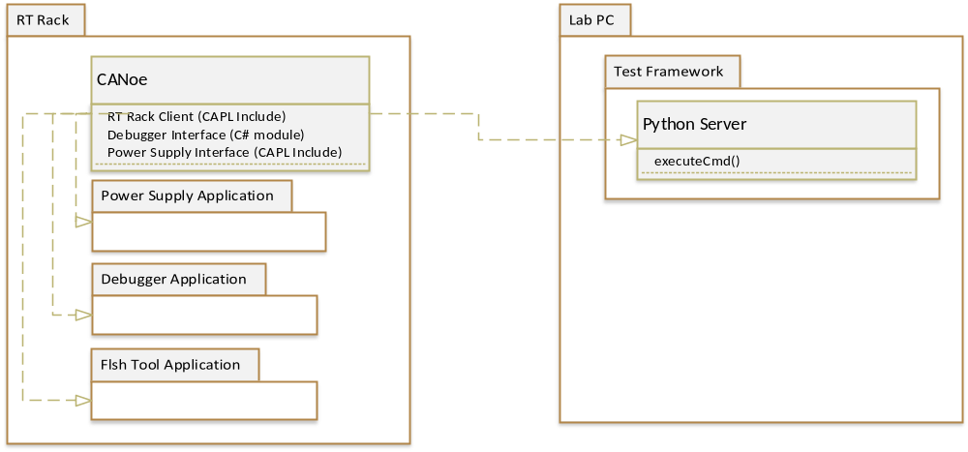
SW Case 2
Architecture
CANoe on the RT rack can send commands to the Python server on the Lab PC
Commands can be batch files, scripts, starting applications, …
Python Server is started by the Test Framework (to be implemented)
Debugger, Power Supply, Flash applications can be controlled by there own interface

Slide 8
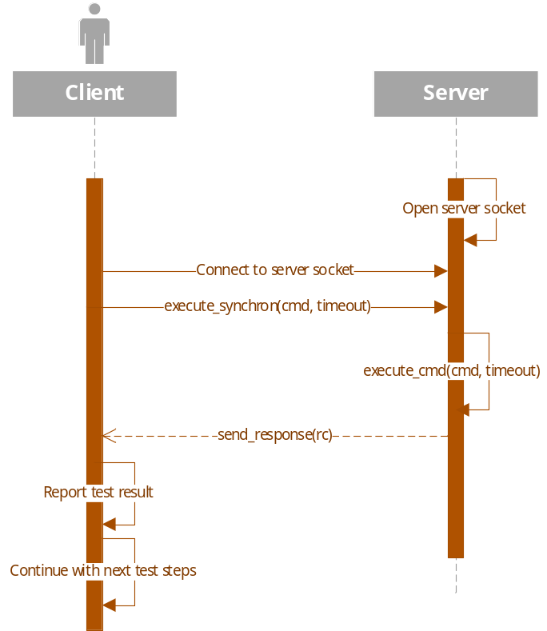
Use case 1 - Call any application and wait until finished
Design
Client sends commands to be executed as a string
e.g. “C:\myFolder\execMe.bat”
Advantage:
Any batch file, script, tool can be called. Don’t have to be preconfigured in the server
Any return code or error code is send back synchronously to the client, has to be processed in the client application

Slide 9
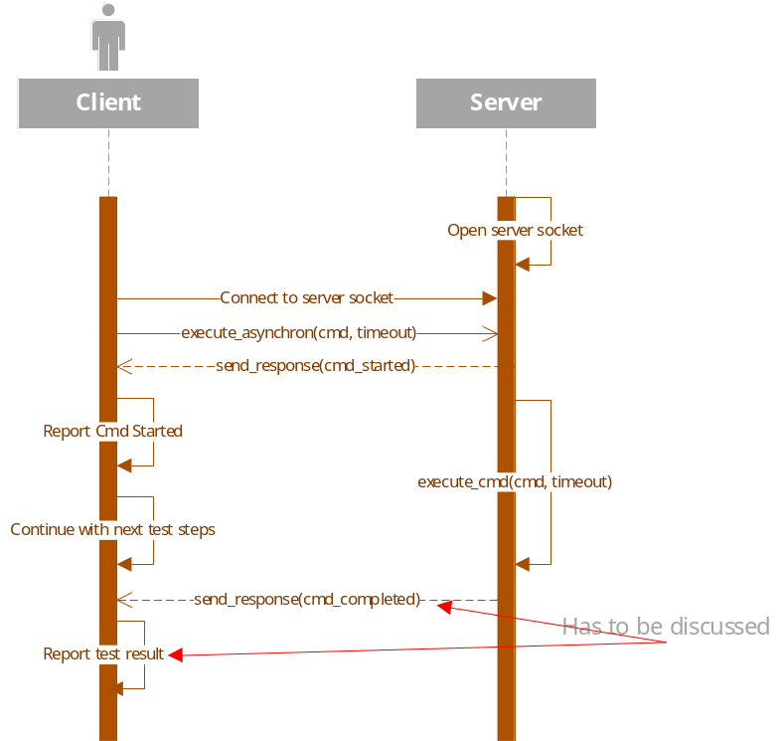
Use case 2 - Call any application and return immediately, don’t wait until finished
Design
Client sends commands to be executed as a string
e.g. “C:\myFolder\execMe.bat”
Advantage:
Any batch file, script, tool can be called. Don’t have to be preconfigured in the server
Any return code or error code is send back asynchronously to the client, has to be processed in the client application
Can this be handled in vTESTstudio? Is this a needed use case?

Slide 10
Programming languages
Implementation
Client, vTESTstudio project:
- CAPL include file
Server:
- Python server script
Windows Defender Firewall with Advanced Security
- allow TCP connection on port 5555
(or any other port chosen for the communication)

