Slide 1
Tutorial of sentiment analysis
Fabio Benedetti

Slide 2
Outline
Introduction to vocabularies used in sentiment analysis
Description of GitHub project
Twitter Dev & script for download of tweets
Simple sentiment classification with AFINN-111
Define sentiment scores of new words
Sentiment classification with SentiWordNet
Document sentiment classification

Slide 3
AFINN-111
AFINN is a list of English words rated for sentiment score.
between -5 (negative) to +5 (positive).
AFINN-111: Newest version with 2477 words and phrases.
…
Abilities 2
Ability 2
Aboard 1
Absentee -1
…

Slide 4

WordNet
WordNet is lexical database for the English language that groups English word into set of synonyms called synset
WordNet distinguishes between :
nouns
verbs
adjectives
adverbs
SYNSET#
SYNSET₄
SYNSET₂
SYNSET₁

Slide 5

SentiWordNet is an extension of WordNet that adds for each synset 3 measures:
PosScore [0,1] : positivity measure
NegScore [0,1]: negativity measure
ObjScore [0,1]: objective measure
ObjScore = 1 – (PosScore + NegScore )
SentiWordNet 3.0: An Enhanced Lexical Resource for Sentiment Analysis and Opinion Mining
http://sentiwordnet.isti.cnr.it/
a 00016135 0 0.25 rank#5 growing profusely; "rank jungle vegetation"
a 00016247 0.125 0.5 superabundant#1 most excessively abundant

Slide 6
Project on GitHub
https://github.com/linkTDP/BigDataAnalysis_TweetSentiment
AFINN-111.txt
SentiWordNet_3.0.0_20130122.txt
config.json
ExtractTweet.py
DeriveTweetSentimentEasy.py
NewTermSentimentInference.py
SentiWordnet.py
DocumentSentimentClassification.py

Slide 7
config.json & ExtractTweet.py (1)
This script can be used to download tweets in a csv file and is configurable through config.json
The authentication fields that must be set are:
consumer_key
consumer_secret
access_token
access_token_secret
These fields can be retrieved from https://dev.twitter.com creating an account and an application

Slide 8
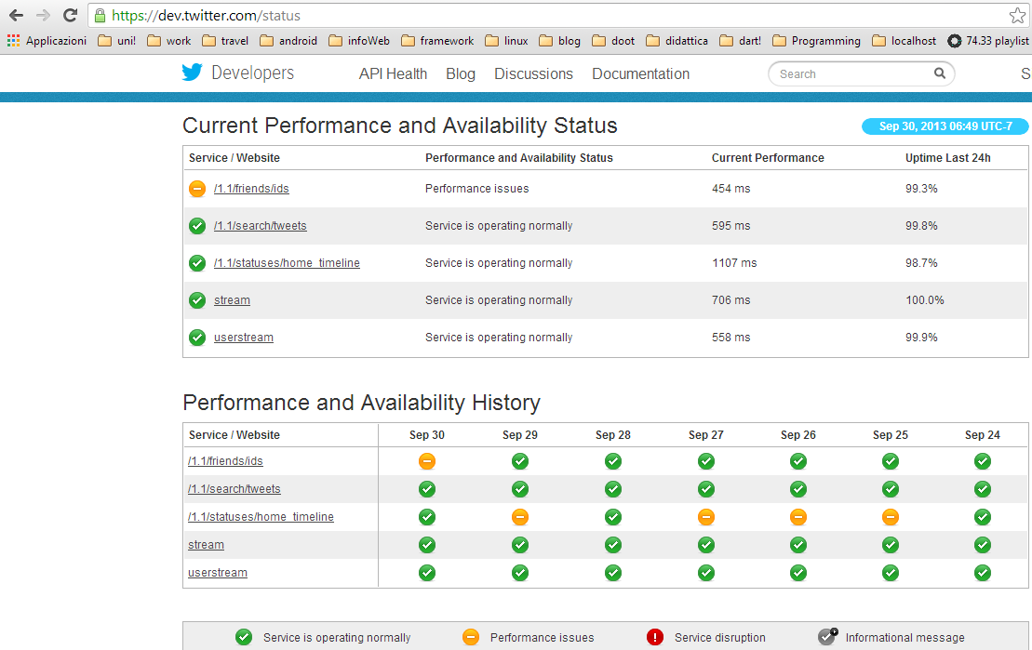
Twitter Developers
Create an account on the site: https://dev.twitter.com/

Slide 9
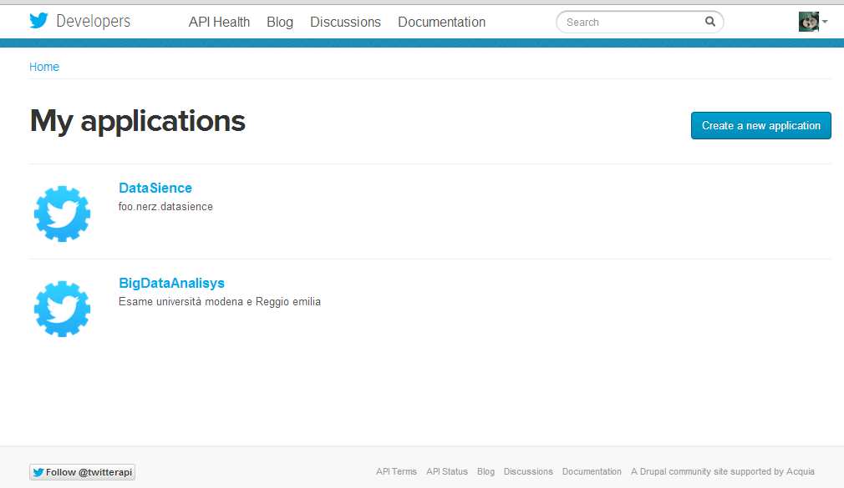
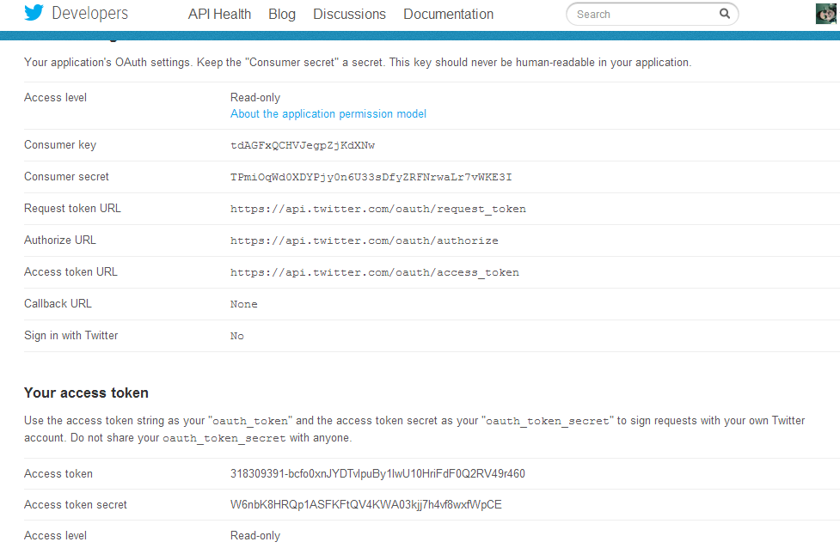

Slide 10
config.json & ExtractTweet.py (2)
Other fields:
file_name (name of the .cvs output file)
count (number of tweet to download)
filter (a word used to filter the tweet in output)
The CSV file produced in output can be used as input of the other three script.

Slide 11
DeriveTweetSentimentEasy.py
This script use AFINN-111 as vocabulary
In AFINN-111 the score is negative and positive according to sentiment of the word.
Therefore a very rudimental sentiment score of the tweet can be calculated summing the score of each word.
Issue:
In AFINN-111 not all the words are present.

Slide 12
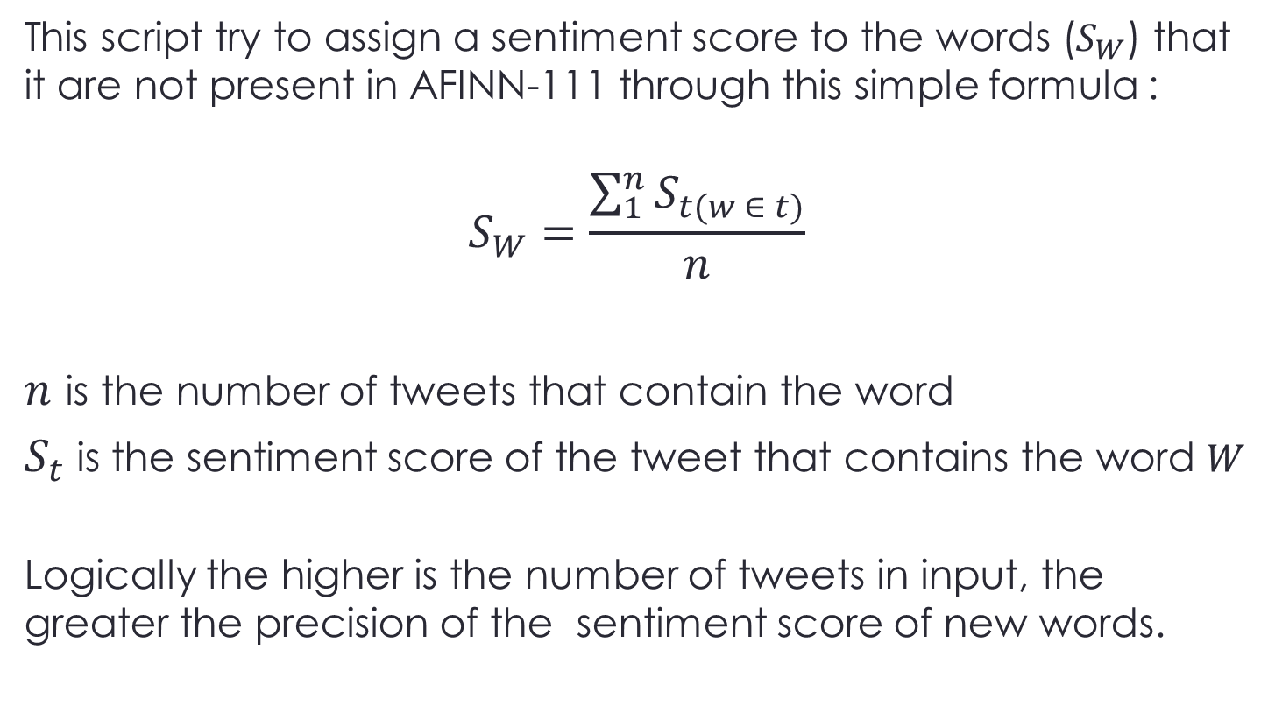
NewTermSentimentInference.py
This script try to assign a sentiment score to the words ($S_{W}$) that it are not present in AFINN-111 through this simple formula :
$$S_{W}=\frac{\sum_{1}^{n}{S_{t(w ∈ t)}}}{n}$$
$n$ is the number of tweets that contain the word
$S_{t}$ is the sentiment score of the tweet that contains the word $W$
Logically the higher is the number of tweets in input, the greater the precision of the sentiment score of new words.

Slide 13
SentiWordnet.py
This script use SentiWordNet as vocabulary and an the algorithm that is implemented is inspired by :
Hamouda, Alaa, and Mohamed Rohaim. "Reviews classification using sentiwordnet lexicon." World Congress on Computer Science and Information Technology. 2011.
http://www.academia.edu/1336655/Reviews_Classification_Using_SentiWordNet_Lexicon

Slide 14
Sentiment Classification Phases
Tweet
Tokenization
Speech Tagging
WordNet
WSD
SentiWordNet Interpretation
Sentiment Orientation
Tweet
Classified

Slide 15
Tokenization & Speech Tagging
Tokenization process: splits the text into very simple tokens such as numbers, punctuation and words of different types.
Speech Tagging process: produces a tag as an annotation based on the role of each word in the tweet.
noun | verb | noun | adverb
Francesco | speaks | English | well

Slide 16
Word Sense Disambiguation
The techniques of WSD are aimed at the determination of the meaning of every word in his context.
In this case the disambiguation happens selecting for each words in a tweet the synset in WordNet that best represents this word in his context.

Slide 17
Word Sense Disambiguation (2)
I have implemented a simple (and inaccurate) algorithm of WSD using NLTK (Python's library for NLP).
Each synset in WordNet has a textual a brief description called Gloss.
Very intuitively this algorithm choose as synset of the word the one whose Gloss contains the largest number of words present in the tweet.
If no Gloss has a match with the tweet's words, the algorithm choose the first synset, that usually is the most used.
Issue:
The corpus of a tweet is very small (max 140 character), so this algorithm could produce a bad disambiguation of the word's sense.

Slide 18
SentiWordNet Interpretation
Given a synset (after the phase of WSD) we can search in SentiWordNet the sentiment score associated to this synset
tweet
@BonksMullet @chet_sellers This is very accurate and hilarious. Well done :)
WSD
synset
accurate#1 conforming exactly or almost exactly to fact or to a standard or performing with total accuracy; "an accurate reproduction"; "the accounting was accurate"; "accurate measurements"; "an accurate scale"
SentiWordNet
score
Pos_score Neg_score Obj_score
0.5 0 0.5

Slide 19
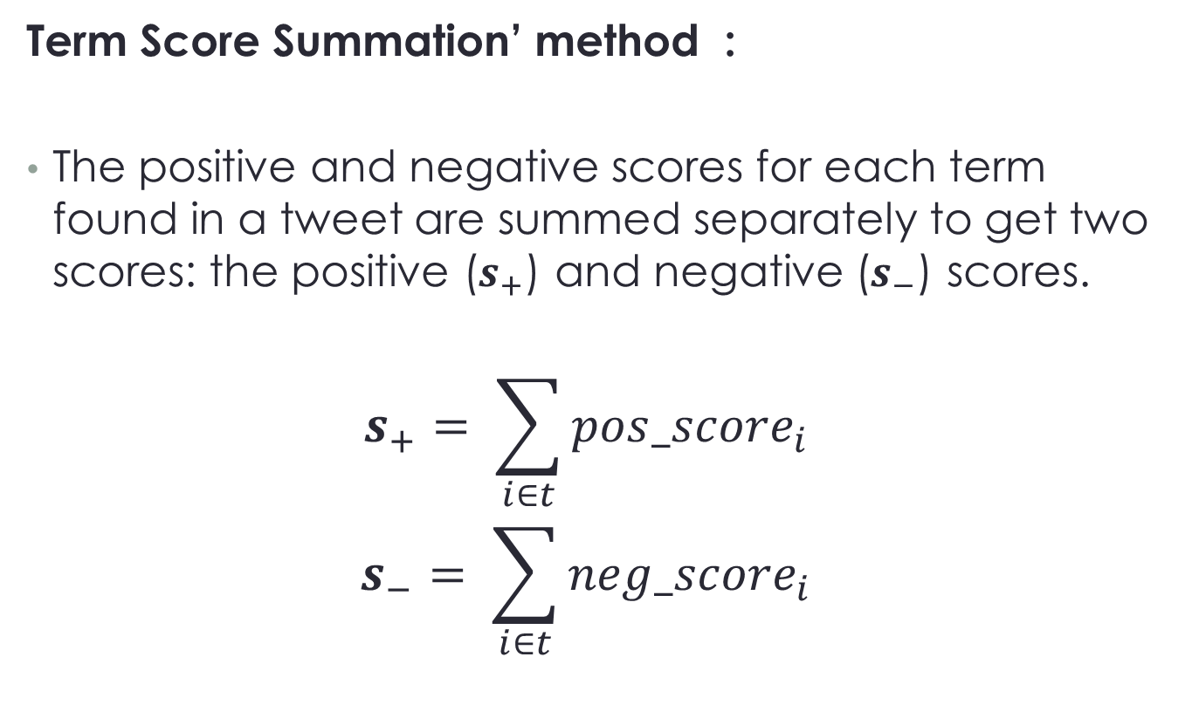
Sentiment Orientation
Term Score Summation’ method :
The positive and negative scores for each term found in a tweet are summed separately to get two scores: the positive ($s_{+}$) and negative ($s_{−}$) scores.
$$s_{+}= \sum_{i∈t}{{pos_score}_{i} }$$
$$s_{−}= \sum_{i∈t}{{neg_score}_{i} }$$

Slide 20
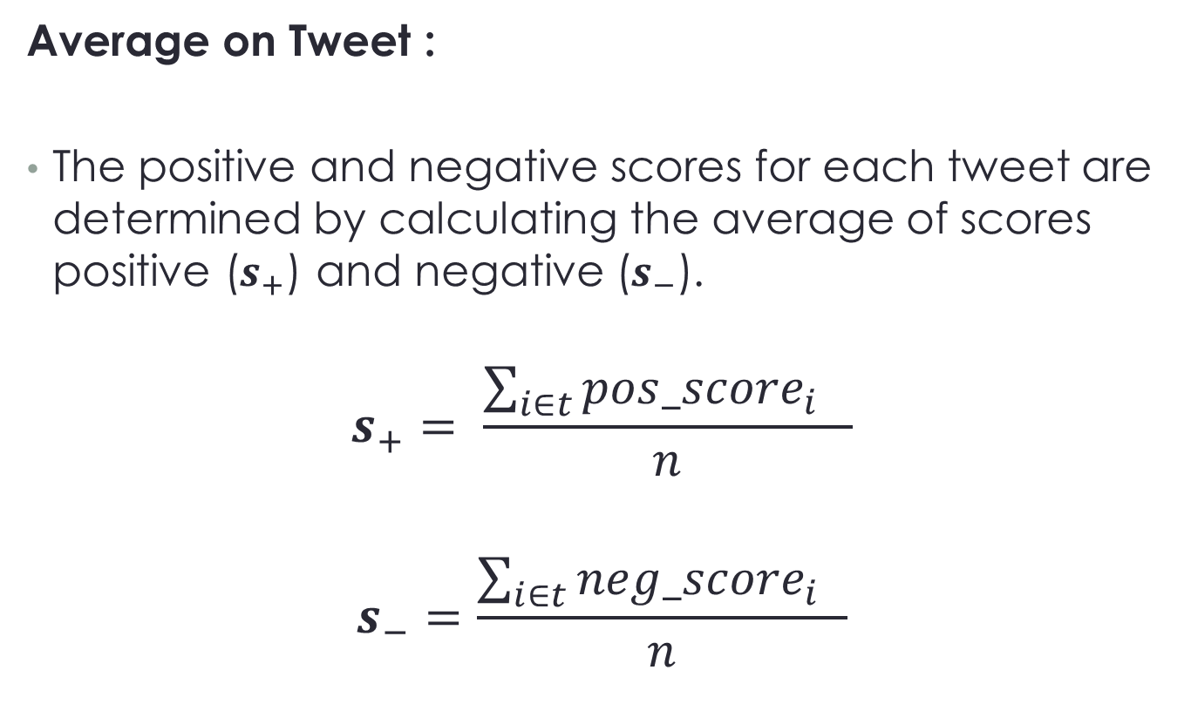
Sentiment Orientation (1)
Average on Tweet :
The positive and negative scores for each tweet are determined by calculating the average of scores positive ($s_{+}$) and negative ($s_{−}$).
$$s_{+}= \frac{\sum_{i∈t}{{pos_score}_{i} }}{n}$$
$$s_{−}=\frac{\sum_{i∈t}{{neg_score}_{i } }}{n}$$

Slide 21
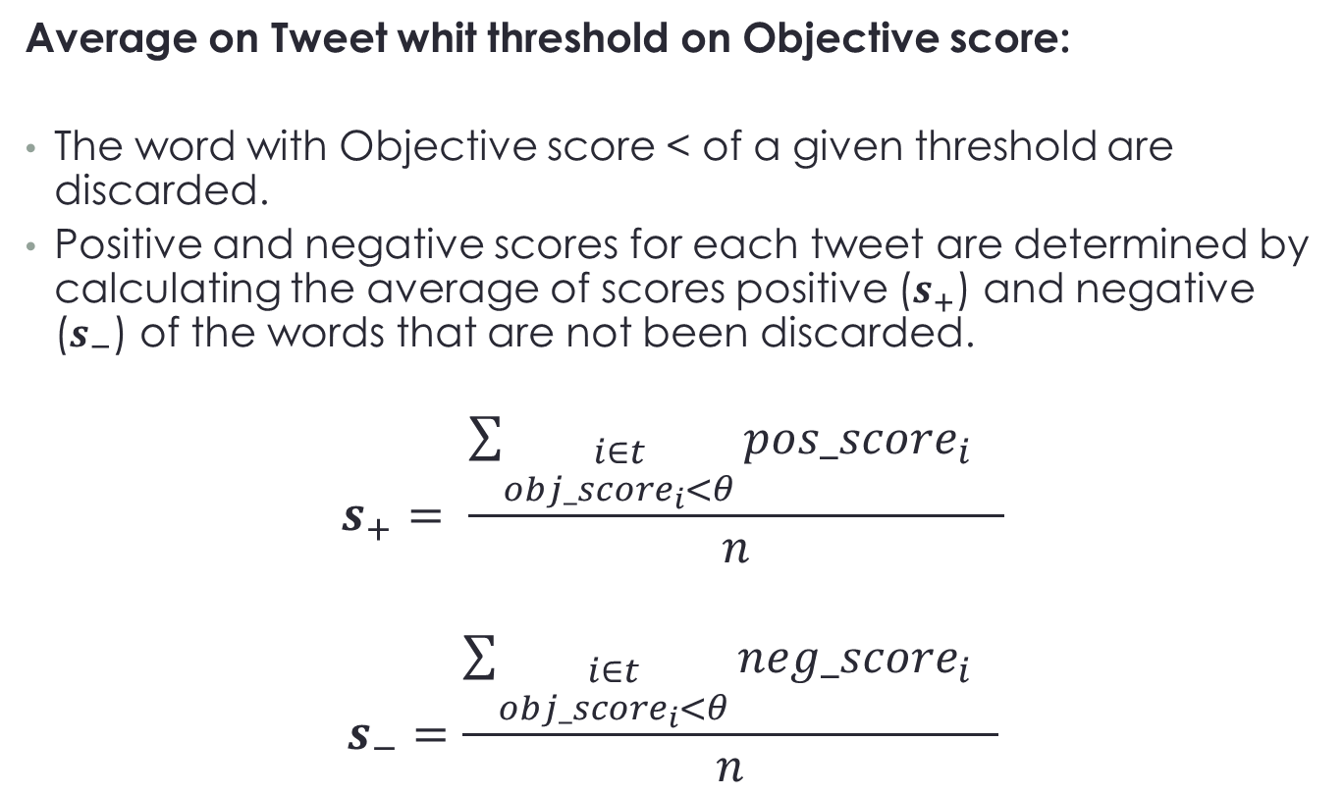
Sentiment Orientation (2)
Average on Tweet whit threshold on Objective score:
The word with Objective score < of a given threshold are discarded.
Positive and negative scores for each tweet are determined by calculating the average of scores positive ($s_{+}$) and negative ($s_{−}$) of the words that are not been discarded.
$$s_{+}= \frac{\sum_{\begin{aligned}i∈t \\ {obj_score}_{i}<θ\end{aligned}}{{pos_score}_{i} }}{n}$$
$$s_{−}=\frac{\sum_{\begin{aligned}i∈t \\ {obj_score}_{i}<θ\end{aligned}}{{neg_score}_{i } }}{n}$$

Slide 22
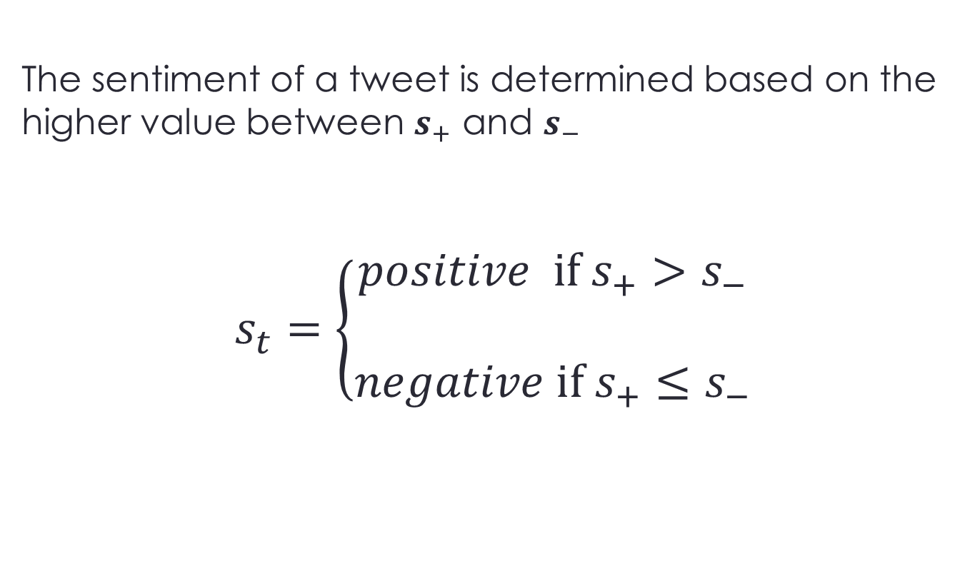
Tweet Classified
The sentiment of a tweet is determined based on the higher value between $s_{+}$ and $s_{−}$
$$s_{t}=\left\{\begin{aligned}positive if s_{+}>s_{−} \\ \\ negative if{ s}_{+}≤s_{−}\end{aligned}\right.$$

Slide 23
Open issues
the tweet's corpus is too short to use the great part of the WSD techniques
In this kind of short texts (tweet or Facebook's comments) is used a particular slang that needs ad hoc techniques to be processed.
Insights:
Apoorv Agarwal, Boyi Xie, Ilia Vovsha, Owen Rambow, and Rebecca Passonneau. 2011. Sentiment analysis of Twitter data. In Proceedings of the Workshop on Languages in Social Media (LSM '11)
Gokulakrishnan, B.; Priyanthan, P.; Ragavan, T.; Prasath, N.; Perera, A., "Opinion mining and sentiment analysis on a Twitter data stream," Advances in ICT for Emerging Regions (ICTer), 2012 International Conference on.

Slide 24
Example of Documents Sentiment Classification
DocumentSentimentClassification.py
Implementation of the algorithm for Document Classification see at lesson
Turney, Peter D., and Michael L. Littman. "Measuring praise and criticism: Inference of semantic orientation from association." ACM Transactions on Information Systems (TOIS) 21.4 (2003): 315-346.

Slide 25
Parameters
Parameters (at the start of the code):
FILE_NAME = “ name of the file .txt on which you want execute the classification”
API_KEY_BING = “Api Key Bing”
API_KEY_GOOGLE = “Api Key for Custom Search Api”
USE_GOOGLE = (Boolean) Enable (True) or Disable (False) the use of the Google Api for Custom Search
The number of free queries per day using Google Api are limited to 100!!

Slide 26
Libraries
NLTK – Natural Language Toolkit
tokenizers/punkt/english.pickle Module
Requests
Math
Urllib2
google-api-python-client
https://code.google.com/p/google-api-python-client/
This libraries could be installed using Pip:
pip install <library name>

Slide 27
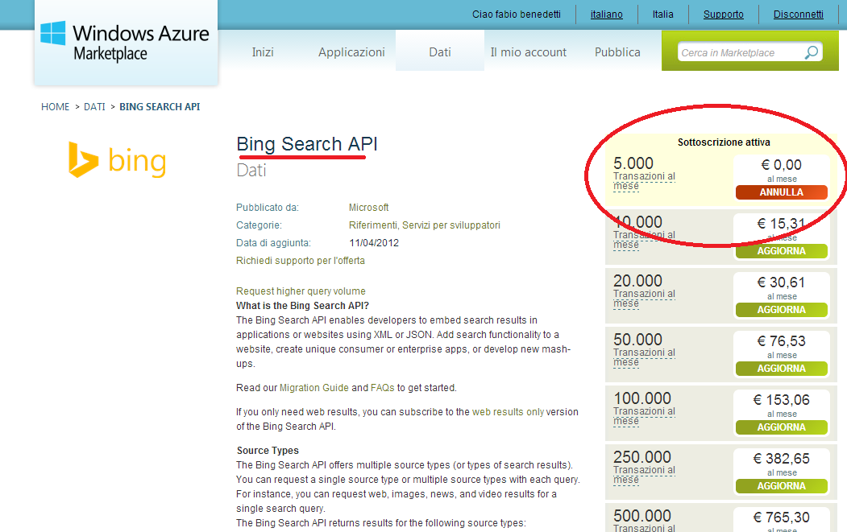
Bing API
https://datamarket.azure.com/dataset/bing/search

Slide 28
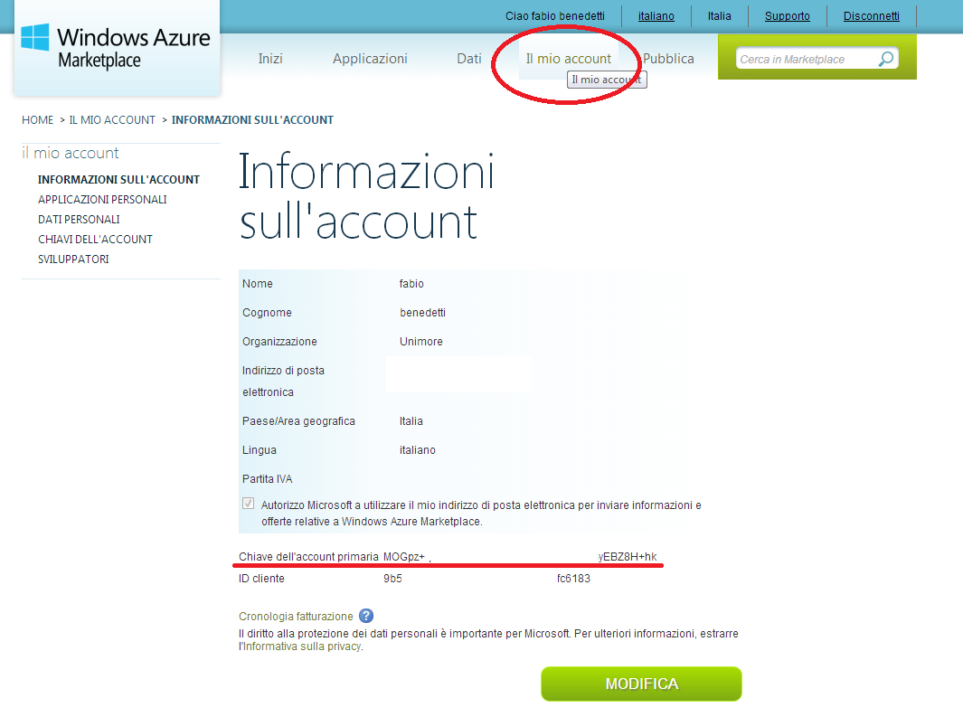
Bing API - Key

Slide 29
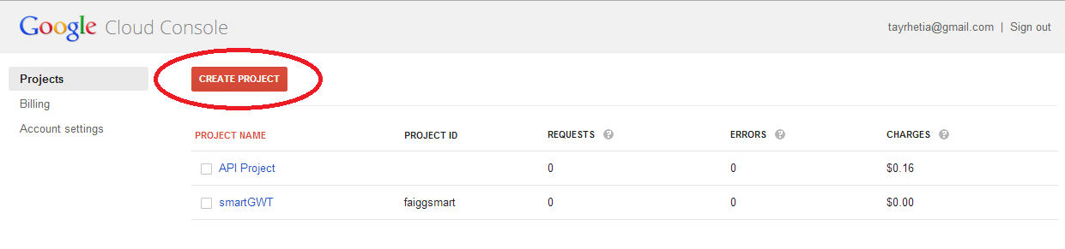
Google API – Custom Search
https://cloud.google.com/console#/project

Slide 30
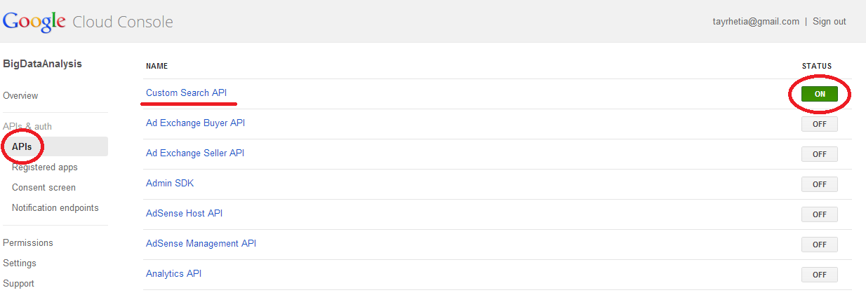
Google API – Custom Search
https://cloud.google.com/console#/project

Slide 31
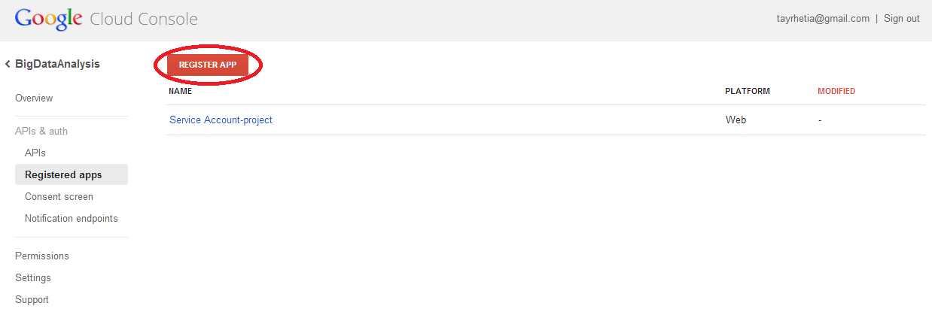
Google API – Custom Search (1)

Slide 32
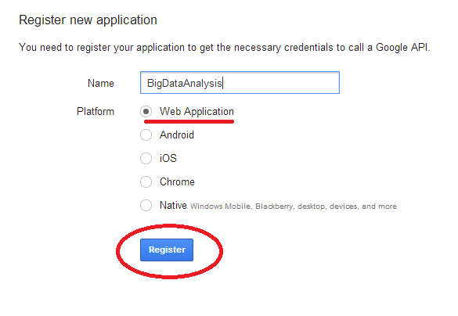
Google API – Custom Search (1)

Slide 33
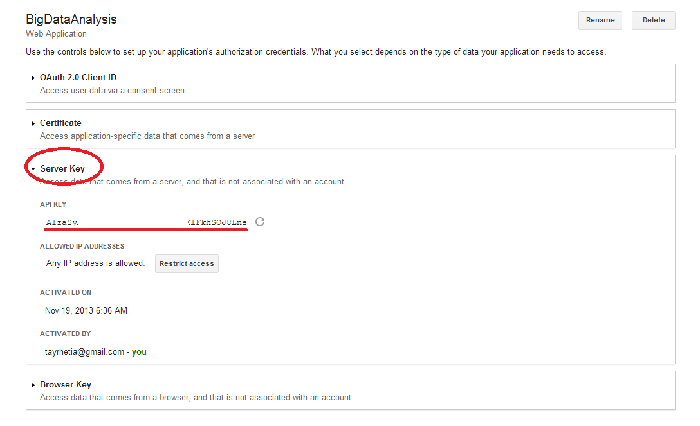
Google API – Custom Search (1)

Slide 34
References
AFFIN-111 - http://www2.imm.dtu.dk/pubdb/views/publication_details.php?id=6010
SentiWordNet - http://sentiwordnet.isti.cnr.it/
SENTIWORDNET: A Publicly Available Lexical Resource for Opinion Mining - http://nmis.isti.cnr.it/sebastiani/Publications/LREC06.pdf
Reviews ClassificationUsing SentiWordNet Lexicon - http://www.academia.edu/1336655/Reviews_Classification_Using_SentiWordNet_Lexicon
Using SentiWordNet and Sentiment Analysis for Detecting Radical Content on Web Forums - http://www.jeremyellman.com/jeremy_unn/pdfs/1_____Chalothorn_Ellman_SKIMA_2012.pdf
From tweets to polls: Linking text sentiment to public opinion time series - http://www.aaai.org/ocs/index.php/ICWSM/ICWSM10/paper/viewFile/1536/1842

Slide 35
References
Natural Language Toolkit - http://nltk.org/
Twitter Developers - https://dev.twitter.com/
Tweepy - https://github.com/tweepy/tweepy
Python csv - http://www.pythonforbeginners.com/systems-programming/using-the-csv-module-in-python/

