Slide 1

Lecture Slides
Elementary Statistics
Twelfth Edition
and the Triola Statistics Series
by Mario F. Triola

Slide 2
Preview
Polls, studies, surveys and other data collecting tools collect data from a small part of a larger group so that we can learn something about the larger group.
This is a common and important goal of statistics: Learn about a large group by examining data from some of its members.

Slide 3
Preview
In this context, the terms sample and population have special meaning. Formal definitions for these and other basic terms will be given here.
In this chapter, we will look at some of the ways to describe data.

Slide 4
What is Statistics
The practice or science of collecting and analyzing numerical data in large quantities, especially for the purpose of inferring proportions in a whole from those in a representative sample.
“There are lies damn lies and statistics”- Mark Twain

Slide 5
Chapter 1
Introduction to Statistics
1-1 Review and Preview
1-2 Statistical and Critical Thinking
1-3 Types of Data
1-4 Collecting Sample Data

Slide 6
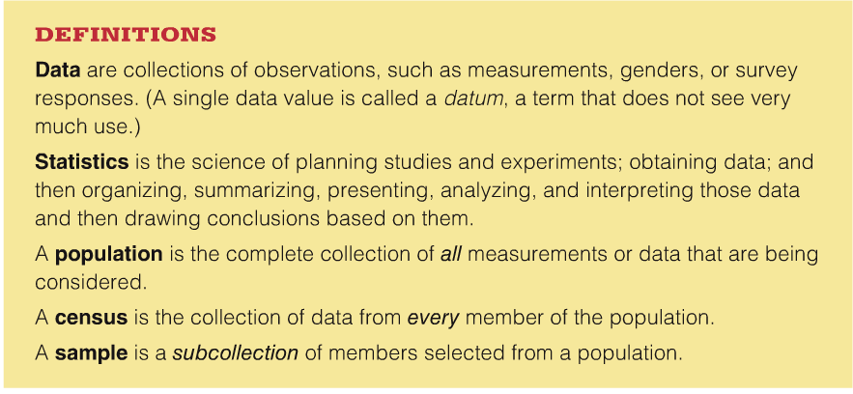
Vocabulary

Slide 7
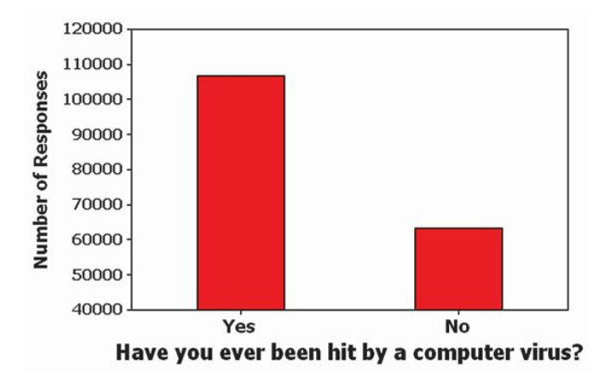
Graphs

Slide 8
Flawed Methods
Misleading Graph

Slide 9
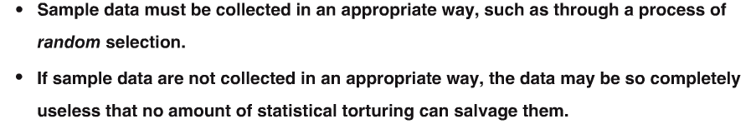
Selecting Samplings

Slide 10
Example
The Gallup corporation collected data from 1013 adults in the United States. Results showed that 66% of the respondents worried about identity theft.
The population consists of all 241,472,385 adults in the United States.
The sample consists of the 1013 polled adults.
The objective is to use the sample data as a basis for drawing a conclusion about the whole population.

Slide 11
Chapter 1
Introduction to Statistics
1-1 Review and Preview
1-2 Statistical and Critical Thinking
1-3 Types of Data
1-4 Collecting Sample Data

Slide 12
Key Concept
This section provides an overview of the process involved in conducting a statistical study:
Prepare
Analyze
Conclude

Slide 13
Prepare - Context
What do the data mean?
What is the goal of the study?

Slide 14
Prepare - Source of the Data
Is the source objective?
Is the source biased?
Be vigilant and skeptical of studies from sources that may be biased.

Slide 15
Prepare - Sampling Method
Does the method chosen greatly influence the validity of the conclusion?
Voluntary response (or self-selected) samples often have bias (those with special interest are more likely to participate).
Other methods are more likely to produce good results.

Slide 16
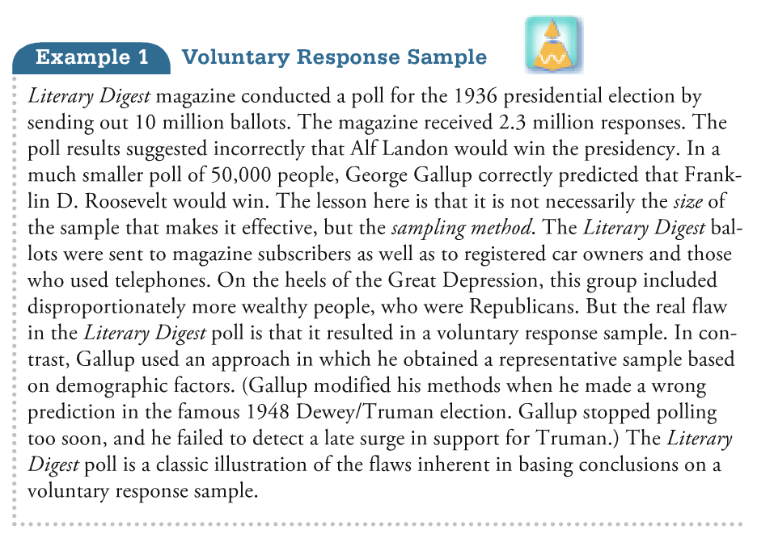

Slide 17
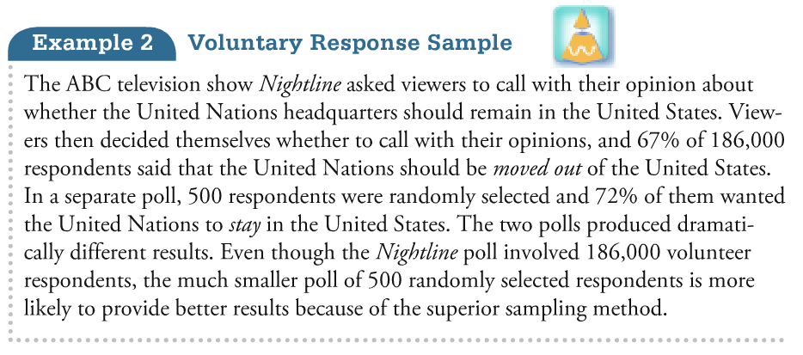

Slide 18
Analyze – Graph and Explore
Every analysis should begin with appropriate graphs (Chapter 2).

Slide 19
Analyze – Apply Statistical Methods
Later chapters describe important statistical methods.
With technology, good analysis does not require strong computational skills, but it does require using common sense and paying attention to sound statistical methods.

Slide 20
Conclude – Statistical Significance
Statistical significance is achieved in a study when we get a result that is very unlikely to occur by chance.

Slide 21
Conclude - Practical Significance
State practical implications of the results.
Common sense might suggest that the finding does not make enough of a difference to justify its use or to be practical.

Slide 22
Example
In a test of the Atkins weight loss program, 40 subjects had a mean weight loss of 4.6 pounds after one year.
Using formal methods of statistical analysis, we can conclude the diet appears to be effective.

Slide 23
Example - continued
However, although 4.6 pounds is statistically significant, using common sense, it does not seem very worthwhile.

Slide 24
Potential Pitfalls – Misleading Conclusions
Concluding that one variable causes the other variable when in fact the variables are only correlated or associated together.
Two variables that may seemed linked, are smoking and pulse rate.
We cannot conclude the one causes the other. Correlation does not imply causality.

Slide 25
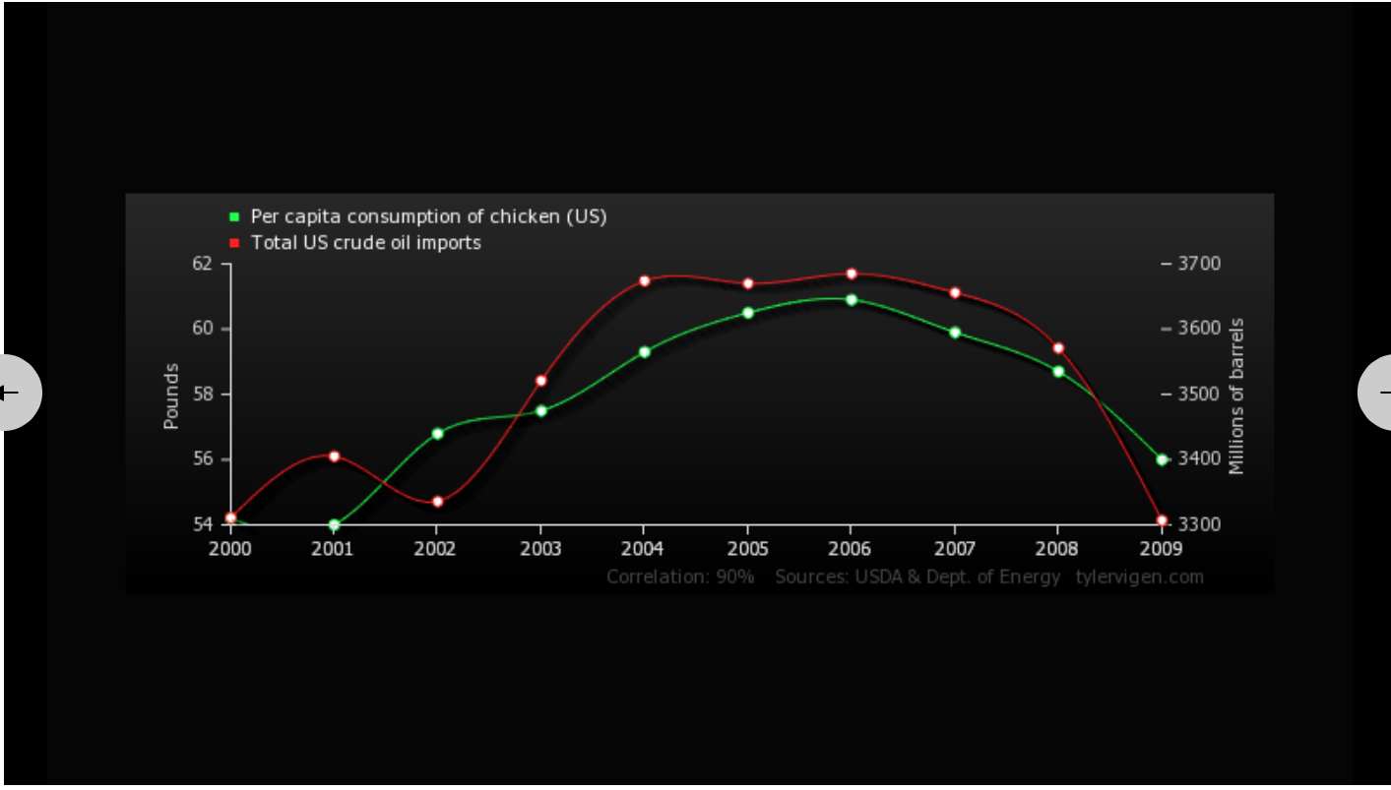

Slide 26
Potential Pitfalls - Small Samples
Conclusions should not be based on samples that are far too small.
Example: Basing a school suspension rate on a sample of only three students

Slide 27
Potential Pitfalls - Loaded Questions
If survey questions are not worded carefully, the results of a study can be misleading.
97% yes: “Should the President have the line item veto to eliminate waste?”
57% yes: “Should the President have the line item veto, or not?”

Slide 28
Potential Pitfalls - Order of Questions
Questions are unintentionally loaded by such factors as the order of the items being considered.
Would you say traffic contributes more or less to air pollution than industry? Results: traffic - 45%; industry - 27%
When order reversed.
Results: industry - 57%; traffic - 24%

Slide 29
Potential Pitfalls - Nonresponse
Occurs when someone either refuses to respond to a survey question or is unavailable.
People who refuse to talk to pollsters have a view of the world around them that is markedly different than those who will let pollsters into their homes.

Slide 30
Potential Pitfalls - Missing Data
Can dramatically affect results.
Subjects may drop out for reasons unrelated to the study.
Example - People with low incomes are less likely to report their incomes.
Example – U.S. Census suffers from missing people (tend to be homeless or low income).

Slide 31
Potential Pitfalls - Precise Numbers
Because as a figure is precise, many people incorrectly assume that it is also accurate.
A precise number can be an estimate, and it should be referred to that way.

Slide 32
Potential Pitfalls - Percentages
Misleading or unclear percentages are sometimes used.
Example – Continental Airlines ran an ad claiming “We’ve already improved 100% in the last six months” with respect to lost baggage.
Does this mean Continental made no mistakes?

Slide 33
Chapter 1
Introduction to Statistics
1-1 Review and Preview
1-2 Statistical and Critical Thinking
1-3 Types of Data
1-4 Collecting Sample Data

Slide 34
Key Concept
The subject of statistics is largely about using sample data to make inferences about an entire population.
It is essential to know and understand the definitions that follow.

Slide 35
Parameter
Parameter
a numerical measurement describing some characteristic of a population.
population
parameter

Slide 36
Statistic
Statistic
a numerical measurement describing some characteristic of a sample.
sample
statistic

Slide 37
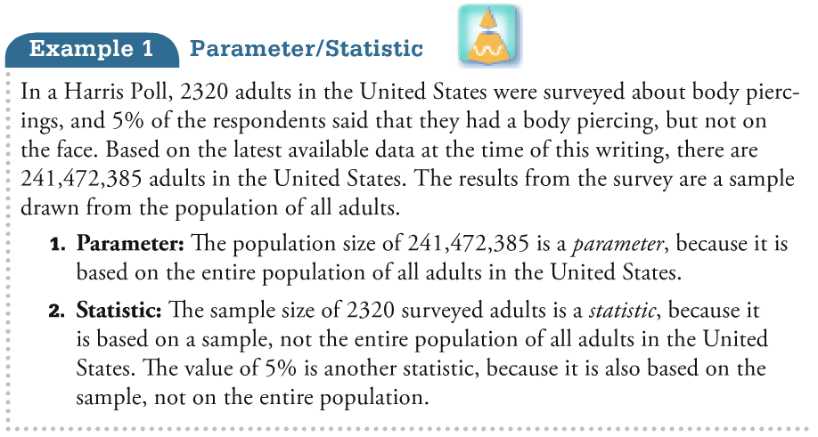

Slide 38
Quantitative Data
Quantitative (or numerical) data
consists of numbers representing counts or measurements.
Example: The weights of supermodels
Example: The ages of respondents

Slide 39
Categorical Data
Categorical (or qualitative or attribute) data
consists of names or labels (representing
categories).
Example: The gender (male/female) of professional athletes
Example: Shirt numbers on professional athletes uniforms - substitutes for names.

Slide 40
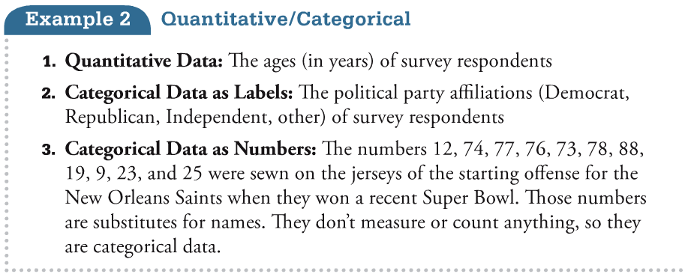

Slide 41
Working with Quantitative Data
Quantitative data can be further described by distinguishing between discrete and continuous types.

Slide 42
Discrete Data
Discrete data
result when the number of possible values is either a finite number or a ‘countable’ number
(i.e. the number of possible values is
0, 1, 2, 3, . . .).
Example: The number of eggs that a hen lays

Slide 43
Continuous Data
Continuous (numerical) data
result from infinitely many possible values that correspond to some continuous scale that covers a range of values without gaps, interruptions, or jumps.
Example: The amount of milk that a cow produces; e.g. 2.343115 gallons per day

Slide 44
Levels of Measurement
Another way to classify data is to use levels of measurement.

Slide 45
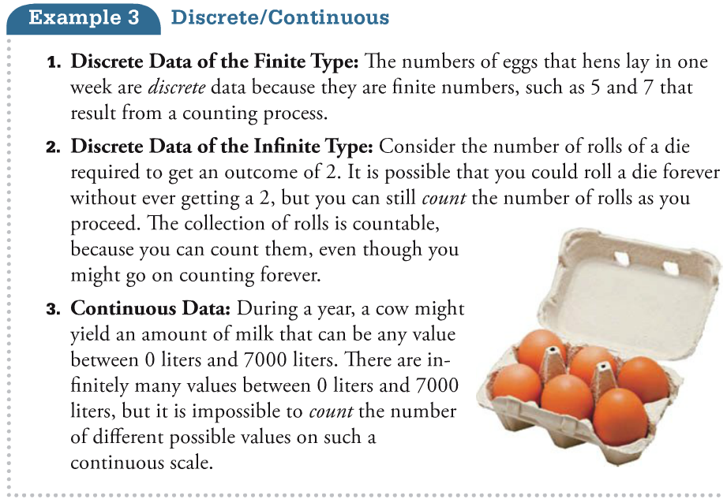

Slide 46
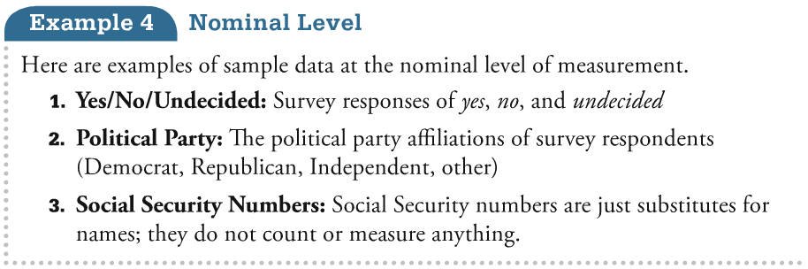
Nominal Level
Nominal level of measurement
characterized by data that consist of names, labels, or categories only, and the data cannot be arranged in an ordering scheme (such as low to high).
Example: Survey responses yes, no, undecided

Slide 47
Ordinal Level
Ordinal level of measurement
involves data that can be arranged in some order, but differences between data values either cannot be determined or are meaningless.
Example: Course grades A, B, C, D, or F

Slide 48
Interval Level
Interval level of measurement
involves data that can be arranged in order and the difference between any two data values is meaningful. However, there is no natural zero starting point (where none of the quantity is present).
Example: Years 1000, 2000, 1776, and 1492

Slide 49
Ratio Level
Ratio level of measurement
the interval level with the additional property that there is also a natural zero starting point (where zero indicates that none of the quantity is present); for values at this level, differences and ratios are meaningful.
Example: Prices of college textbooks ($0 represents no cost, a $100 book costs twice as much as a $50 book)

Slide 50
Summary - Levels of Measurement
Nominal - categories only
Ordinal - categories with some order
Interval - differences but no natural zero point
Ratio - differences and a natural zero point

Slide 51
Chapter 1
Introduction to Statistics
1-1 Review and Preview
1-2 Statistical and Critical Thinking
1-3 Types of Data
1-4 Collecting Sample Data

Slide 52
Key Concept
If sample data are not collected in an appropriate way, the data may be so completely useless that no amount of statistical torturing can salvage them.
The method used to collect sample data influences the quality of the statistical analysis.
Of particular importance is the simple random sample.

Slide 53
Basics of Collecting Data
Statistical methods are driven by the data that we collect. We typically obtain data from two distinct sources: observational studies and experiment.

Slide 54
Observational Study
Observational study
observing and measuring specific characteristics without attempting to modify the subjects being studied.

Slide 55
Experiment
Experiment
apply some treatment and then observe its effects on the subjects (subjects in
experiments are called experimental units)

Slide 56
Example
The Pew Research Center surveyed 2252 adults and found that 59% of them go online wirelessly.
This an observational study because the adults had no treatment applied to them.

Slide 57
Example
In the largest public health experiment ever conducted, 200,745 children were given the Salk vaccine, while another 201,229 children were given a placebo.
The vaccine injections constitute a treatment that modified the subjects, so this is an example of an experiment.

Slide 58
Simple Random Sample
Simple Random Sample
A sample of n subjects is selected in such a way that every possible sample of the same size n has the same chance of being chosen.

Slide 59
Random Sample
Random Sample
Members from the population are selected in such a way that each individual member in the population has an equal chance of being selected.

Slide 60
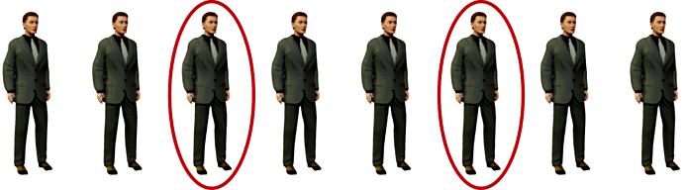
Systematic Sampling
Select some starting point and then select every kth element in the population.

Slide 61
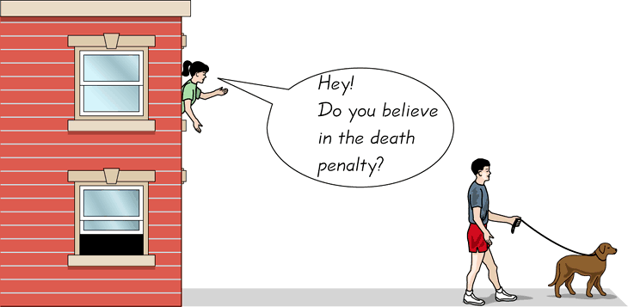
Convenience Sampling
Use results that are easy to get.

Slide 62
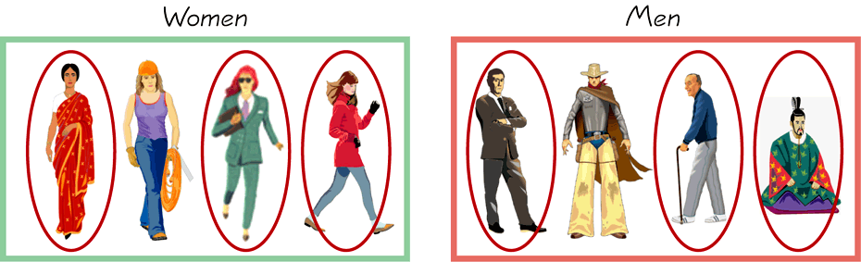
Stratified Sampling
Subdivide the population into at least two different subgroups that share the same characteristics, then draw a sample from each subgroup (or stratum).

Slide 63
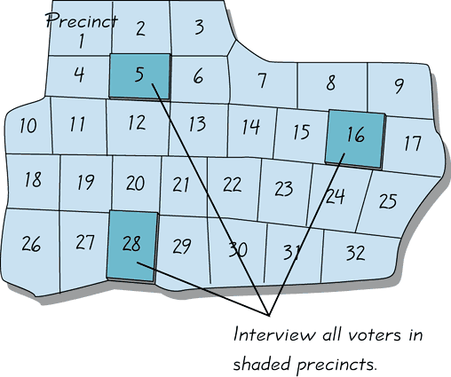
Cluster Sampling
Divide the population area into sections (or clusters). Then randomly select some of those clusters. Now choose all members from selected clusters.

Slide 64
Multistage Sampling
Collect data by using some combination of the basic sampling methods.
In a multistage sample design, pollsters select a sample in different stages, and each stage might use different methods of sampling.

Slide 65
Methods of Sampling - Summary
Random
Systematic
Convenience
Stratified
Cluster
Multistage

Slide 66
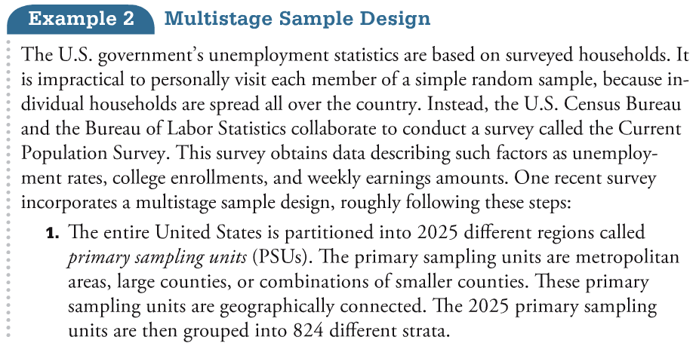

Slide 67
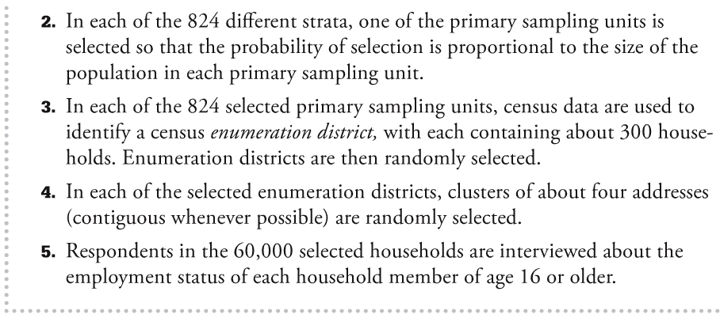

Slide 68
Beyond the Basics of Collecting Data
Different types of observational studies and experiment design.

Slide 69
Types of Studies
Cross-sectional study
  Data are observed, measured, and collected at one point in time.
Retrospective (or case control) study
  Data are collected from the past by going back in time (examine records, interviews, and so on …).
Prospective (or longitudinal or cohort) study
  Data are collected in the future from groups sharing common factors (called cohorts).

Slide 70
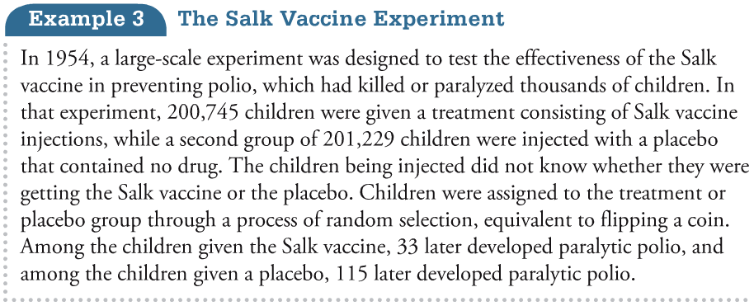

Slide 71
Design of Experiments
Randomization
is used when subjects are assigned to different groups through a process of random selection. The logic is to use chance as a way to create two groups that are similar.

Slide 72
Design of Experiments
Replication
is the repetition of an experiment on more than one subject.
  Samples should be large enough so that the erratic behavior that is characteristic of very small samples will not disguise the true effects of different treatments.
  It is used effectively when there are enough subjects to recognize the differences from different treatments.

Slide 73
Design of Experiments
Replication
Use a sample size that is large enough to let us see the true nature of any effects, and obtain the sample using an appropriate method, such as one based on randomness.

Slide 74
Design of Experiments
Blinding
is a technique in which the subject doesn’t know whether he or she is receiving a treatment or a placebo.
Blinding allows us to determine whether the treatment effect is significantly different from a placebo effect, which occurs when an untreated subject reports improvement in symptoms.

Slide 75
Design of Experiments
Double-Blind
Blinding occurs at two levels:
(1) The subject doesn’t know whether he or she is receiving the treatment or a placebo.
(2) The experimenter does not know whether he or she is administering the treatment or placebo.

Slide 76
Design of Experiments
Confounding
occurs in an experiment when the experimenter is not able to distinguish between the effects of different factors.
Try to plan the experiment so that confounding does not occur.

Slide 77
Controlling Effects of Variables
Completely Randomized Experimental Design
assign subjects to different treatment groups through a process of random selection.
Randomized Block Design
a block is a group of subjects that are similar, but blocks differ in ways that might affect the outcome of the experiment.

Slide 78
Controlling Effects of Variables
Matched Pairs Design
compare exactly two treatment groups using subjects matched in pairs that are somehow related or have similar characteristics.
Rigorously Controlled Design
carefully assign subjects to different treatment groups, so that those given each treatment are similar in ways that are important to the experiment.

Slide 79
Summary
Three very important considerations in the design of experiments are the following:
1. Use randomization to assign subjects to different groups.
2. Use replication by repeating the experiment on enough subjects so that effects of treatment or other factors can be clearly seen.
3. Control the effects of variables by using such techniques as blinding and a completely randomized experimental design.

Slide 80
Errors
No matter how well you plan and execute the sample collection process, there is likely to be some error in the results.
Sampling error
the difference between a sample result and the true population result, such an error results from chance sample fluctuations.
Nonsampling error
sample data incorrectly collected, recorded, or analyzed (such as by selecting a biased sample, using a defective instrument, or copying the data incorrectly).

Slide 81
Errors
No matter how well you plan and execute the sample collection process, there is likely to be some error in the results.
Nonrandom sampling error
result of using a sampling method that is not random, such as using a convenience sample or a voluntary response sample.

