Slide 1

Lecture Slides
Elementary Statistics
Twelfth Edition
and the Triola Statistics Series
by Mario F. Triola

Slide 2
Chapter 3
Statistics for Describing, Exploring, and Comparing Data
3-1 Review and Preview
3-2 Measures of Center
3-3 Measures of Variation
3-4 Measures of Relative Standing and Boxplots

Slide 3
Review
Chapter 1
Distinguish between population and sample, parameter and statistic, good sampling methods: simple random sample, stratified sample, etc.
Chapter 2
Frequency distributions, summarizing data with graphs, describing the center, variation, distribution, outliers, and changing characteristics over time in a data set

Slide 4
Preview
Descriptive Statistics
In this chapter we’ll learn to summarize or describe the important characteristics of a data set (mean, standard deviation, etc.).
Inferential Statistics
In later chapters we’ll learn to use sample data to make inferences or generalizations about a population.

Slide 5
Chapter 3
Statistics for Describing, Exploring, and Comparing Data
3-1 Review and Preview
3-2 Measures of Center
3-3 Measures of Variation
3-4 Measures of Relative Standing and Boxplots

Slide 6
Key Concept
Characteristics of center of a data set.
Measures of center, including mean and median, as tools for analyzing data.
Not only determine the value of each measure of center, but also interpret those values.

Slide 7
Part 1
Basics Concepts of Measures of Center
Measure of Center
the value at the center or middle of a data set

Slide 8
Arithmetic Mean
Arithmetic Mean (Mean)
the measure of center obtained by adding the values and dividing the total by the number of values
What most people call an average.

Slide 9




Notation
denotes the sum of a set of values.
is the variable usually used to represent the individual data values.
represents the number of data values in a sample.
represents the number of data values in a population.

Slide 10

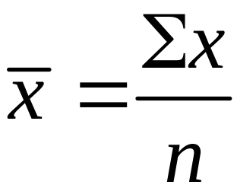

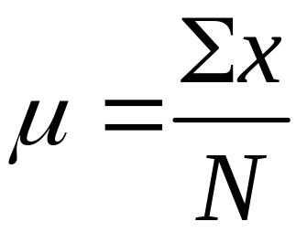
Notation
is pronounced ‘x-bar’ and denotes the mean of a set of sample values
is pronounced ‘mu’ and denotes the mean of all values in a population

Slide 11
Mean
Advantages
  Sample means drawn from the same population tend to vary less than other measures of center
  Takes every data value into account
Disadvantage
  Is sensitive to every data value, one extreme value can affect it dramatically; is not a resistant measure of center

Slide 12
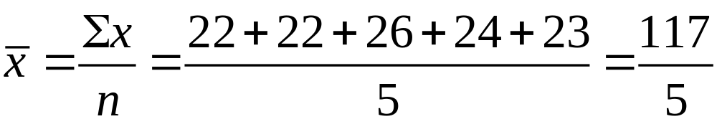
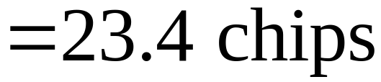
Example 1 - Mean
Table 3-1 includes counts of chocolate chips in different cookies. Find the mean of the first five counts for Chips Ahoy regular cookies: 22 chips, 22 chips, 26 chips, 24 chips, and 23 chips.
Solution
First add the data values, then divide by the number of data values.

Slide 13

Median
Median
the middle value when the original data values are arranged in order of increasing (or decreasing) magnitude
often denoted by (pronounced ‘x-tilde’)
is not affected by an extreme value - is a resistant measure of the center

Slide 14
Finding the Median
First sort the values (arrange them in order). Then –
1. If the number of data values is odd, the median is the number located in the exact middle of the list.
2. If the number of data values is even, the median is found by computing the mean of the two middle numbers.

Slide 15
Median – Odd Number of Values
5.40 1.10 0.42 0.73 0.48 1.10 0.66
Sort in order:
0.42 0.48 0.66 0.73 1.10 1.10 5.40
(in order - odd number of values)
Median is 0.73

Slide 16
Median – Even Number of Values
5.40 1.10 0.42 0.73 0.48 1.10
Sort in order:
0.42 0.48 0.73 1.10 1.10 5.40
(in order - even number of values – no exact middle
shared by two numbers)
0.73 + 1.10
Median is 0.915
2

Slide 17
Mode
Mode
the value that occurs with the greatest frequency
Data set can have one, more than one, or no mode
Bimodal two data values occur with the same greatest frequency
Multimodal more than two data values occur with the same greatest frequency
No Mode no data value is repeated
Mode is the only measure of central tendency that can be used with nominal data.

Slide 18
Mode - Examples
a. 5.40 1.10 0.42 0.73 0.48 1.10
b. 27 27 27 55 55 55 88 88 99
c. 1 2 3 6 7 8 9 10
Mode is 1.10
Bimodal - 27 & 55
No Mode

Slide 19
Definition
Midrange
the value midway between the maximum and minimum values in the original data set
Midrange =
maximum value + minimum value
2

Slide 20
Midrange
Sensitive to extremes
because it uses only the maximum and minimum values, it is rarely used
Redeeming Features
(1) very easy to compute
(2) reinforces that there are several ways to define the center
(3) avoid confusion with median by defining the midrange along with the median

Slide 21
Part 2
Beyond the Basics of Measures of Center

Slide 22
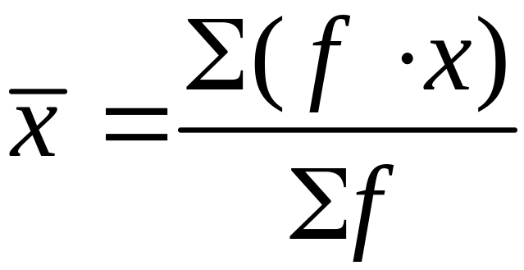
Calculating a Mean from
a Frequency Distribution
Assume that all sample values in each class are equal to the class midpoint.
Use class midpoint of classes for variable x.

Slide 23
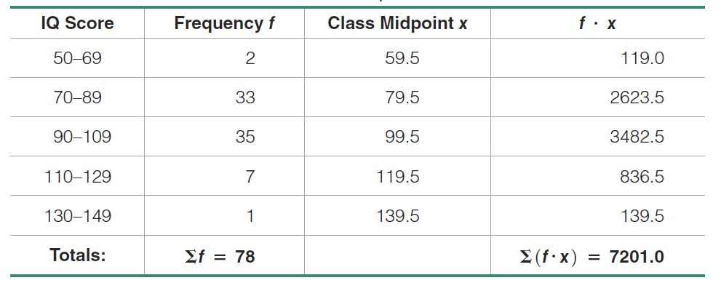
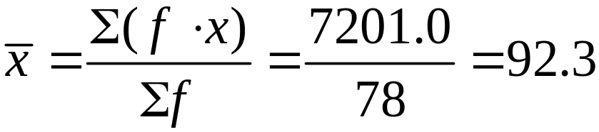
Example
Estimate the mean from the IQ scores in Chapter 2.

Slide 24
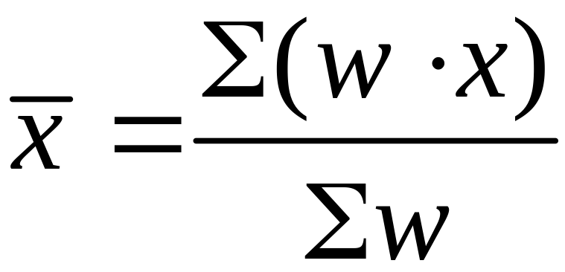
Weighted Mean
When data values are assigned different weights, w, we can compute a weighted mean.

Slide 25
Example – Weighted Mean
In her first semester of college, a student of the author took five courses.
Her final grades along with the number of credits for each course were A (3 credits), A (4 credits), B (3 credits), C (3 credits), and F (1 credit).
The grading system assigns quality points to letter grades as follows:
A = 4; B = 3; C = 2; D = 1; F = 0.
Compute her grade point average.
Solution
Use the numbers of credits as the weights: w = 3, 4, 3, 3, 1.
Replace the letters grades of A, A, B, C, and F with the corresponding quality points: x = 4, 4, 3, 2, 0.

Slide 26
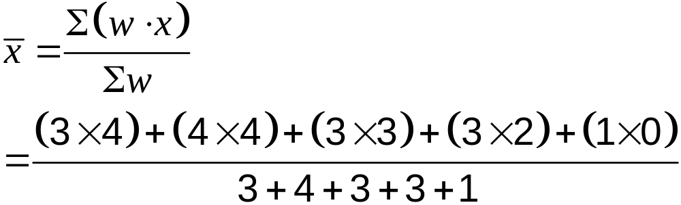
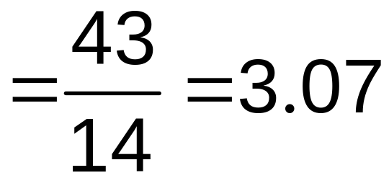
Example – Weighted Mean
Solution

Slide 27
Chapter 3
Statistics for Describing, Exploring, and Comparing Data
3-1 Review and Preview
3-2 Measures of Center
3-3 Measures of Variation
3-4 Measures of Relative Standing and Boxplots

Slide 28
Key Concept
Discuss characteristics of variation, in particular, measures of variation, such as standard deviation, for analyzing data.
Make understanding and interpreting the standard deviation a priority.

Slide 29
Part 1
Basics Concepts of Variation

Slide 30
Definition
The range of a set of data values is the difference between the maximum data value and the minimum data value.
Range = (maximum value) – (minimum value)
It is very sensitive to extreme values; therefore, it is not as useful as other measures of variation.

Slide 31
Definition
The standard deviation of a set of sample values, denoted by s, is a measure of how much data values deviate away from the mean.

Slide 32
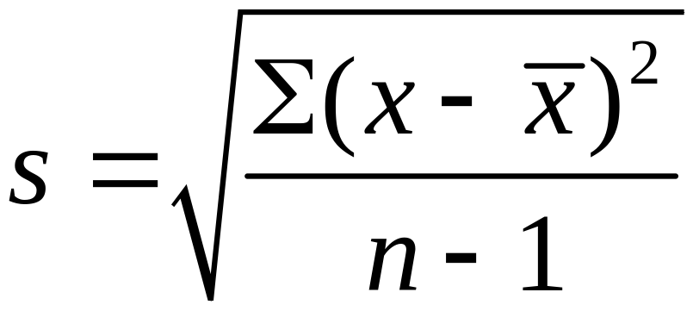
Sample Standard
Deviation Formula

Slide 33
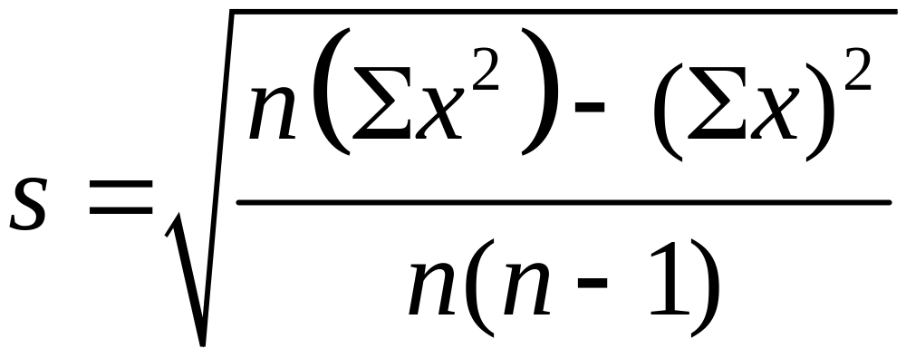
Sample Standard Deviation (Shortcut Formula)

Slide 34
Standard Deviation –
Important Properties
The standard deviation is a measure of variation of all values from the mean.
The value of the standard deviation s is usually positive (it is never negative).
The value of the standard deviation s can increase dramatically with the inclusion of one or more outliers (data values far away from all others).
The units of the standard deviation s are the same as the units of the original data values.

Slide 35
Example
Use either formula to find the standard deviation of these numbers of chocolate chips:
22, 22, 26, 24

Slide 36
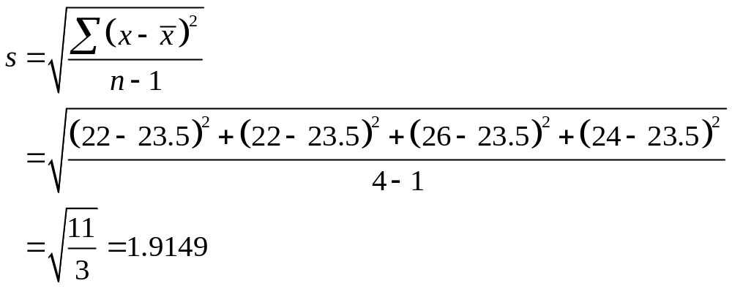
Example

Slide 37
Range Rule of Thumb for Understanding Standard Deviation
It is based on the principle that for many data sets, the vast majority (such as 95%) of sample values lie within two standard deviations of the mean.

Slide 38
Range Rule of Thumb for
Interpreting a Known Value of the Standard Deviation
Informally define usual values in a data set to be those that are typical and not too extreme. Find rough estimates of the minimum and maximum “usual” sample values as follows:
=
Minimum “usual” value (mean) – 2 × (standard deviation)
=
Maximum “usual” value (mean) + 2 × (standard deviation)

Slide 39
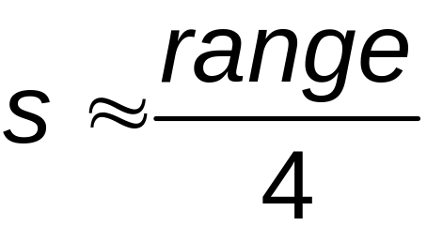
Range Rule of Thumb for
Estimating a Value of the
Standard Deviation s
To roughly estimate the standard deviation from a collection of known sample data use
where
range = (maximum value) – (minimum value)

Slide 40
Example
Using the 40 chocolate chip counts for the Chips Ahoy cookies, the mean is 24.0 chips and the standard deviation is 2.6 chips.
Use the range rule of thumb to find the minimum and maximum “usual” numbers of chips.
Would a cookie with 30 chocolate chips be “unusual”?

Slide 41
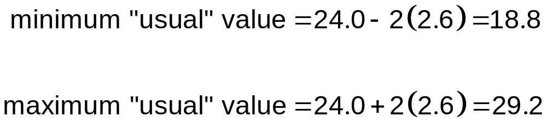
Example
*Because 30 falls above the maximum “usual” value, we can consider it to be a cookie with an unusually high number of chips.

Slide 42
Comparing Variation in
Different Samples
It’s a good practice to compare two sample standard deviations only when the sample means are approximately the same.
When comparing variation in samples with very different means, it is better to use the coefficient of variation, which is defined later in this section.

Slide 43
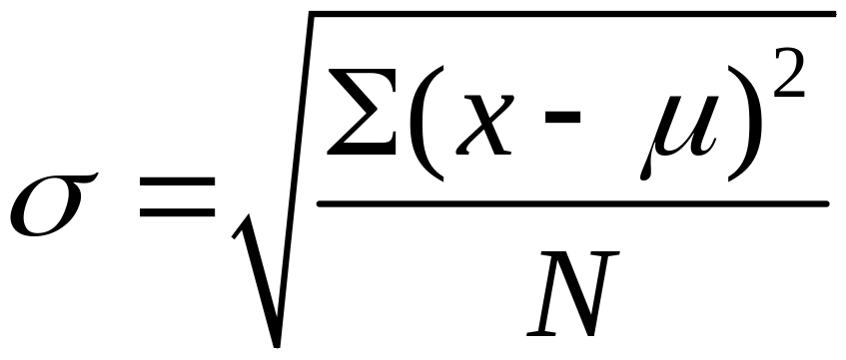
Population Standard
Deviation
This formula is similar to the previous formula, but the population mean and population size are used.

Slide 44
Variance
The variance of a set of values is a measure of variation equal to the square of the standard deviation.
Sample variance: s² - Square of the sample standard deviation s
Population variance: σ² - Square of the population standard deviation σ

Slide 45

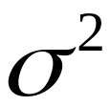
Variance - Notation
s = sample standard deviation
s² = sample variance
= population standard deviation
= population variance

Slide 46
Part 2
Beyond the Basics of Variation

Slide 47
Rationale for using (n – 1) versus n
There are only (n – 1) independent values. With a given mean, only (n – 1) values can be freely assigned any number before the last value is determined.
Dividing by (n – 1) yields better results than dividing by n. It causes s² to target whereas division by n causes s² to underestimate .

Slide 48
Empirical (or 68-95-99.7) Rule
For data sets having a distribution that is approximately bell shaped, the following properties apply:
About 68% of all values fall within 1 standard deviation of the mean.
About 95% of all values fall within 2 standard deviations of the mean.
About 99.7% of all values fall within 3 standard deviations of the mean.

Slide 49
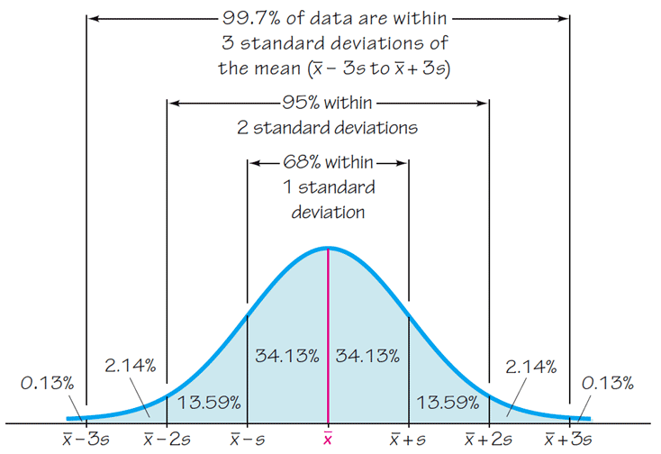
The Empirical Rule

Slide 50
Chebyshev’s Theorem
The proportion (or fraction) of any set of data lying within K standard deviations of the mean is always at least 1–1/K², where K is any positive number greater than 1.
For K = 2, at least 3/4 (or 75%) of all values lie within 2 standard deviations of the mean.
For K = 3, at least 8/9 (or 89%) of all values lie within 3 standard deviations of the mean.

Slide 51
Example
IQ scores have a mean of 100 and a standard deviation of 15. What can we conclude from Chebyshev’s theorem?
At least 75% of IQ scores are within 2 standard deviations of 100, or between 70 and 130.
At least 88.9% of IQ scores are within 3 standard deviations of 100, or between 55 and 145.

Slide 52
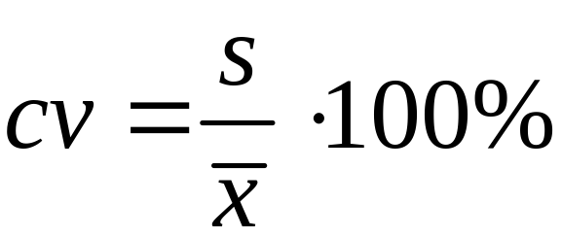
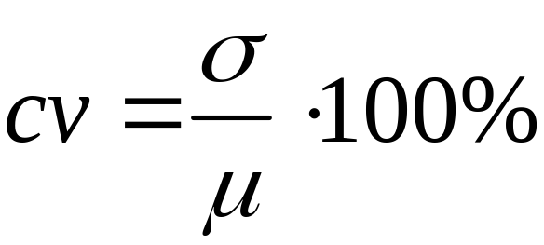
Coefficient of Variation
The coefficient of variation (or CV) for a set of nonnegative sample or population data, expressed as a percent, describes the standard deviation relative to the mean.
Sample
Population
Notes:
Ý nghĩa:
CV nhỏ: Tập dữ liệu ít biến động so với giá trị trung bình, dữ liệu có tính đồng nhất cao.
CV lớn: Tập dữ liệu có mức độ biến động lớn so với giá trị trung bình.
Ứng dụng:
So sánh sự biến động giữa các tập dữ liệu khác nhau trong các lĩnh vực như kinh tế, y học, quản lý chất lượng, và khoa học.
Đánh giá mức độ rủi ro trong các tập dữ liệu tài chính.

Slide 53
Chapter 3
Statistics for Describing, Exploring, and Comparing Data
3-1 Review and Preview
3-2 Measures of Center
3-3 Measures of Variation
3-4 Measures of Relative Standing and Boxplots

Slide 54
Key Concept
This section introduces measures of relative standing, which are numbers showing the location of data values relative to the other values within a data set.
They can be used to compare values from different data sets, or to compare values within the same data set.
The most important concept is the z score.
We will also discuss percentiles and quartiles, as well as a new statistical graph called the boxplot.

Slide 55
Part 1
Basics of z Scores, Percentiles, Quartiles, and Boxplots

Slide 56
z score
z Score (or standardized value)
the number of standard deviations that a given value x is above or below the mean

Slide 57
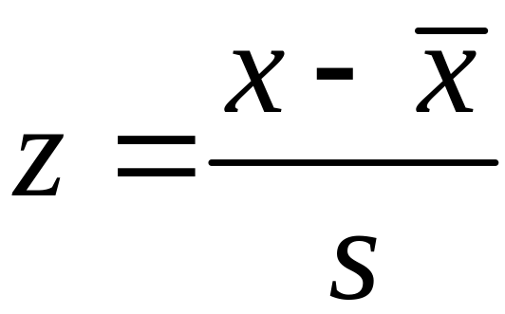
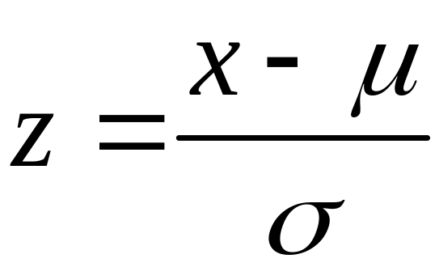
Measures of Position z Score
Sample
Population
Round z scores to 2 decimal places

Slide 58
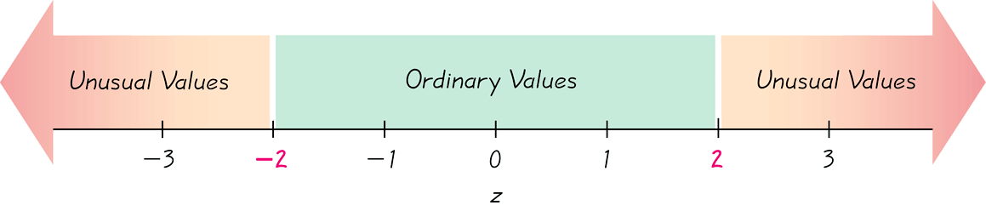

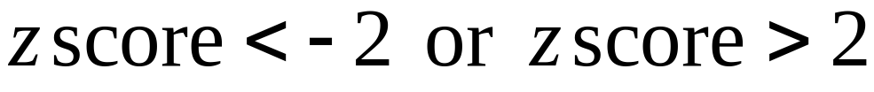
Interpreting Z Scores
Whenever a value is less than the mean, its corresponding z score is negative
Ordinary values:
Unusual Values:

Slide 59
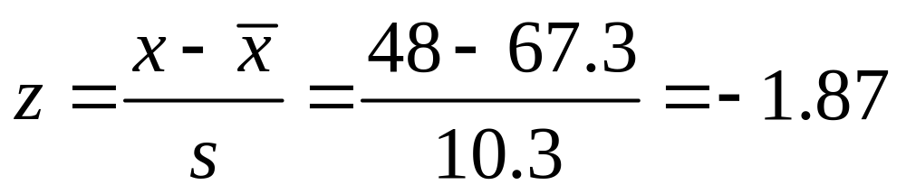
Example
The author of the text measured his pulse rate to be 48 beats per minute.
Is that pulse rate unusual if the mean adult male pulse rate is 67.3 beats per minute with a standard deviation of 10.3?
Answer: Since the z score is between – 2 and +2, his pulse rate is not unusual.

Slide 60
Percentiles
are measures of location. There are 99 percentiles denoted P₁, P₂, . . ., P₉₉, which divide a set of data into 100 groups with about 1% of the values in each group.

Slide 61
Finding the Percentile
of a Data Value
number of values less than x
Percentile of value x = • 100
total number of values

Slide 62
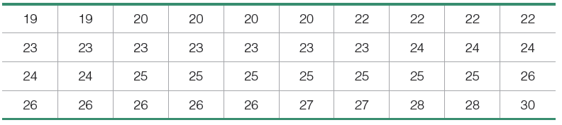

Example
For the 40 Chips Ahoy cookies, find the percentile for a cookie with 23 chips.
Answer: We see there are 10 cookies with fewer than 23 chips, so
A cookie with 23 chips is in the 25th percentile.

Slide 63

Converting from the kth Percentile to the Corresponding Data Value
Notation
n total number of values in the data set
k percentile being used
L locator that gives the position of a value
P_{k} kth percentile

Slide 64
Quartiles
Are measures of location, denoted Q₁, Q₂, and Q₃, which divide a set of data into four groups with about 25% of the values in each group.
Q₁ (First quartile) separates the bottom 25% of sorted values from the top 75%.
Q₂ (Second quartile) same as the median; separates the bottom 50% of sorted values from the top 50%.
Q₃ (Third quartile) separates the bottom 75% of sorted values from the top 25%.

Slide 65
Quartiles
Q₁, Q₂, Q₃
divide sorted data values into four equal parts
25%
25%
25%
25%
Q₁
Q₂
Q₃
(minimum)
(maximum)
(median)

Slide 66

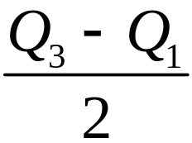
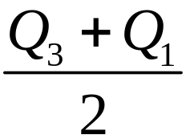
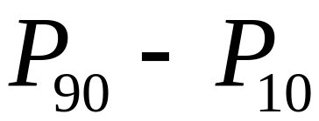
Other Statistics
Interquartile Range (or IQR):
Semi-interquartile Range:
Midquartile:
10 - 90 Percentile Range:

Slide 67
5-Number Summary
For a set of data, the 5-number summary consists of these five values:
1. Minimum value
2. First quartile Q₁
3. Second quartile Q₂ (same as median)
4. Third quartile, Q₃
5. Maximum value

Slide 68
Boxplot
A boxplot (or box-and-whisker-diagram) is a graph of a data set that consists of a line extending from the minimum value to the maximum value, and a box with lines drawn at the first quartile, Q₁, the median, and the third quartile, Q_{3.}

Slide 69
Boxplot - Construction
Find the 5-number summary.
Construct a scale with values that include the minimum and maximum data values.
Construct a box (rectangle) extending from Q1 to Q3 and draw a line in the box at the value of Q2 (median).
Draw lines extending outward from the box to the minimum and maximum values.

Slide 70
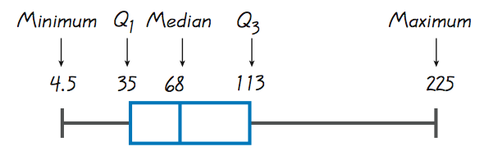
Boxplots

Slide 71
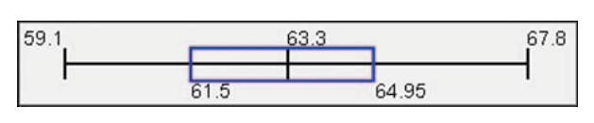
Boxplots - Normal Distribution
Normal Distribution:
Heights from a Simple Random Sample of Women

Slide 72
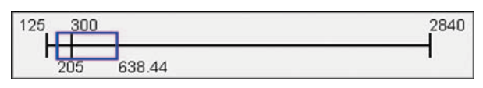
Boxplots - Skewed Distribution
Skewed Distribution:
Salaries (in thousands of dollars) of NCAA Football Coaches

Slide 73
Part 2
Outliers and
Modified Boxplots

Slide 74
Outliers
An outlier is a value that lies very far away from the vast majority of the other values in a data set.

Slide 75
Important Principles
An outlier can have a dramatic effect on the mean and the standard deviation.
An outlier can have a dramatic effect on the scale of the histogram so that the true nature of the distribution is totally obscured.

Slide 76
Outliers for Modified Boxplots
For purposes of constructing modified boxplots, we can consider outliers to be data values meeting specific criteria.
In modified boxplots, a data value is an outlier if it is:
above Q₃ by an amount greater than 1.5 × IQR
or
below Q₁ by an amount greater than 1.5 × IQR

Slide 77
Modified Boxplots
Boxplots described earlier are called skeletal (or regular) boxplots.
Some statistical packages provide modified boxplots which represent outliers as special points.

Slide 78
Modified Boxplot Construction
A modified boxplot is constructed with these specifications:
A special symbol (such as an asterisk) is used to identify outliers.
The solid horizontal line extends only as far as the minimum data value that is not an outlier and the maximum data value that is not an outlier.

Slide 79
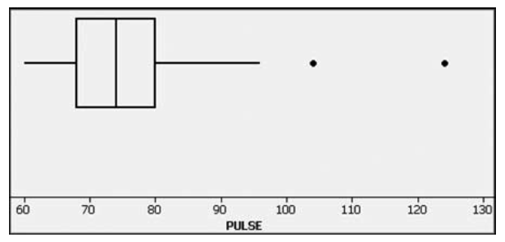
Modified Boxplots - Example

Slide 80
Putting It All Together
So far, we have discussed several basic tools commonly used in statistics –
  Context of data
  Source of data
  Sampling method
  Measures of center and variation
  Distribution and outliers
  Changing patterns over time
  Conclusions and practical implications
This is an excellent checklist, but it should not replace thinking about any other relevant factors.

