Slide 1

Lecture Slides
Elementary Statistics
Twelfth Edition
and the Triola Statistics Series
by Mario F. Triola

Slide 2
Chapter 5
Probability Distributions
5-1 Review and Preview
5-2 Probability Distributions
5-3 Binomial Probability Distributions
5-4 Parameters for Binomial Distributions
5-5 Poisson Probability Distributions

Slide 3
Review and Preview
This chapter combines the methods of descriptive statistics presented in Chapter 2 and 3 and those of probability presented in Chapter 4 to describe and analyze probability distributions.
Probability distributions describe what will probably happen instead of what actually did happen, and they are often given in the format of a graph, table, or formula.
Notes:
Emphasize the combination of the methods in Chapter 3 (descriptive statistics) with the methods in Chapter 4 (probability).
Chapter 3 one would conduct an actual experiment and find and observe the mean, standard deviation, variance, etc. and construct a frequency table or histogram
Chapter 4 finds the probability of each possible outcome
Chapter 5 presents the possible outcomes along with the relative frequencies we expect
Page 200 of Elementary Statistics, 10th Edition

Slide 4
Preview
In order to fully understand probability distributions, we must first understand the concept of a random variable, and be able to distinguish between discrete and continuous random variables. In this chapter we focus on discrete probability distributions. In particular, we discuss binomial and Poisson probability distributions.
Notes:
Emphasize the combination of the methods in Chapter 3 (descriptive statistics) with the methods in Chapter 4 (probability).
Chapter 3 one would conduct an actual experiment and find and observe the mean, standard deviation, variance, etc. and construct a frequency table or histogram
Chapter 4 finds the probability of each possible outcome
Chapter 5 presents the possible outcomes along with the relative frequencies we expect
Page 200 of Elementary Statistics, 10th Edition

Slide 5
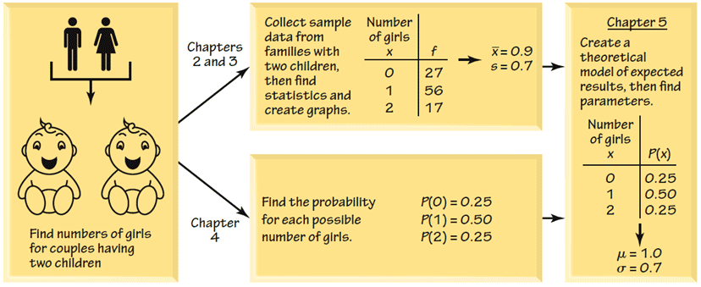
Combining Descriptive Methods
and Probabilities
In this chapter we will construct probability distributions by presenting possible outcomes along with the relative frequencies we expect.
Notes:
page 200 of Elementary Statistics, 10th Edition

Slide 6
Chapter 5
Probability Distributions
5-1 Review and Preview
5-2 Probability Distributions
5-3 Binomial Probability Distributions
5-4 Parameters for Binomial Distributions
5-5 Poisson Probability Distributions

Slide 7
Key Concept
This section introduces the important concept of a probability distribution, which gives the probability for each value of a variable that is determined by chance.
Give consideration to distinguishing between outcomes that are likely to occur by chance and outcomes that are “unusual” in the sense they are not likely to occur by chance.

Slide 8
Random Variable
Probability Distribution
Random Variable
a variable (typically represented by x) that has a single numerical value, determined by chance, for each outcome of a procedure
Probability Distribution
a description that gives the probability for each value of the random variable, often expressed in the format of a graph, table, or formula

Slide 9
Discrete and Continuous Random Variables
Discrete Random Variable
either a finite number of values or countable number of values, where “countable” refers to the fact that there might be infinitely many values, but that they result from a counting process
Continuous Random Variable
has infinitely many values, and those values can be associated with measurements on a continuous scale without gaps or interruptions.
Notes:
This chapter deals exclusively with discrete random variables - experiments where the data observed is a ‘countable’ value. Give examples.
Following chapters will deal with continuous random variables.
Page 201 of Elementary Statistics, 10th Edition

Slide 10
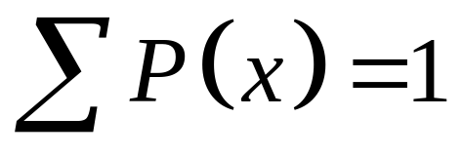
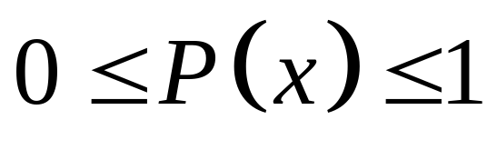
Probability Distribution: Requirements
There is a numerical random variable x and its values are associated with corresponding probabilities.
The sum of all probabilities must be 1.
Each probability value must be between 0 and 1 inclusive.
Notes:
This chapter deals exclusively with discrete random variables - experiments where the data observed is a ‘countable’ value. Give examples.
Following chapters will deal with continuous random variables.
Page 201 of Elementary Statistics, 10th Edition

Slide 11
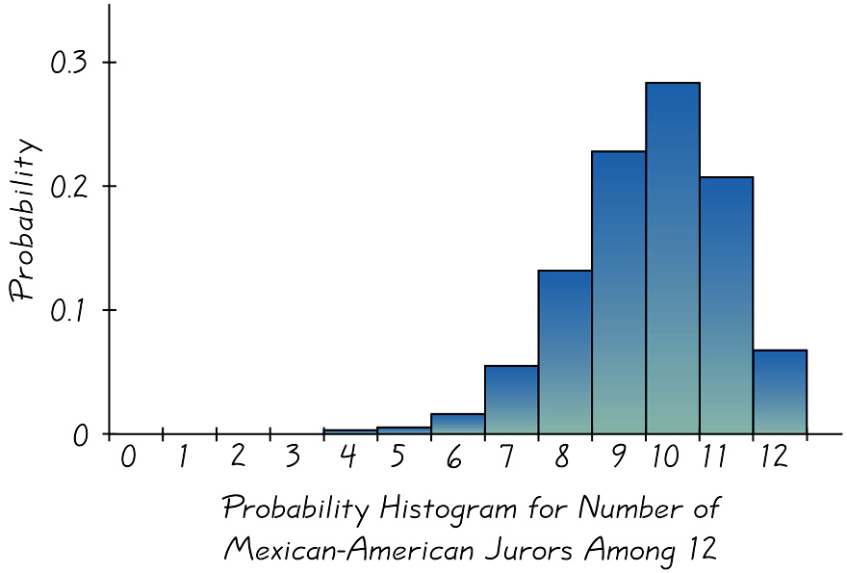
Graphs
The probability histogram is very similar to a relative frequency histogram, but the vertical scale shows probabilities.
Notes:
page 202 of Elementary Statistics, 10th Edition
Probability Histograms relate nicely to Relative Frequency Histograms of Chapter 2, but the vertical scale shows probabilities instead of relative frequencies based on actual sample results
Observe that the probabilities of each random variable is also the same as the AREA of the rectangle representing the random variable. This fact will be important when we need to find probabilities of continuous random variables - Chapter 6.

Slide 12
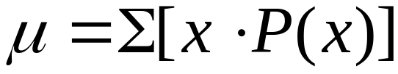
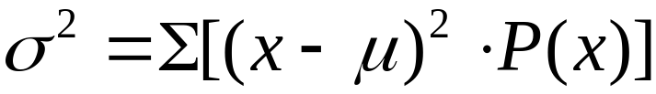


Mean, Variance and
Standard Deviation of a
Probability Distribution
Mean
Variance
 Variance (shortcut)
 Standard Deviation
Notes:
In Chapter 3, we found the mean, standard deviation,variance, and shape of the distribution for actual observed experiments.
The probability distribution and histogram can provide the same type information.
These formulas will apply to ANY type of probability distribution as long as you have have all the P(x) values for the random variables in the distribution.
In section 4 of this chapter, there will be special EASIER formulas for the special binomial distribution.
The TI-83 and TI-83 Plus calculators can find the mean, standard deviation, and variance in the same way that one finds those values for a frequency table.
With the TI-82, TI-81, and TI-85 calculators, one would have to multiply all decimal values in the P(x) column by the same factor so that there were no decimals and proceed as usual.
Page 204 of Elementary Statistics, 10th Edition

Slide 13
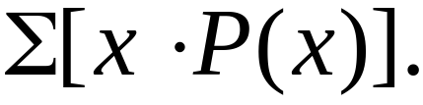
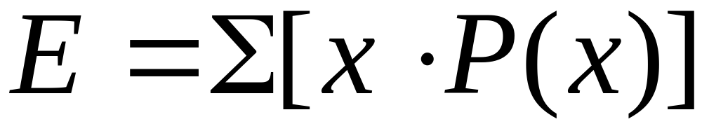
Expected Value
The expected value of a discrete random variable is denoted by E, and it represents the mean value of the outcomes. It is obtained by finding the value of
Notes:
Also called expectation or mathematical expectation
Plays a very important role in decision theory
page 208 of Elementary Statistics, 10th Edition

Slide 14
Example
The following table describes the probability distribution for the number of girls in two births.
Find the mean, variance, and standard deviation.
x | P(x)
0 | 0.25
1 | 0.50
2 | 0.25
Total
Notes:
Also called expectation or mathematical expectation
Plays a very important role in decision theory
page 208 of Elementary Statistics, 10th Edition

Slide 15


Example
The following table describes the probability distribution for the number of girls in two births.
Find the mean, variance, and standard deviation.
x | P(x)
0 | 0.25 | 0.00 | 0.25
1 | 0.50 | 0.50 | 0.00
2 | 0.25 | 0.50 | 0.25
Total |  | 1.00 | 0.50
Notes:
Also called expectation or mathematical expectation
Plays a very important role in decision theory
page 208 of Elementary Statistics, 10th Edition

Slide 16
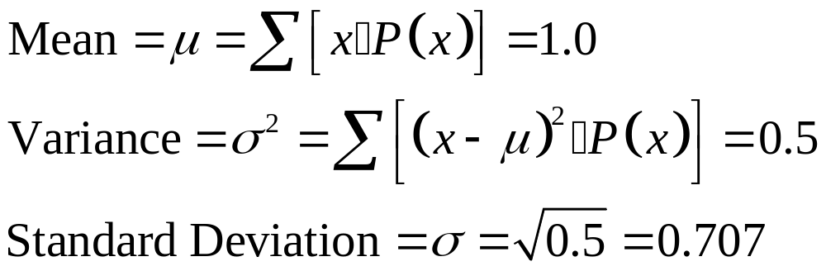
Example
The following table describes the probability distribution for the number of girls in two births.
Find the mean, variance, and standard deviation.
Notes:
Also called expectation or mathematical expectation
Plays a very important role in decision theory
page 208 of Elementary Statistics, 10th Edition

Slide 17


Identifying Unusual Results
Range Rule of Thumb
According to the range rule of thumb, most values should lie within 2 standard deviations of the mean.
We can therefore identify “unusual” values by determining if they lie outside these limits:
Maximum usual value =
Minimum usual value =
Notes:
Page 205-206 of Elementary Statistics, 10th Edition

Slide 18
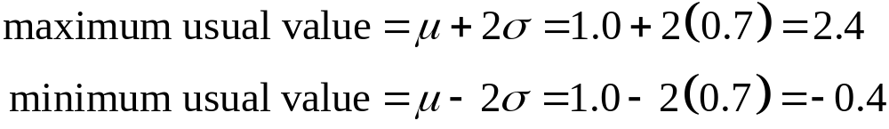
Example – continued
We found for families with two children, the mean number of girls is 1.0 and the standard deviation is 0.7 girls.
Use those values to find the maximum and minimum usual values for the number of girls.
Notes:
Page 205-206 of Elementary Statistics, 10th Edition

Slide 19
Identifying Unusual Results
Probabilities
Rare Event Rule for Inferential Statistics
If, under a given assumption (such as the assumption that a coin is fair), the probability of a particular observed event (such as 992 heads in 1000 tosses of a coin) is extremely small, we conclude that the assumption is probably not correct.
Notes:
The discussion of this topic in the text includes some difficult concepts, but it also includes an extremely important approach used often in statistics.
Page 207-208 of Elementary Statistics, 10th Edition

Slide 20


Identifying Unusual Results
Probabilities
Using Probabilities to Determine When Results Are Unusual
Unusually high: x successes among n trials is an unusually high number of successes if .
Unusually low: x successes among n trials is an unusually low number of successes if .
Notes:
The discussion of this topic in the text includes some difficult concepts, but it also includes an extremely important approach used often in statistics.
Page 207-208 of Elementary Statistics, 10th Edition

Slide 21
Chapter 5
Probability Distributions
5-1 Review and Preview
5-2 Probability Distributions
5-3 Binomial Probability Distributions
5-4 Parameters for Binomial Distributions
5-5 Poisson Probability Distributions

Slide 22
Key Concept
This section presents a basic definition of a binomial distribution along with notation and methods for finding probability values.
Binomial probability distributions allow us to deal with circumstances in which the outcomes belong to two relevant categories such as acceptable/defective or survived/died.

Slide 23
Binomial Probability Distribution
A binomial probability distribution results from a procedure that meets all the following requirements:
1. The procedure has a fixed number of trials.
2. The trials must be independent. (The outcome of any individual trial doesn’t affect the probabilities in the other trials.)
3. Each trial must have all outcomes classified into two categories (commonly referred to as success and failure).
4. The probability of a success remains the same in all trials.
Notes:
Binomial probability distributions are important because they allow us to deal with circumstances in which the outcomes belong to TWO categories, such as pass/fall, acceptable/defective, etc.
page 214 of Elementary Statistics, 10th Edition

Slide 24
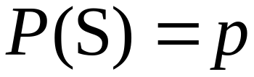
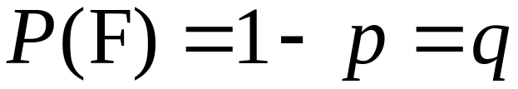
Notation for Binomial
Probability Distributions
S and F (success and failure) denote the two possible categories of all outcomes; p and q will denote the probabilities of S and F, respectively, so
(p = probability of success)
(q = probability of failure)
Notes:
The word success is arbitrary and does not necessarily represent something GOOD. If you are trying to find the probability of deaths from hang-gliding, the ‘success’ probability is that of dying from hang-gliding.
Remind students to carefully look at the probability (percentage or rate) provided and whether it matches the probability desired in the question. It might be necessary to determine the complement of the given probability to establish the ‘p’ value of the problem.
Page 214 of Elementary Statistics, 10th Edition.

Slide 25
Notation (continued)
n denotes the fixed number of trials.
x denotes a specific number of successes in n trials, so x can be any whole number between 0 and n, inclusive.
p denotes the probability of success in one of the n trials.
q denotes the probability of failure in one of the n trials.
P(x) denotes the probability of getting exactly x successes among the n trials.
Notes:
Page 214 of Elementary Statistics, 10th Edition.

Slide 26

Caution
Be sure that x and p both refer to the same category being called a success.
When sampling without replacement, consider events to be independent if .
Notes:
Page 214-215 of Elementary Statistics, 10th Edition.

Slide 27
Example
When an adult is randomly selected, there is a 0.85 probability that this person knows what Twitter is.
Suppose we want to find the probability that exactly three of five randomly selected adults know of Twitter.
Does this procedure result in a binomial distribution?
  Yes. There are five trials which are independent. Each trial has two outcomes and there is a constant probability of 0.85 that an adult knows of Twitter.
Notes:
Page 214-215 of Elementary Statistics, 10th Edition.

Slide 28
Methods for Finding
Probabilities
We will now discuss three methods for finding the probabilities corresponding to the random variable x in a binomial distribution.
Notes:
Page 216 of Elementary Statistics, 10th Edition.

Slide 29
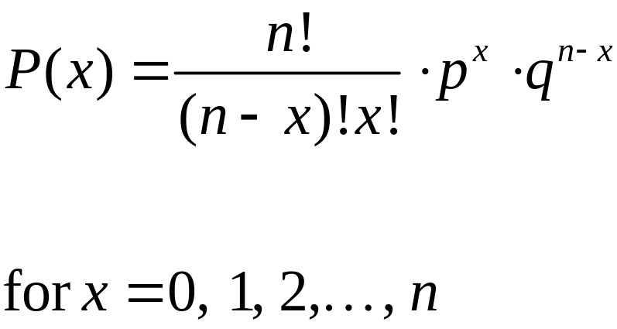
Method 1: Using the Binomial
Probability Formula
where
n = number of trials
x = number of successes among n trials
p = probability of success in any one trial
q = probability of failure in any one trial (q = 1 – p)
Notes:
page 216 of Elementary Statistics, 10th Edition

Slide 30
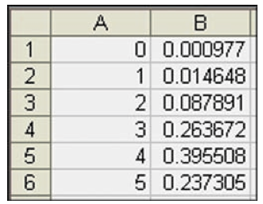
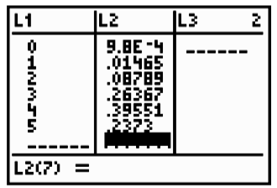
Method 2: Using Technology
STATDISK, Minitab, Excel and the TI-83 Plus calculator can all be used to find binomial probabilities.
EXCEL
TI-83 PLUS Calculator
Notes:
Page 218 of Elementary Statistics, 10th Edition.

Slide 31
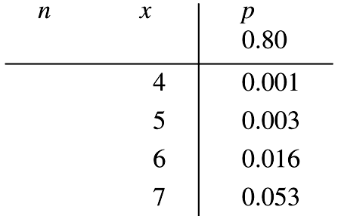
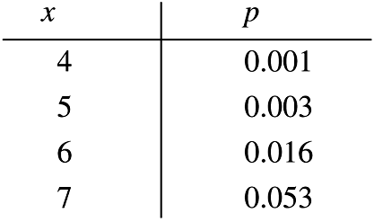
Method 3: Using
Table A-1 in Appendix A
Part of Table A-1 is shown below. With n = 12 and p = 0.80 in the binomial distribution, the probabilities of 4, 5, 6, and 7 successes are 0.001, 0.003, 0.016, and 0.053 respectively.
Notes:
Page 217 of Elementary Statistics, 10th Edition.

Slide 32
Strategy for Finding Binomial Probabilities
Use computer software or a TI-83/84 Plus calculator, if available.
If neither software nor the TI-83/84 Plus calculator is available, use Table A-1, if possible.
If neither software nor the TI-83/84 Plus calculator is available and the probabilities can’t be found using Table A-1, use the binomial probability formula.
Notes:
Page 219 of Elementary Statistics, 10th Edition

Slide 33
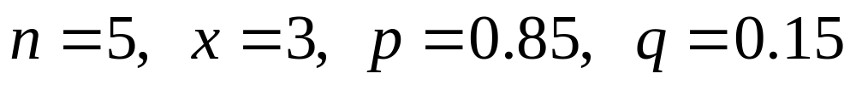
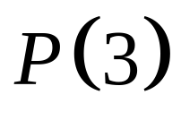
Example
Given there is a 0.85 probability that any given adult knows of Twitter, use the binomial probability formula to find the probability of getting exactly three adults who know of Twitter when five adults are randomly selected.
We have:
We want:
Notes:
Page 216 of Elementary Statistics, 10th Edition.

Slide 34
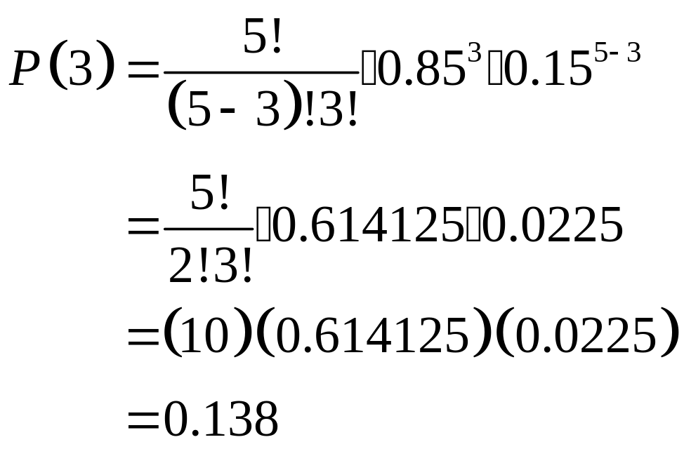
Example
We have:
Notes:
Page 216 of Elementary Statistics, 10th Edition.

Slide 35
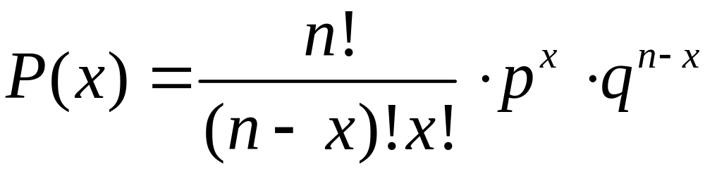
Rationale for the Binomial Probability Formula
The number of
outcomes with exactly x successes among n trials
Notes:
The ‘counting’ factor of the formula counts the number of ways the x successes and (n-x) failures can be arranged - i.e.. the number of arrangements (Review section 4-7, page 181).
Discussion is on page 219 of Elementary Statistics, 10th Edition.

Slide 36
Rationale for the Binomial Probability Formula
Number of
outcomes with exactly x successes among n trials
The probability of x successes among n trials for any one particular order
Notes:
The remaining two factors of the formula will compute the probability of any one arrangement of successes and failures. This probability will be the same no matter what the arrangement is.
The three factors multiplied together give the correct probability of ‘x’ successes.

Slide 37
Chapter 5
Probability Distributions
5-1 Review and Preview
5-2 Probability Distributions
5-3 Binomial Probability Distributions
5-4 Parameters for Binomial Distributions
5-5 Poisson Probability Distributions

Slide 38
Key Concept
In this section we consider important characteristics of a binomial distribution including center, variation and distribution. That is, given a particular binomial probability distribution we can find its mean, variance and standard deviation.
A strong emphasis is placed on interpreting and understanding those values.

Slide 39

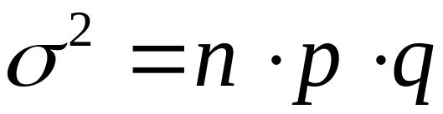
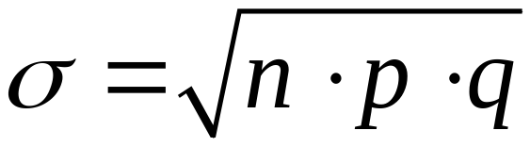
Binomial Distribution: Formulas
Mean
Variance
Std. Dev.
Where
n = number of fixed trials
p = probability of success in one of the n trials
q = probability of failure in one of the n trials
Notes:
The obvious advantage to the formulas for the mean, standard deviation, and variance of a binomial distribution is that you do not need the values in the distribution table. You need only the n, p, and q values.
A common error students tend to make is to forget to take the square root of (n)(p)(q) to find the standard deviation, especially if they used L1 and L2 lists in a graphical calculator to find the standard deviation with non-binomial distributions. The square root is built into the programming of the calculator and students do not have to remember it. These formulas do require the student to remember to take the square root of the three factors.
Page 225 of Elementary Statistics, 10th Edition

Slide 40
Interpretation of Results
It is especially important to interpret results. The range rule of thumb suggests that values are unusual if they lie outside of these limits:
maximum usual value =
minimum usual value =
Notes:
Page 225 of Elementary Statistics, 10th Edition.

Slide 41
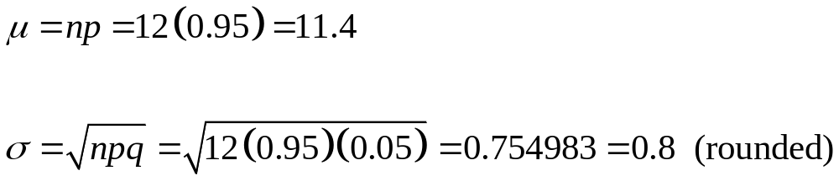
Example
McDonald’s has a 95% recognition rate. A special focus group consists of 12 randomly selected adults.
For such a group, find the mean and standard deviation.
Notes:
Page 225 of Elementary Statistics, 10th Edition.

Slide 42
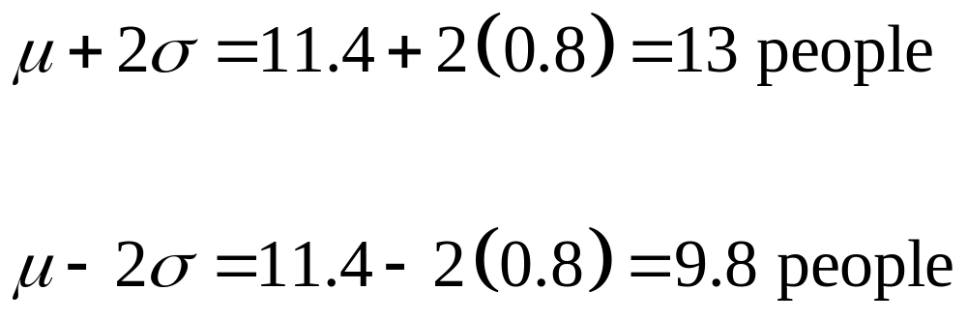
Example - continued
Use the range rule of thumb to find the minimum and maximum usual number of people who would recognize McDonald’s.
If a particular group of 12 people had all 12 recognize the brand name of McDonald’s, that would not be unusual.
Notes:
Page 225 of Elementary Statistics, 10th Edition.

Slide 43
Chapter 5
Probability Distributions
5-1 Review and Preview
5-2 Probability Distributions
5-3 Binomial Probability Distributions
5-4 Parameters for Binomial Distributions
5-5 Poisson Probability Distributions

Slide 44
Key Concept
The Poisson distribution is another discrete probability distribution which is important because it is often used for describing the behavior of rare events (with small probabilities).

Slide 45
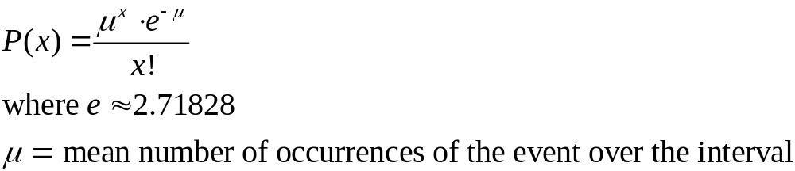
Poisson Distribution
The Poisson distribution is a discrete probability distribution that applies to occurrences of some event over a specified interval. The random variable x is the number of occurrences of the event in an interval. The interval can be time, distance, area, volume, or some similar unit.
Formula
Notes:
Some discussion of the what the value of ‘e’ represents might be necessary.
A minimal scientific calculator with factorial key is required for this formula. Most instructors will want students to use the calculator representation of ‘e’, rather than the rounded version of ‘e’, which might provide a very slightly different final answer.
Page 230 of Elementary Statistics, 10th Edition.

Slide 46

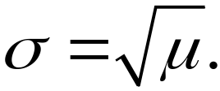
Requirements of the
Poisson Distribution
The random variable x is the number of occurrences of an event over some interval.
The occurrences must be random.
The occurrences must be independent of each other.
The occurrences must be uniformly distributed over the interval being used.
Parameters
The mean is .
The standard deviation is
Notes:
Page 231 of Elementary Statistics, 10th Edition.

Slide 47
Differences from a
Binomial Distribution
The Poisson distribution differs from the binomial distribution in these fundamental ways:
The binomial distribution is affected by the sample size n and the probability p, whereas the Poisson distribution is affected only by the mean .
In a binomial distribution the possible values of the random variable x are 0, 1, . . ., n, but a Poisson distribution has possible x values of 0, 1, 2, . . . , with no upper limit.
Notes:
Page 231 of Elementary Statistics, 10th Edition.

Slide 48
Example
For a recent period of 100 years, there were 530 Atlantic hurricanes. Assume the Poisson distribution is a suitable model.
Find μ, the mean number of hurricanes per year.
If P(x) is the probability of x hurricanes in a randomly selected year, find P(2).

Slide 49
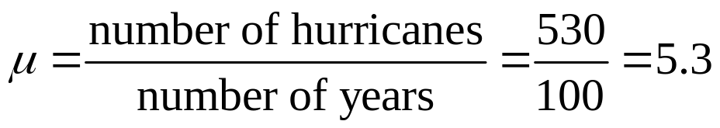
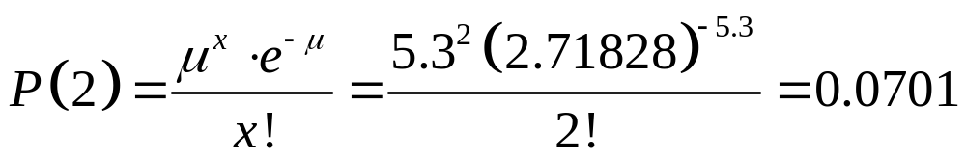
Example
Find μ, the mean number of hurricanes per year.
If P(x) is the probability of x hurricanes in a randomly selected year, find P(2).

Slide 50


Poisson as an Approximation to the Binomial Distribution
The Poisson distribution is sometimes used to approximate the binomial distribution when n is large and p is small.
Rule of Thumb to Use the Poisson to Approximate the Binomial
Notes:
If n is large (greater than or equal to 100) and np is less than or equal to 10, then the Poisson distribution can be used to approximate the binomial distribution.
Page 232 of Elementary Statistics, 10th Edition.

Slide 51


Poisson as an Approximation to the Binomial Distribution -
If both of the following requirements are met,
then use the following formula to calculate ,
Value for
Notes:
Page 232 of Elementary Statistics, 10th Edition.

Slide 52
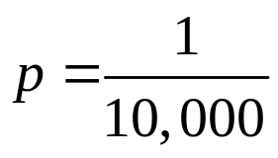
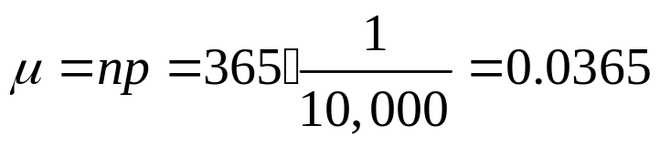
Example
In the Maine Pick 4 game, you pay $0.50 to select a sequence of four digits, such as 2449.
If you play the game once every day, find the probability of winning at least once in a year with 365 days.
The chance of winning is
Then, we need μ:

Slide 53
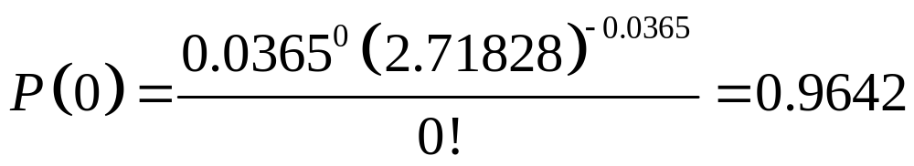
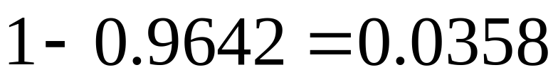
Example - continued
Because we want the probability of winning “at least” once, we will first find P(0).
There is a 0.9642 probability of no wins, so the probability of at least one win is:

