Slide 1
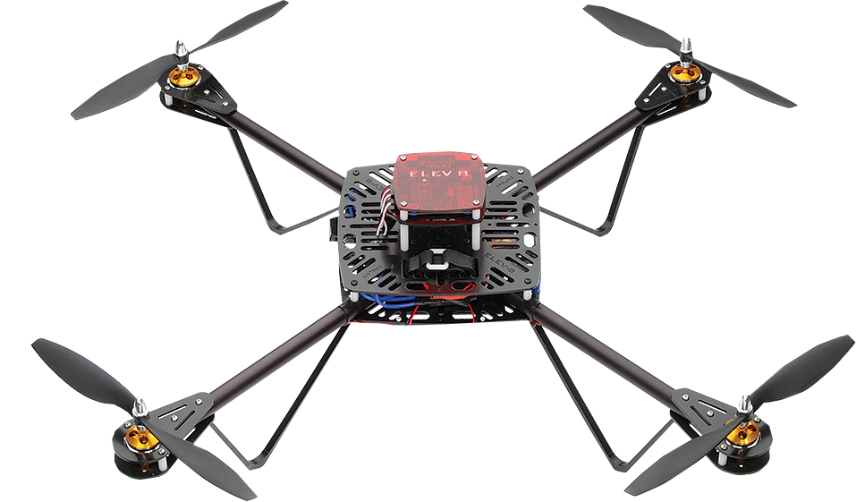
PRESENTATION ON
QUAD-COPTER
PRESENTED BY :
Vivek Tiwari
Lokesh Bansod
Guided By :
Mr. Swapnil Ambade Sir
Studying in
“GOVERNMENT POLYTECHNIC GONDIA”
Final Year Diploma in Electronics & Telecommunication Engineering

Slide 2
Outline
Quad-copter
Basic material required
Quad copter movement
Brushless dc motor
Electronic speed control
Propeller
Battery
Power distribution
Quad-copter processes
Advantage
Disadvantage
Application
References

Slide 3
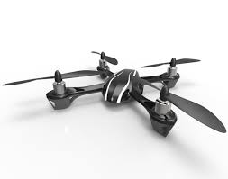
quad copter
The quad-copter is one of the most complex flying machines due to its versatility to perform many types of tasks. Classical quad-copters are usually equipped with a four rotors. Quad-copters are symmetrical vehicles with four equally sized rotors at the end of four equal length rods.

Slide 4
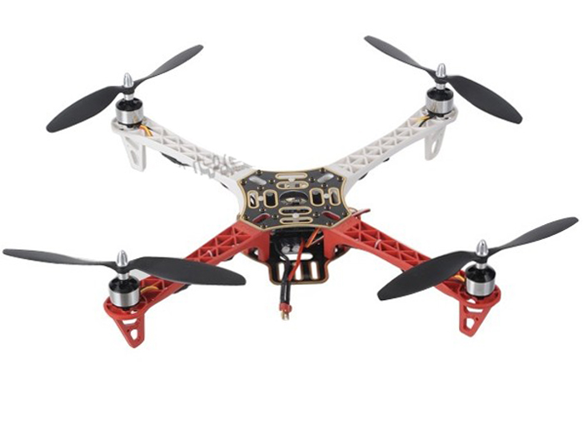
abstract
The project goal was to design a semi-autonomous Quad-copter capable of self-sustained flight while utilizing a microcontroller. The Quad-copter was designed to be small so that costs would be minimized, which is why small motors and propellers are being used. While a microcontroller, will allocate the area for monitoring which will help us for automation of Quad-copter

Slide 5
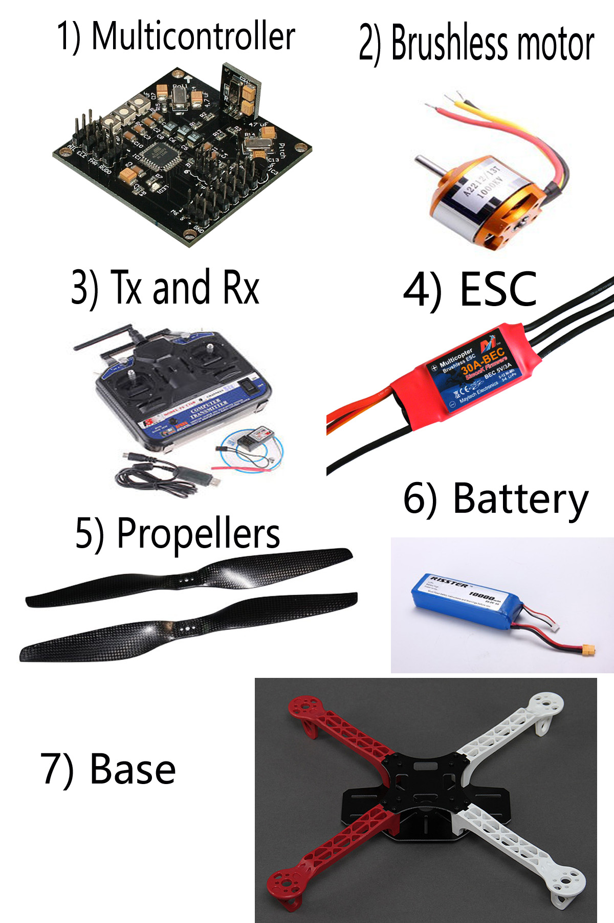
Basic materials required
Multicontroller
Brushless Motors
Transmitter and receiver
Electronic Speed Controller (ESC)
Bullet Connectors
Propellers
A strong base as to hold the structure
Lithium Polymer Battery
Accelerometer

Slide 6
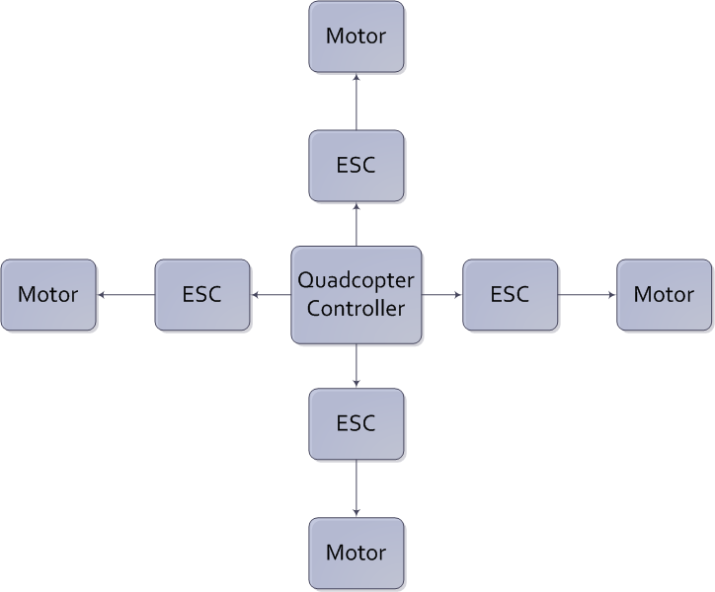
Block diagram

Slide 7
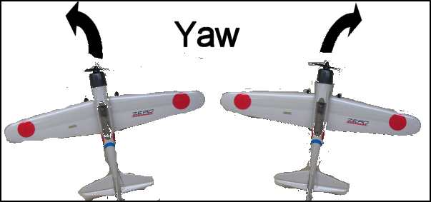
Quad-Copter Movement
1) Yaw (right/left)
Each of the rotors on the quad-copter produces both thrust and torque. Given that the front-left and rear-right motors both rotate counter-clockwise and the other two rotate clockwise, the net aerodynamic torque will be zero.

Slide 8
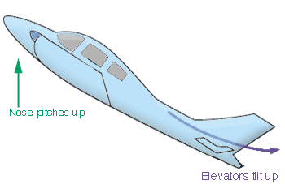
2) PITCH
The pitch axis (also called lateral or transverse axis) passes through the plane from wing tip to wing tip. Pitch moves the aircraft's nose up and down. A positive pitch angle raises the nose and lowers the tail. The elevators are the primary control of pitch.

Slide 9
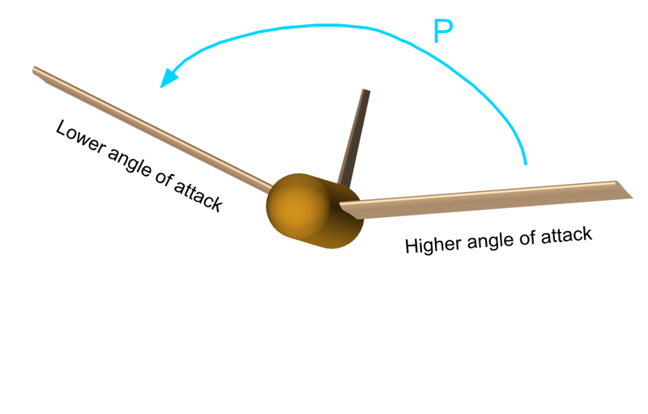
3) roll
The roll axis (or longitudinal axis) passes through the plane from nose to tail. The angular displacement about this axis is called bank. The pilot changes bank angle by increasing the lift on one wing and decreasing it on the other. A positive roll angle lifts the left wing and lowers the right wing..

Slide 10
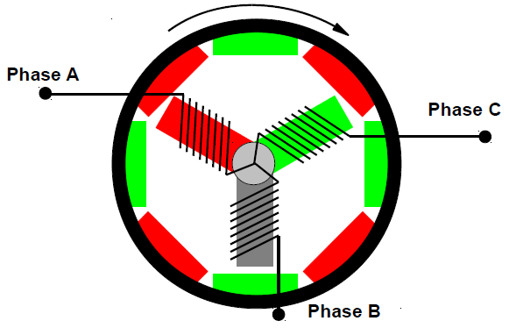
BRUSHLESS MOTOR
Brushless DC electric motor also known as electronically commutated motors (ECMs, EC motors) are synchronous motors that are powered by a DC electric source via an integrated inverter/switching power supply, which produces an AC electric signal to drive the motor. In this context, AC, alternating current, does not imply a sinusoidal waveform, but rather a bi-directional current with no restriction on waveform.

Slide 11
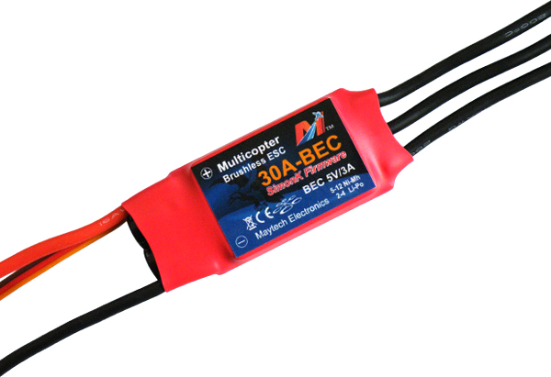
Electronic speed control
An electronic speed control or ESC is an electronic circuit with the purpose to vary an electric motor's speed, its direction and possibly also to act as a dynamic brake. ESCs are often used on electrically powered radio controlled models, with the variety most often used for brushless motors essentially providing an electronically generated three-phase electric power low voltage source of energy for the motor.

Slide 12
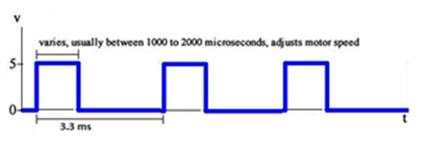
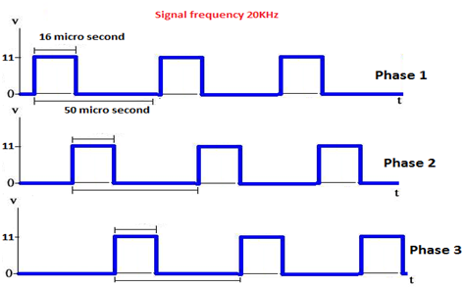
Electronic Speed Controller (ESC)
Signal output from MCU to ESC
ESC handle (1-2 ms ) pulse width but we use output signal frequency 300Hz not 500Hz .
Signal output from ESC to motor
The frequency of output signal from
ESC to motors 10-30KHz.
Notes:
The Turnigy Plush ESCs have been reported to be able to handle the higher frequency, and thus more adjustments in motor speed can be made per second, therefor the quad-copter will become more stable.

Slide 13
Propeller
* Dimension: 10X4.7 inch
● 2 blades
● Directly attached to motor
● 2 each rotating CW and CCW (a "pusher" and a "puller").
● Propeller balance reduces vibrations .

Slide 14
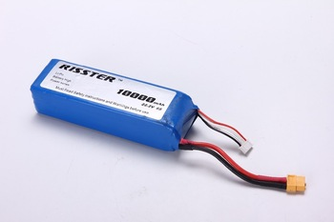
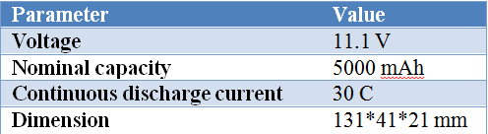
Battery
● Lightweight
● High discharging current and capacity
● low internal resistance.
We select Lithium Polymer (LiPo) to achieve these characteristics
Max current can be calculated by using the following equation:
Max current=Ah*C = 5A *30 =150A
Notes:
Our battery has flat discharge rate (30C), this allow high current from the battery with small Ampere per hours.

Slide 15
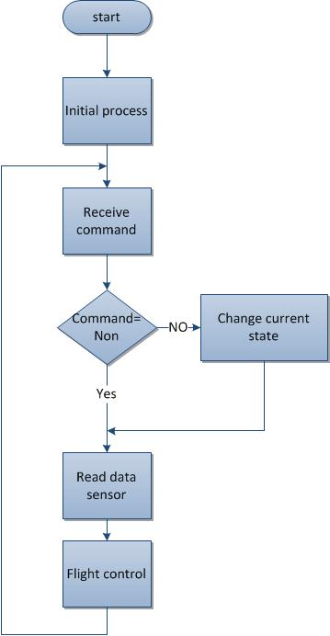
Quad-copter processes
To maintain the stability and response to control command from transmitter,
Notes:
there are many stages to be implemented that shown in the next flowchart.
Initial process : This stage performs at once when the quad-copter starts working to calibrate accelerometer, gyroscope and calibrate ESC for all motors.
Receive We receive different commands that indicate the behavior of quad-copter .
1. Up and down.
2. Left and right.
Forward and backward.
Read data :Read data from IMU(Acc. & gyro), by sending addresses for each accelerometer and gyroscope, using fast I2C mode (400 KHz).

Slide 16
ADVANTAGES
Small scale UAV’S makes the vehicles safer for close interactions.
Quad copters do not require mechanical linkages to vary
the rotor blade pitch angle as they spin.
This implies the design and maintenance of the vehicle.
The use of four rotors allows each individual rotor to have
smaller diameter than the equivalent

Slide 17
DISADVANTAGES
The most significant problem to date have been an ambitious development schedule coupled with very limited funds.
The ambition is followed by complexity in calculation and designing.

Slide 18
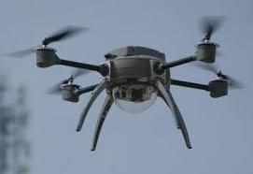
APPLICATIONS
Research platform
Military and law enforcement
Commercial use

Slide 19
Reference
https://www.reddit.com/r/Quadcopter/
www.instructables.com/id/Scratch-build-your-own-quad-copter/
https://howthingsfly.si.edu/flight-dynamics/roll-pitch-and-yaw
www.popularmechanics.com/.../whats-so-great-about-brushless-motor-p
www.propeller.se/
Book “Build your own quad copter” by Donald Norris

Slide 20



