Slide 1
Next up:
Martin Walther

Slide 2
3
3

Slide 3
2

Slide 4
1

Slide 5
PowerShell RotaMaster
Absence and duty scheduling program for teams
Martin Walther

Slide 6
Martin Walther
DevOps Engineer
Senior Systems Engineer Cloud Inventx AG
Bluesky: @tinuwalther.bsky.social
LinkedIn: https://www.linkedin.com/in/tinuwalther/
GitHub: https://github.com/tinuwalther

Slide 7
What is RotaMaster?
The Rotation Master is an absence and on-call duty planning program for teams with Integration of Opsgenie.
It’s based on Pode (PowerShell) for the API, and FullCalendar (JavaScript) for the Frontend, and SQLite as Database.
I used ChatGPT prompt for building the JavaScript code.

Slide 8
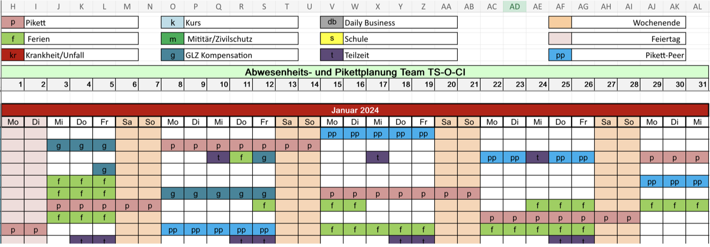
Why I need the RotaMaster?
You can do it in Excel like the last 20 years, yes

Slide 9
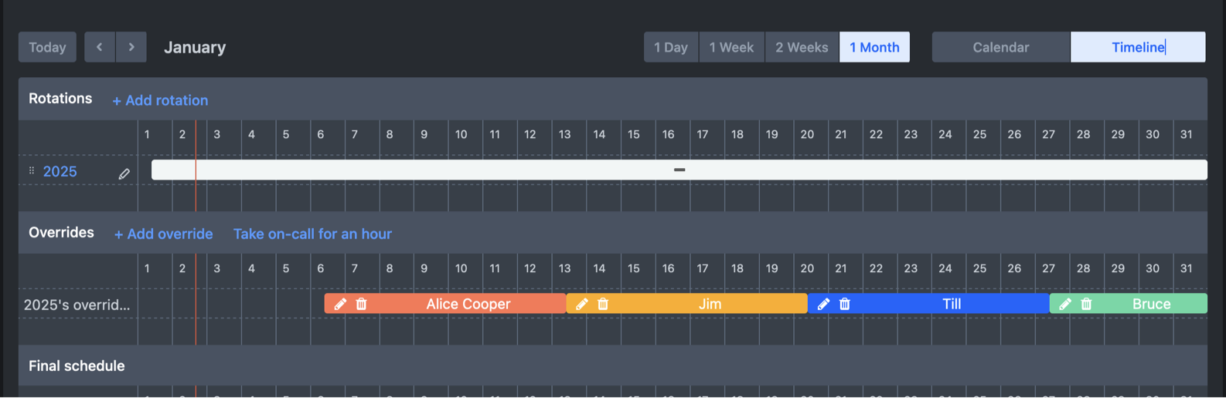
Why I need the RotaMaster?
Then you have to do the same thing in OpsGenie again

Slide 10
Why I need the RotaMaster?
And if you would have the absences and on-call schedules in your Outlook, do the same thing again, in another program, and again, and again, and again, …

Slide 11
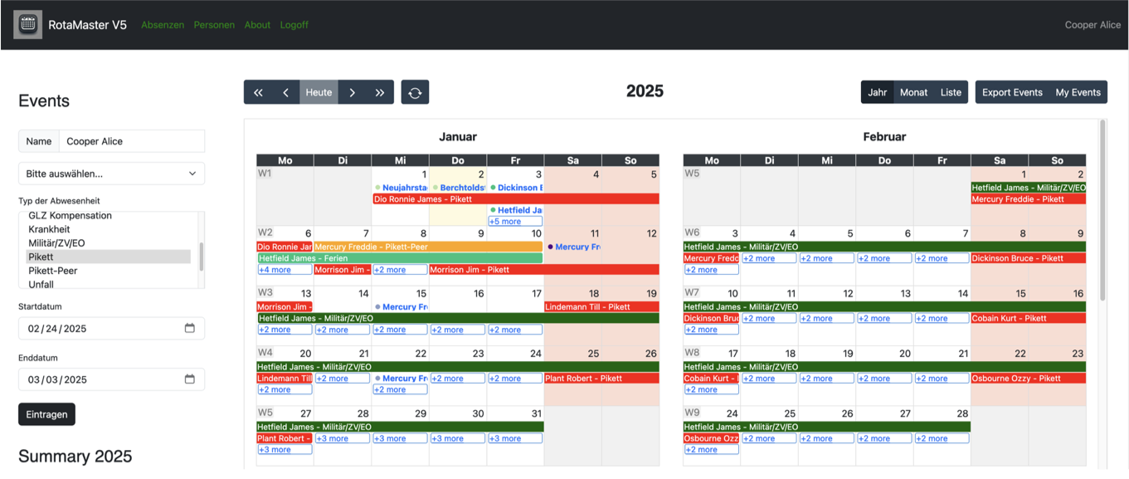
Why I need the RotaMaster?
Or use the RotaMaster and do it only once!

Slide 12
Key Features
Planning of absences
Planning of on-call duty
Planning off on-call peer
Export as iCalendar-file
OpsGenie Integration
Import of iCalendar and CSV-files
Manage absence types
Manage users
Public Holidays for CH (BE, ZH, GR, SG)

Slide 13
Demo

Slide 14
Learnings
Yes, you can!
Split your big project into small tasks
Write JavaScript with help from ChatGPT
Debugging is the hell with JavaScript
How easy is the Active Directory Integration in Pode
How easy is the Integration of OpsGenie over API
I forgot a good Database design, so I have to alter some tables more than once

Slide 15
The future
Enable automatic rotation planning in the front-end
Logic for legal break between rotations during on-call duty
Logic for the minimal staffing of the team
Optimise database design
And much more

Slide 16
References
https://pode.readthedocs.io/
https://fullcalendar.io/
https://chatgpt.com/
https://github.com/tinuwalther/RotaMaster

Slide 17
Q&A
15 minutes

