Slide 1
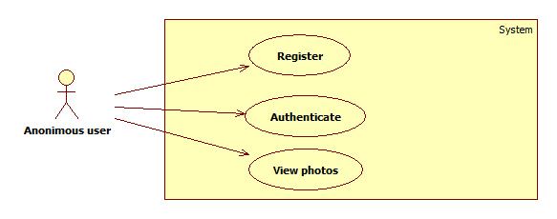
Use Cases - Guest

Slide 2
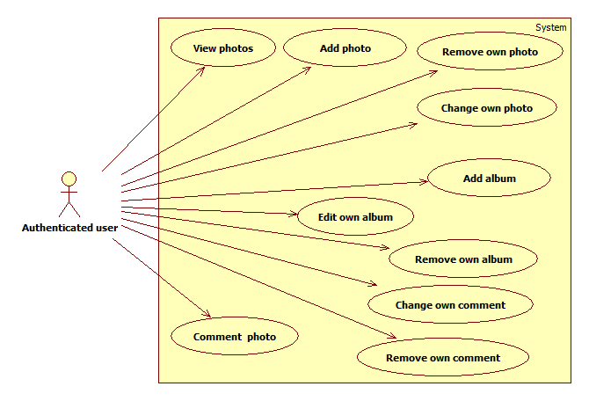
Use Cases - Author

Slide 3
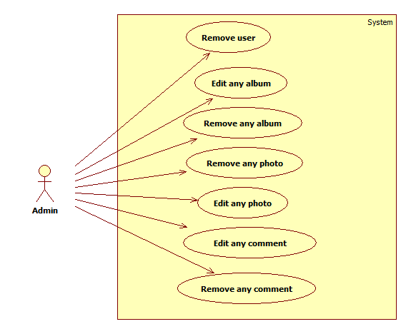
Use Cases - Admin

Slide 4
Application Architecture

