Slide 1
Agenda
Use cases requirements analysis
Application architecture
Database architecture
Desktop calculator
Readability test application

Slide 2
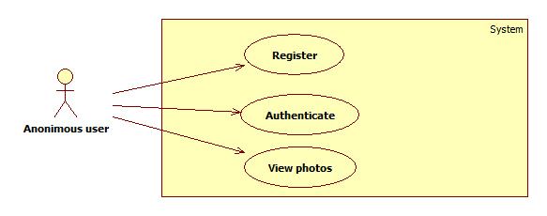
Use Cases - Guest

Slide 3
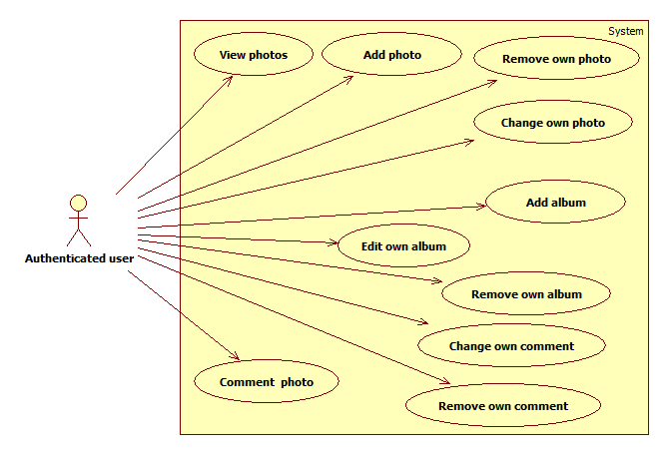
Use Cases - Author

Slide 4
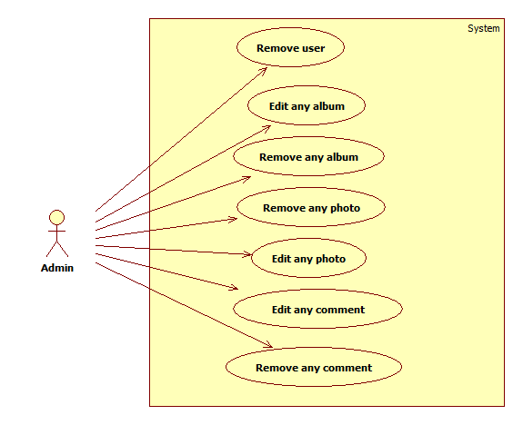
Use Cases - Admin

Slide 5
Application Architecture

Slide 6
Architecture - I

Slide 7
Architecture - II

Slide 8
Architecture - III

Slide 9
Database model

Slide 10
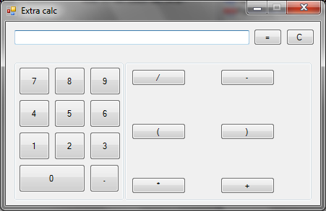
Calculator
Widows Forms GUI
Plugins API via reflection

Slide 11
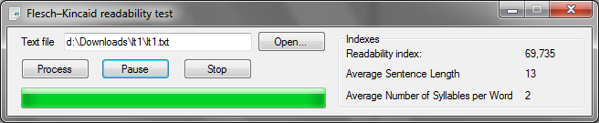
Readability test
GUI is not blocked until text is processed
Stop, Pause, Resume are supported

Slide 12
Summary
UML modeling
Three-tier architecture
Entity-relationship database modeling
ASP.NET Web Forms framework
Windows Forms framework

