Slide 1
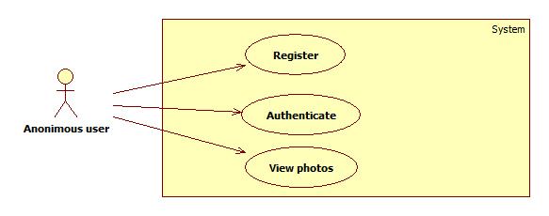
Use Cases - Guest

Slide 2
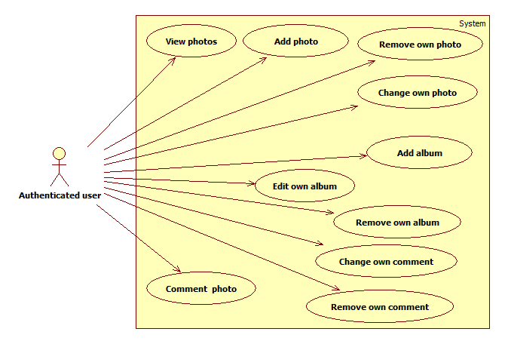
Use Cases - Author

Slide 3
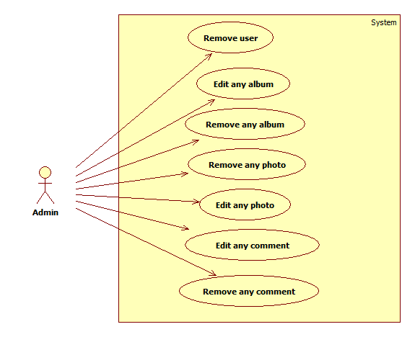
Use Cases - Admin

Slide 4
Application Architecture

Slide 5
Architecture - I

Slide 6
Architecture - II

Slide 7
Architecture - III

Slide 8
Database model

Slide 9
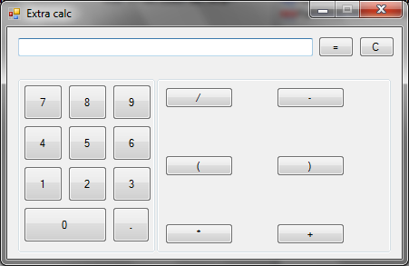
Calculator

