Slide 1
INTERNAL · EQUITY RESEARCH
Perplexity Enterprise
How I'm using it — features, prompts, and the workflows that have changed
PRESENTED BY Aman Jain
FOR Equity Research — analysts & associates
GOAL Get to first prompt, first Space, and first scheduled search in one week

Slide 2
SETUP
PROMPTING
AUTOMATION
FINANCE
SPACES
LIMITS
START
FRAMING
02 / 17
What Perplexity changes — and what it doesn't
Not a replacement for Bloomberg or AlphaSense. A complement.
Bloomberg owns the numbers. AlphaSense owns the curated finance corpus — filings, transcripts, broker research. Perplexity earns its keep in three places they don't reach as well.
01
02
03
The open web
Reasoning over our documents
Automation we couldn't do before
Real-time news, regional press, regulatory pages, social signals — synthesized with citations.
Upload filings, transcripts, broker notes. Ask precise questions. Get structured answers back.
Scheduled searches, price alerts with custom analyst queries, rephrasing in our voice.
Perplexity Enterprise · Aman Jain · Internal

Slide 3
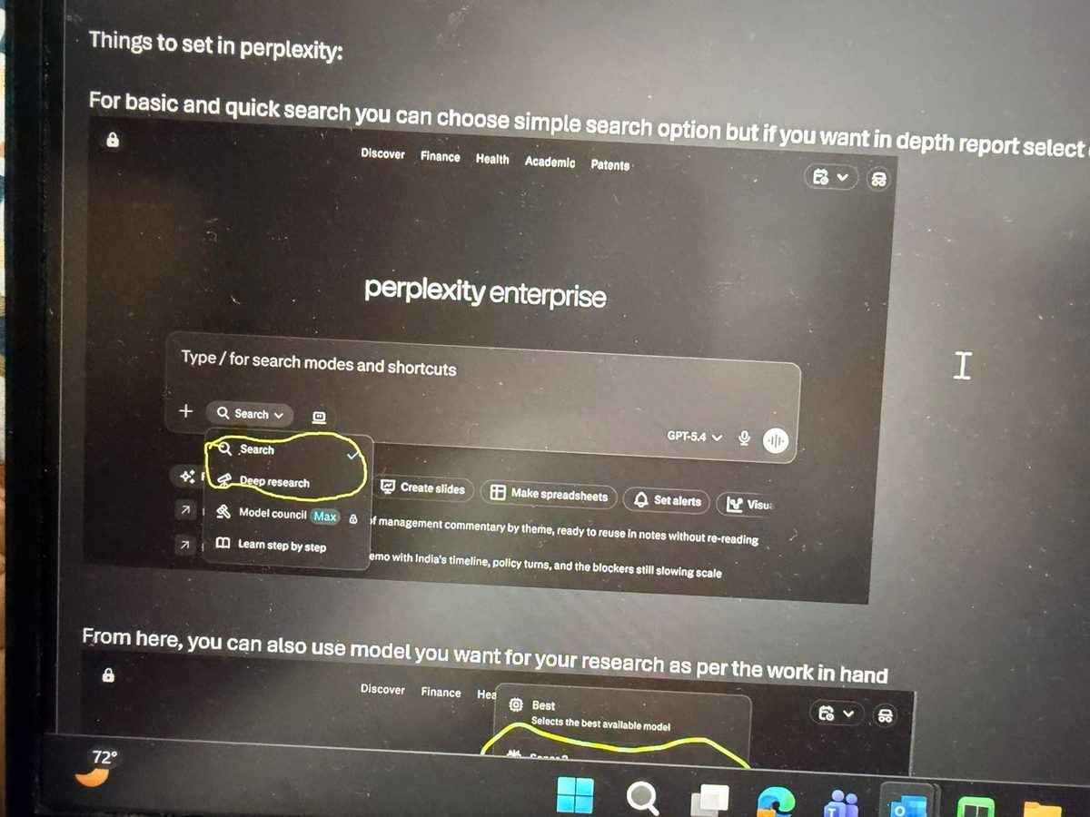
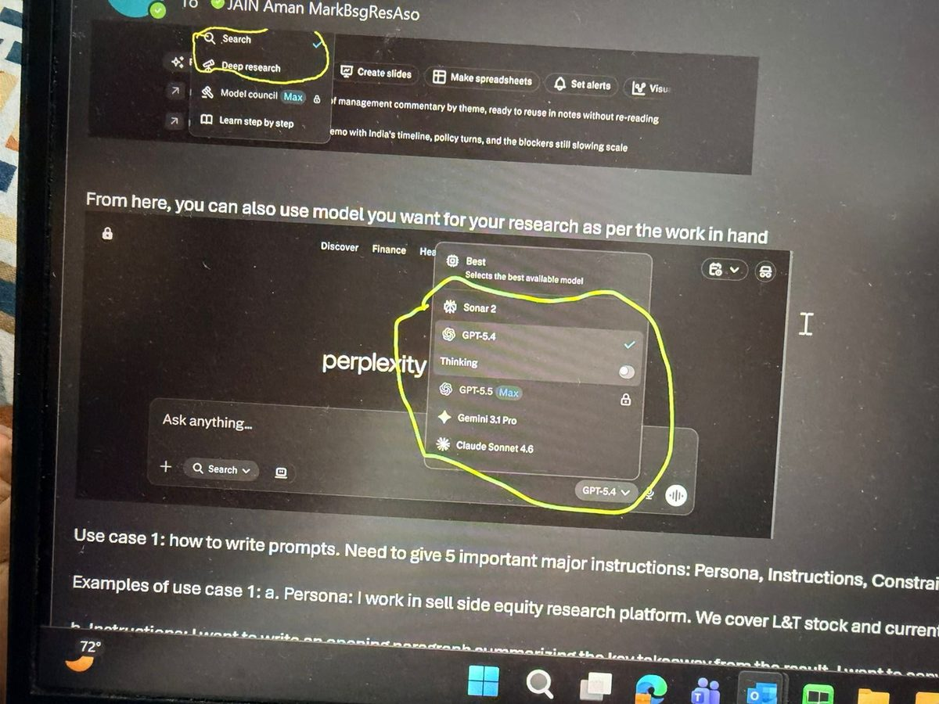
SETUP
PROMPTING
AUTOMATION
FINANCE
SPACES
LIMITS
START
SETUP
03 / 17
Two switches to know before you start
Behaviour of every prompt depends on these two settings. Worth a moment up front.
SWITCH 1 · SEARCH MODE
SWITCH 2 · MODEL
Search vs Deep Research
Pick the right model for the job
Default to Search for daily work. Use Deep Research when you need a multi-source brief and can wait 5–10 minutes — it goes deeper and structures the answer.
GPT-5.4 default for general work. Claude Sonnet 4.6 for synthesis and writing. Thinking / GPT-5.5 Max for multi-step reasoning over long documents.
Perplexity Enterprise · Aman Jain · Internal

Slide 4
SETUP
PROMPTING
AUTOMATION
FINANCE
SPACES
LIMITS
START
PROMPTING
04 / 17
How to write a prompt — the PICOE framework
Most people type questions. Power users write prompts. The difference is structure.
P
Persona
Who you are. "I work in sell-side equity research at Bernstein, covering Indian financials."
I
Instructions
What you want done. Be specific about the topic, the angle, and the inputs to use.
C
Constraint
What to avoid. Style, length, jargon level, tone — anything that's a hard no.
O
Output format
Shape of the answer. One paragraph / table / bullets / 1-page brief.
E
Examples
What good looks like. Paste 2–3 examples of past notes, paragraphs, or output styles.
The more constrained the prompt, the better the output. Two examples follow.
Perplexity Enterprise · Aman Jain · Internal

Slide 5
SETUP
PROMPTING
AUTOMATION
FINANCE
SPACES
LIMITS
START
PROMPTING · WORKED EXAMPLE
05 / 17
L&T result note — opening paragraph
The brief I gave Perplexity, mapped to PICOE
P PERSONA
I INSTRUCTIONS
C CONSTRAINT
Sell-side equity research. Covering L&T. Writing result note.
Opening paragraph. Order inflow beat (Middle East). Revenue & earnings miss (~₹50bn Q4). Near-term risks. Guidance: 10–12% inflow vs consensus ~17%. New 5-yr plan. Maintain Outperform.
Impactful, no beating around the bush. Match the example style. Simple precise language, minimal jargon.
O OUTPUT FORMAT
E EXAMPLES
One paragraph.
Three prior L&T opening paragraphs from past notes, pasted in full.
Output on next slide →
STYLE EXAMPLES INCLUDED:
Three opening paragraphs from prior L&T result notes — different quarters, similar voice — pasted verbatim so the model could learn the cadence, hedging, and structure of how we write.
Perplexity Enterprise · Aman Jain · Internal

Slide 6
SETUP
PROMPTING
AUTOMATION
FINANCE
SPACES
LIMITS
START
PROMPTING · WORKED EXAMPLE
06 / 17
L&T result note — the output Perplexity returned
“
L&T reported a quarter with a meaningful miss on revenue and earnings — ₹50bn of headwinds from Middle East project disruptions and India water sector delays weighed on execution — but the order inflow story more than held up, with inflows beating expectations on the back of strong international demand, particularly from the Middle East. The near-term read-through is mixed: execution delays, supply chain disruptions, and higher insurance costs remain live risks, and consensus will need to reset revenue growth expectations from ~17% closer to the company's own guidance of 10–12%. What keeps us constructive is the demand backdrop — Middle East capex pipeline remains robust, and management's new 5-year plan articulates a credible expansion into industrial electronics, nuclear, data centers, and green hydrogen, with targets of 10–12% order inflow CAGR, 12–15% revenue growth, and 16–17% ROE. Near-term execution headwinds are real, but the long-term structural story remains firmly intact — we maintain Outperform.
THE POINT Same length, same hedging, same Bernstein voice. The structure does the work — minutes saved per note.
Perplexity Enterprise · Aman Jain · Internal

Slide 7
SETUP
PROMPTING
AUTOMATION
FINANCE
SPACES
LIMITS
START
PROMPTING · QUICK WINS
07 / 17
Two more places PICOE pays off
EXAMPLE 2
EXAMPLE 3 · MULTIPLIER
Personal — draft a tricky email
Use AI to write prompts for AI
Leave request for a wedding during earnings season, to a boss 15 years senior. PICOE handles the diplomacy: persona (junior analyst), constraint (busy season, may not approve), output (short, effective email).
Ask Perplexity to generate a high-quality, structured prompt for ChatGPT / Claude / Gemini on a specific research task. Paste that prompt into any other tool and reuse it across names.
WHAT I ASKED
WHAT CAME BACK
"I need research on HDFC Bank. Give me a strong prompt I can use in other AI platforms."
"…I'm aware this falls during earnings season, so I'll ensure all my key deliverables are covered in advance and remain available on call for any critical items if needed. Please let me know if this works, or if you'd prefer any adjustments…"
WHAT CAME BACK
A 1,500-word structured analyst prompt with 8 scope sections: investment snapshot → business model → financials → strategy → competitive positioning → valuation → risks → actionable takeaways. Reusable for every name.
→ Same logic works for difficult client emails, pushback to a PM, escalations.
→ This is the meta-skill. Learn it once.
Perplexity Enterprise · Aman Jain · Internal

Slide 8
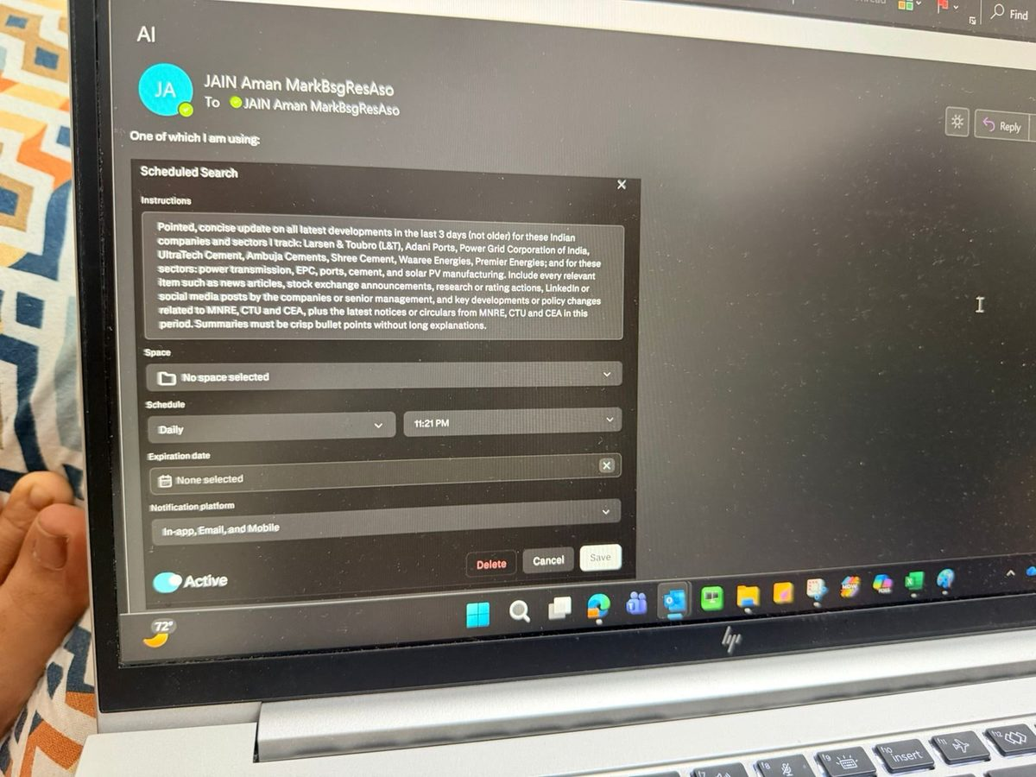
SETUP
PROMPTING
AUTOMATION
FINANCE
SPACES
LIMITS
START
AUTOMATION
08 / 17
Scheduled searches — daily intelligence on autopilot
MY SCHEDULED SEARCH
OUTPUT — DAILY DIGEST
WHAT WE'RE DOING
Set a recurring search at a fixed time on covered names and sectors. Output arrives by email, app, and in-product.
⎘
WHY IT MATTERS
News flow on 10+ names is impossible to track manually each morning. Important moves slip through.
Daily digest screenshot
To be added
WHAT IT SOLVES
Runs daily at 11:21 PM. Covers L&T, Adani Ports, Power Grid, UltraTech, Ambuja, Shree Cement, Waaree, Premier Energies + MNRE / CTU / CEA.
The actual digest that lands in my inbox each morning.
The "what did I miss overnight?" tax at the start of every working day. Replaces 30 minutes of triage with a 2-minute scan.
Perplexity Enterprise · Aman Jain · Internal

Slide 9
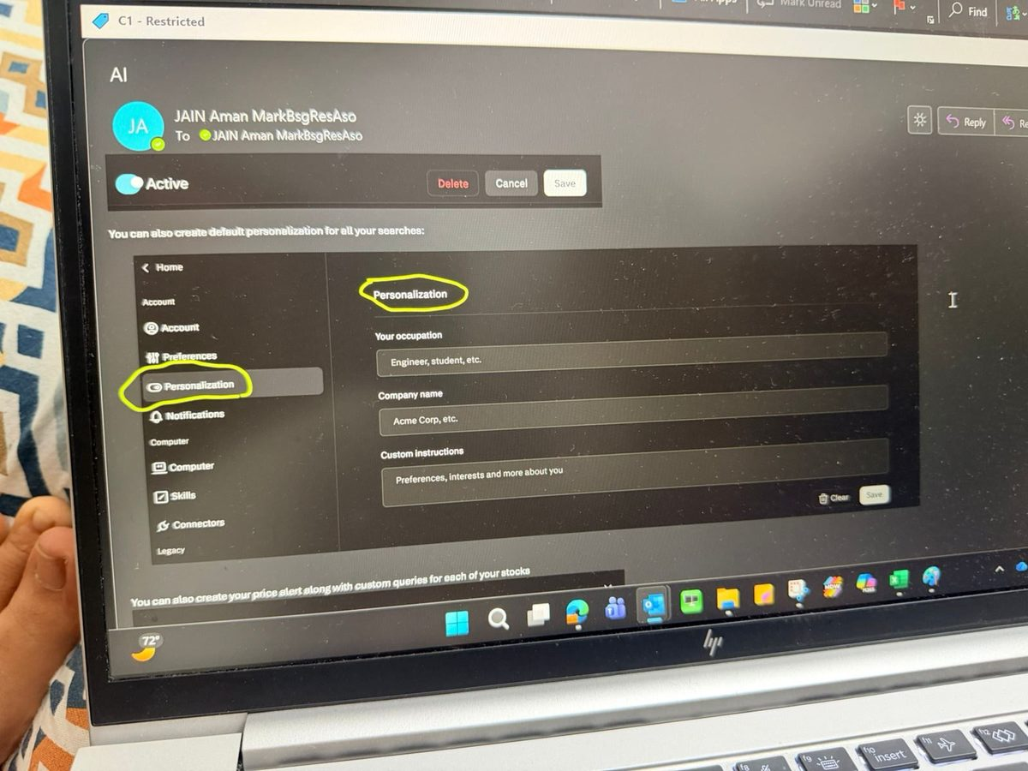
SETUP
PROMPTING
AUTOMATION
FINANCE
SPACES
LIMITS
START
AUTOMATION
09 / 17
Personalization — tell Perplexity who you are, once
PERSONALIZATION SETTINGS
OUTPUT — A PROMPT WITH IT ON
WHAT WE'RE DOING
Fill in occupation, firm, and custom instructions (preferred jargon level, tone, sectors covered) in settings.
⎘
WHY IT MATTERS
Without it, every prompt is doing two jobs: re-establishing who you are AND asking the actual question. Wasted effort.
Before / after example
To be added
WHAT IT SOLVES
One-time setup. Persists across every search going forward.
A simple prompt run with personalization on vs off, side by side.
Generic, retail-tone outputs from a tool that should be writing for analysts. Saves a sentence of context per prompt.
Perplexity Enterprise · Aman Jain · Internal

Slide 10
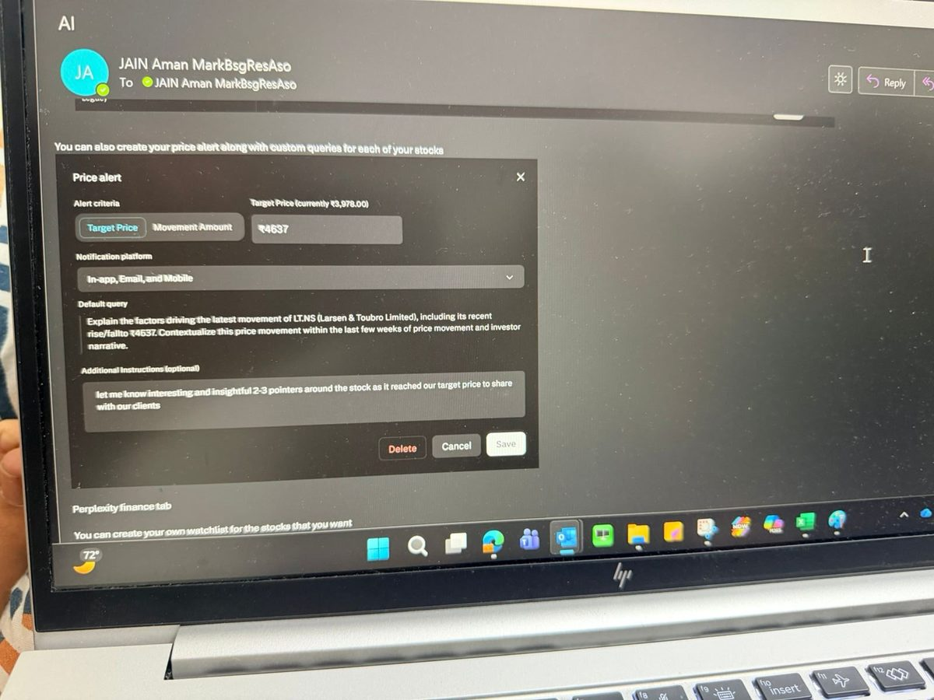
SETUP
PROMPTING
AUTOMATION
FINANCE
SPACES
LIMITS
START
AUTOMATION
10 / 17
Price alerts with a custom analyst query
ALERT + QUERY SETUP
OUTPUT — THE ALERT IT SENDS
WHAT WE'RE DOING
Set a target price on a covered name. Attach a default analyst query that auto-runs when the target is hit.
⎘
WHY IT MATTERS
When a stock moves, clients want a fast take — and I'm usually mid-something-else. Reactive scrambling is the norm.
Alert email screenshot
To be added
WHAT IT SOLVES
L&T set to ₹4,637 with a custom 2–3 pointer query attached.
The alert + auto-generated client-ready insight when target hits.
The 10–15 minutes of writing a 2–3 line client note on the fly when a name moves. Arrives client-ready in my inbox.
Perplexity Enterprise · Aman Jain · Internal

Slide 11
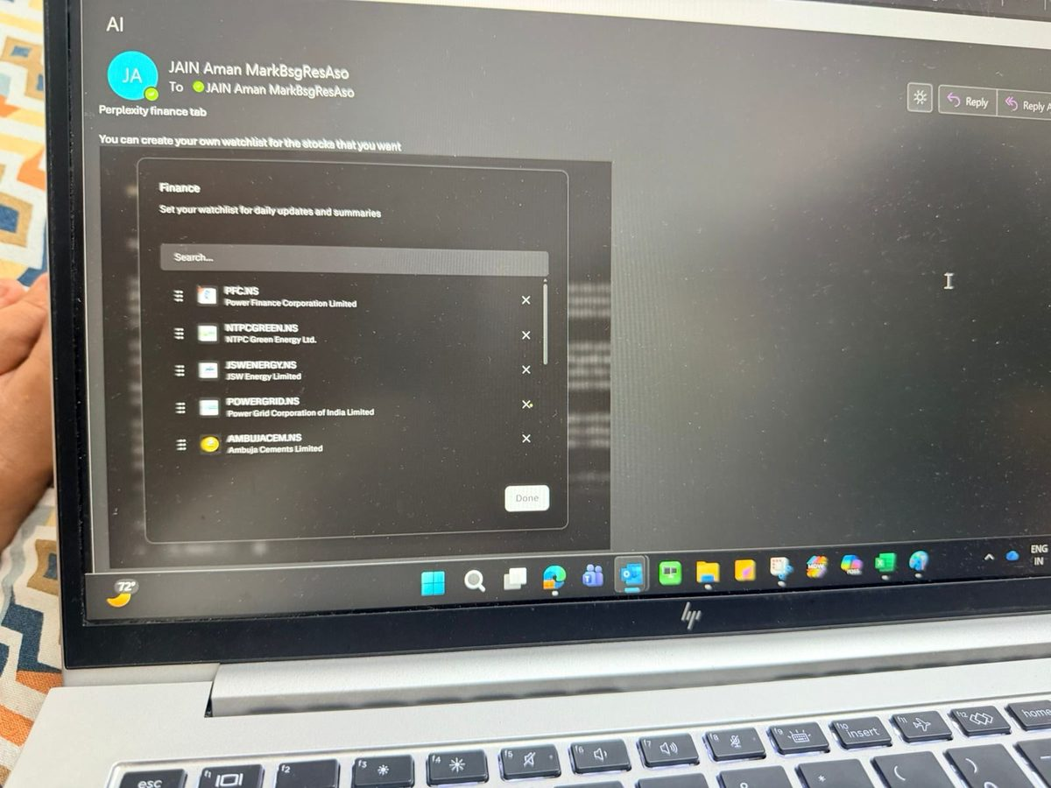
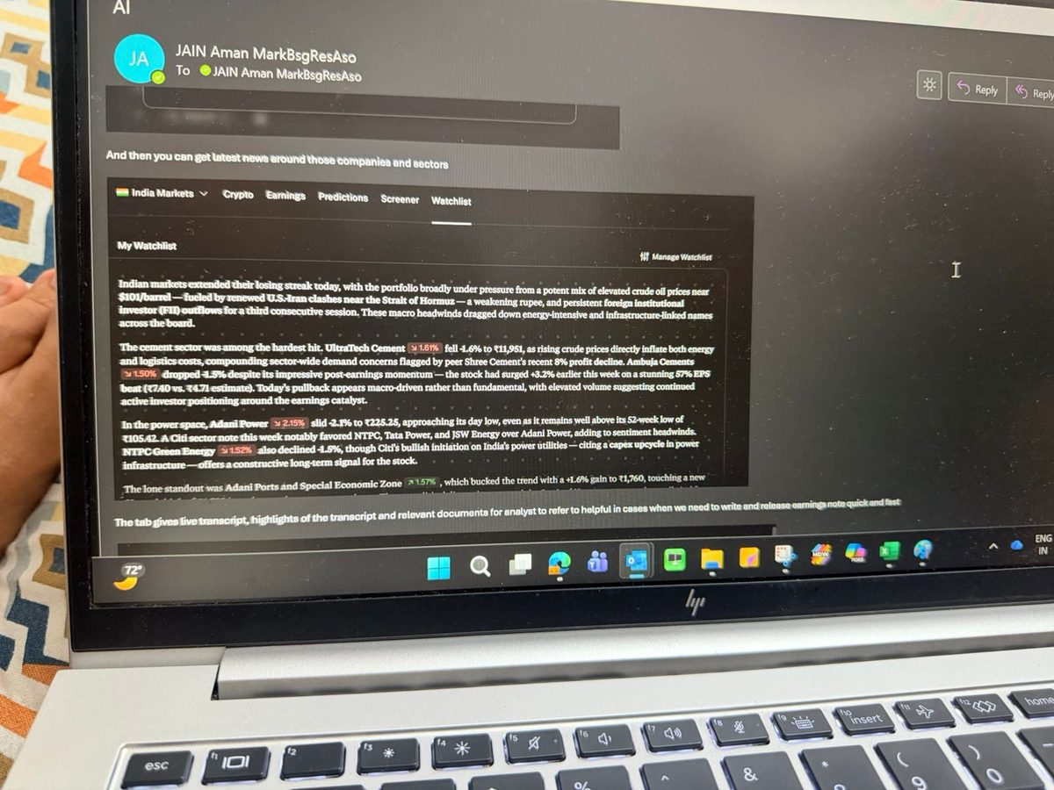
SETUP
PROMPTING
AUTOMATION
FINANCE
SPACES
LIMITS
START
FINANCE TAB
11 / 17
Daily market view + watchlist of covered names
WATCHLIST
DAILY COMMENTARY
WHAT WE'RE DOING
Add covered names to a Finance-tab watchlist. Get a daily market summary written for analyst-level context.
WHY IT MATTERS
Mainstream financial news is written for retail investors. My morning briefing needs to assume domain knowledge.
WHAT IT SOLVES
PFC, NTPC Green, JSW Energy, Power Grid, Ambuja — the names I care about.
Sector-level synthesis with peer moves, sell-side calls, and macro context.
The first 30 minutes of every day spent triaging which sector moves matter and why. The synthesis is done for me.
Perplexity Enterprise · Aman Jain · Internal

Slide 12
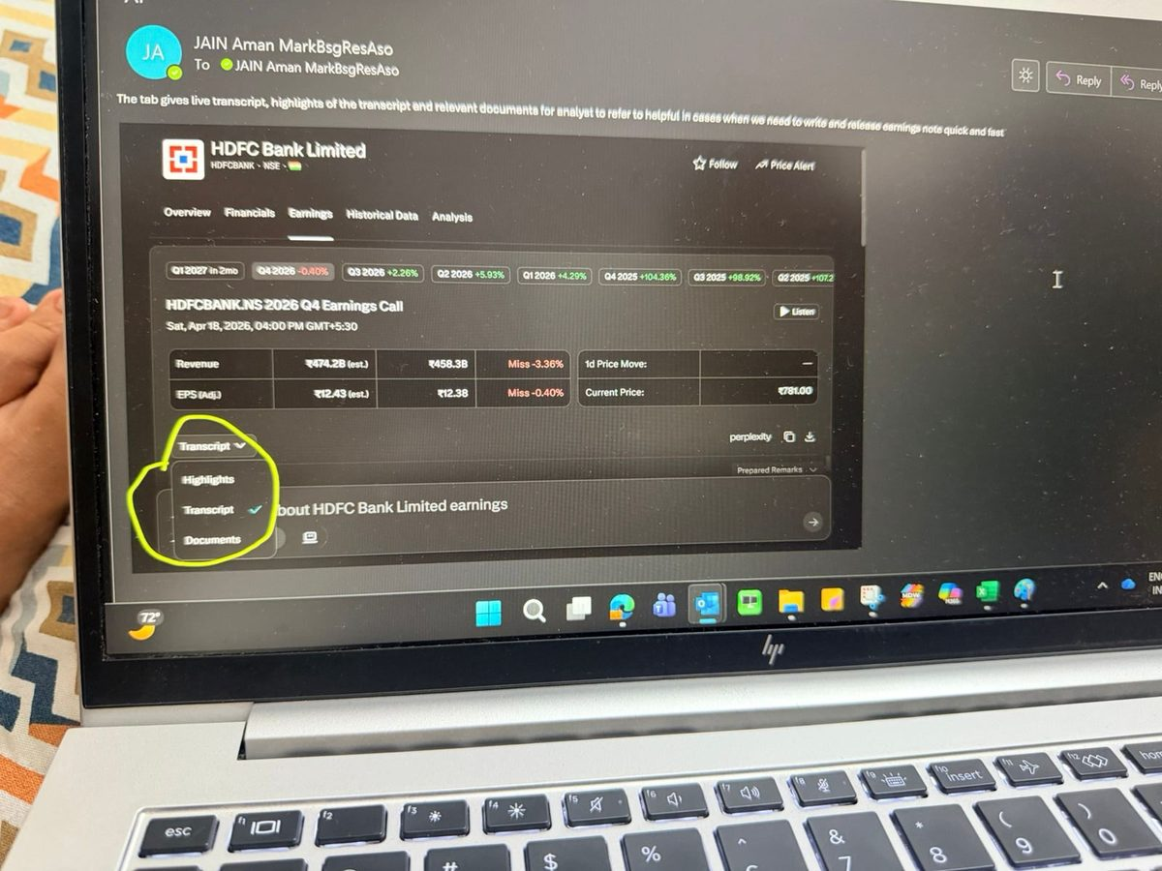
SETUP
PROMPTING
AUTOMATION
FINANCE
SPACES
LIMITS
START
FINANCE TAB
12 / 17
Earnings tab — three things in one place
EARNINGS TAB — HDFC BANK
OUTPUT — HIGHLIGHTS VIEW
WHAT WE'RE DOING
Live transcript, AI-summarized highlights, and source documents (filings, presentations, prepared remarks) for any covered name.
⎘
WHY IT MATTERS
Earnings days are a sprint — multiple calls back-to-back, every minute counts. Tab-switching is a tax.
Highlights view screenshot
To be added
WHAT IT SOLVES
Revenue / EPS estimates vs actual, with the three sub-tabs shown.
Click into Highlights for the AI-summarized commentary by theme.
Switching between Bloomberg, the IR webcast, the deck, and our note system mid-call. Everything stays in one view.
Perplexity Enterprise · Aman Jain · Internal

Slide 13
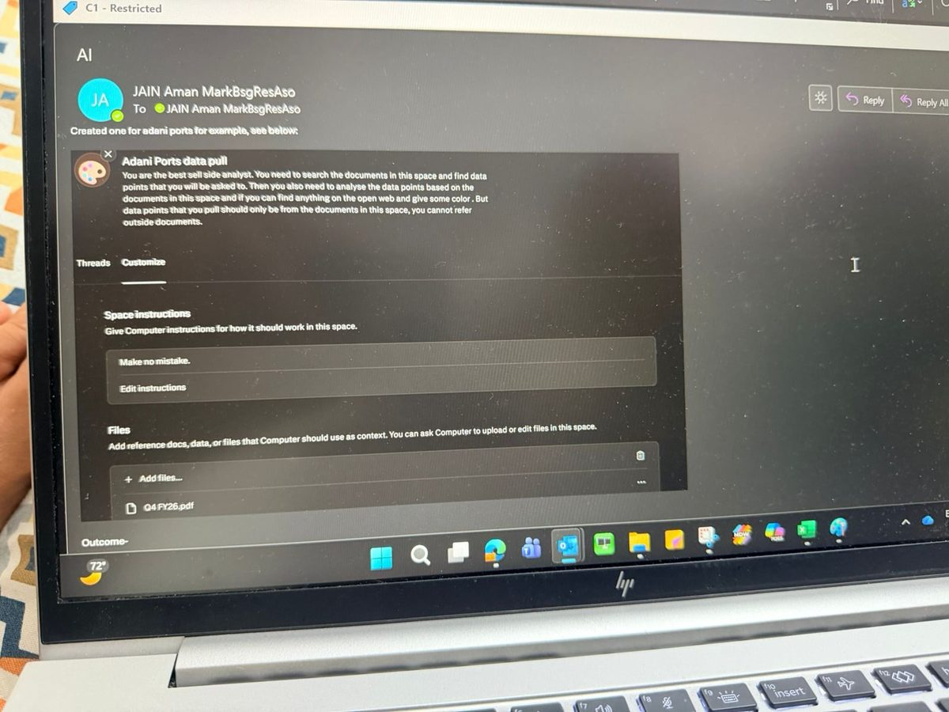
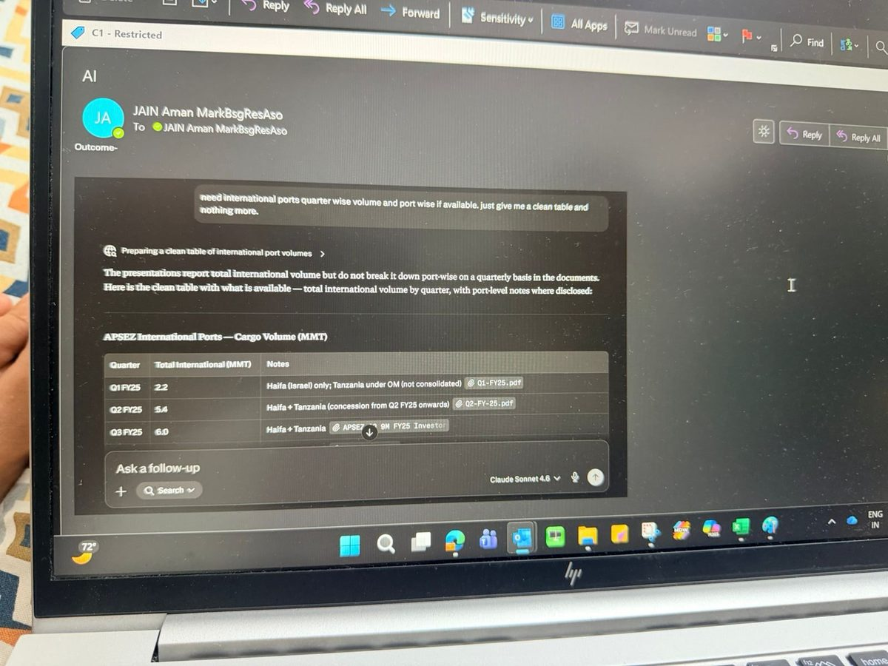
SETUP
PROMPTING
AUTOMATION
FINANCE
SPACES
LIMITS
START
SPACES
13 / 17
Spaces — purpose-built rooms for repeated data pulls
SETUP — ADANI PORTS
OUTPUT — A CLEAN TABLE
WHAT WE'RE DOING
Create a Space, upload relevant filings, give it custom instructions. Ask precise questions across them.
WHY IT MATTERS
The same data pulls (volumes, segment breakouts, capex) come up every quarter on the same names.
WHAT IT SOLVES
Custom instructions + uploaded filings define a guarded scope.
Quarter-wise international cargo volume, sourced from my uploaded filings.
Re-opening 5 PDFs and Ctrl-F'ing through them every time I need a number. Output cites only the docs I uploaded.
Perplexity Enterprise · Aman Jain · Internal

Slide 14
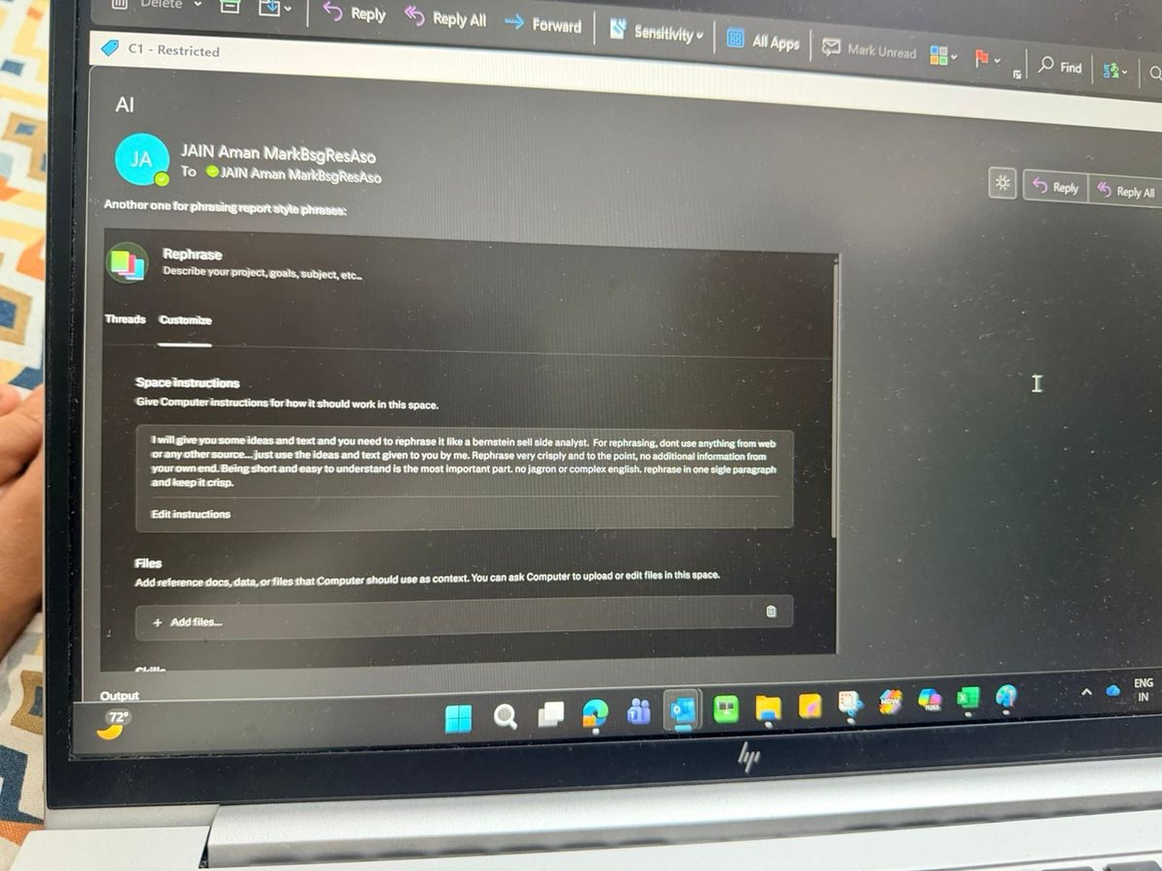
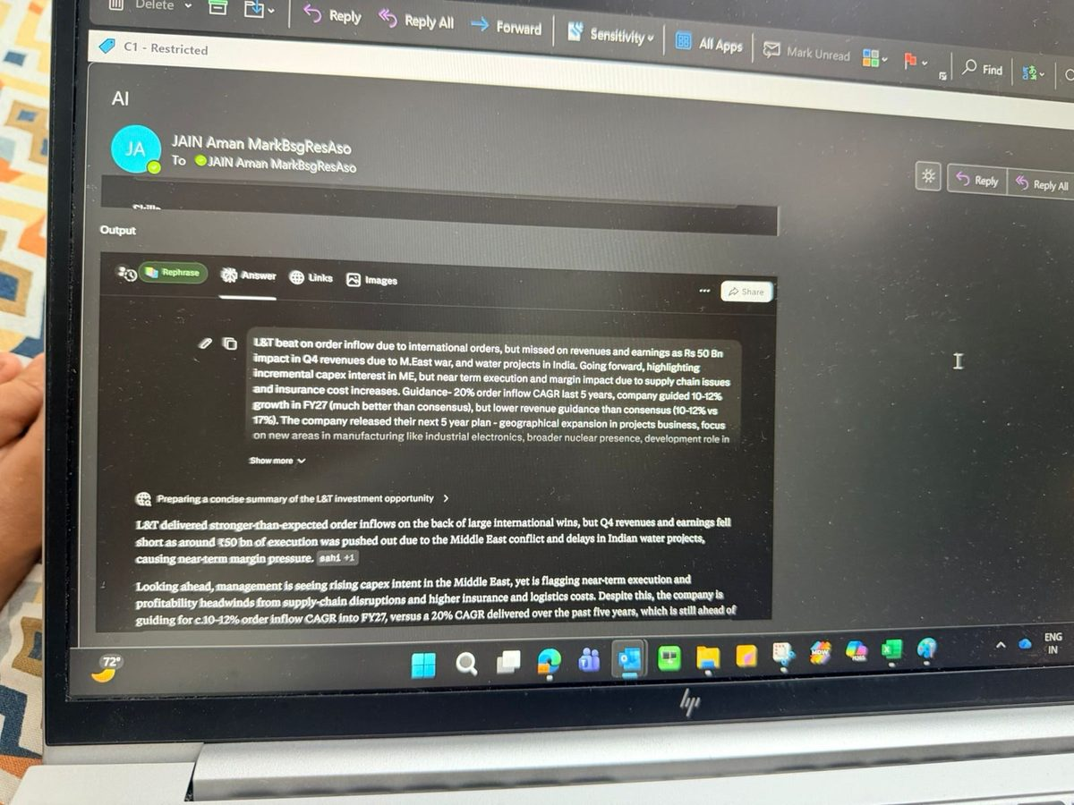
SETUP
PROMPTING
AUTOMATION
FINANCE
SPACES
LIMITS
START
SPACES
14 / 17
Spaces — capture our house voice for rephrasing
SETUP — REPHRASE SPACE
OUTPUT — POLISHED PARAGRAPH
WHAT WE'RE DOING
A Space configured with style instructions: rephrase anything I paste in to sound like a published Bernstein note.
WHY IT MATTERS
AI drafts are fast but generic. The tone shows up immediately in published research and undermines credibility.
WHAT IT SOLVES
Instructions: "Rephrase like a Bernstein sell-side analyst. No jargon. One paragraph. Crisp."
Raw bullets in. Result-note opening paragraph out. Reusable for every result.
Spending 10 minutes rewording every AI draft to make it sound like us. Now I get the speed without the AI tell.
Perplexity Enterprise · Aman Jain · Internal

Slide 15
SETUP
PROMPTING
AUTOMATION
FINANCE
SPACES
LIMITS
START
LIMITS
15 / 17
Where NOT to use Perplexity — hard rules
Four lines I don't cross. The presentation loses credibility if we pretend they don't exist.
✕
Quant data & financial statements
✕
Direct quotes in published notes
Numerical precision is unreliable. It will confidently misreport a margin or growth figure.
Quoted text occasionally drifts from the source. URLs occasionally hallucinate.
USE INSTEAD Bloomberg, AlphaSense Financials, the source filing.
USE INSTEAD Always open the cited URL and copy from there.
✕
Anything MNPI or potentially-MNPI
✕
Niche topics — small geos, micro-caps
No client names. No draft views. No positioning. No deal chatter.
Hallucination risk peaks where web coverage is thin.
USE INSTEAD If in doubt, don't prompt it. Ask Compliance.
USE INSTEAD Verify against a primary source before any external use.
Rule of thumb — if the answer ends up in a published note, the source must be opened and verified.
Perplexity Enterprise · Aman Jain · Internal

Slide 16
SETUP
PROMPTING
AUTOMATION
FINANCE
SPACES
LIMITS
START
LIMITS
16 / 17
Use with caution — second-order risks
Not bans. Just things that bite if you forget.
⚠
Citation drift
⚠
Numerical confidence ≠ correctness
The cited URL is sometimes only loosely related to the quoted line. Open every link you intend to use externally.
A clean-looking number with two decimals is still a guess if it wasn't sourced from a filing. Spot-check against Bloomberg.
⚠
Model mismatch
⚠
No firm-wide compliance policy yet
Wrong model for the task = poor output. Multi-doc synthesis on the default model is the most common failure mode.
We don't have explicit guardrails on prompts and uploads. Until we do, default to the hard rules on the previous slide.
→ Treat it as a research accelerator, not as a citation. Your name is on the note.
Perplexity Enterprise · Aman Jain · Internal

Slide 17
SETUP
PROMPTING
AUTOMATION
FINANCE
SPACES
LIMITS
START
WEEK ONE
Getting started
01
Set personalization defaults
Today. Five minutes. Saves a sentence in every prompt going forward.
02
Add covered names to your watchlist
All of them. Drives the daily market commentary and earnings feeds.
03
Build one scheduled search
Daily digest on your sectors. Set the time, set the prompt, walk away.
04
Run one PICOE prompt on a real task
A result note opening or a draft summary. Compare against what you would have written.
05
Spin up your first Space
Either a data-pull Space (filings + question), or a rephrase Space (paste 2–3 of your own paragraphs).
Questions, pushback, prompt swaps — let's start a thread.

