Slide 1










Plant Taxonomy Meets Plant Counting
A Fine-Grained, Taxonomic Dataset for Counting Hundreds of Plant Species
Huazhong University of Science and Technology, China
Jinyu Xu
Tianqi Hu
Xiaonan Hu
Letian Zhou
Songliang Cao
Meng Zhang
Hao Lu*

Slide 2
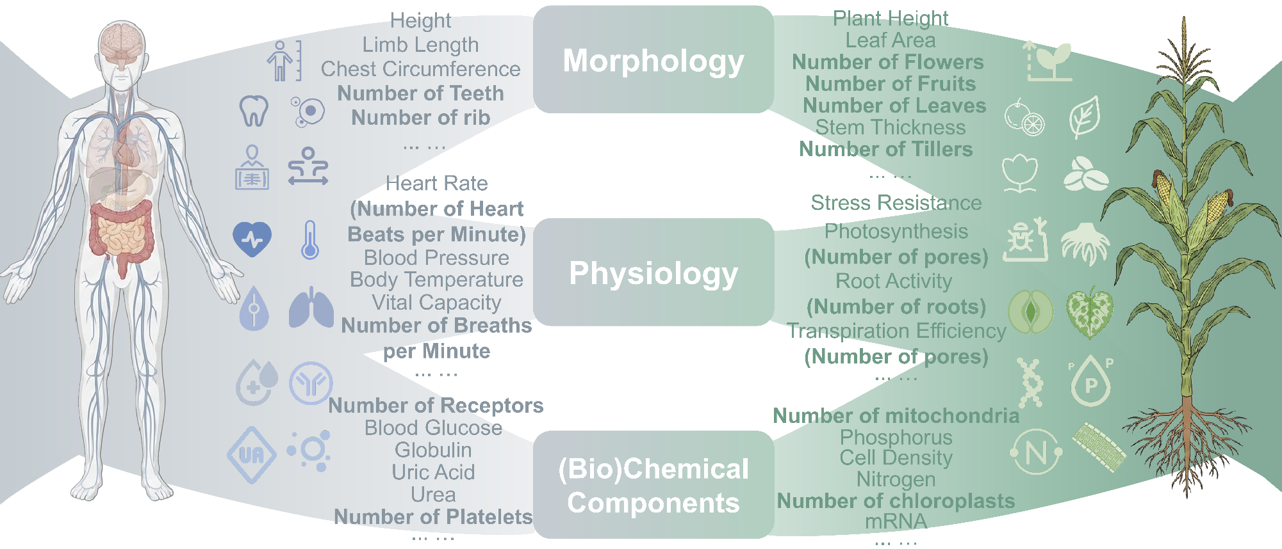
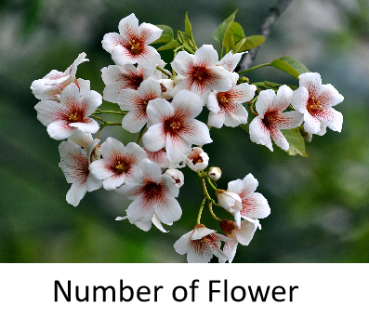
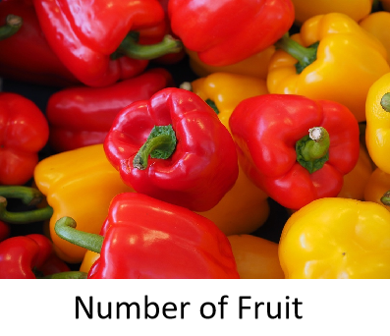
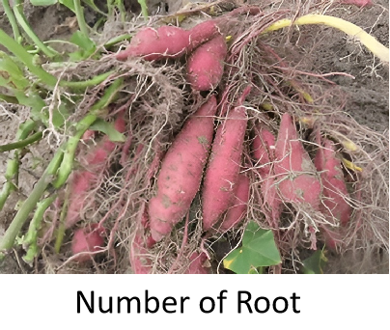
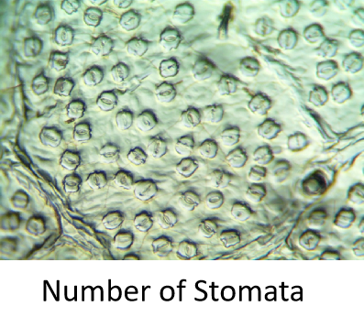
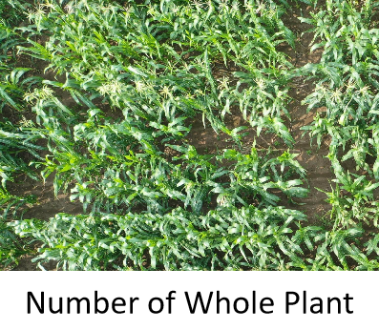
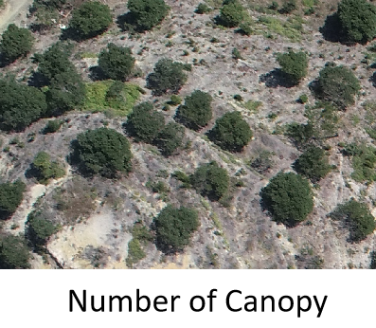
Plant Counting Is More Than “How Many”
Akin to human health checks, plant counts are important indicators quantifying plant morphology, physiology, and chemical components.

Slide 3
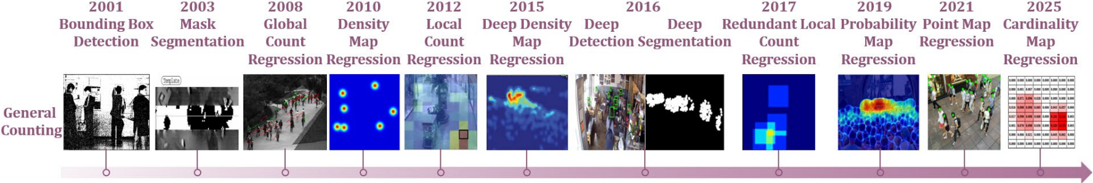


Visual Counting: A Long-Standing Vision Problem
Evolution of visual counting paradigms
Crowd and vehicle counting benchmarks are the main testbeds for visual counting.
Crowds
Vehicles
Since 2008, visual counting paradigms have rapidly evolved.
But “ what we count ” has changed much less, mostly centered on crowds.

Slide 4
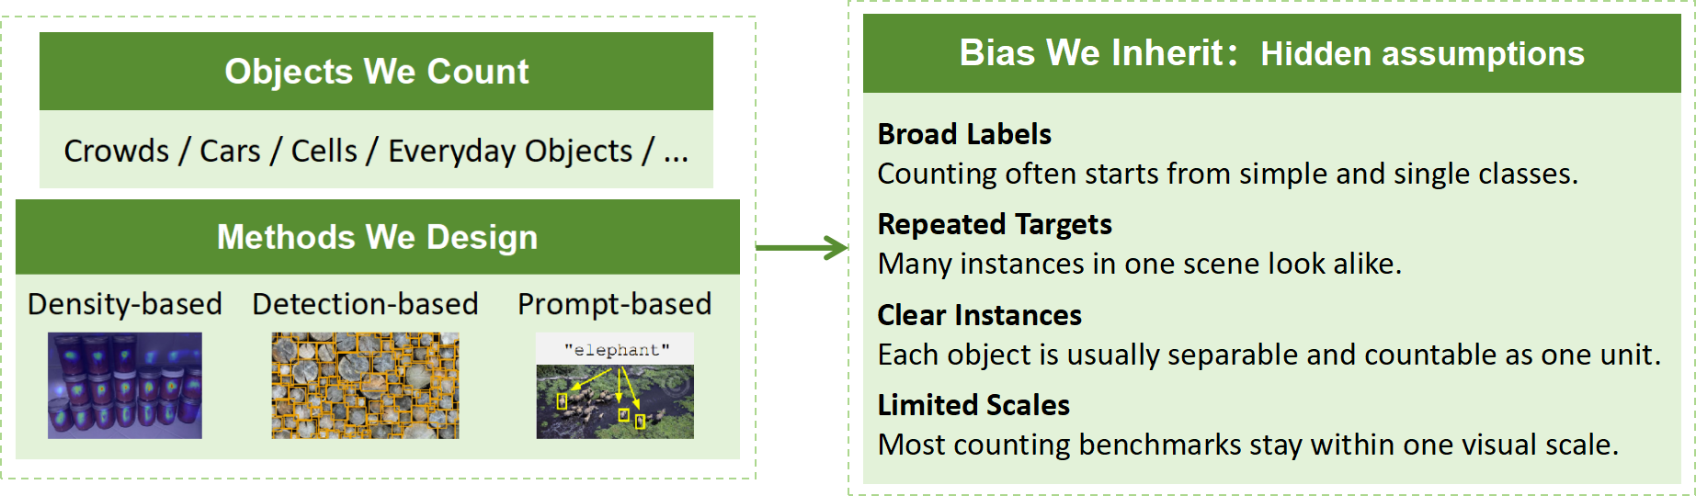
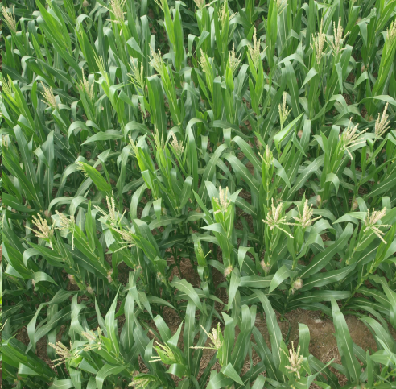
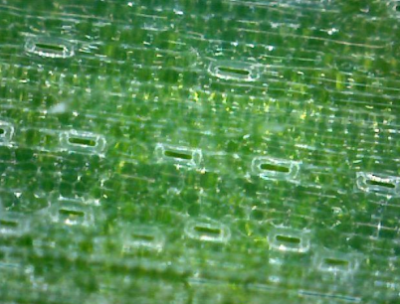


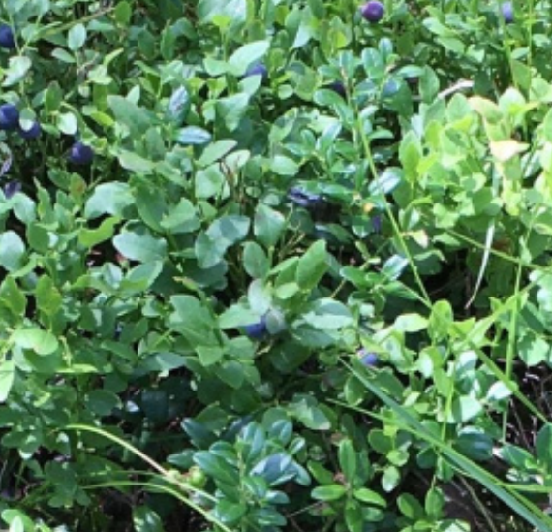
What We Count Shapes How We Count
What happens when the objects become “ plants” ?

Slide 5


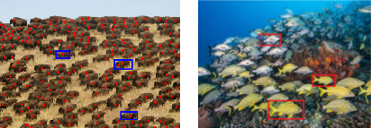
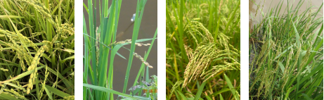
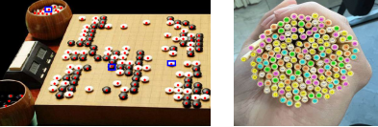
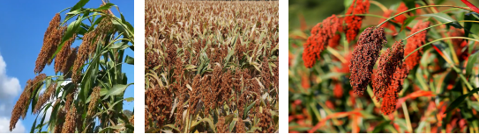

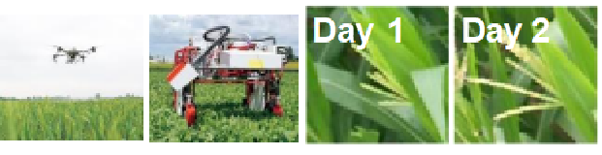
Plant Counting vs. Conventional Counting
Biodiversity vs Homogeneity
Fine Granularity vs Coarse Category
Nonrigid Structure vs Rigid Shape
Spatiotemporal Variability
Physical Stability
vs

Slide 6
From Crowd Counting to Plant Counting
Visual Counting
Dense instances
Occlusion
Scale variations
Plant
Counting
Natural World
Biodiversity
Uncontrolled scenes
Long-tailed distribution
Plant Biology
Organs & tissues
Growth stages
Biological hierarchy
Plant counting invites visual counting into the natural world,
combining biodiversity, biological structure, and multi-scale observation.

Slide 7


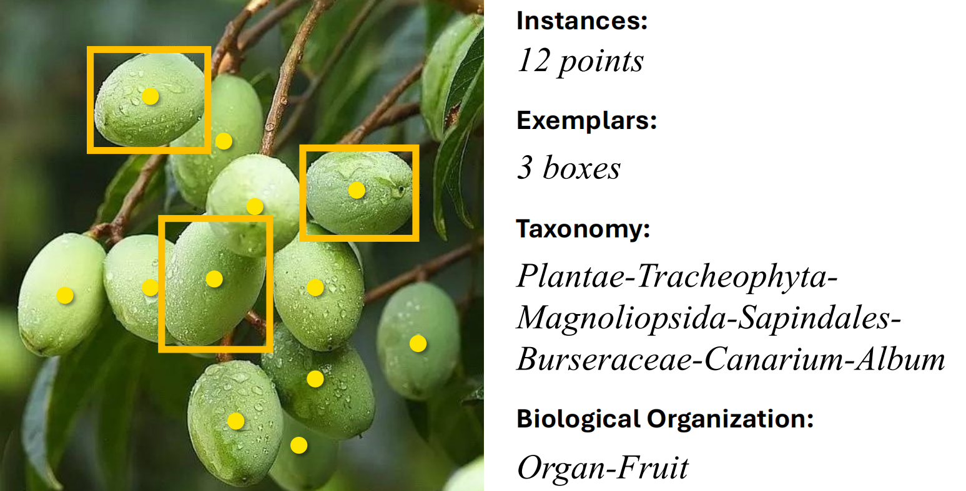
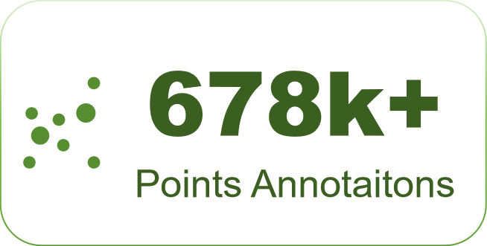

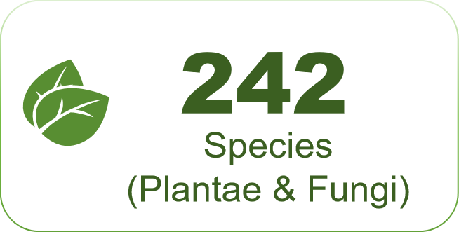

TPC–268: A Taxonomic Benchmark for Plant Counting
One image annotation contains points, boxes,
taxonomy, and biological organization.
TPC–268 combines large-scale plant diversity with rich biological annotations.

Slide 8
TPC-268 Spans Five Hierarchical Levels
Different Scenes
Varied Observation Scales
Visible-Light Modality
Changed Instance Granularity
Different levels introduce distinct visual challenges for plant counting.

Slide 9
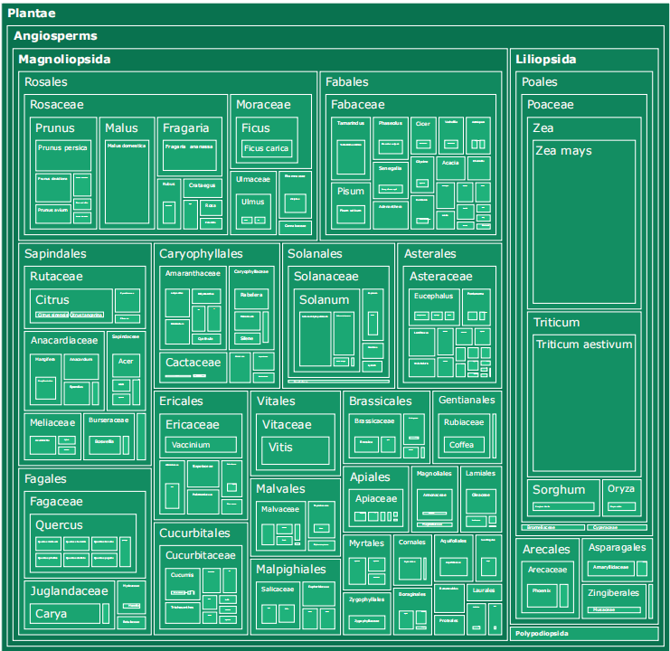
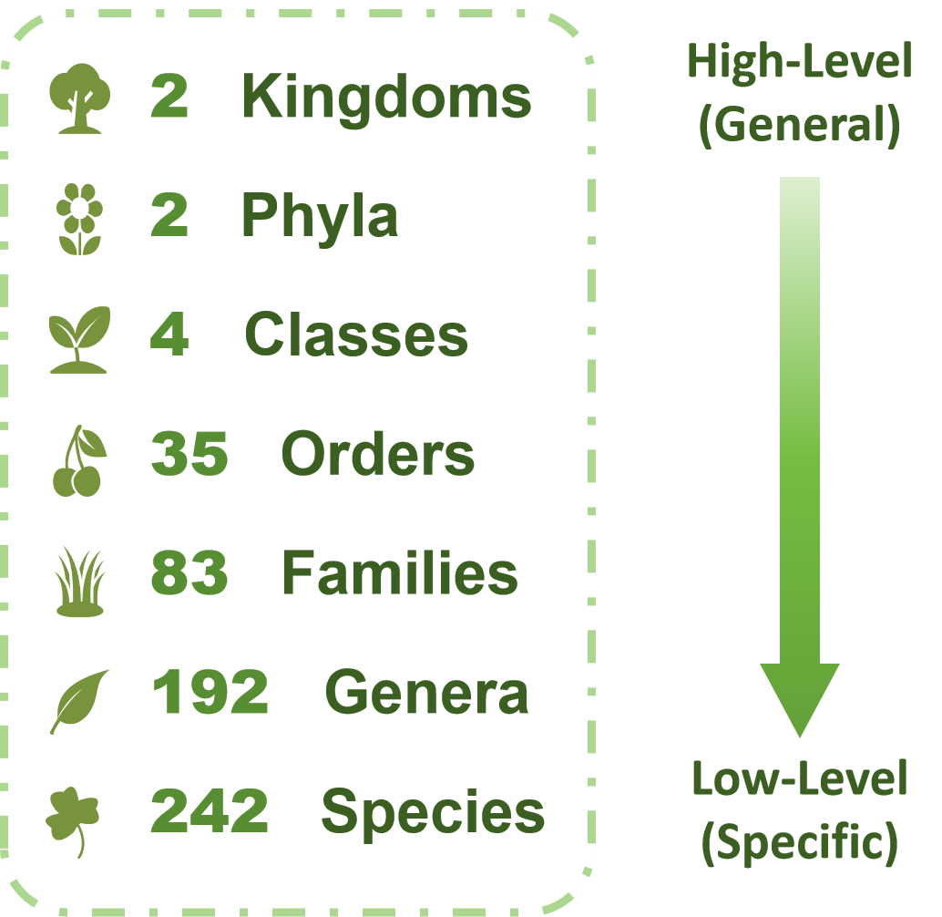
A Taxonomic Map of Plant Diversity
TPC–268 organizes fine-grained plant diversity into a biological hierarchy, enabling taxonomy-aware counting and cross-species generalization.

Slide 10
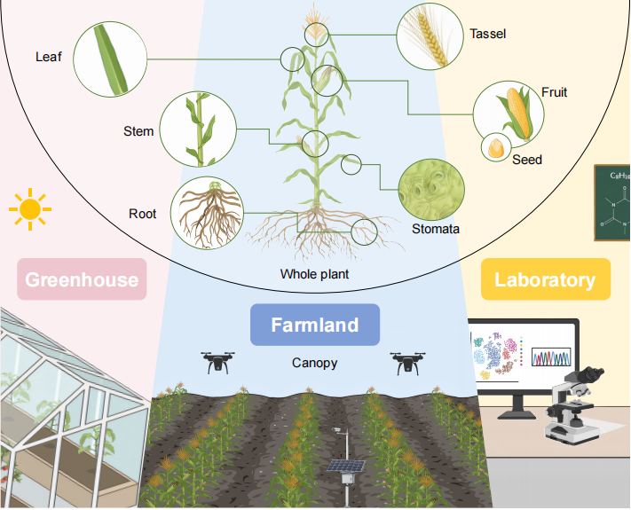
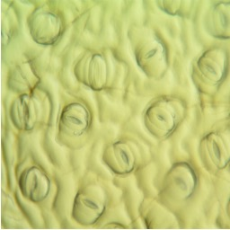
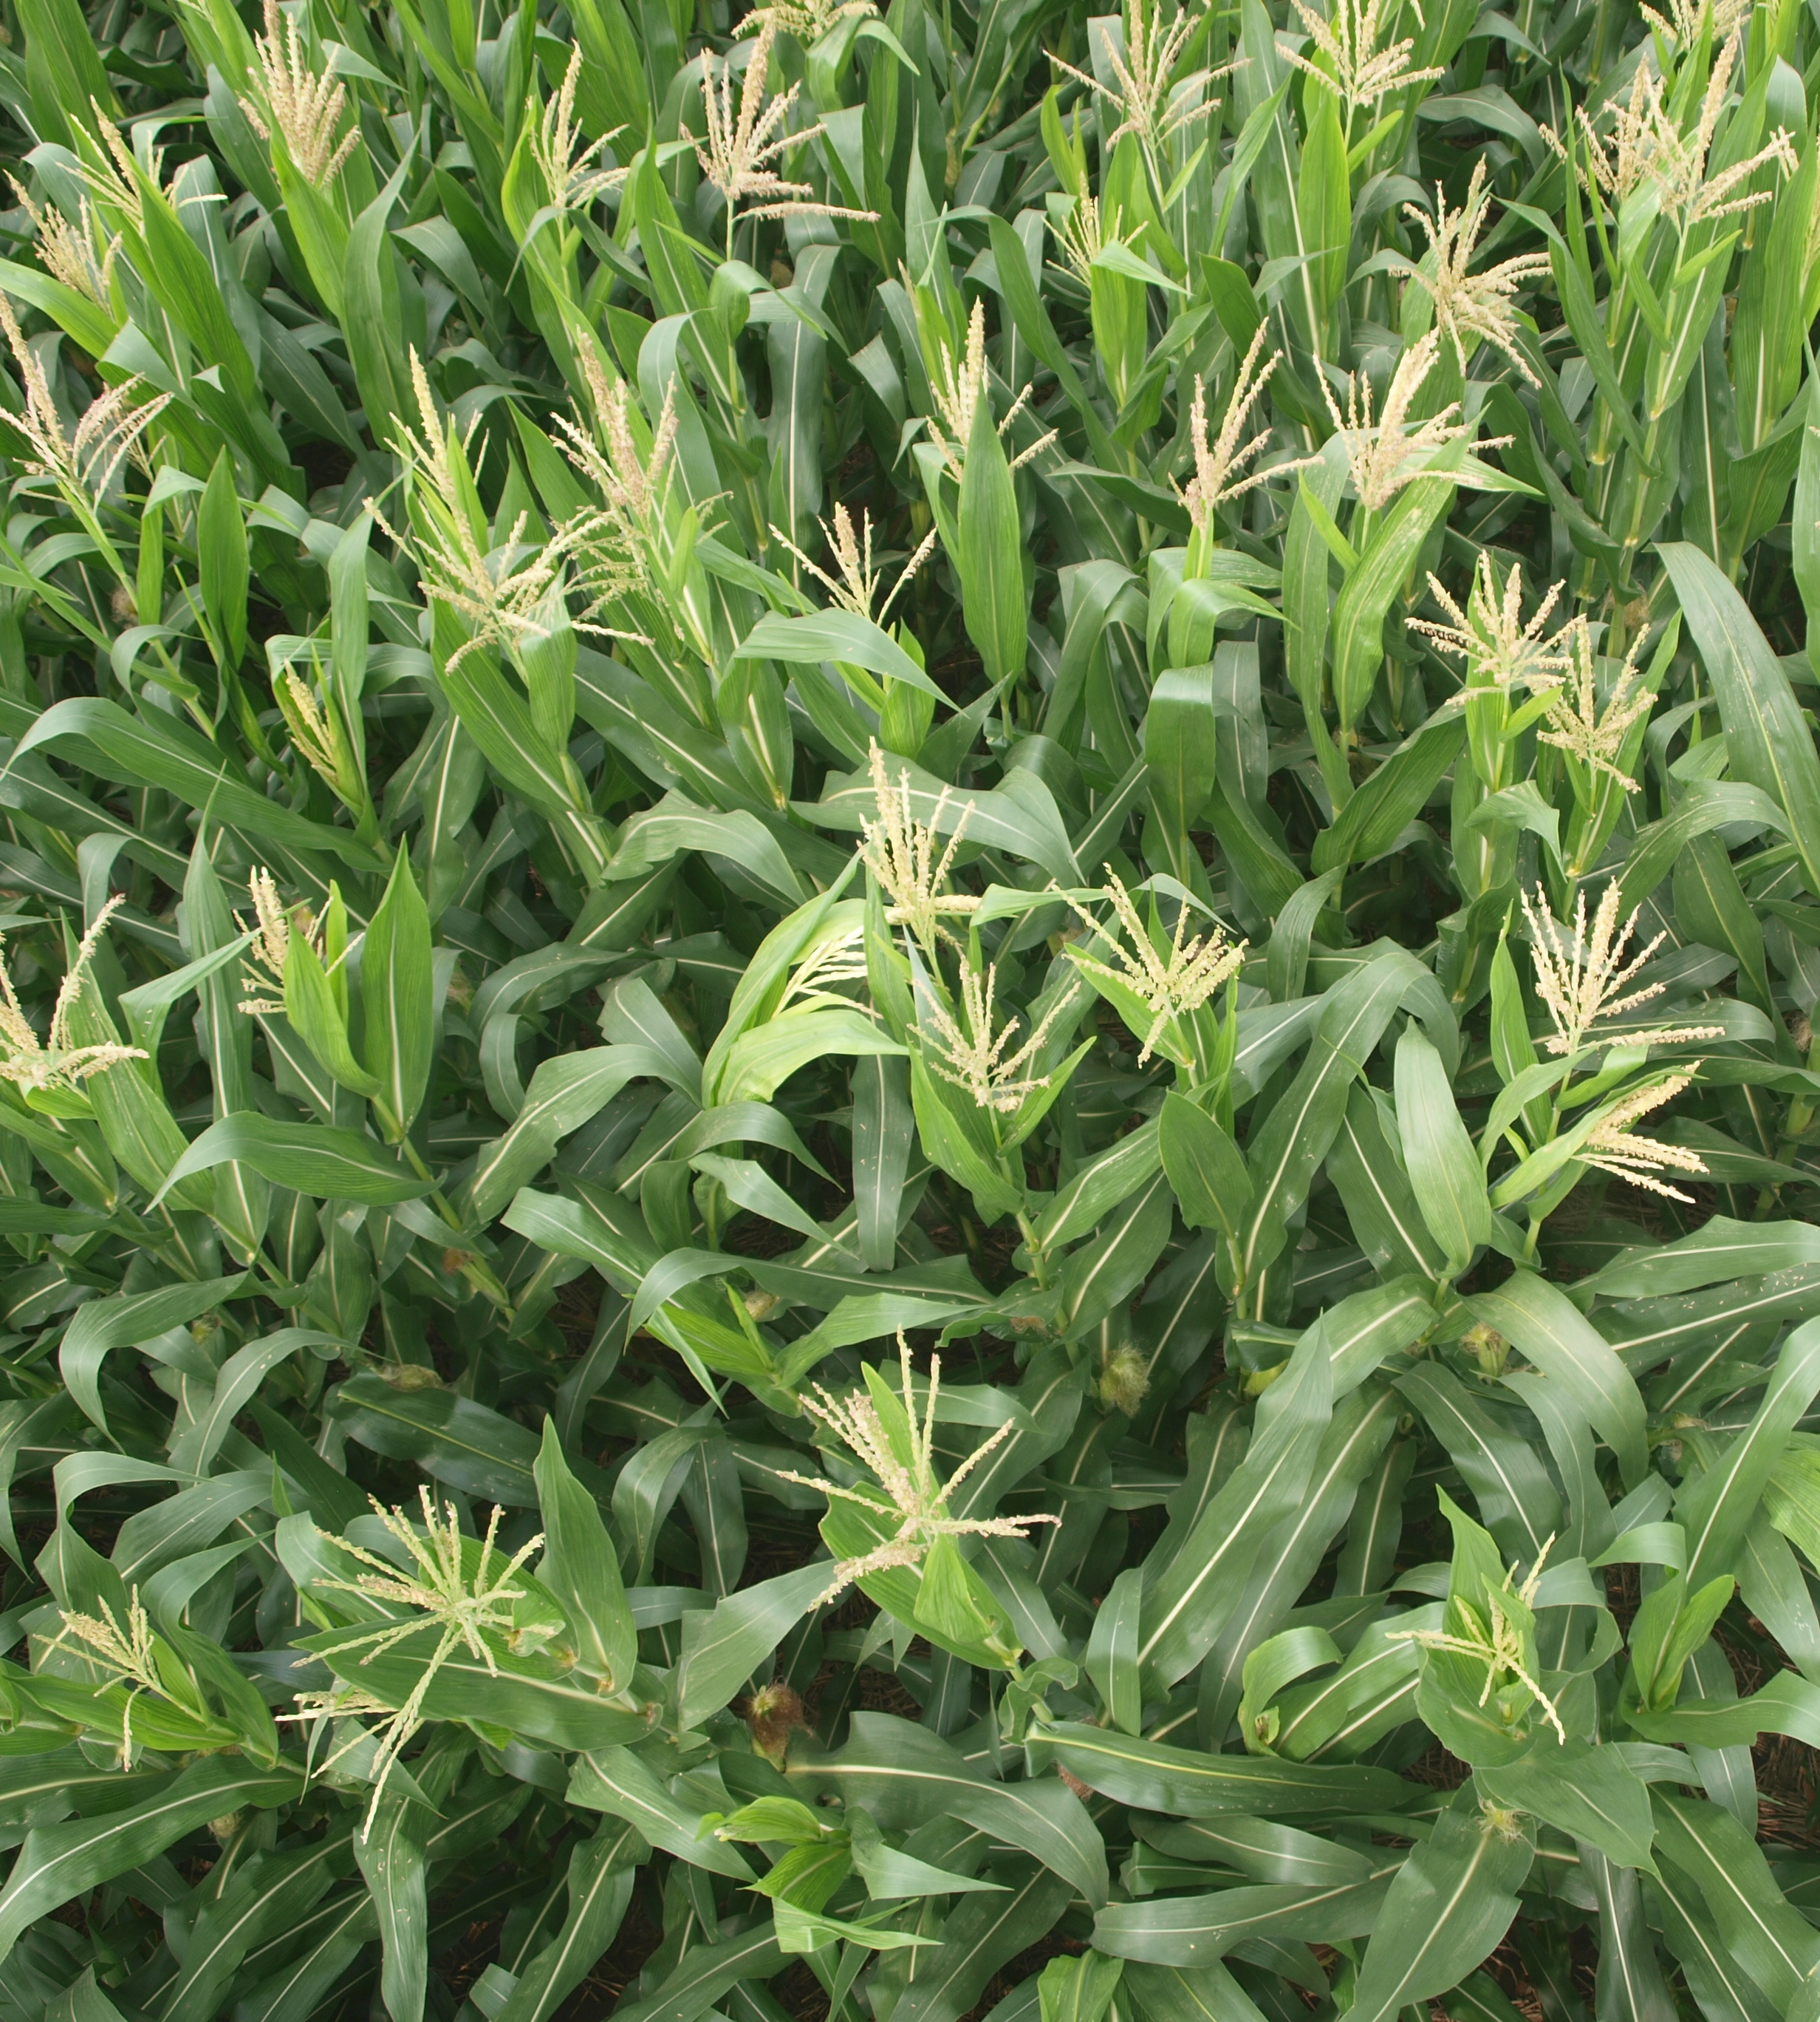
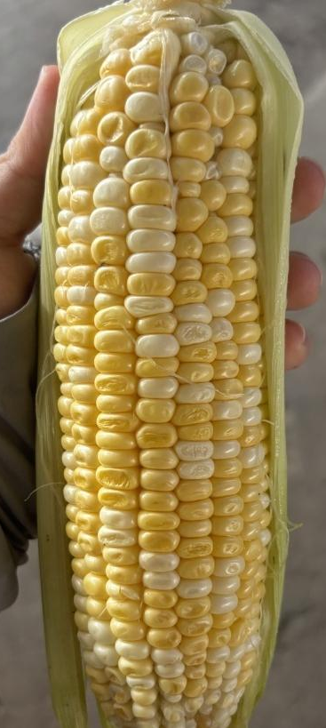
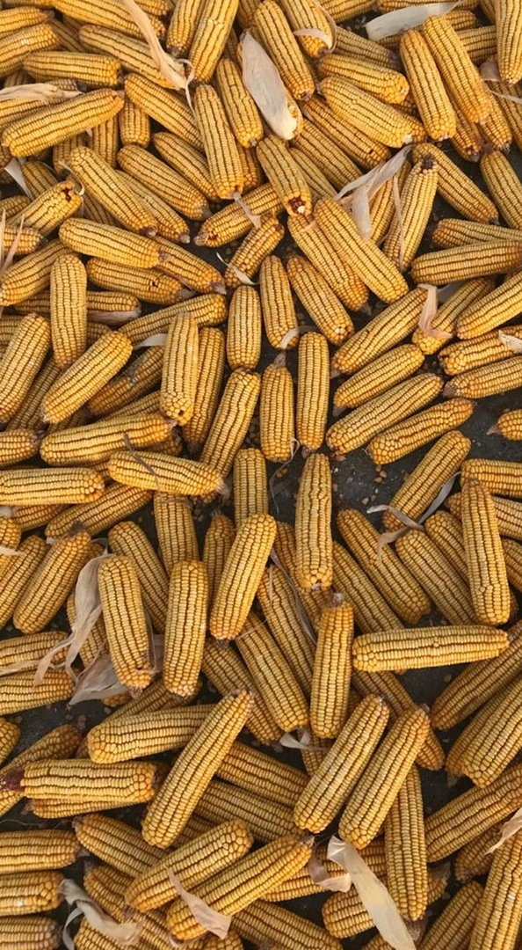
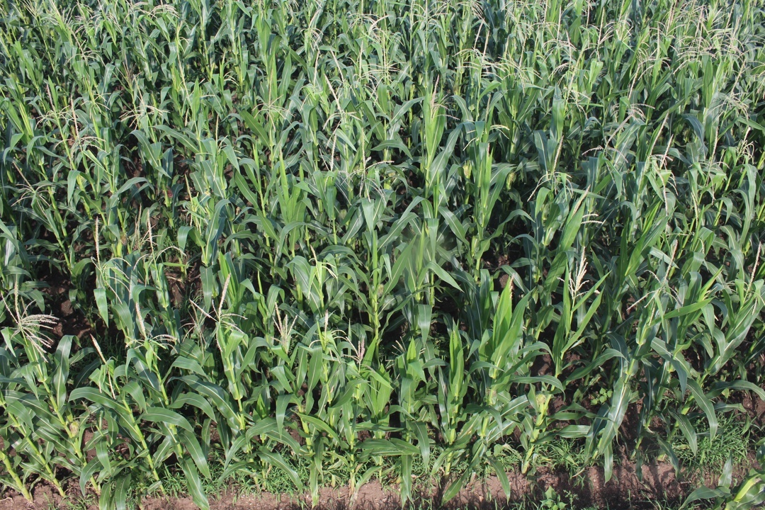

Counting Across Biology and Scale
Category = Species × Biological Organization Example species: Maize (Zea mays)
The same species can look different fundamentally across organizations and scales.
Biological Organization axis
Tissue
Organ
Organism
Population
Stomata
Flower
Seed
Fruit
Whole Plant
Canopy
Microscope
Close-range Camera
Field Camera
Aerial View
Observation Scale axis
What to Count: Biologically-Grounded Plants How to Observe: Micro-to-Macro Imaging

Slide 11
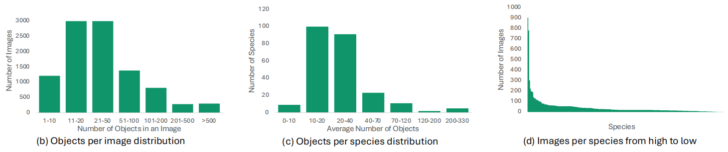
Real-World Plants Are Long-Tailed and Uneven
72.1% images contain <50 instances
but 3.0% exceed 500 instances
5–1,462 instances per image
from sparse samples to extremely dense scenes
53.5% species have <20 images
8.3% have ≤5 images
Top-10 Species cover 32.0% of images
long-tail persists across taxonomic ranks
The benchmark captures both density variation and long-tailed biodiversity.

Slide 12
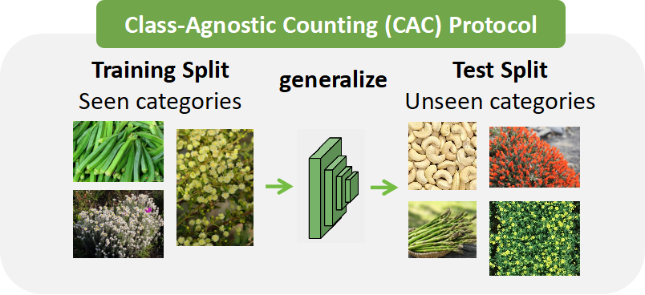
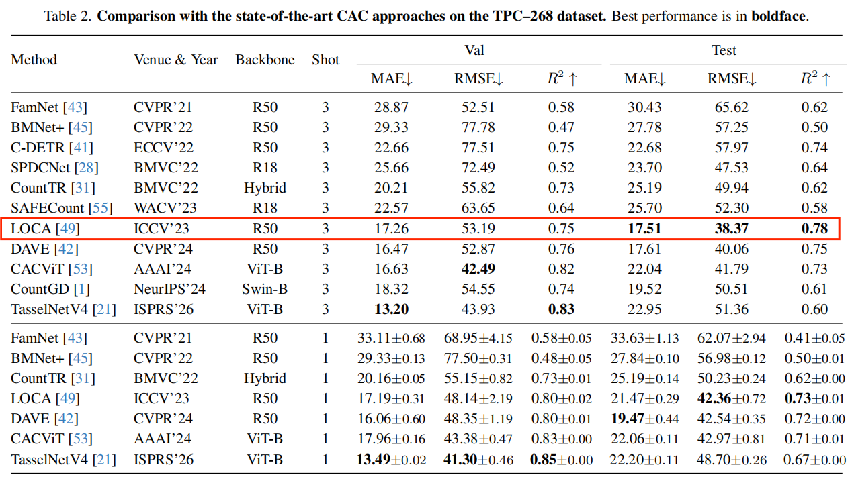
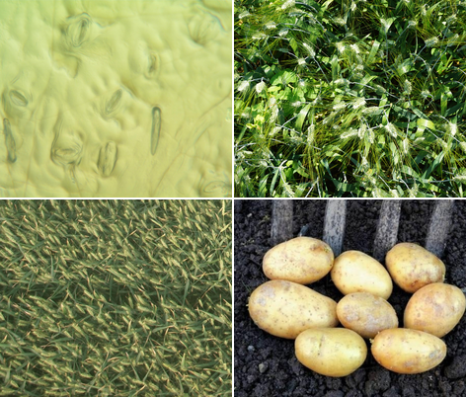
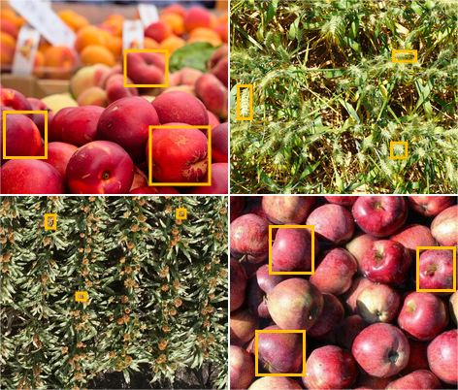
Current Models Are Not Ready for Plant Counting
Plant diversity motivates the CAC setting.
Train/test categories are strictly disjoint.
Test targets are specified by exemplar boxes.
Best 3-shot result：LOCA 17.51 MAE / 38.37 RMSE
Even the best counting model leaves clear counting errors.

Slide 13
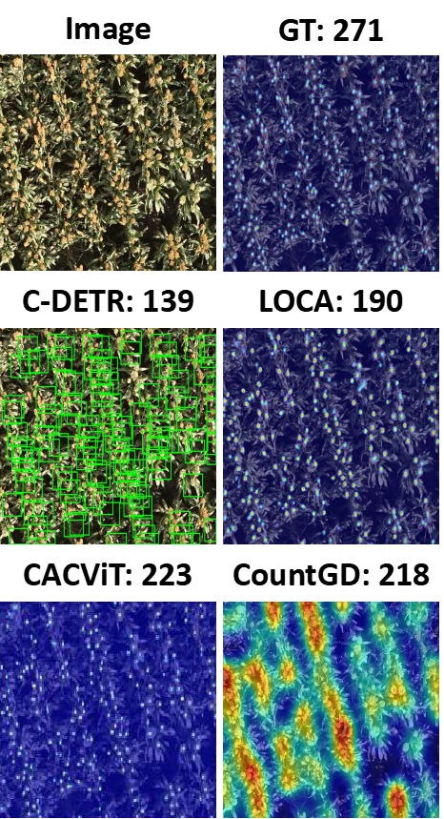
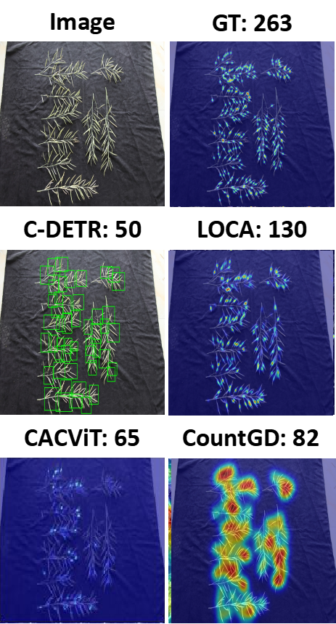
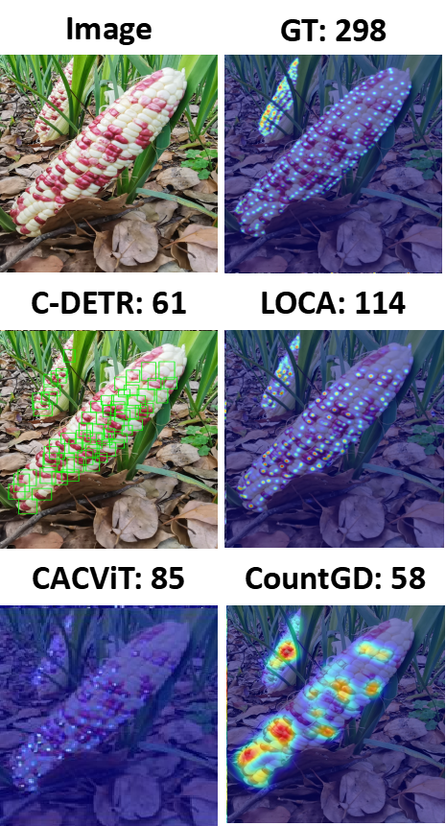
Seeing Why Models Struggle with Plants
Small-Scale Instances
Morphological Variations
Object Adhesion

Slide 14
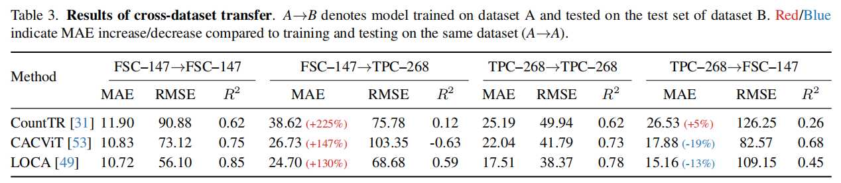

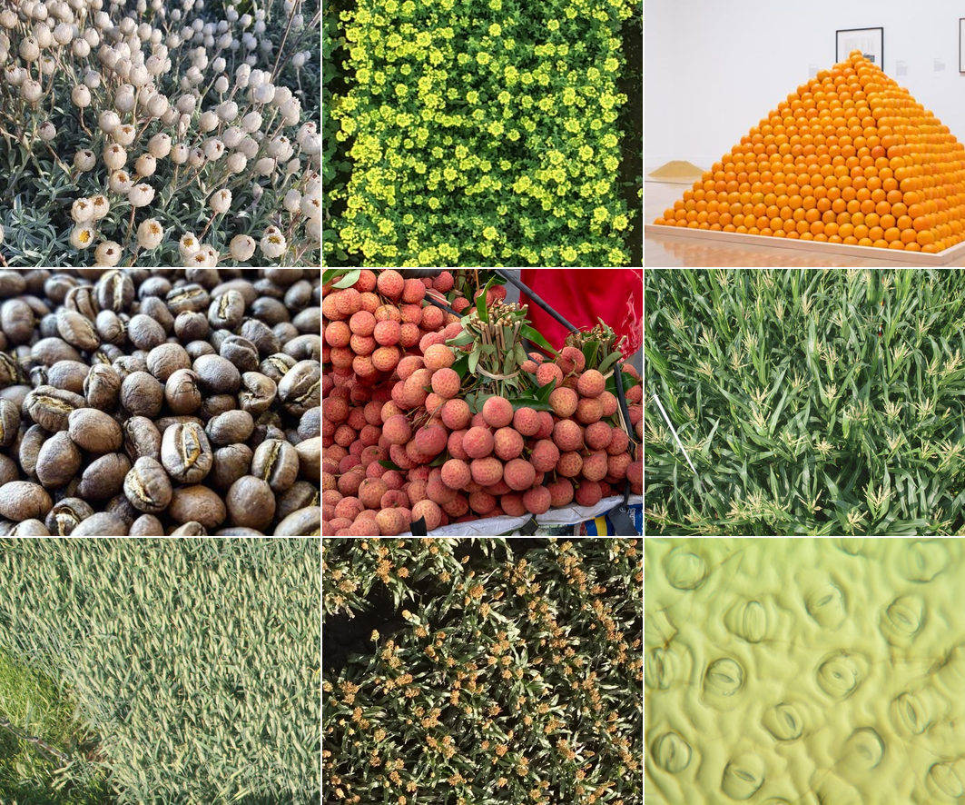
Plant Counting Challenges Generic Counting
Cross-Dataset Transfer
FSC-147
TPC-268
Models trained on FSC-147 show severe degradation on TPC-268, but not vice versa.

Slide 15
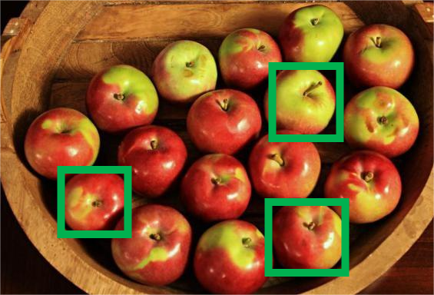
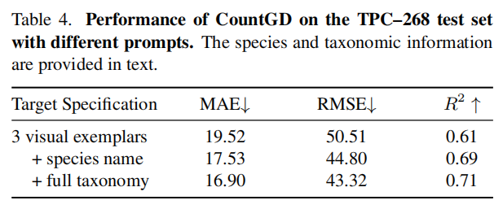
Taxonomy Helps, Biology Understanding Is Needed
Visual: 3 exemplar boxes
Text: None
MAE: 19.52
Visual: 3 exemplar boxes
Text (species): Malus domestica
MAE: 17.53 (-10.19%)
Taxonomy improves performance,
even when used only as text prompts.
Visual: 3 exemplar boxes
Text (full taxonomy):
Plantae, Tracheophyta, Magnoliopsida,
Rosales, Rosaceae, Malus domestica
MAE: 16.90 (-13.42%)

Slide 16

Taxonomy Helps, Biology Understanding Is Needed
Visual: 3 exemplar boxes
Text: None
MAE: 19.52
Visual: 3 exemplar boxes
Text (species): Malus domestica
MAE: 17.53 (-10.19%)
Taxonomy improves performance,
even when used only as text prompts.
Visual: 3 exemplar boxes
Text (full taxonomy):
Plantae, Tracheophyta, Magnoliopsida,
Rosales, Rosaceae, Malus domestica
MAE: 16.90 (-13.42%)
How can we better use taxonomic
hierarchy for plant counting?

Slide 17






Bridging Computer Vision and Plant Biology
TPC-268
Counting × Taxonomy
Hierarchical labels
Species-aware evaluation
Taxonomic generalization
Computer Vision
Dense Prediction
Open-World Recognition
Generalizable Counting
Exemplar Learning
Few-Shot Learning
Fine-Grained Recognition
Cross-Domain Generalization
Scale Representation
Plant Biology
Species Hierarchy
Genus Relations
Organ Hierarchy
Tissue Levels
Plant Diversity
Phenotypic Variation
Growth Variation
Morphological Traits
Vision × Biology
Biological organization
Fine-Grained structures
Morphological diversity
Scale × Diversity
Micro-to-UAV views
Long-tailed species
Natural-scene variation
TPC–268 brings plant counting to a shared problem for vision and taxonomy.

Slide 18
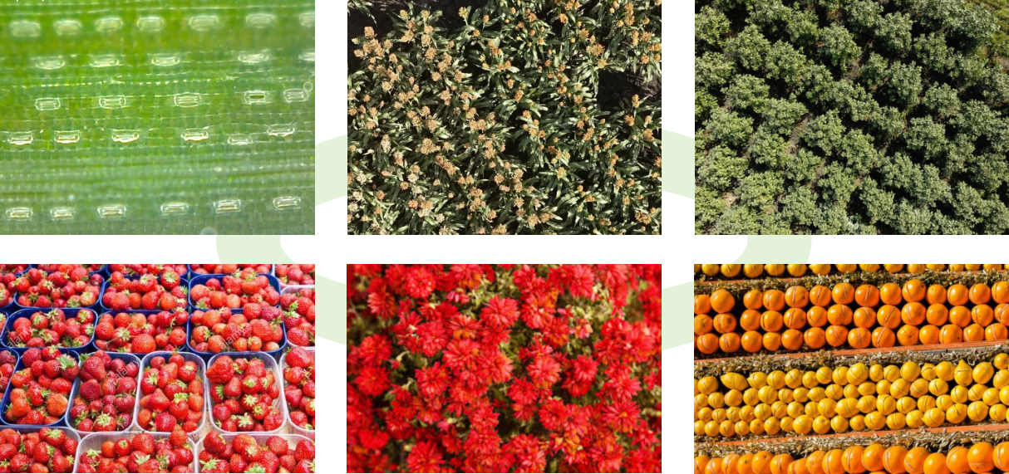
From Counting Numbers to Understanding Nature
Beyond “how many”: what to count, where it sits in hierarchy, and at which biological level.
Cross-Scale Understanding
Micro-to-macro
observation generalization
Cross-Level Targets
Counting across
biological organizations
Taxonomic Hierarchy
Learning structured
biological taxonomy
Biological Relatedness
Generalizing across
related species
The next generation of plant counting models should reason over biological structure.

Slide 19
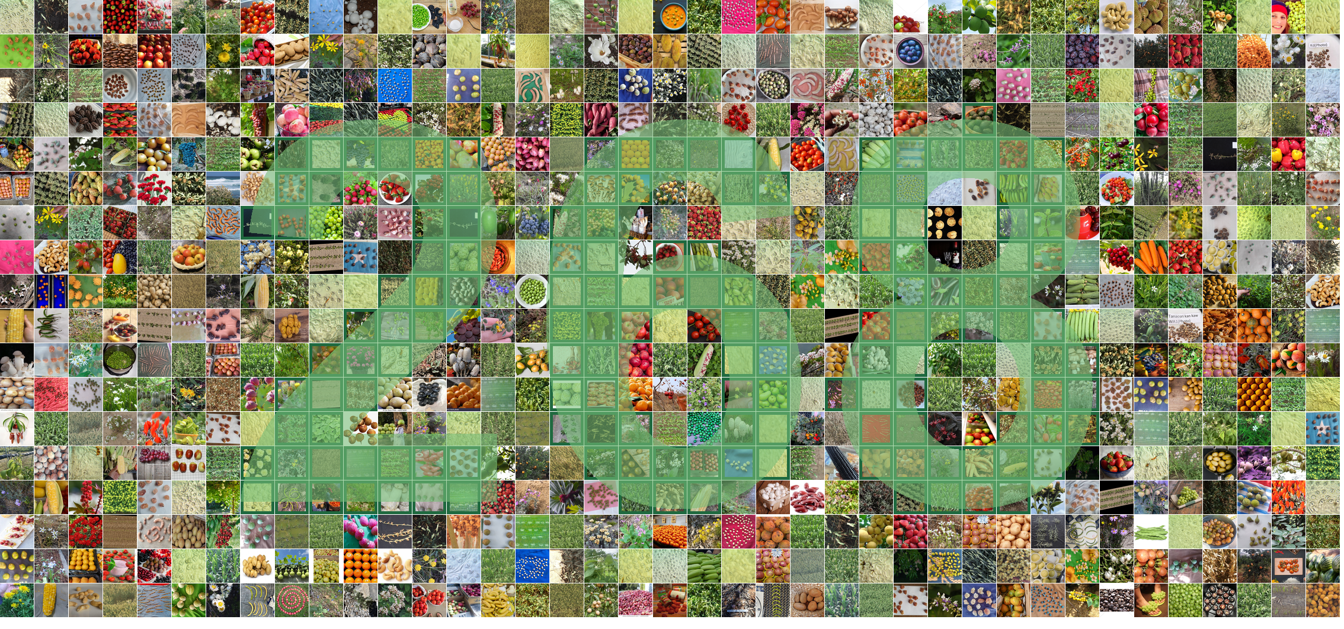

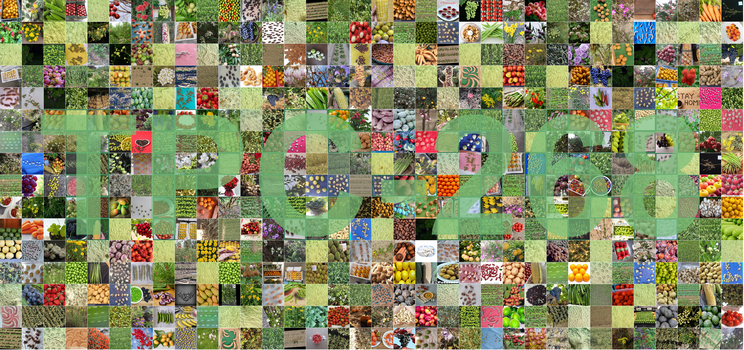
THANK YOU Q&A

