Slide 1
Bachelor Thesis Defence
Investigating the Optimal Geometry of a
Vanadium Calibration Sample for Neutron
Scattering
Christian Kaas Thyssen
Niels Bohr institute
Niels Bohr Building, 1.3.B.015,
30. June 2026

Slide 2
Why vanadium and why geometry matters
Bachelor Thesis Defense
Independent Monte Carlo Code, McMini
Validate McStas / Union Framework
Use McStas to study hollow cylinder sample geometry
Investigating the Optimal Geometry of a
Vanadium Calibration Sample for Neutron
Scattering
Christian Kaas Thyssen
Niels Bohr institute
Niels Bohr Building, 1.3.B.015,
30. June 2026
Intro
Theory
McMini
Validation
Conclusion
Thin-limit
CAMEA
Optimize
Notes:
• Vanadium is used for calibration because incoherent scattering dominates.
• Ideally, it gives an approximately isotropic signal.
• But real samples are not ideal: absorption, attenuation, multiple scattering and geometry change the angular distribution.
• For detector calibration, this matters because detector efficiency corrections assume a reliable scattering pattern
Q: “What is the neutron magnetic moment?”
A: The neutron is electrically neutral, but it has a magnetic dipole moment because it is made of charged quarks. Its magnetic moment is approximately $−1.913$nuclear magnetons. The negative sign means that the magnetic moment is antiparallel to the neutron spin. This allows neutrons to interact with magnetic fields and magnetic moments in materials, which is why neutron scattering can probe magnetic structures. In my project, however, I focus on nuclear scattering and absorption in vanadium, so magnetic scattering is not included

Slide 3
Why vanadium and why geometry matters
Vanadium
Expected isotropic scattered signal
Intro
Theory
McMini
Validation
Conclusion
Thin-limit
CAMEA
Optimize
Notes:
• Vanadium is used for calibration because incoherent scattering dominates.
• Ideally, it gives an approximately isotropic signal.
• But real samples are not ideal: absorption, attenuation, multiple scattering and geometry change the angular distribution.
• For detector calibration, this matters because detector efficiency corrections assume a reliable scattering pattern
Q: “What is the neutron magnetic moment?”
A: The neutron is electrically neutral, but it has a magnetic dipole moment because it is made of charged quarks. Its magnetic moment is approximately $−1.913$nuclear magnetons. The negative sign means that the magnetic moment is antiparallel to the neutron spin. This allows neutrons to interact with magnetic fields and magnetic moments in materials, which is why neutron scattering can probe magnetic structures. In my project, however, I focus on nuclear scattering and absorption in vanadium, so magnetic scattering is not included

Slide 4
Why vanadium and why geometry matters
Vanadium
Geometry
Gives rise to angular distortion
Expected isotropic scattered signal
Intro
Theory
McMini
Validation
Conclusion
Thin-limit
CAMEA
Optimize
Notes:
• Vanadium is used for calibration because incoherent scattering dominates.
• Ideally, it gives an approximately isotropic signal.
• But real samples are not ideal: absorption, attenuation, multiple scattering and geometry change the angular distribution.
• For detector calibration, this matters because detector efficiency corrections assume a reliable scattering pattern
Q: “What is the neutron magnetic moment?”
A: The neutron is electrically neutral, but it has a magnetic dipole moment because it is made of charged quarks. Its magnetic moment is approximately $−1.913$nuclear magnetons. The negative sign means that the magnetic moment is antiparallel to the neutron spin. This allows neutrons to interact with magnetic fields and magnetic moments in materials, which is why neutron scattering can probe magnetic structures. In my project, however, I focus on nuclear scattering and absorption in vanadium, so magnetic scattering is not included

Slide 5
Why vanadium and why geometry matters
Vanadium
Geometry
Calibration
Biased calibration if pattern is wrong
Gives rise to angular distortion
Expected isotropic signal
Intro
Theory
McMini
Validation
Conclusion
Thin-limit
CAMEA
Optimize
Notes:
• Vanadium is used for calibration because incoherent scattering dominates.
• Ideally, it gives an approximately isotropic signal.
• But real samples are not ideal: absorption, attenuation, multiple scattering and geometry change the angular distribution.
• For detector calibration, this matters because detector efficiency corrections assume a reliable scattering pattern
Q: “What is the neutron magnetic moment?”
A: The neutron is electrically neutral, but it has a magnetic dipole moment because it is made of charged quarks. Its magnetic moment is approximately $−1.913$nuclear magnetons. The negative sign means that the magnetic moment is antiparallel to the neutron spin. This allows neutrons to interact with magnetic fields and magnetic moments in materials, which is why neutron scattering can probe magnetic structures. In my project, however, I focus on nuclear scattering and absorption in vanadium, so magnetic scattering is not included

Slide 6
Research objectives
Vanadium
Geometry
Calibration
Biased correction if pattern is wrong
Angular distortion due to absorption, attenuation, and multiple scattering
Expected isotropic signal
Intro
Theory
McMini
Validation
Conclusion
Thin-limit
CAMEA
Optimize

Slide 7
Research objectives
Develop independent Monte Carlo code, McMini
Intro
Theory
McMini
Validation
Conclusion
Thin-limit
CAMEA
Optimize

Slide 8
Research objectives
Develop independent Monte Carlo code, McMini
Validate McStas / Union framework
Intro
Theory
McMini
Validation
Conclusion
Thin-limit
CAMEA
Optimize

Slide 9
Research objectives
Develop independent Monte Carlo code, McMini
Validate McStas / Union framework
Use McStas to study hollow cylinder sample geometry
Intro
Theory
McMini
Validation
Conclusion
Thin-limit
CAMEA
Optimize

Slide 10
Theory
Develop independent Monte Carlo code, McMini
Validate McStas / Union framework
Use McStas to study hollow cylinder sample geometry
Intro
Theory
McMini
Validation
Conclusion
Thin-limit
CAMEA
Optimize
Notes:
$Σ_{t}$: macroscopic cross section.
$s$: sampled free-flight distance.
$I_{exp}^{(1)}$: The expected single-scattering intensity
$R$: observed-to-expected single-scattering intensity ratio.
$R→1$in the thin limit.
$R<1$means self-absorption / redistribution / multiple scattering effects.

Slide 11
Theory
$$Σ_{t}=nσ_{t}$$
Σ_𝑡=𝑛𝜎_𝑡
The macroscopic cross section
Intro
Theory
McMini
Validation
Conclusion
Thin-limit
CAMEA
Optimize
Notes:
$Σ_{t}$: macroscopic cross section.
$s$: sampled free-flight distance.
$I_{exp}^{(1)}$: The expected single-scattering intensity
$R$: observed-to-expected single-scattering intensity ratio.
$R→1$in the thin limit.
$R<1$means self-absorption / redistribution / multiple scattering effects.

Slide 12
Theory
$$Σ_{t}=nσ_{t}$$
Σ_𝑡=𝑛𝜎_𝑡
The macroscopic cross section
$$s=−\frac{\ln{𝒰}}{Σ_{t}}, 𝒰∈(0,1]$$
𝑠=−ln⁡𝒰/Σ_𝑡 , 𝒰∈(0,1]
Sampled free-flight distance
Intro
Theory
McMini
Validation
Conclusion
Thin-limit
CAMEA
Optimize
Notes:
$Σ_{t}$: macroscopic cross section.
$s$: sampled free-flight distance.
$I_{exp}^{(1)}$: The expected single-scattering intensity
$R$: observed-to-expected single-scattering intensity ratio.
$R→1$in the thin limit.
$R<1$means self-absorption / redistribution / multiple scattering effects.

Slide 13
Theory
$$Σ_{t}=nσ_{t}$$
Σ_𝑡=𝑛𝜎_𝑡
The macroscopic cross section
$$s=−\frac{\ln{𝒰}}{Σ_{t}}, 𝒰∈(0,1]$$
𝑠=−ln⁡𝒰/Σ_𝑡 , 𝒰∈(0,1]
Sampled free-flight distance
$$I_{exp}^{(1)}=ΨNσ_{inc,V}\frac{ΔΩ}{4π}$$
𝐼_exp^((1))=Ψ𝑁𝜎_(inc,V) ΔΩ/4𝜋
Expected single-scattering intensity
Intro
Theory
McMini
Validation
Conclusion
Thin-limit
CAMEA
Optimize
Notes:
$Σ_{t}$: macroscopic cross section.
$s$: sampled free-flight distance.
$I_{exp}^{(1)}$: The expected single-scattering intensity
$R$: observed-to-expected single-scattering intensity ratio.
$R→1$in the thin limit.
$R<1$means self-absorption / redistribution / multiple scattering effects.

Slide 14
Theory
$$Σ_{t}=nσ_{t}$$
Σ_𝑡=𝑛𝜎_𝑡
The macroscopic cross section
$$s=−\frac{\ln{𝒰}}{Σ_{t}}, 𝒰∈(0,1]$$
𝑠=−ln⁡𝒰/Σ_𝑡 , 𝒰∈(0,1]
Sampled free-flight distance
$$I_{exp}^{(1)}=ΨNσ_{inc,V}\frac{ΔΩ}{4π}$$
𝐼_exp^((1))=Ψ𝑁𝜎_(inc,V) ΔΩ/4𝜋
Expected single-scattering intensity
$$R=\frac{I_{obs}}{I_{exp}^{(1)}}$$
𝑅=𝐼_obs/(𝐼_exp^((1)) )
Observed-to-expected ratio
$$R→1$$
𝑅→1
in the thin limit.
$$R<1$$
𝑅<1
Self-shielding
Intro
Theory
McMini
Validation
Conclusion
Thin-limit
CAMEA
Optimize
Notes:
$Σ_{t}$: macroscopic cross section.
$s$: sampled free-flight distance.
$I_{exp}^{(1)}$: The expected single-scattering intensity
$R$: observed-to-expected single-scattering intensity ratio.
$R→1$in the thin limit.
$R<1$means self-absorption / redistribution / multiple scattering effects.

Slide 15
Theory
The McMini implementation
$$Σ_{t}=nσ_{t}$$
Σ_𝑡=𝑛𝜎_𝑡
The macroscopic cross section
$$s=−\frac{\ln{𝒰}}{Σ_{t}}, 𝒰∈(0,1]$$
𝑠=−ln⁡𝒰/Σ_𝑡 , 𝒰∈(0,1]
Sampled free-flight distance
$$I_{exp}^{(1)}=ΨNσ_{inc,V}\frac{ΔΩ}{4π}$$
𝐼_exp^((1))=Ψ𝑁𝜎_(inc,V) ΔΩ/4𝜋
Expected single-scattering intensity
$$R=\frac{I_{obs}}{I_{exp}^{(1)}}$$
𝑅=𝐼_obs/(𝐼_exp^((1)) )
Observed-to-expected ratio
$$R→1$$
𝑅→1
in the thin limit.
$$R<1$$
𝑅<1
Self-shielding
Intro
Theory
McMini
Validation
Conclusion
Thin-limit
CAMEA
Optimize
Notes:
$Σ_{t}$: macroscopic cross section.
$s$: sampled free-flight distance.
$I_{exp}^{(1)}$: The expected single-scattering intensity
$R$: observed-to-expected single-scattering intensity ratio.
$R→1$in the thin limit.
$R<1$means self-absorption / redistribution / multiple scattering effects.

Slide 16
The McMini implementation
Theory
$$Σ_{t}=nσ_{t}$$
Σ_𝑡=𝑛𝜎_𝑡
The macroscopic cross section
$$s=−\frac{\ln{𝒰}}{Σ_{t}}, 𝒰∈(0,1]$$
𝑠=−ln⁡𝒰/Σ_𝑡 , 𝒰∈(0,1]
Sampled free-flight distance
$$I_{exp}^{(1)}=ΨNσ_{inc,V}\frac{ΔΩ}{4π}$$
𝐼_exp^((1))=Ψ𝑁𝜎_(inc,V) ΔΩ/4𝜋
Expected single-scattering intensity
$$R=\frac{I_{obs}^{(1)}}{I_{exp}^{(1)}}$$
𝑅=(𝐼_obs^((1)))/(𝐼_exp^((1)) )
Observed-to-expected ratio
$$R→1$$
𝑅→1
in the thin limit.
$$R<1$$
𝑅<1
Self-shielding
Intro
Theory
McMini
Validation
Conclusion
Thin-limit
CAMEA
Optimize

Slide 17
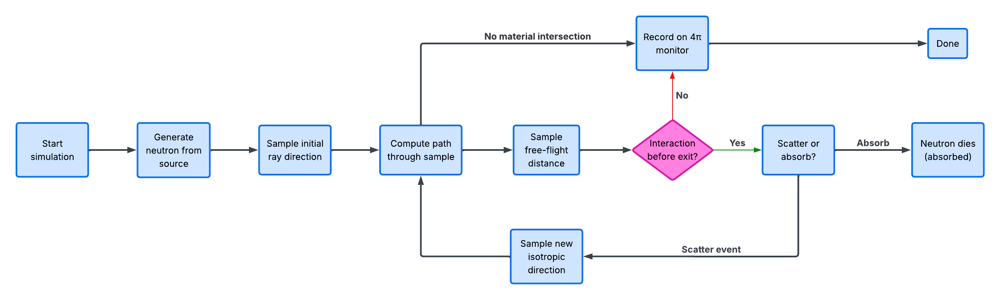
The McMini implementation
Intro
Theory
McMini
Validation
Conclusion
Thin-limit
CAMEA
Optimize
Notes:
Mention that McMini is deliberately simple, while McStas uses more advanced weighted absorption.
This is actually a strength of the validation: different implementations give similar physical results.

Slide 18
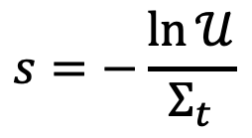
The McMini implementation
$$s=−\frac{\ln{𝒰}}{Σ_{t}}$$
Intro
Theory
McMini
Validation
Conclusion
Thin-limit
CAMEA
Optimize
Notes:
Mention that McMini is deliberately simple, while McStas uses more advanced weighted absorption.
This is actually a strength of the validation: different implementations give similar physical results.

Slide 19
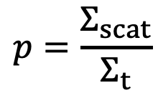
The McMini implementation
$$p=\frac{Σ_{scat}}{Σ_{t}}$$
$$s=−\frac{\ln{𝒰}}{Σ_{t}}$$
Intro
Theory
McMini
Validation
Conclusion
Thin-limit
CAMEA
Optimize
Notes:
Mention that McMini is deliberately simple, while McStas uses more advanced weighted absorption.
This is actually a strength of the validation: different implementations give similar physical results.

Slide 20
Validation result: McMini vs McStas
Intro
Theory
McMini
Validation
Conclusion
Thin-limit
CAMEA
Optimize
Notes:
Raw total intensity ratio was $1+3×{10}^{−7}$
Equator-cut Pearson correlation was $0.999961$
Raw equator-cut s$um ratio was 0.997910$
Raw equator-cut $χ_{υ}^{2}=3.02$

Slide 21
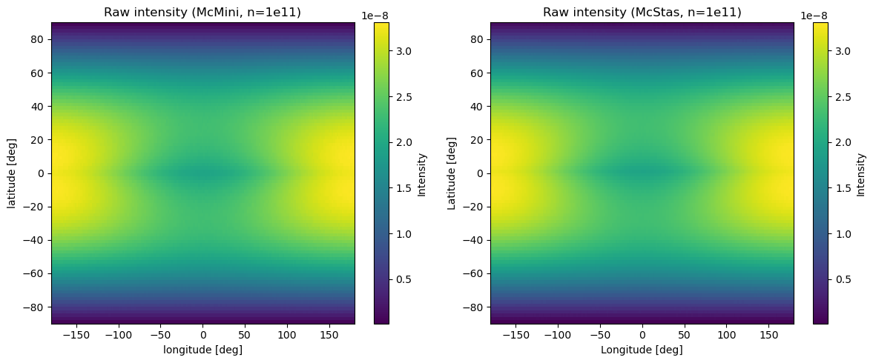
Validation result: McMini vs McStas
Raw total intensity ratio was: $1+3×{10}^{−7}$
Raw total intensity ratio was: 1+3×10^(−7)
Equator-cut Pearson correlation: $0.999961$
Equator-cut Pearson correlation: 0.999961
Equator-cut: $χ_{υ}^{2}=3.02$
Equator-cut: 𝜒_𝜐^2=3.02
Equator-cut shape only: $χ_{υ}^{2}=1.74×{10}^{−8}$
Equator-cut shape only: 𝜒_𝜐^2=1.74×10^(−8)
Intro
Theory
McMini
Validation
Conclusion
Thin-limit
CAMEA
Optimize
Notes:
Raw total intensity ratio was $1+3×{10}^{−7}$
Equator-cut Pearson correlation was $0.999961$
Raw equator-cut s$um ratio was 0.997910$
Raw equator-cut $χ_{υ}^{2}=3.02$
“This raw χ²ν is sensitive to the tiny normalization difference because the statistics are very high. If I compare only the shape, the agreement is essentially exact.”
Equator-cut shape only: $χ_{υ}^{2}=1.74×{10}^{−8}$
Say: “The important conclusion is not that every bin is identical, but that the physical scattering behavior and integrated intensity agree extremely well.”

Slide 22
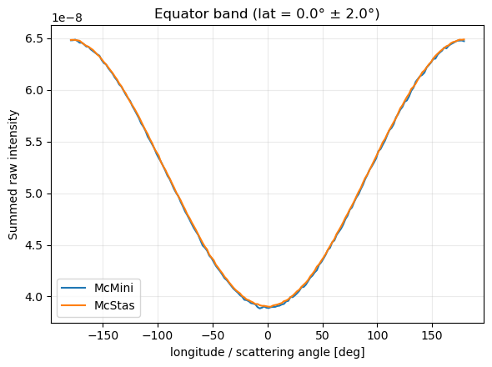
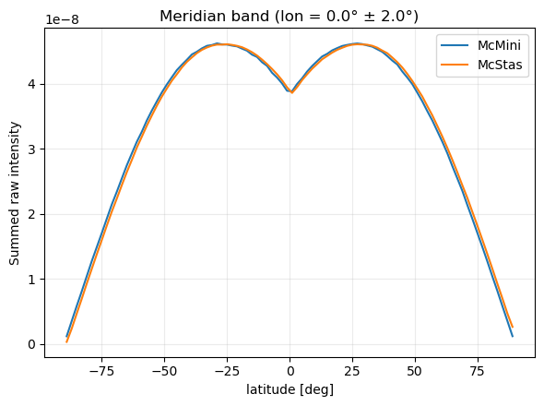
Validation result: McMini vs McStas
Raw total intensity ratio was: $1+3×{10}^{−7}$
Raw total intensity ratio was: 1+3×10^(−7)
Equator-cut Pearson correlation: $0.999961$
Equator-cut Pearson correlation: 0.999961
Equator-cut: $χ_{υ}^{2}=3.02$
Equator-cut: 𝜒_𝜐^2=3.02
Equator-cut shape only: $χ_{υ}^{2}=1.74×{10}^{−8}$
Equator-cut shape only: 𝜒_𝜐^2=1.74×10^(−8)
Integrated intensity ratio:
$$I_{McMini}/I_{McStas}=1+3×{10}^{−7}$$
𝐼_McMini/𝐼_Mc𝑆𝑡𝑎𝑠=1+3×10^(−7)
Intro
Theory
McMini
Validation
Conclusion
Thin-limit
CAMEA
Optimize
Notes:
Raw total intensity ratio was $1+3×{10}^{−7}$
Equator-cut Pearson correlation was $0.999961$
Raw equator-cut s$um ratio was 0.997910$
Raw equator-cut $χ_{υ}^{2}=3.02$
“This raw χ²ν is sensitive to the tiny normalization difference because the statistics are very high. If I compare only the shape, the agreement is essentially exact.”
Equator-cut shape only: $χ_{υ}^{2}=1.74×{10}^{−8}$
Say: “The important conclusion is not that every bin is identical, but that the physical scattering behavior and integrated intensity agree extremely well.”

Slide 23
Validation result: McMini vs McStas
Raw total intensity ratio was: $1+3×{10}^{−7}$
Raw total intensity ratio was: 1+3×10^(−7)
Equator-cut Pearson correlation: $0.999961$
Equator-cut Pearson correlation: 0.999961
Equator-cut: $χ_{υ}^{2}=3.02$
Equator-cut: 𝜒_𝜐^2=3.02
Equator-cut shape only: $χ_{υ}^{2}=1.74×{10}^{−8}$
Equator-cut shape only: 𝜒_𝜐^2=1.74×10^(−8)
Integrated intensity ratio:
$$I_{McMini}/I_{McStas}=1+3×{10}^{−7}$$
𝐼_McMini/𝐼_Mc𝑆𝑡𝑎𝑠=1+3×10^(−7)
Intro
Theory
McMini
Validation
Conclusion
Thin-limit
CAMEA
Optimize
Notes:
Raw total intensity ratio was $1+3×{10}^{−7}$
Equator-cut Pearson correlation was $0.999961$
Raw equator-cut s$um ratio was 0.997910$
Raw equator-cut $χ_{υ}^{2}=3.02$
“This raw χ²ν is sensitive to the tiny normalization difference because the statistics are very high. If I compare only the shape, the agreement is essentially exact.”
Equator-cut shape only: $χ_{υ}^{2}=1.74×{10}^{−8}$
Say: “The important conclusion is not that every bin is identical, but that the physical scattering behavior and integrated intensity agree extremely well.”

Slide 24
Validation result: McMini vs McStas
Raw total intensity ratio was: $1+3×{10}^{−7}$
Raw total intensity ratio was: 1+3×10^(−7)
Equator-cut Pearson correlation: $0.999961$
Equator-cut Pearson correlation: 0.999961
Equator-cut: $χ_{υ}^{2}=3.02$
Equator-cut: 𝜒_𝜐^2=3.02
Equator-cut shape only: $χ_{υ}^{2}=1.74×{10}^{−8}$
Equator-cut shape only: 𝜒_𝜐^2=1.74×10^(−8)
Integrated intensity ratio:
$$I_{McMini}/I_{McStas}=1+3×{10}^{−7}$$
𝐼_McMini/𝐼_Mc𝑆𝑡𝑎𝑠=1+3×10^(−7)
Intro
Theory
McMini
Validation
Conclusion
Thin-limit
CAMEA
Optimize
Notes:
Raw total intensity ratio was $1+3×{10}^{−7}$
Equator-cut Pearson correlation was $0.999961$
Raw equator-cut s$um ratio was 0.997910$
Raw equator-cut $χ_{υ}^{2}=3.02$
“This raw χ²ν is sensitive to the tiny normalization difference because the statistics are very high. If I compare only the shape, the agreement is essentially exact.”
Equator-cut shape only: $χ_{υ}^{2}=1.74×{10}^{−8}$
Say: “The important conclusion is not that every bin is identical, but that the physical scattering behavior and integrated intensity agree extremely well.”

Slide 25
Validation result: McMini vs McStas
Raw total intensity ratio was: $1+3×{10}^{−7}$
Raw total intensity ratio was: 1+3×10^(−7)
Equator-cut Pearson correlation: $0.999961$
Equator-cut Pearson correlation: 0.999961
Equator-cut: $χ_{υ}^{2}=3.02$
Equator-cut: 𝜒_𝜐^2=3.02
Equator-cut shape only: $χ_{υ}^{2}=1.74×{10}^{−8}$
Equator-cut shape only: 𝜒_𝜐^2=1.74×10^(−8)
Integrated intensity ratio:
$$I_{McMini}/I_{McStas}=1+3×{10}^{−7}$$
𝐼_McMini/𝐼_Mc𝑆𝑡𝑎𝑠=1+3×10^(−7)
Equator-cut correlation:
$$ρ=0.999961$$
𝜌=0.999961
Intro
Theory
McMini
Validation
Conclusion
Thin-limit
CAMEA
Optimize
Notes:
Raw total intensity ratio was $1+3×{10}^{−7}$
Equator-cut Pearson correlation was $0.999961$
Raw equator-cut s$um ratio was 0.997910$
Raw equator-cut $χ_{υ}^{2}=3.02$
“This raw χ²ν is sensitive to the tiny normalization difference because the statistics are very high. If I compare only the shape, the agreement is essentially exact.”
Equator-cut shape only: $χ_{υ}^{2}=1.74×{10}^{−8}$
Say: “The important conclusion is not that every bin is identical, but that the physical scattering behavior and integrated intensity agree extremely well.”

Slide 26
Validation result: McMini vs McStas
Raw total intensity ratio was: $1+3×{10}^{−7}$
Raw total intensity ratio was: 1+3×10^(−7)
Equator-cut Pearson correlation: $0.999961$
Equator-cut Pearson correlation: 0.999961
Equator-cut: $χ_{υ}^{2}=3.02$
Equator-cut: 𝜒_𝜐^2=3.02
Equator-cut shape only: $χ_{υ}^{2}=1.74×{10}^{−8}$
Equator-cut shape only: 𝜒_𝜐^2=1.74×10^(−8)
Integrated intensity ratio:
$$I_{McMini}/I_{McStas}=1+3×{10}^{−7}$$
𝐼_McMini/𝐼_Mc𝑆𝑡𝑎𝑠=1+3×10^(−7)
Equator-cut correlation:
$$ρ=0.999961$$
𝜌=0.999961
Equator-cut $χ_{υ}^{2}$:
Equator-cut 𝜒_𝜐^2:
$$χ_{υ}^{2}=3.02$$
𝜒_𝜐^2=3.02
Intro
Theory
McMini
Validation
Conclusion
Thin-limit
CAMEA
Optimize
Notes:
Raw total intensity ratio was $1+3×{10}^{−7}$
Equator-cut Pearson correlation was $0.999961$
Raw equator-cut s$um ratio was 0.997910$
Raw equator-cut $χ_{υ}^{2}=3.02$
“This raw χ²ν is sensitive to the tiny normalization difference because the statistics are very high. If I compare only the shape, the agreement is essentially exact.”
Equator-cut shape only: $χ_{υ}^{2}=1.74×{10}^{−8}$
Say: “The important conclusion is not that every bin is identical, but that the physical scattering behavior and integrated intensity agree extremely well.”

Slide 27
Validation result: McMini vs McStas
Raw total intensity ratio was: $1+3×{10}^{−7}$
Raw total intensity ratio was: 1+3×10^(−7)
Equator-cut Pearson correlation: $0.999961$
Equator-cut Pearson correlation: 0.999961
Equator-cut: $χ_{υ}^{2}=3.02$
Equator-cut: 𝜒_𝜐^2=3.02
Equator-cut shape only: $χ_{υ}^{2}=1.74×{10}^{−8}$
Equator-cut shape only: 𝜒_𝜐^2=1.74×10^(−8)
Integrated intensity ratio:
$$I_{McMini}/I_{McStas}=1+3×{10}^{−7}$$
𝐼_McMini/𝐼_Mc𝑆𝑡𝑎𝑠=1+3×10^(−7)
Equator-cut correlation:
$$ρ=0.999961$$
𝜌=0.999961
Equator-cut $χ_{υ}^{2}$:
Equator-cut 𝜒_𝜐^2:
$$χ_{υ}^{2}=3.02$$
𝜒_𝜐^2=3.02
RMS shape residual
$$RMS=1.74×{10}^{−8}$$
𝑅𝑀𝑆=1.74×10^(−8)
Intro
Theory
McMini
Validation
Conclusion
Thin-limit
CAMEA
Optimize
Notes:
Raw total intensity ratio was $1+3×{10}^{−7}$
Equator-cut Pearson correlation was $0.999961$
Raw equator-cut s$um ratio was 0.997910$
Raw equator-cut $χ_{υ}^{2}=3.02$
“This raw χ²ν is sensitive to the tiny normalization difference because the statistics are very high. If I compare only the shape, the agreement is essentially exact.”
Equator-cut shape only: $χ_{υ}^{2}=1.74×{10}^{−8}$
Say: “The important conclusion is not that every bin is identical, but that the physical scattering behavior and integrated intensity agree extremely well.”

Slide 28
$4π$ monitor artifact
Integrated intensity ratio:
$$I_{McMini}/I_{McStas}=1+3×{10}^{−7}$$
𝐼_McMini/𝐼_Mc𝑆𝑡𝑎𝑠=1+3×10^(−7)
Asymmetry method:
$$I\left(φ,θ\right)−I\left(φ,−θ\right)$$
Asymmetry method:
𝐼(𝜙,𝜃)−𝐼(𝜙,−𝜃)
Equator-cut correlation:
$$ρ=0.999961$$
𝜌=0.999961
Equator-cut $χ_{υ}^{2}$:
Equator-cut 𝜒_𝜐^2:
$$χ_{υ}^{2}=3.02$$
𝜒_𝜐^2=3.02
Shape only $χ_{υ}^{2}$:
Shape only 𝜒_𝜐^2:
$$χ_{υ}^{2}=1.74×{10}^{−8}$$
𝜒_𝜐^2=1.74×10^(−8)
Intro
Theory
McMini
Validation
Conclusion
Thin-limit
CAMEA
Optimize
Notes:
4PI monitor
McMini raw north-south asymmetry: $3.07×{10}^{−6}$
McStas raw north-south asymmetry: $1.47×{10}^{−2}$
Asymmetry method
$$I\left(φ,θ\right)−I\left(φ,−θ\right)$$
Possible examiner question: “Does this invalidate your results?”
Answer: “No. It limits interpretation near the poles, but the optimization uses equatorial
detector windows where the artifact is avoided or strongly reduced.”
Possible examiner question: “Why does north-south asymmetry value not match those that use vanadium samples?”
Answer: “The 4π source test shows that the artifact exists.
The sample simulations show how strongly that artifact appears under the actual sample illumination.
Those are related tests, but they are not expected to give identical numerical asymmetry values.”

Slide 29
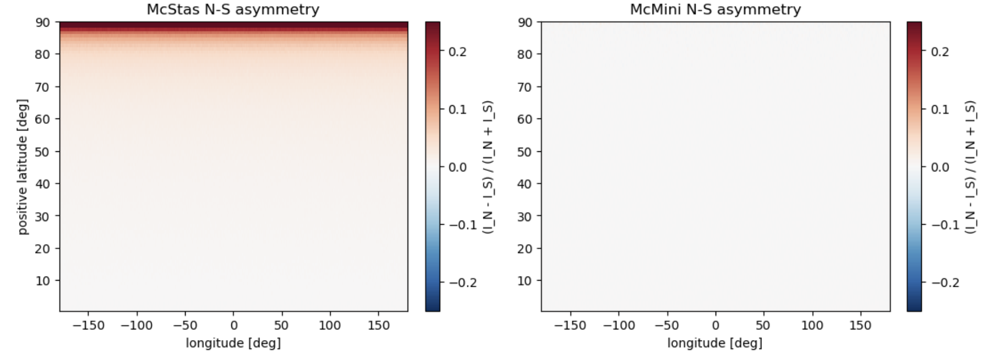
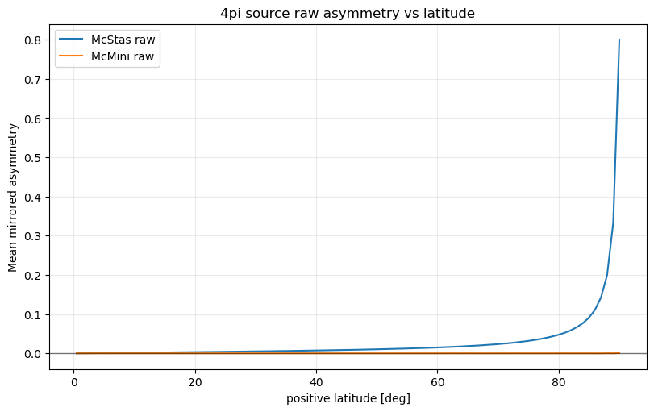
$4π$ monitor artifact
Asymmetry method:
$$I\left(φ,θ\right)−I\left(φ,−θ\right)$$
Asymmetry method:
𝐼(𝜙,𝜃)−𝐼(𝜙,−𝜃)
Intro
Theory
McMini
Validation
Conclusion
Thin-limit
CAMEA
Optimize
Notes:
4PI monitor
McMini raw north-south asymmetry: $3.07×{10}^{−6}$
McStas raw north-south asymmetry: $1.47×{10}^{−2}$
Asymmetry method
$$I\left(φ,θ\right)−I\left(φ,−θ\right)$$
Possible examiner question: “Does this invalidate your results?”
Answer: “No. It limits interpretation near the poles, but the optimization uses equatorial
detector windows where the artifact is avoided or strongly reduced.”
Possible examiner question: “Why does north-south asymmetry value not match those that use vanadium samples?”
Answer: “The 4π source test shows that the artifact exists.
The sample simulations show how strongly that artifact appears under the actual sample illumination.
Those are related tests, but they are not expected to give identical numerical asymmetry values.”

Slide 30
$4π$ monitor artifact
McStas
North-south asymmetry: $8.72×{10}^{−3}$
North-south asymmetry: 8.72×10^(−3)
$χ_{υ}^{2}$: $1.25×{10}^{3}$
𝜒_𝜐^2: 1.25×10^3
p-value: $<{10}^{−30}$
p-value: <10^(−30)
Asymmetry method:
$$I\left(φ,θ\right)−I\left(φ,−θ\right)$$
Asymmetry method:
𝐼(𝜙,𝜃)−𝐼(𝜙,−𝜃)
Intro
Theory
McMini
Validation
Conclusion
Thin-limit
CAMEA
Optimize
Notes:
4PI monitor
McMini raw north-south asymmetry: $3.07×{10}^{−6}$
McStas raw north-south asymmetry: $1.47×{10}^{−2}$
Asymmetry method
$$I\left(φ,θ\right)−I\left(φ,−θ\right)$$
Possible examiner question: “Does this invalidate your results?”
Answer: “No. It limits interpretation near the poles, but the optimization uses equatorial
detector windows where the artifact is avoided or strongly reduced.”
Possible examiner question: “Why does north-south asymmetry value not match those that use vanadium samples?”
Answer: “The 4π source test shows that the artifact exists.
The sample simulations show how strongly that artifact appears under the actual sample illumination.
Those are related tests, but they are not expected to give identical numerical asymmetry values.”

Slide 31
$4π$ monitor artifact
McStas
North-south asymmetry: $8.72×{10}^{−3}$
North-south asymmetry: 8.72×10^(−3)
$χ_{υ}^{2}$: $1.25×{10}^{3}$
𝜒_𝜐^2: 1.25×10^3
p-value: $≈0$
p-value: ≈0
Asymmetry method:
$$I\left(φ,θ\right)−I\left(φ,−θ\right)$$
Asymmetry method:
𝐼(𝜙,𝜃)−𝐼(𝜙,−𝜃)
Intro
Theory
McMini
Validation
Conclusion
Thin-limit
CAMEA
Optimize
Notes:
4PI monitor
McMini raw north-south asymmetry: $3.07×{10}^{−6}$
McStas raw north-south asymmetry: $1.47×{10}^{−2}$
Asymmetry method
$$I\left(φ,θ\right)−I\left(φ,−θ\right)$$
Possible examiner question: “Does this invalidate your results?”
Answer: “No. It limits interpretation near the poles, but the optimization uses equatorial
detector windows where the artifact is avoided or strongly reduced.”
Possible examiner question: “Why does north-south asymmetry value not match those that use vanadium samples?”
Answer: “The 4π source test shows that the artifact exists.
The sample simulations show how strongly that artifact appears under the actual sample illumination.
Those are related tests, but they are not expected to give identical numerical asymmetry values.”

Slide 32
$4π$ monitor artifact
McStas
North-south asymmetry: $8.72×{10}^{−3}$
North-south asymmetry: 8.72×10^(−3)
$χ_{υ}^{2}$: $1.25×{10}^{3}$
𝜒_𝜐^2: 1.25×10^3
p-value: $≈0$
p-value: ≈0
McMini
North-south asymmetry: $2.52×{10}^{−6}$
North-south asymmetry: 2.52×10^(−6)
$χ_{υ}^{2}$: $1.004$
𝜒_𝜐^2: 1.004
p-value: $0.308$
p-value: 0.308
Asymmetry method:
$$I\left(φ,θ\right)−I\left(φ,−θ\right)$$
Asymmetry method:
𝐼(𝜙,𝜃)−𝐼(𝜙,−𝜃)
Intro
Theory
McMini
Validation
Conclusion
Thin-limit
CAMEA
Optimize
Notes:
4PI monitor
McMini raw north-south asymmetry: $3.07×{10}^{−6}$
McStas raw north-south asymmetry: $1.47×{10}^{−2}$
Asymmetry method
$$I\left(φ,θ\right)−I\left(φ,−θ\right)$$
Possible examiner question: “Does this invalidate your results?”
Answer: “No. It limits interpretation near the poles, but the optimization uses equatorial
detector windows where the artifact is avoided or strongly reduced.”
Possible examiner question: “Why does north-south asymmetry value not match those that use vanadium samples?”
Answer: “The 4π source test shows that the artifact exists.
The sample simulations show how strongly that artifact appears under the actual sample illumination.
Those are related tests, but they are not expected to give identical numerical asymmetry values.”

Slide 33
$4π$ monitor artifact
McStas
North-south asymmetry: $8.72×{10}^{−3}$
North-south asymmetry: 8.72×10^(−3)
$χ_{υ}^{2}$: $1.25×{10}^{3}$
𝜒_𝜐^2: 1.25×10^3
p-value: $≈0$
p-value: ≈0
$χ_{υ}^{2}$: $1.004$
𝜒_𝜐^2: 1.004
North-south asymmetry: $2.52×{10}^{−6}$
North-south asymmetry: 2.52×10^(−6)
p-value: $0.308$
p-value: 0.308
McMini
Asymmetry method:
$$I\left(φ,θ\right)−I\left(φ,−θ\right)$$
Asymmetry method:
𝐼(𝜙,𝜃)−𝐼(𝜙,−𝜃)
Takeaway: McStas 4π monitor shows systematic north-south asymmetry.
Intro
Theory
McMini
Validation
Conclusion
Thin-limit
CAMEA
Optimize
Notes:
4PI monitor
McMini raw north-south asymmetry: $3.07×{10}^{−6}$
McStas raw north-south asymmetry: $1.47×{10}^{−2}$
Asymmetry method
$$I\left(φ,θ\right)−I\left(φ,−θ\right)$$
Possible examiner question: “Does this invalidate your results?”
Answer: “No. It limits interpretation near the poles, but the optimization uses equatorial
detector windows where the artifact is avoided or strongly reduced.”
Possible examiner question: “Why does north-south asymmetry value not match those that use vanadium samples?”
Answer: “The 4π source test shows that the artifact exists.
The sample simulations show how strongly that artifact appears under the actual sample illumination.
Those are related tests, but they are not expected to give identical numerical asymmetry values.”

Slide 34
Cylindrical monitor artifact
McStas
North-south asymmetry: $8.72×{10}^{−3}$
North-south asymmetry: 8.72×10^(−3)
$χ_{υ}^{2}$: $1.25×{10}^{3}$
𝜒_𝜐^2: 1.25×10^3
p-value: $<{10}^{−30}$
p-value: <10^(−30)
McMini
North-south asymmetry: $2.52×{10}^{−6}$
North-south asymmetry: 2.52×10^(−6)
$χ_{υ}^{2}$: $1.004$
𝜒_𝜐^2: 1.004
p-value: $0.308$
p-value: 0.308
Cylindrical monitor
Left-right asymmetry after zero bin shift: $3.60×{10}^{−2}$
Left-right asymmetry after zero bin shift: 3.60×10^(−2)
Left-right asymmetry after one bin shift: $1.63×{10}^{−6}$
Left-right asymmetry after one bin shift: 1.63×10^(−6)
Intro
Theory
McMini
Validation
Conclusion
Thin-limit
CAMEA
Optimize
Takeaway: $4π$ monitor has clear north-south asymmetry
Takeaway: 4𝜋 monitor has clear north-south asymmetry
Notes:
Cylindrical monitor
Left-right asymmetry after zero bin shift: $3.60×{10}^{−2}$
Left-right asymmetry after one bin shift: $1.63×{10}^{−6}$
I found two separate monitor-related effects.
The 4π monitor shows a systematic north–south asymmetry in McStas even for a uniform 4π source, where symmetry is expected.
The cylindrical monitor artifact was different: it appeared as a left-right asymmetry, but was essentially removed by a one-bin shift, indicating a bin-alignment issue.
These effects are important for validation, but they do not invalidate the geometry optimization because the final analysis uses the equatorial detector windows and avoids the problematic high-latitude regions.

Slide 35
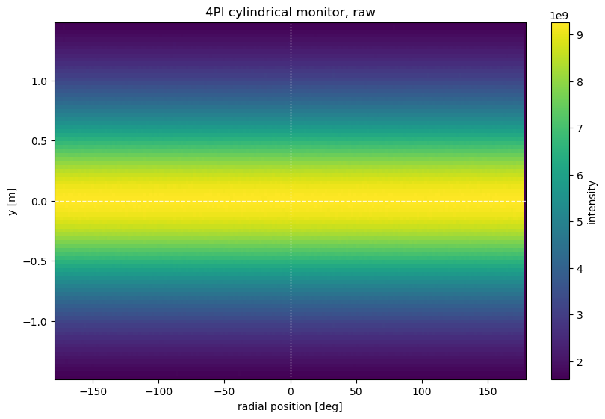
Cylindrical monitor artifact
Cylindrical monitor
Left-right asymmetry after zero bin shift: $3.60×{10}^{−2}$
Left-right asymmetry after zero bin shift: 3.60×10^(−2)
Left-right asymmetry after one bin shift: $1.63×{10}^{−6}$
Left-right asymmetry after one bin shift: 1.63×10^(−6)
Intro
Theory
McMini
Validation
Conclusion
Thin-limit
CAMEA
Optimize
Notes:
Cylindrical monitor
Left-right asymmetry after zero bin shift: $3.60×{10}^{−2}$
Left-right asymmetry after one bin shift: $1.63×{10}^{−6}$
I found two separate monitor-related effects.
The 4π monitor shows a systematic north–south asymmetry in McStas even for a uniform 4π source, where symmetry is expected.
The cylindrical monitor artifact was different: it appeared as a left-right asymmetry, but was essentially removed by a one-bin shift, indicating a bin-alignment issue.
These effects are important for validation, but they do not invalidate the geometry optimization because the final analysis uses the equatorial detector windows and avoids the problematic high-latitude regions.

Slide 36
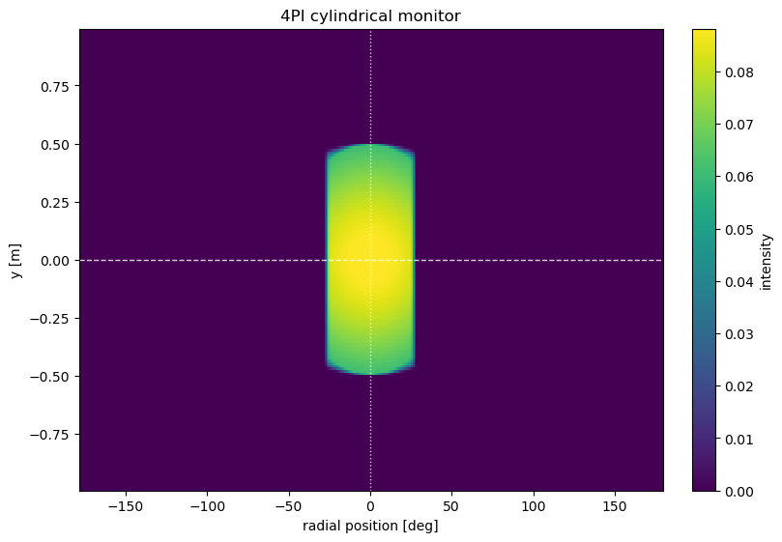
Cylindrical monitor artifact
Cylindrical monitor
Left-right asymmetry after zero bin shift: $3.60×{10}^{−2}$
Left-right asymmetry after zero bin shift: 3.60×10^(−2)
Left-right asymmetry after one bin shift: $1.63×{10}^{−6}$
Left-right asymmetry after one bin shift: 1.63×10^(−6)
Intro
Theory
McMini
Validation
Conclusion
Thin-limit
CAMEA
Optimize
Notes:
Cylindrical monitor
Left-right asymmetry after zero bin shift: $3.60×{10}^{−2}$
Left-right asymmetry after one bin shift: $1.63×{10}^{−6}$
I found two separate monitor-related effects.
The 4π monitor shows a systematic north–south asymmetry in McStas even for a uniform 4π source, where symmetry is expected.
The cylindrical monitor artifact was different: it appeared as a left-right asymmetry, but was essentially removed by a one-bin shift, indicating a bin-alignment issue.
These effects are important for validation, but they do not invalidate the geometry optimization because the final analysis uses the equatorial detector windows and avoids the problematic high-latitude regions.

Slide 37
Cylindrical monitor artifact
Left-right asymmetry after bin shifts
+0 bin shift: $3.60×{10}^{−2}$
+0 bin shift: 3.60×10^(−2)
+1 bin shift: $1.63×{10}^{−6}$
+1 bin shift: 1.63×10^(−6)
+2 bin shift: 3.6$×{10}^{−2}$
+2 bin shift: 3.6×10^(−2)
-1 bin shift: 5.12$×{10}^{−2}$
-1 bin shift: 5.12×10^(−2)
Cylindrical monitor
Left-right asymmetry after zero bin shift: $3.60×{10}^{−2}$
Left-right asymmetry after zero bin shift: 3.60×10^(−2)
Left-right asymmetry after one bin shift: $1.63×{10}^{−6}$
Left-right asymmetry after one bin shift: 1.63×10^(−6)
Intro
Theory
McMini
Validation
Conclusion
Thin-limit
CAMEA
Optimize
Notes:
Cylindrical monitor
Left-right asymmetry after zero bin shift: $3.60×{10}^{−2}$
Left-right asymmetry after one bin shift: $1.63×{10}^{−6}$
I found two separate monitor-related effects.
The 4π monitor shows a systematic north–south asymmetry in McStas even for a uniform 4π source, where symmetry is expected.
The cylindrical monitor artifact was different: it appeared as a left-right asymmetry, but was essentially removed by a one-bin shift, indicating a bin-alignment issue.
These effects are important for validation, but they do not invalidate the geometry optimization because the final analysis uses the equatorial detector windows and avoids the problematic high-latitude regions.

Slide 38
Cylindrical monitor artifact
Left-right asymmetry after bin shifts
+0 bin shift: $3.60×{10}^{−2}$
+0 bin shift: 3.60×10^(−2)
+1 bin shift: $1.63×{10}^{−6}$
+1 bin shift: 1.63×10^(−6)
+2 bin shift: 3.6$×{10}^{−2}$
+2 bin shift: 3.6×10^(−2)
-1 bin shift: 5.12$×{10}^{−2}$
-1 bin shift: 5.12×10^(−2)
Cylindrical monitor
Left-right asymmetry after zero bin shift: $3.60×{10}^{−2}$
Left-right asymmetry after zero bin shift: 3.60×10^(−2)
Left-right asymmetry after one bin shift: $1.63×{10}^{−6}$
Left-right asymmetry after one bin shift: 1.63×10^(−6)
Takeaway: McStas has a missing column
Intro
Theory
McMini
Validation
Conclusion
Thin-limit
CAMEA
Optimize
Notes:
Cylindrical monitor
Left-right asymmetry after zero bin shift: $3.60×{10}^{−2}$
Left-right asymmetry after one bin shift: $1.63×{10}^{−6}$
I found two separate monitor-related effects.
The 4π monitor shows a systematic north–south asymmetry in McStas even for a uniform 4π source, where symmetry is expected.
The cylindrical monitor artifact was different: it appeared as a left-right asymmetry, but was essentially removed by a one-bin shift, indicating a bin-alignment issue.
These effects are important for validation, but they do not invalidate the geometry optimization because the final analysis uses the equatorial detector windows and avoids the problematic high-latitude regions.

Slide 39
Thin-limit study
Left-right asymmetry after bin shifts
+0 bin shift: $3.60×{10}^{−2}$
+0 bin shift: 3.60×10^(−2)
+1 bin shift: $1.63×{10}^{−6}$
+1 bin shift: 1.63×10^(−6)
+2 bin shift: 3.6$×{10}^{−2}$
+2 bin shift: 3.6×10^(−2)
-1 bin shift: 5.12$×{10}^{−2}$
-1 bin shift: 5.12×10^(−2)
Takeaway: McStas has a missing column
Intro
Theory
McMini
Validation
Conclusion
Thin-limit
CAMEA
Optimize
Notes:
The discussion states that the thinnest sample gave R = 1.0013, the linear extrapolation gave
R(0) = 1.0077, and the exponential extrapolation gave R(0) = 0.9577.
Say: “This was an important sanity check: in the limit where self-absorption should disappear,
the simulation approaches the expected single-scattering estimate.”

Slide 40

Thin-limit study
$$t→{10}^{−6} m={10}^{−3} mm$$
Intro
Theory
McMini
Validation
Conclusion
Thin-limit
CAMEA
Optimize
Notes:
The discussion states that the thinnest sample gave R = 1.0013, the linear extrapolation gave
R(0) = 1.0077, and the exponential extrapolation gave R(0) = 0.9577.
Say: “This was an important sanity check: in the limit where self-absorption should disappear,
the simulation approaches the expected single-scattering estimate.”

Slide 41
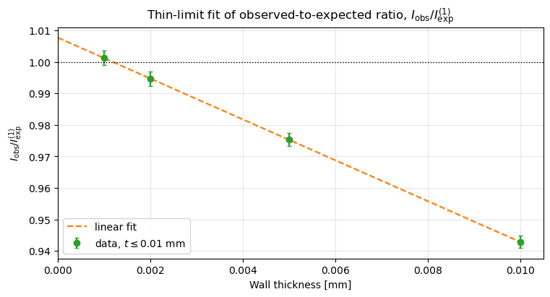
Thin-limit study
$$t→{10}^{−6} m={10}^{−3} mm$$
Intro
Theory
McMini
Validation
Conclusion
Thin-limit
CAMEA
Optimize
Notes:
The discussion states that the thinnest sample gave R = 1.0013, the linear extrapolation gave
R(0) = 1.0077, and the exponential extrapolation gave R(0) = 0.9577.
Say: “This was an important sanity check: in the limit where self-absorption should disappear,
the simulation approaches the expected single-scattering estimate.”

Slide 42
Thin-limit study
$$t→{10}^{−6} m={10}^{−3} mm$$
Linear fit:
$$R\left(t\right)=1.0077−6.4787∙t$$
𝑅(𝑡)=1.0077−6.4787∙𝑡
Intro
Theory
McMini
Validation
Conclusion
Thin-limit
CAMEA
Optimize
Notes:
The discussion states that the thinnest sample gave R = 1.0013, the linear extrapolation gave
R(0) = 1.0077, and the exponential extrapolation gave R(0) = 0.9577.
Say: “This was an important sanity check: in the limit where self-absorption should disappear,
the simulation approaches the expected single-scattering estimate.”

Slide 43
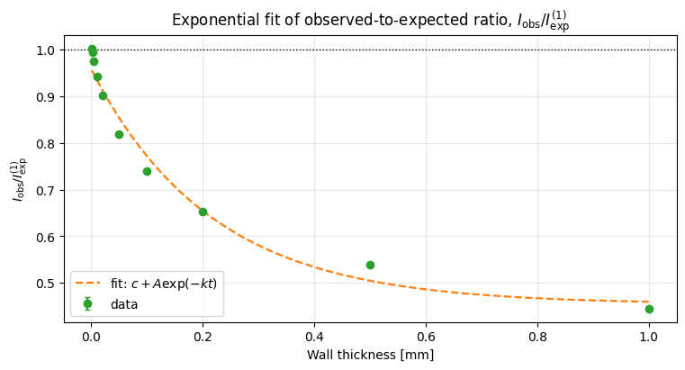

CAMEA geometry study
$$t→{10}^{−6} m=1 mm$$
$$R\left(0\right)=0.9577$$
𝑅(0)=0.9577
Linear fit:
$$R\left(t\right)=1.0077−6.4787∙t$$
𝑅(𝑡)=1.0077−6.4787∙𝑡
Exponential fit:
$$R\left(t\right)=0.4545+0.5032e^{−4.6175t}$$
𝑅(𝑡)=0.4545+0.5032𝑒^(−4.6175𝑡)
Intro
Theory
McMini
Validation
Conclusion
Thin-limit
CAMEA
Optimize
Notes:
Say: “The CAMEA geometry gives a strong signal, but it is not angularly flat. The forward
direction is suppressed, and the observed-to-expected ratio varies with longitude.”

Slide 44
CAMEA geometry study
CAMEA sample geometry
Type: Hollow cylinder
Radius: 10mm
Height: 10mm
Wall thickness: 2.6mm
Intro
Theory
McMini
Validation
Conclusion
Thin-limit
CAMEA
Optimize
Notes:
Say: “The CAMEA geometry gives a strong signal, but it is not angularly flat. The forward
direction is suppressed, and the observed-to-expected ratio varies with longitude.”

Slide 45
CAMEA geometry study
CAMEA sample geometry
Type: Hollow cylinder
Radius: 10mm
Height: 10mm
Wall thickness: 2.6mm
Intro
Theory
McMini
Validation
Conclusion
Thin-limit
CAMEA
Optimize
Notes:
Say: “The CAMEA geometry gives a strong signal, but it is not angularly flat. The forward
direction is suppressed, and the observed-to-expected ratio varies with longitude.”

Slide 46
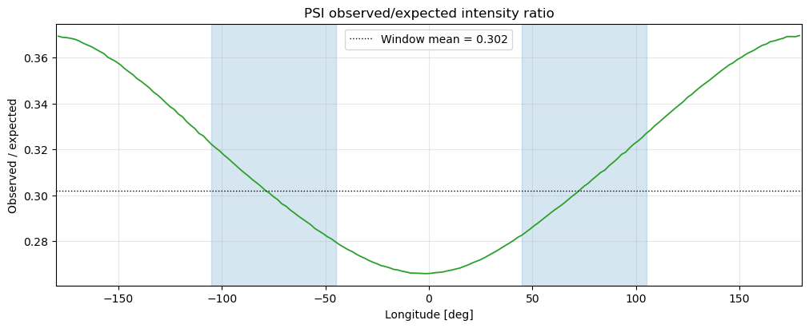
CAMEA geometry study
CAMEA sample geometry
Type: Hollow cylinder
Radius: 10mm
Height: 10mm
Wall thickness: 2.6mm
CAMEA simulation values
$$I_{exp}^{(1)}=61285.3$$
𝐼_exp^((1))=61285.3
$$\frac{I_{max}−I_{min}}{\overline{I}}=0.156791$$
(𝐼_max−𝐼_min)/𝐼 ̅ =0.156791
$$R=0.302$$
𝑅=0.302
$$I_{obs}=18509.0$$
𝐼_obs=18509.0
Intro
Theory
McMini
Validation
Conclusion
Thin-limit
CAMEA
Optimize
Notes:
Say: “The CAMEA geometry gives a strong signal, but it is not angularly flat. The forward
direction is suppressed, and the observed-to-expected ratio varies with longitude.”

Slide 47
CAMEA geometry study
CAMEA sample geometry
Type: Hollow cylinder
Radius: 10mm
Height: 10mm
Wall thickness: 2.6mm
CAMEA simulation values
$$I_{exp}^{(1)}=61285.3$$
𝐼_exp^((1))=61285.3
$$\frac{I_{max}−I_{min}}{\overline{I}}=0.156791$$
(𝐼_max−𝐼_min)/𝐼 ̅ =0.156791
$$R=0.302$$
𝑅=0.302
$$I_{obs}=18509.0$$
𝐼_obs=18509.0
Intro
Theory
McMini
Validation
Conclusion
Thin-limit
CAMEA
Optimize
Notes:
Say: “The CAMEA geometry gives a strong signal, but it is not angularly flat. The forward
direction is suppressed, and the observed-to-expected ratio varies with longitude.”
CAMEA is located in the SINQ in the cold neutron guide and it is multiplexing spectrometer (cold neutrons).
Types of neutron instruments: Diffraction, reflection, SANS, and spectroscopy.
Since CAMEA measures scattering over detector windows, a vanadium calibration sample should ideally produce a predictable and uniform signal. My project tries to reduce geometry-induced anisotropy so that detector normalization is less biased by the sample itself.
CAMEA is designed to efficiently collect scattered neutrons over a continuous angular range and multiple final energies. This makes detector normalization and sample-independent calibration important. Vanadium is useful because it ideally provides a nearly isotropic incoherent scattering signal, but my project shows that the finite geometry of the vanadium sample can still introduce angular anisotropy through self-absorption and multiple scattering. Therefore, optimizing the sample geometry can improve the reliability of the calibration signal used for instruments such as CAMEA

Slide 48
Optimization method
CAMEA sample geometry
Type: Hollow cylinder
Radius: 10mm
Height: 10mm
Wall thickness: 2.6mm
CAMEA simulation values
$$I_{exp}^{(1)}=61285.3$$
𝐼_exp^((1))=61285.3
$$\frac{I_{max}−I_{min}}{\overline{I}}=0.156791$$
(𝐼_max−𝐼_min)/𝐼 ̅ =0.156791
$$R=0.302$$
𝑅=0.302
$$I_{obs}=18509.0$$
𝐼_obs=18509.0
Intro
Theory
McMini
Validation
Conclusion
Thin-limit
CAMEA
Optimize

Slide 49
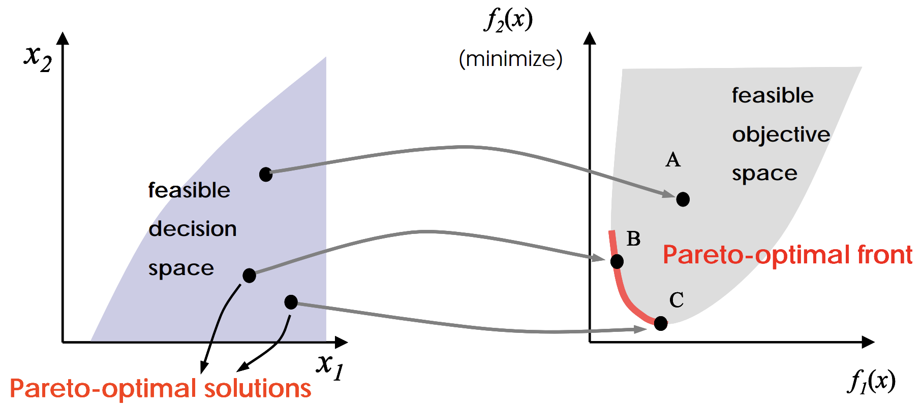
Optimization method
Figure from Scott D. Sudhoff. Lecture 9: Multi-Objective Optimization
Intro
Theory
McMini
Validation
Conclusion
Thin-limit
CAMEA
Optimize
Notes:
Say: “You cannot simply maximize intensity, because thicker or larger samples may also increase anisotropy.
Therefore, the answer is a Pareto front rather than a single universal optimum.”

Slide 50
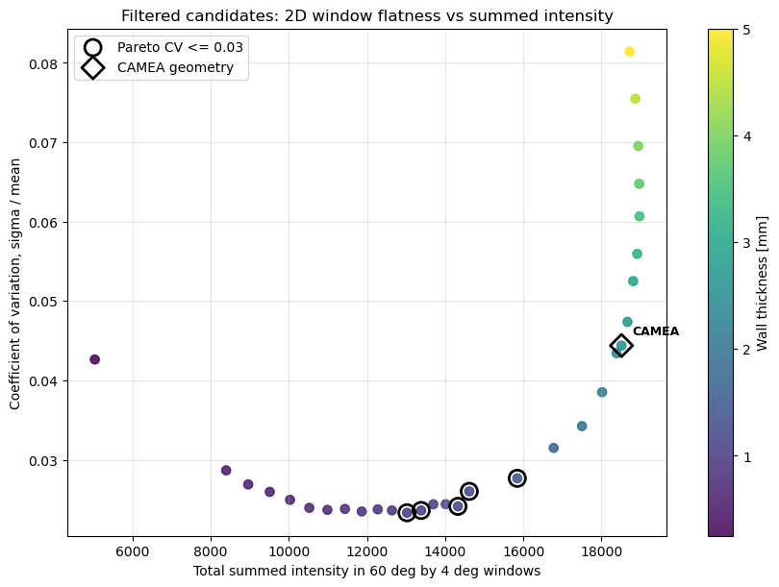
Optimization results
Without sample constraints:
Intro
Theory
McMini
Validation
Conclusion
Thin-limit
CAMEA
Optimize
Notes:
CEMEA was run with same n_count to ensure same statistical precision as the other optimization runs.

Slide 51
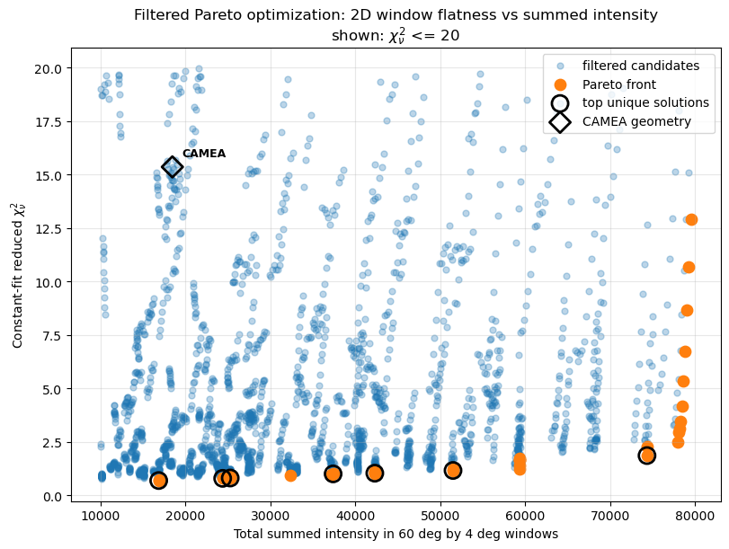
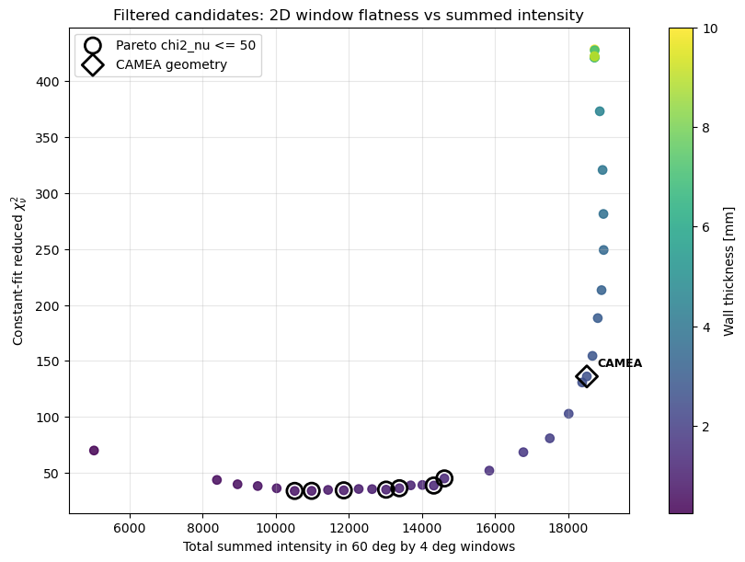
Optimization results
Without sample constraints:
Intro
Theory
McMini
Validation
Conclusion
Thin-limit
CAMEA
Optimize
Notes:
CEMEA was run with same n_count to ensure same statistical precision as the other optimization runs.

Slide 52
Optimization results
Without sample constraints:
Height: 30-40 mm
Radius: 7.5-12.5 mm
Wall thickness: ~1-2.5 mm
Intro
Theory
McMini
Validation
Conclusion
Thin-limit
CAMEA
Optimize
Notes:
CEMEA was run with same n_count to ensure same statistical precision as the other optimization runs.

Slide 53
Optimization results
Without sample constraints:
Height: 30-40 mm
Radius: 7.5-12.5 mm
Wall thickness: ~1-2.5 mm
With sample constraint:
Intro
Theory
McMini
Validation
Conclusion
Thin-limit
CAMEA
Optimize
Notes:
CEMEA was run with same n_count to ensure same statistical precision as the other optimization runs.
At first it seems unintuitive, because the metric is evaluated in an equatorial latitude band. But that band is a cut in detector angle, not a slice through the sample. Neutrons detected in the equatorial band can originate from the full illuminated sample volume, so the vertical extent still affects the path-length and escape-probability distribution. For short cylinders, the top and bottom boundaries are relatively important, so end effects can influence even the horizontal angular response. Increasing the height reduces the relative importance of the end caps and makes the illuminated region behave more like a long cylinder with approximate translational symmetry along the vertical direction. Therefore the equatorial response can become flatter. I would not interpret this as taller samples being globally more isotropic; rather, within the chosen equatorial CAMEA window, the taller geometries reduce the particular geometry-induced anisotropy measured by the metric.

Slide 54
Optimization results
Without sample constraints:
Height: 30-40 mm
Radius: 7.5-12.5 mm
Wall thickness: ~1-2.5 mm
With sample constraint:
Intro
Theory
McMini
Validation
Conclusion
Thin-limit
CAMEA
Optimize
Notes:
For the fixed-height/radius scan, your thesis reports a strong candidate with r = 10 mm,
h = 10 mm, t = 1.25 mm, I_obs/Ie_xp = 0.413 and lower maximum deviation than the CAMEA
geometry.

Slide 55
Optimization results
Without sample constraints:
Height: 30-40 mm
Radius: 7.5-12.5 mm
Wall thickness: ~1-2.5 mm
With sample constraint:
Height: 10 mm
Radius: 10 mm
Wall thickness ~1-1.25 mm
Intro
Theory
McMini
Validation
Conclusion
Thin-limit
CAMEA
Optimize
Notes:
For the fixed-height/radius scan, your thesis reports a strong candidate with r = 10 mm,
h = 10 mm, t = 1.25 mm, I_obs/Ie_xp = 0.413 and lower maximum deviation than the CAMEA
geometry.

Slide 56
Optimization results
Without sample constraints:
Height: 30-40 mm
Radius: 7.5-12.5 mm
Wall thickness: ~1-2.5 mm
With sample constraint:
Height: 10 mm
Radius: 10 mm
Wall thickness ~1-1.25 mm
Using Coefficient of variation
wall thickness ~1-1.5mm
Intro
Theory
McMini
Validation
Conclusion
Thin-limit
CAMEA
Optimize
Notes:
For the fixed-height/radius scan, your thesis reports a strong candidate with r = 10 mm,
h = 10 mm, t = 1.25 mm, I_obs/Ie_xp = 0.413 and lower maximum deviation than the CAMEA
geometry.

Slide 57
Limitations
Without sample constraints:
Height: 30-40 mm
Radius: 7.5-12.5 mm
Wall thickness: ~1 mm
With sample constraint:
Height: 10 mm
Radius: 10 mm
Wall thickness ~1 mm
For t=1.25 mm: $I_{obs}/I_{exp}=0.413$
For t=1.25 mm: 𝐼_obs/𝐼_exp=0.413
Intro
Theory
McMini
Validation
Conclusion
Thin-limit
CAMEA
Optimize
Notes:
The 4π monitor artifact should be fixed or further validated.
The expected intensity for taller samples was difficult because the beam did not illuminate the full sample uniformly.
The optimization depends on the chosen detector windows and quality metrics.
McMini is intentionally minimal and does not include every McStas feature.
Some simulations have finite Monte Carlo statistics

Slide 58
Limitations
The $4π$ monitor artifact should be further investigated or corrected.
The 4𝜋 monitor artifact should be further investigated or corrected.
Intro
Theory
McMini
Validation
Conclusion
Thin-limit
CAMEA
Optimize
Notes:
Limitations
The 4π monitor artifact should be further investigated or corrected.
The expected intensity is less well defined for taller samples because the beam does not illuminate the full sample uniformly.
The optimization result depends on the chosen detector windows and quality metrics.
McMini is intentionally minimal and does not reproduce every McStas feature.
Finite Monte Carlo statistics limited some low-intensity cases.
These limitations do not change the main conclusion, but they define where the result should be interpreted carefully.

Slide 59
Limitations
The $4π$ monitor artifact should be further investigated or corrected.
The 4𝜋 monitor artifact should be further investigated or corrected.
The expected intensity is less well defined for taller samples because the beam does not illuminate the full sample uniformly.
Intro
Theory
McMini
Validation
Conclusion
Thin-limit
CAMEA
Optimize
Notes:
Limitations
The 4π monitor artifact should be further investigated or corrected.
The expected intensity is less well defined for taller samples because the beam does not illuminate the full sample uniformly.
The optimization result depends on the chosen detector windows and quality metrics.
McMini is intentionally minimal and does not reproduce every McStas feature.
Finite Monte Carlo statistics limited some low-intensity cases.
These limitations do not change the main conclusion, but they define where the result should be interpreted carefully.

Slide 60
Limitations
The $4π$ monitor artifact should be further investigated or corrected.
The 4𝜋 monitor artifact should be further investigated or corrected.
The expected intensity is less well defined for taller samples because the beam does not illuminate the full sample uniformly.
The optimization result depends on the chosen detector windows and quality metrics.
Intro
Theory
McMini
Validation
Conclusion
Thin-limit
CAMEA
Optimize
Notes:
Limitations
The 4π monitor artifact should be further investigated or corrected.
The expected intensity is less well defined for taller samples because the beam does not illuminate the full sample uniformly.
The optimization result depends on the chosen detector windows and quality metrics.
McMini is intentionally minimal and does not reproduce every McStas feature.
Finite Monte Carlo statistics limited some low-intensity cases.
These limitations do not change the main conclusion, but they define where the result should be interpreted carefully.

Slide 61
Limitations
The $4π$ monitor artifact should be further investigated or corrected.
The 4𝜋 monitor artifact should be further investigated or corrected.
The expected intensity is less well defined for taller samples because the beam does not illuminate the full sample uniformly.
The optimization result depends on the chosen detector windows and quality metrics.
McMini is intentionally minimal and does not reproduce every McStas feature.
Intro
Theory
McMini
Validation
Conclusion
Thin-limit
CAMEA
Optimize
Notes:
Limitations
The 4π monitor artifact should be further investigated or corrected.
The expected intensity is less well defined for taller samples because the beam does not illuminate the full sample uniformly.
The optimization result depends on the chosen detector windows and quality metrics.
McMini is intentionally minimal and does not reproduce every McStas feature.
Finite Monte Carlo statistics limited some low-intensity cases.
These limitations do not change the main conclusion, but they define where the result should be interpreted carefully.

Slide 62
Limitations
The $4π$ monitor artifact should be further investigated or corrected.
The 4𝜋 monitor artifact should be further investigated or corrected.
The expected intensity is less well defined for taller samples because the beam does not illuminate the full sample uniformly.
The optimization result depends on the chosen detector windows and quality metrics.
McMini is intentionally minimal and does not reproduce every McStas feature.
Some parameter scans were limited by finite Monte Carlo statistics.
Intro
Theory
McMini
Validation
Conclusion
Thin-limit
CAMEA
Optimize
Notes:
Limitations
The 4π monitor artifact should be further investigated or corrected.
The expected intensity is less well defined for taller samples because the beam does not illuminate the full sample uniformly.
The optimization result depends on the chosen detector windows and quality metrics.
McMini is intentionally minimal and does not reproduce every McStas feature.
Finite Monte Carlo statistics limited some low-intensity cases.
These limitations do not change the main conclusion, but they define where the result should be interpreted carefully.

Slide 63
Final conclusion
Intro
Theory
McMini
Validation
Conclusion
Thin-limit
CAMEA
Optimize
Notes:
• Validation: McMini and McStas/Union agree very well in integrated intensity and angular
scattering behavior, supporting the use of Union for this sample problem.
• Physics: The current CAMEA hollow vanadium sample shows significant angular depen-
dence due to self-absorption and multiple scattering, despite vanadium’s nearly isotropic
incoherent scattering.
• Optimization: Thinner walls and/or taller geometries reduce anisotropy while maintaining
useful intensity; if constrained to h = r = 10 mm, a wall thickness around 0.75-1.25 mmis
preferable to 2.6 mm.
Final sentence: “The main result is therefore not a single optimal sample, but a physically
motivated range of geometries that improve calibration behavior depending on the experimental
constraints.”

Slide 64
Final conclusion
Validation
Intro
Theory
McMini
Validation
Conclusion
Thin-limit
CAMEA
Optimize
Notes:
• Validation: McMini and McStas/Union agree very well in integrated intensity and angular
scattering behavior, supporting the use of Union for this sample problem.
• Physics: The current CAMEA hollow vanadium sample shows significant angular depen-
dence due to self-absorption and multiple scattering, despite vanadium’s nearly isotropic
incoherent scattering.
• Optimization: Thinner walls and/or taller geometries reduce anisotropy while maintaining
useful intensity; if constrained to h = r = 10 mm, a wall thickness around 0.75-1.25 mmis
preferable to 2.6 mm.
Final sentence: “The main result is therefore not a single optimal sample, but a physically
motivated range of geometries that improve calibration behavior depending on the experimental
constraints.”

Slide 65
Final conclusion
Validation
Physics
Intro
Theory
McMini
Validation
Conclusion
Thin-limit
CAMEA
Optimize
Notes:
• Validation: McMini and McStas/Union agree very well in integrated intensity and angular
scattering behavior, supporting the use of Union for this sample problem.
• Physics: The current CAMEA hollow vanadium sample shows significant angular depen-
dence due to self-absorption and multiple scattering, despite vanadium’s nearly isotropic
incoherent scattering.
• Optimization: Thinner walls and/or taller geometries reduce anisotropy while maintaining
useful intensity; if constrained to h = r = 10 mm, a wall thickness around 0.75-1.25 mmis
preferable to 2.6 mm.
Final sentence: “The main result is therefore not a single optimal sample, but a physically
motivated range of geometries that improve calibration behavior depending on the experimental
constraints.”

Slide 66
Final conclusion
Validation
Physics
Optimization
Intro
Theory
McMini
Validation
Conclusion
Thin-limit
CAMEA
Optimize
Notes:
• Validation: McMini and McStas/Union agree very well in integrated intensity and angular
scattering behavior, supporting the use of Union for this sample problem.
• Physics: The current CAMEA hollow vanadium sample shows significant angular depen-
dence due to self-absorption and multiple scattering, despite vanadium’s nearly isotropic
incoherent scattering.
• Optimization: Thinner walls and/or taller geometries reduce anisotropy while maintaining
useful intensity; if constrained to h = r = 10 mm, a wall thickness around 0.75-1.25 mmis
preferable to 2.6 mm.
Final sentence: “The main result is therefore not a single optimal sample, but a physically
motivated range of geometries that improve calibration behavior depending on the experimental
constraints.”

Slide 67
Questions
Notes:
SANS measures scattering at very small angles, corresponding to small $Q$, so it probes relatively large structures such as polymers, proteins, nanoparticles, and pores. Vanadium standards are useful in many neutron experiments because vanadium gives an almost featureless incoherent scattering signal, which can be used for detector normalization. My specific optimization was made for the CAMEA detector window, not for SANS, but the principle is transferable. One would simply redefine the detector window to the SANS angular range and optimize the geometry for high intensity and low angular anisotropy. The central point is that even if vanadium scatters approximately isotropically microscopically, the finite sample geometry introduces path-length effects, self-absorption, and multiple scattering, which can bias the observed calibration signal.
“What kind of experiments are performed at CAMEA?”
Mainly inelastic neutron scattering experiments, especially low-energy magnetic excitations and phonons in condensed-matter systems. It is useful when one wants efficient mapping of $S\left(Q , ω\right)$, especially under extreme sample environments such as low temperature, high magnetic field, or pressure.

Slide 68
Other relevant equations
$$\frac{dσ}{dΩ}=\frac{1}{Ψ}\frac{d^{2}N}{dΩdt}$$
𝑑𝜎/𝑑Ω=1/Ψ (𝑑^2 𝑁)/𝑑Ω𝑑𝑡
Differential scattering cross section
$$P\left(s\right)=e^{−Σ_{t}s}$$
𝑃(𝑠)=𝑒^(−Σ_t 𝑠)
Lambert-beer law for attenuation
$$2d\sin{θ=nλ}$$
2𝑑 sin⁡〖𝜃=𝑛𝜆〗
Bragg's Law
$$dΩ=\cos{θ}dθdφ$$
𝑑Ω=cos⁡𝜃 𝑑𝜃𝑑𝜑
Differential solid angle
$$λ=\frac{2πℏ}{m_{n}v}$$
𝜆=2𝜋ℏ/(𝑚_𝑛 𝑣)
De Broglie-wavelength

