Slide 1
Canadian Bioinformatics Workshops
www.bioinformatics.ca

Slide 2
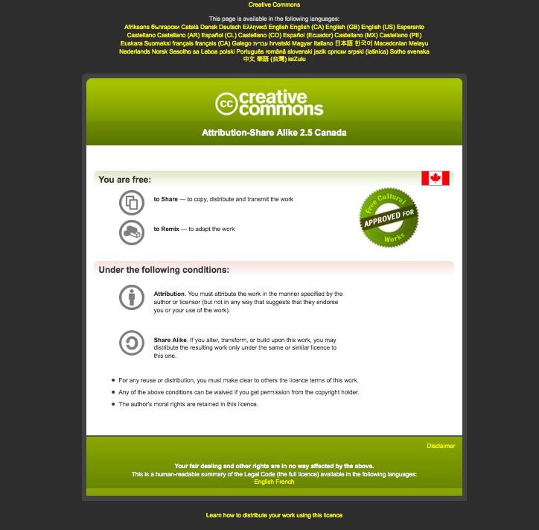
Module #: Title of Module

Slide 3
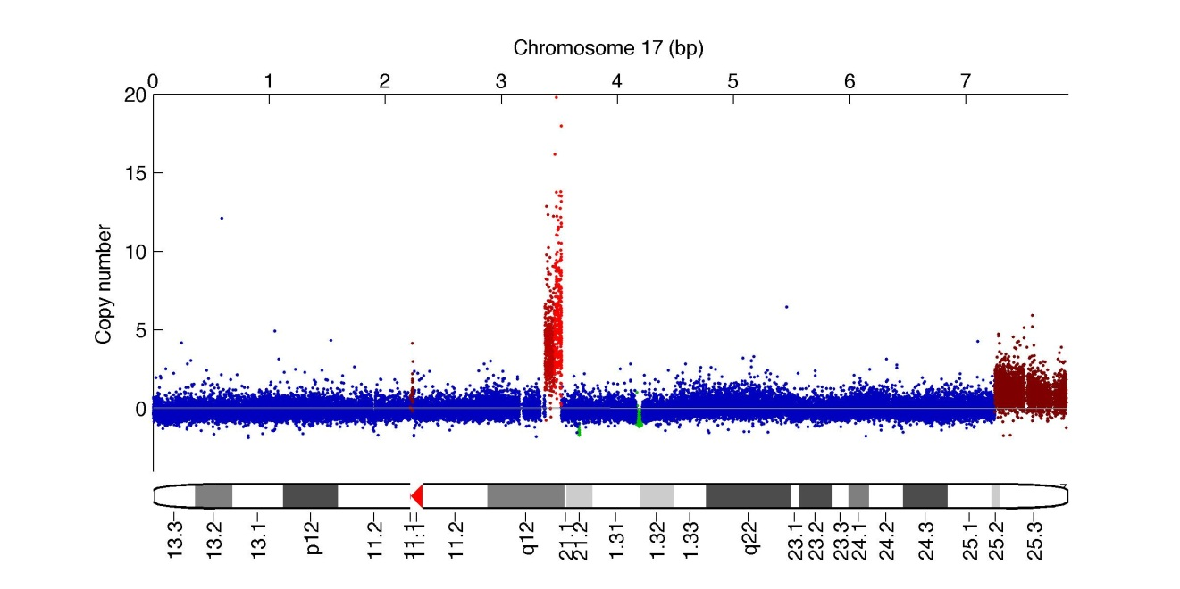


Module 5
Finding somatic copy number alterations in cancer
Sohrab Shah, Andrew McPherson
compbio.bccrc.ca
Bioinformatics for Cancer Genomics
May 26 - June 1 2013
Many slides adapted from Gavin Ha's
Andrew Roths

Slide 4
Lab 5 Learning Objectives
Overall
Understand concepts which confound the inference of copy number variants (CNVs) in cancers
Apply methods to identify CNVs in array and WGSS data
Visualise and understand the results of CNV analyses
Part 1: Array Analysis Of CNVs
Understand the basic workflow for identifying CNVs using arrays
Apply OncoSNP to analyze copy number and LOH
Part 2: WGSS Analysis Of CNVs
Understand the basic workflow for identifying CNVs using arrays
Apply HMMcopy and APOLLOH to analyze copy number and LOH
Part 3: Browse segment data in IGV
Inspect copy number in a large cohort of breast cancer (METABRIC)
Visually distinguish germline and somatic events

Slide 5
Getting started
The Installation wiki page shows installation of tools used in this Module
The PrepData wiki page details where we obtained the data
The Lab wiki page shows the steps taken in this lab
We will work through the Lab wiki page, you can use Installation and PrepData as references if interested

Slide 6
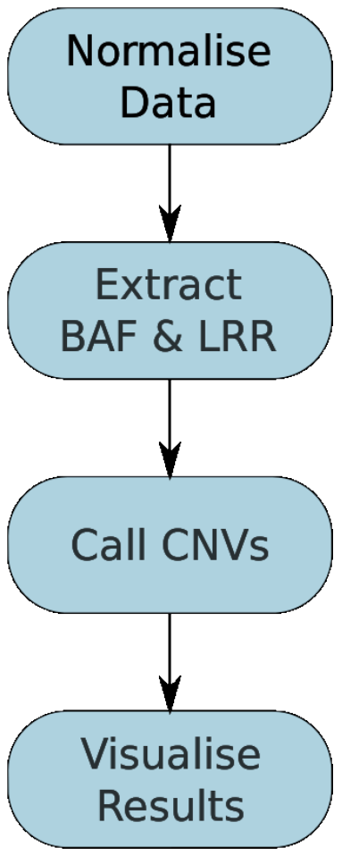
Part 1: Array Analysis Of CNVs

Slide 7
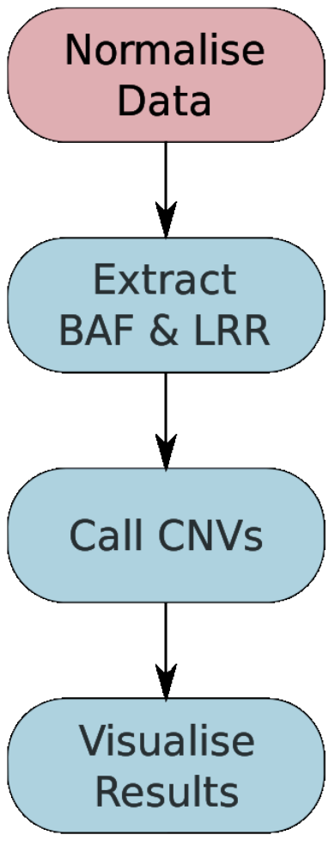
Part 1: Array Analysis Of CNVs

Slide 8
Part 1.1: Normalise Data
Because DNA does not hybridize with the same efficiency in all experiments, some normalisation must be done
In general normalising using a batch of samples run at the same time under the same conditions should be done
Methods for normalisation depend on the platform
Software (Affymetrix)
  Affymetrix Power Tools http://www.affymetrix.com/support/developer/powertools/index.affx
  Using R the AROMA package can be used http://www.aroma-project.org/
For this tutorial we used the Affymetrix Power Tools
A nice description of the entire normalisation process is given on the PennCNV website http://www.openbioinformatics.org/penncnv/penncnv_tutorial_affy_gw6.html

Slide 9
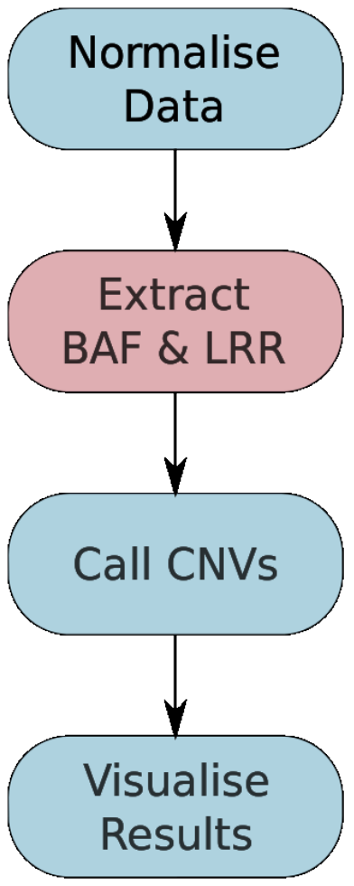
Part 1.2: Extract BAF and LRR

Slide 10
Part 1.2: Extract BAF and LRR
SNP genotyping arrays essentially measure how many copies of the A and B alleles are present.
Most tools prefer to work from the B allele frequencies (BAF) and Log R ratio.
BAF = B / (A+B)
Log R=LRR ≈ log(A + B) – log(x)
x is the intensity we would expect from a probe at normal copy number
x can be estimated, but in tumours it gets difficult if the genome is heavily amplified or delete
We need to convert the normalised outputs from the arrays to these values
For this tutorial we used normalize_affy_geno_cluster.pl supplied as part of the PennCNV package http://www.openbioinformatics.org/penncnv/

Slide 11
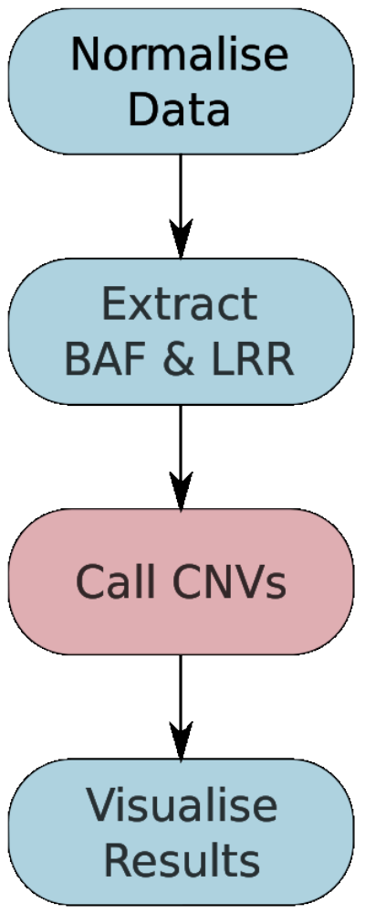
Part 1.3: Call CNVs

Slide 12
Part 1.3: Call CNVs
Calling CNVs converts the BAF and LRR measurements across the many probes (~1.8 million for Affymetrix SNP6) to predictions of the copy number of segments.
In cancer we are generally interested in the parental copy number (PCN) i.e. the number of each the two chromosomes from the parents.
An important case is when the copy number of one parental chromosome is 0, while the other is >0. This is called Loss Of Heterozygosity (LOH).
LOH is a very important mechanism for inactivating tumour suppressors.

Slide 13
Part 1.3: Call CNVs
Calling CNVs in cancers is challenging because of
  Normal contamination
  Germline polymorphisms
  Heterogeneity of cancer cells
  Ploidy i.e. baseline LRR
Software
  OncoSNP (https://sites.google.com/site/oncosnp/)
  PICNIC (http://www.sanger.ac.uk/genetics/CGP/Software/PICNIC/)
  ASCAT (http://heim.ifi.uio.no/bioinf/Projects/ASCAT/)
  HAPSEG (https://confluence.broadinstitute.org/display/CGATools/HAPSEG)
  Many others

Slide 14
Part 1.3: Call CNVs
For this tutorial we will use OncoSNP because
  It is well documented
  Handles all the confounding factors in a statistically sound framework

Slide 15
Part 1.3: Call CNVs
> head ~/CourseData/CG_data/Module5/data/oncosnp_input/HCC1143.normal.tsv
Name Chr Position GSM337662.CEL.Log R Ratio GSM337662.CEL.B Allele Freq
SNP_A-2131660 1 1145994 0.0816 0.5582
SNP_A-1967418 1 2224111 -0.3934 0.9644
SNP_A-1969580 1 2319424 0.3097 0.9634
SNP_A-4263484 1 2543484 -0.2839 0.9690
SNP_A-1978185 1 2926730 0.3044 0.0000
SNP_A-4264431 1 2941694 -1.1158 0.5282
SNP_A-1980898 1 3084986 -0.4366 0.9437
SNP_A-1983139 1 3155127 -0.0854 0.0000
SNP_A-4265735 1 3292731 -0.8953 0.5509

Slide 16
Part 1.3: Call CNVs
> head ~/CourseData/CG_data/Module5/data/oncosnp_input/batch.txt
SampleID TumourFile NormalFile
HCC1143 /home/ubuntu/workspace/CG_data/Module5/results/array/HCC1143.tumour.tsv /home/ubuntu/workspace/CG_data/Module5/results/array/HCC1143.normal.tsv

Slide 17
Part 1.3: Call CNVs
The run_oncosnp.sh provides encodes the arguments to oncosnp
As you can see in the script many arguments need to be passed so using a wrapper script makes life easy
The script will only analyse chromosome 21 because we set -chr 21
The script will also sets -emiters 1, which shortens the run time but leads to a worse fit. Generally -emiters 15 is recommended.
OncoSNP is quite slow so expect up to 24hrs for a whole genome analysis.

Slide 18
Part 1.3: Call CNVs
> cd ~/workspace/Module5/oncosnp
> ls -lh
total 4.4M
-rw-rw-r-- 1 ubuntu ubuntu 19K May 27 23:35 HCC1143.cnv
-rw-rw-r-- 1 ubuntu ubuntu 2.8K May 27 23:36 HCC1143.cnvs
-rw-rw-r-- 1 ubuntu ubuntu 1.5M May 27 23:36 HCC1143.ggs
-rw-rw-r-- 1 ubuntu ubuntu 2.5M May 27 23:36 HCC1143.gn
-rw-rw-r-- 1 ubuntu ubuntu 1.2K May 27 23:36 HCC1143.mat
-rw-rw-r-- 1 ubuntu ubuntu 377K May 27 23:35 HCC1143.ps.gz
-rw-rw-r-- 1 ubuntu ubuntu 389 May 27 23:36 HCC1143.qc
-rw-rw-r-- 1 ubuntu ubuntu 0 May 27 23:28 run.err
-rw-rw-r-- 1 ubuntu ubuntu 4.3K May 27 23:36 run.log

Slide 19
Part 1.3: Call CNVs
> head HCC1143.cnvs
Chromosome StartPosition EndPosition Copy Number LOH Normal Content %
21 9758742 10039978 5 1 0.00
21 10061090 10113553 3 1 0.00
21 10129806 13594550 5 0 0.00
21 13595721 13796570 3 1 0.00
21 13803897 14522718 6 0 0.00
21 14531684 14594247 6 0 0.00
21 14594381 14627425 5 0 0.00
21 14627536 14790109 6 0 0.00
21 14791912 14885990 6 1 0.00

Slide 20
Part 1.3: Call CNVs
> head HCC1143.qc
Sample ID: HCC1143
Outlier Rate: 0.0088
Std. Dev. LRR: 0.3377
Std. Dev. BAF: 0.0396
Stromal Contamination: 0.4000 0.3000
Log R Ratio Baseline Shift: -0.0215 -0.1660
Log-likelihood: 8438.4327 8786.6428
Log R Ratio Levels (1): -4.0000 -0.5111 0.0000 0.3045 0.6906 0.8980 1.0999 1.3000 1.5000
Log R Ratio Levels (2): -4.0000 -0.5766 0.0000 0.3032 0.6998 0.9014 1.0899 1.3000 1.5000

Slide 21
Part 1.3: Call CNVs
> head HCC1143.cnvs
> head /usr/local/oncosnp/configuration/tumourStates.dat
TumourState Normal Copy Number Tumour Copy Number LOH Balanced Amplification Germline NormalBalleles1 NormalBalleles2 NormalBalleles3 NormalBalleles4 TumourBalleles1 TumourBalleles2 TumourBalleles3 TumourBalleles4 Comment
1 2 0 0 0 0 0 1 1 2 0 0 0 0 Homozygous Deletion
1 2 1 1 0 0 0 1 1 2 0 0 1 1 "Hemizygous Deletion (A, B)"
0 2 2 0 0 1 0 1 1 2 0 1 1 2 "Normal (AA, AB, BB)"
1 2 3 0 0 0 0 1 1 2 0 1 2 3 "3n duplication (AAA, AAB, ABB, BBB)"
1 2 4 0 0 0 0 1 1 2 0 1 3 4 "4n monoallelic duplication (AAAA, ABBB, AAAB, BBBB)"
1 2 4 0 1 0 0 1 1 2 0 2 2 4 "4n balanced duplication (AAAA, AABB, BBBB)"
1 2 5 0 0 0 0 1 1 2 0 1 4 5 "5n monoallelic duplication (AAAAA, ABBBB, AAAAB, BBBBB)"
1 2 5 0 0 0 0 1 1 2 0 2 3 5 "5n non-monoallelic duplication (AAAAA, AABBB, AAABB, BBBBB)"
1 2 6 0 0 0 0 1 1 2 0 1 5 6 "6n monoallelic duplication (AAAAAA, ABBBBB, AAAAAB, BBBBBB)"

Slide 22
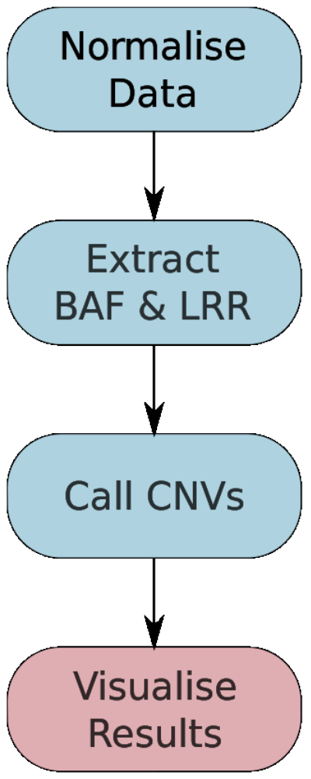
Part 1.4: Visualise Results

Slide 23
Part 1.4: Visualise Results
The OncoSNP results can be found in the module package:
content/results/oncosnp
The plot files HCC1143.*.ps.gz provide a nice summary figure of the data.

Slide 24
Part 2: WGSS Analysis Of CNVs

Slide 25
Part 2: WGSS Analysis Of CNVs
Conceptually CNV analysis for WGSS and Array data follows the same workflow.
The main difference is that we start from aligned read data (BAM) instead of raw array data (CEL, etc).
Some programs will prefer to work with the allelic counts instead of B allele frequencies (digital vs continuous data).
After pre-processing the only new wrinkle you face with WGSS data is mappability. That is some areas of the genome can have reads mapped more readily.

Slide 26
Part 2: WGSS Analysis Of CNVs
Software
  OncoSNP-Seq (https://sites.google.com/site/oncosnpseq/)
  HMMcopy/APOLLOH (http://compbio.bccrc.ca/software/)
  SomitCA (On Bioconductor)
  Many more...
Today we will APOLLOH/HMMcopy because they are published and relatively mature.

Slide 27
Part 2.1/2.2: Normalise Data/Extract BAF & LRR

Slide 28
Part 2.1/2.2 : Normalise Data/Extract BAF & LRR
We will use HMMcopy to handle the normalisation and extraction of LRR values.
We will use GATK to extract the allelic counts from heterozygos SNP positions.
These two inputs will be passed to APOLLOH in 2.3 to generate the final results.

Slide 29
Part 2.3: Call CNVs

Slide 30
Part 2.3: Call CNVs
The run_apolloh.sh script runs the apolloh cnv caller
Also post process to produce segments

Slide 31
Part 3: Browse segment data in IGV
1. Download METABRIC_DatasetI997.seg from the wiki.
  Curtis et al., Nature, 2012.
  997 breast cancer copy number alterations predicted from SNP6 arrays
2. Open IGV
3. Switch reference genome to “Human hg18”
4. File → Load from File…
5. Tracks → Fit Data to Window

Slide 32
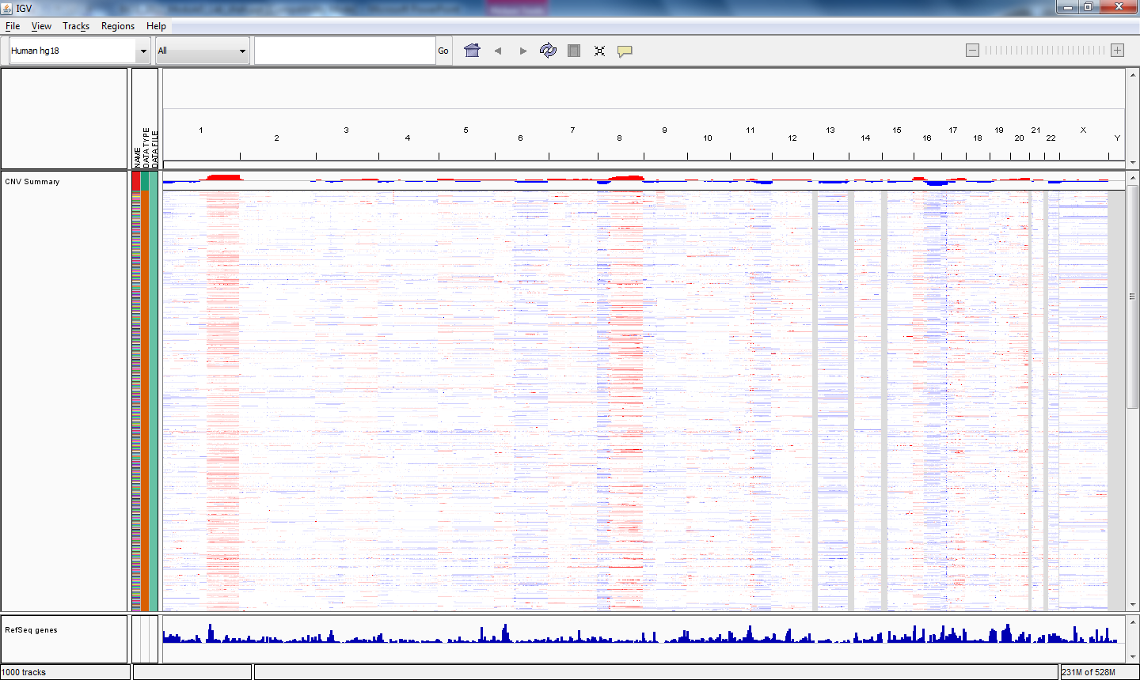
Part 3: Browse segment data in IGV
Notes:
-highly frequent events in chr1, chr8
-mutual exclusivity

Slide 33
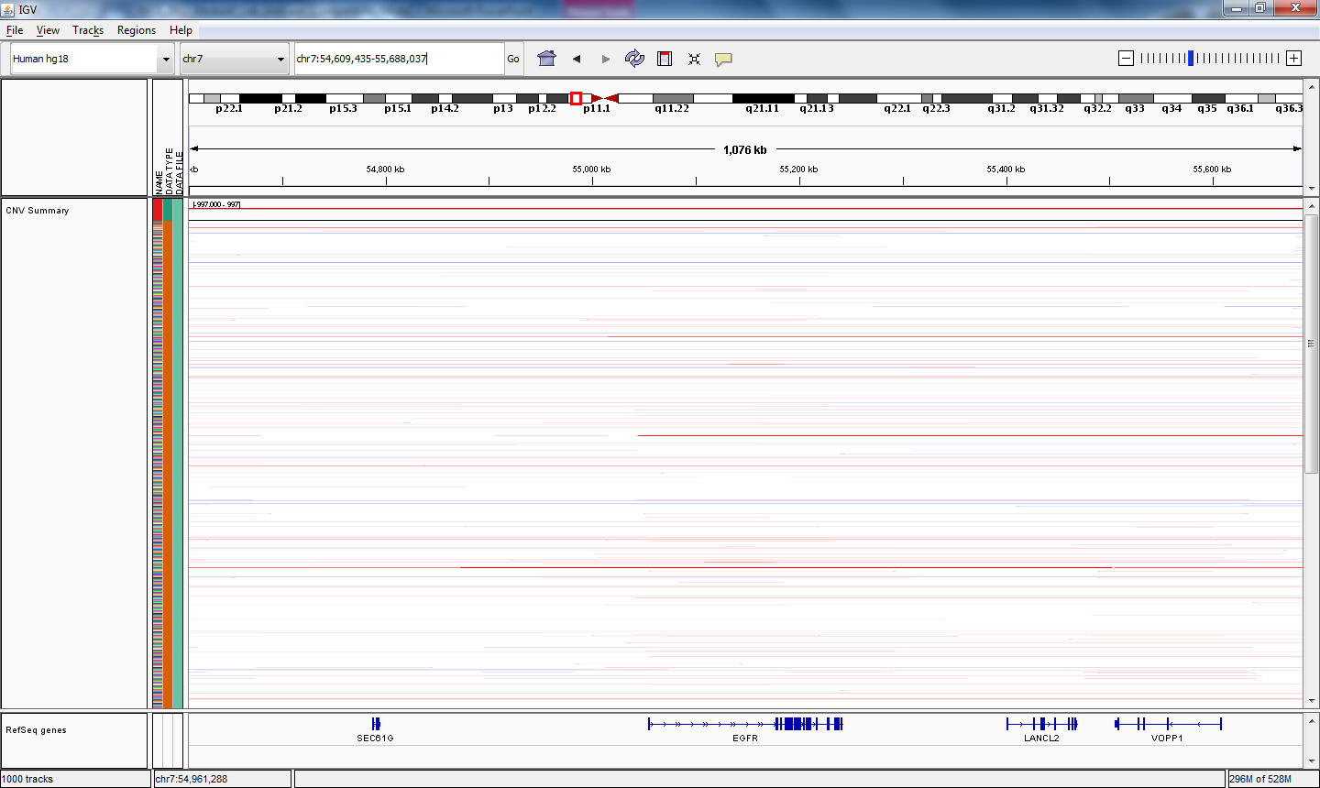
Part 3: Browse segment data in IGV
Examples of EGFR somatic high-level amp
In the Search bar, type the gene:
EGFR
Press Enter, then click zoom out “-” twice.

Slide 34
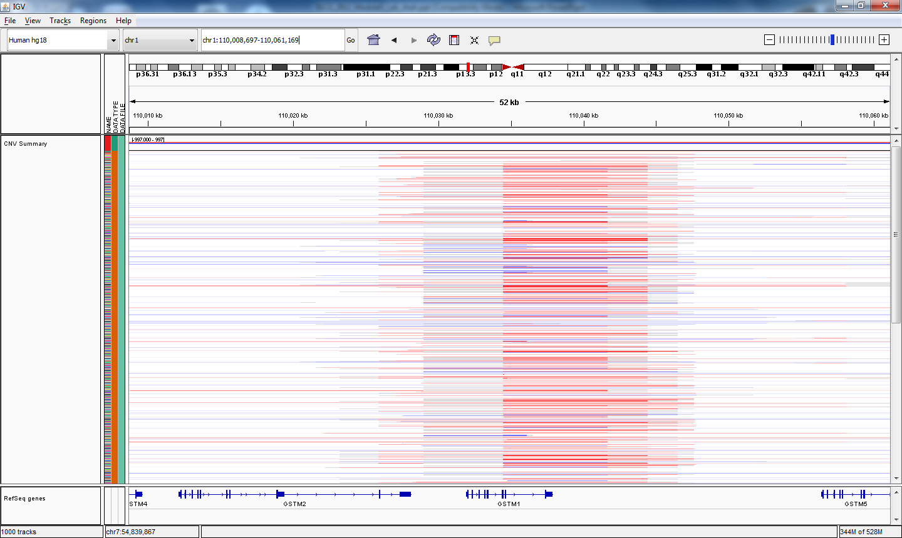
Part 3: Browse segment data in IGV
Examples of germline CNVs
In the Search bar, type the gene:
GSTM1
Note the alternating gains and losses.
Note the length of the markers.

