Slide 1
Canadian Bioinformatics Workshops
www.bioinformatics.ca

Slide 2
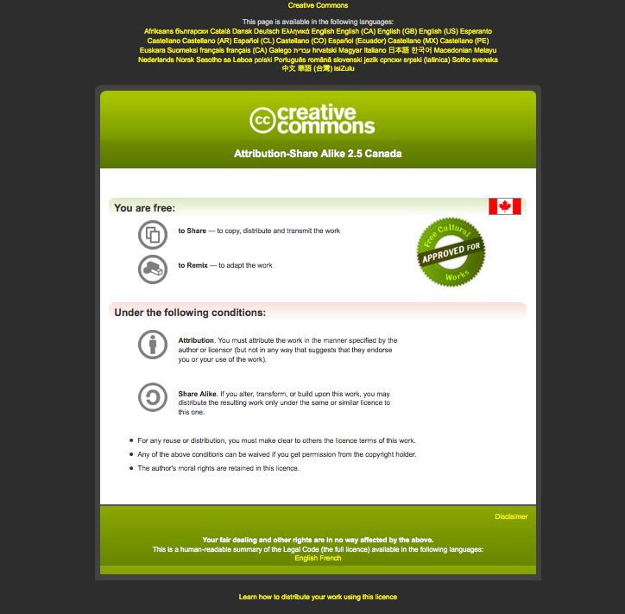
Module #: Title of Module

Slide 3

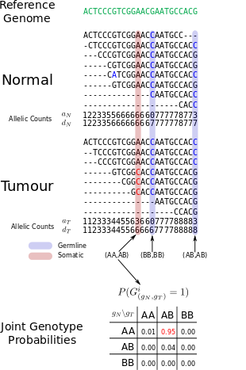


Lab Module 6
Somatic Mutations
Many slides adapted from Gavin Ha,
Andrew Roth, and Andrew McPherson

Slide 4
Lab Module 6: Learning Objectives
Apply methods to identify SNVs from sequencing data
Understand the Variant Call Format (VCF)
Visualize SNV and understand some common technical artifacts

Slide 5
Calling Variants
Strelka (Saunders et al., Bioinformatics, 2012)
  Realignment around indels
MutationSeq (Ding et al., Bioinformatics, 2011)
  Supervised learning based on ~1000 validated events

Slide 6
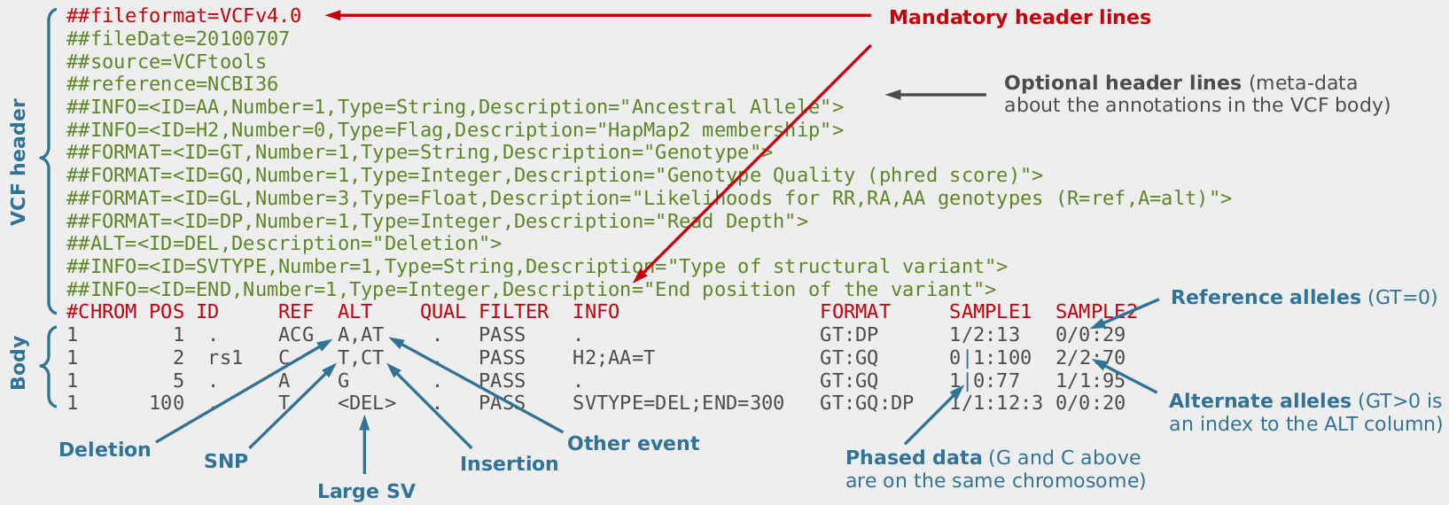
VCF Format
Tab separated
1 line per variant
Structured fields as detailed in header
Jose Blanca & Joaquin Cañizares
http://bioinf.comav.upv.es/courses/sequence_analysis/snp_calling.html

Slide 7
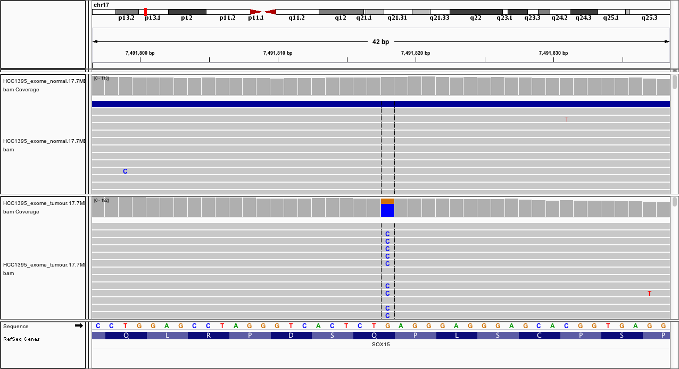
Browsing Somatic Mutations In IGV
  A somatic mutation (17:7491818) predicted by both Strelka and MutationSeq

Slide 8
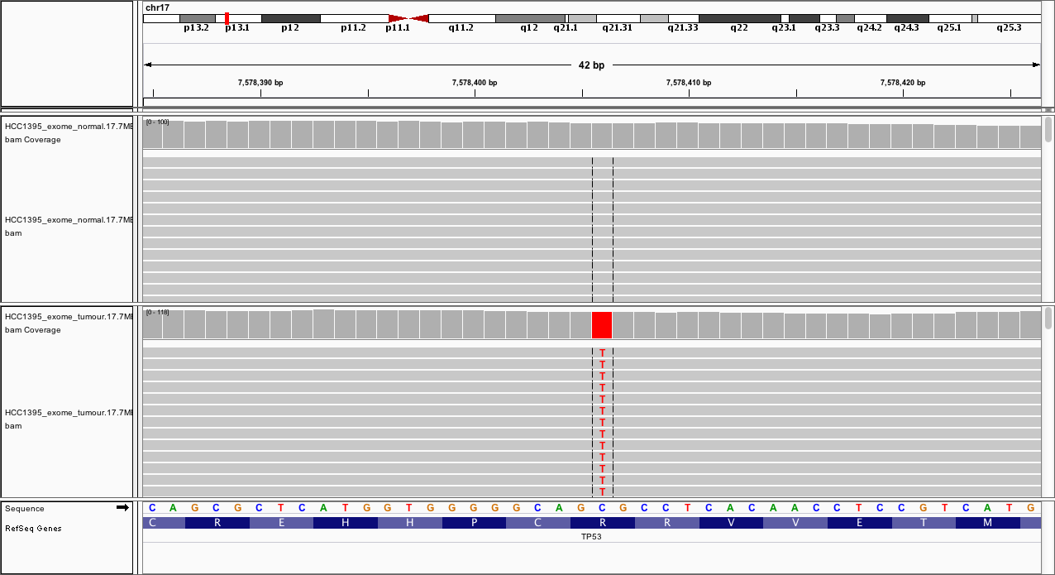
Browsing Somatic Mutations In IGV
  A somatic mutation (17:7578406) predicted only by Strelka (MutationSeq PR = 0.68)

Slide 9
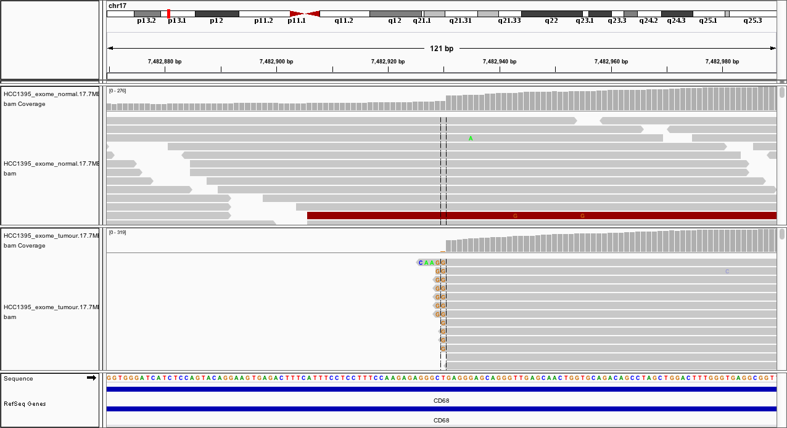
Browsing Somatic Mutations In IGV
Likely false positive (17:7482929) identified by Strelka, but occurs near the end of reads (MutationSeq PR = 0.5)

Slide 10
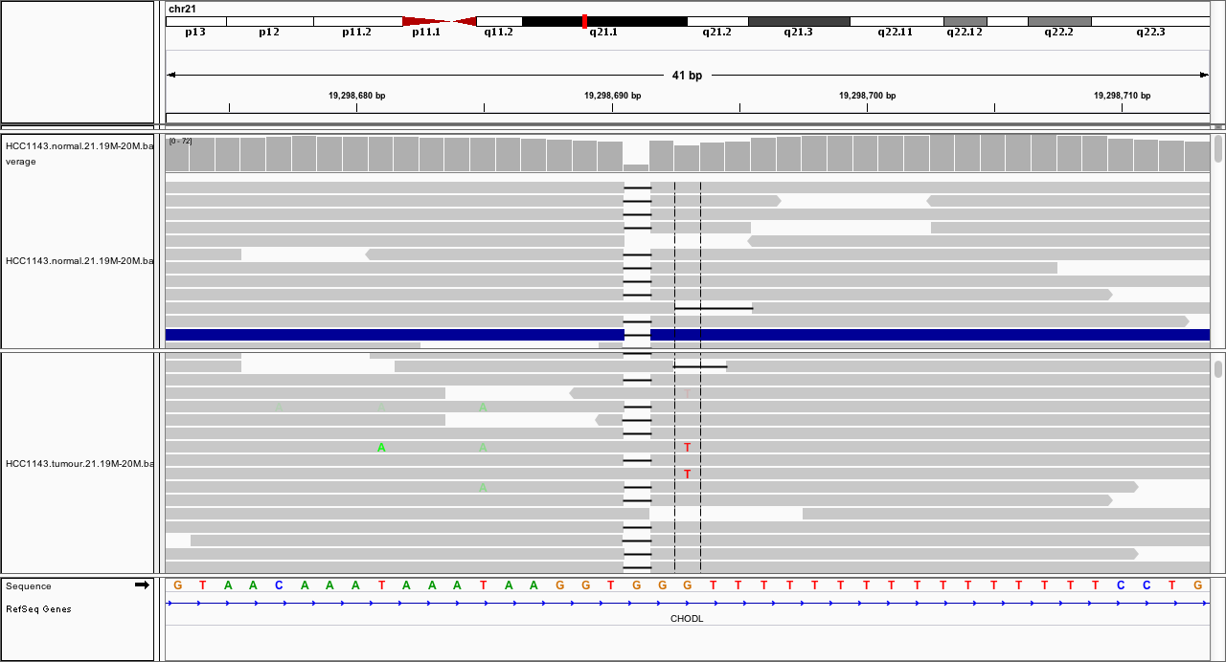
Browsing Somatic Mutations In IGV
Alignment issues with result in false positive; MutationSeq identified this as a “INDL” region (nearby by indels)
Notes:
This particular example is not from this sample

Slide 11
Summary Of Somatic Mutation Calling
Joint analysis of both tumour and normal genomes removes germline false positives effectively
False positives can still arise:
  Sequencing artifacts
  Alignment issues
Post-prediction filter can be further applied to reduce false positives
When possible, manually inspect predicted mutations in IGV

Slide 12
Summary Of Somatic Mutation Calling
Many different software for calling somatic mutations:
Strelka (https://sites.google.com/site/strelkasomaticvariantcaller/)
MutationSeq (http://compbio.bccrc.ca/software/)
Mutect (http://www.broadinstitute.org/cancer/cga/mutect)
EBCall (https://github.com/friend1ws/EBCall)
…
Tools designed for normal tissue work poorly for cancer genomes:
GATK
Samtools
No matter what software you use, all predictions are just predictions. Without validation on an orthogonal platform they should never be considered true.

