Slide 1
Canadian Bioinformatics Workshops
www.bioinformatics.ca

Slide 2
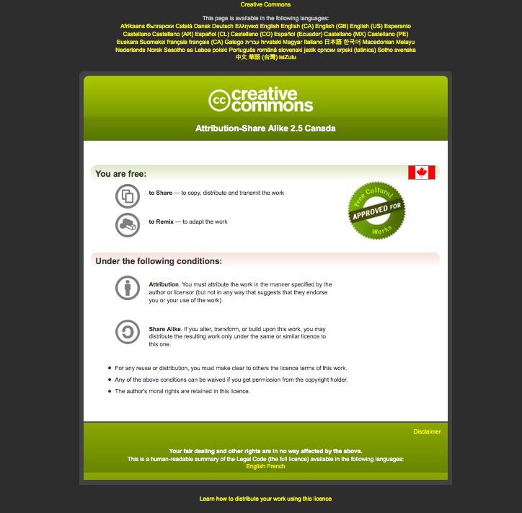
Module #: Title of Module

Slide 3
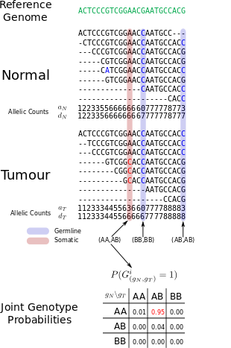


Module 6
Finding somatic mutations in cancer genome sequence data
Sohrab Shah, Andrew McPherson
compbio.bccrc.ca
Bioinformatics for Cancer Genomics
May 26-30, 2014
Many slides adapted from Gavin Ha,
Andrew Roth

Slide 4
Lab 6 Learning Objectives
Use SAMtools to view meta data in Sequence Alignment and Mapping files
Use GATK, Strelka and MutationSeq to call variants
Understand the variant call format (VCF)
Understand technical artifacts and the need to filter variants
Create a mutation portrait

Slide 5
Calling Variants
GATK (McKenna et al., Genome Res, 2010)
  Independent analyses
  post-processing to call somatic
Strelka (Saunders et al., Bioinformatics, 2012)
  Realignment around indels
MutationSeq (Ding et al., Bioinformatics, 2011)
  Supervised learning based on ~1000 validated events

Slide 6
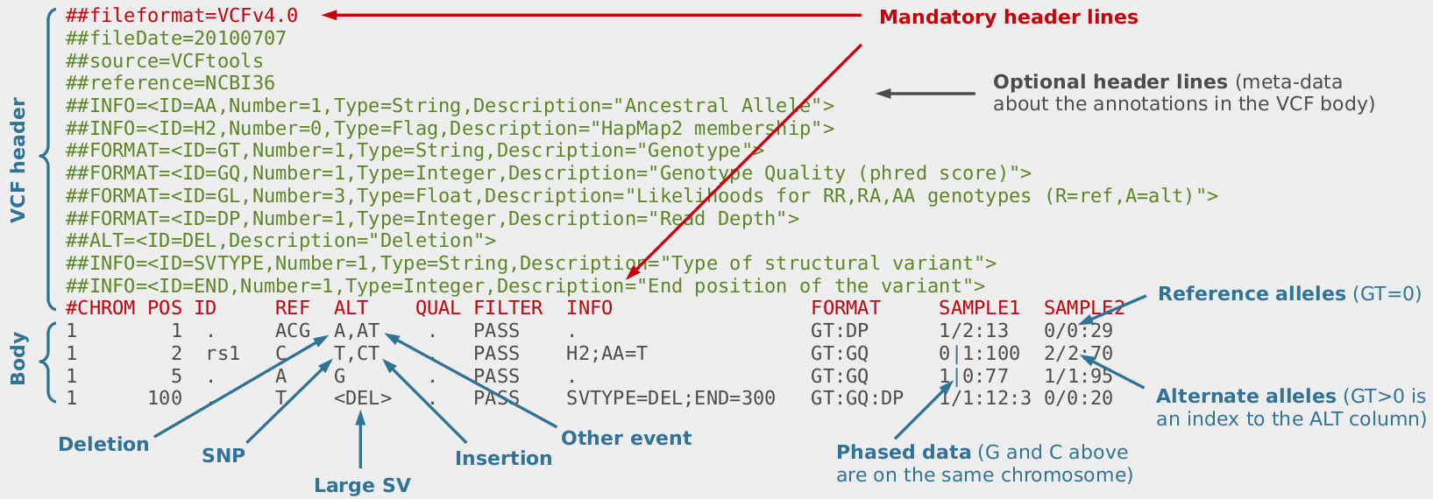
VCF Format
tab separated
1 line per variant
structured fields as detailed in header
Jose Blanca & Joaquin Cañizares
http://bioinf.comav.upv.es/courses/sequence_analysis/snp_calling.html

Slide 7
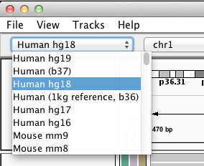
Browsing Somatic Mutations In IGV
Open IGV
Switch reference genome to “Human hg19”

Slide 8
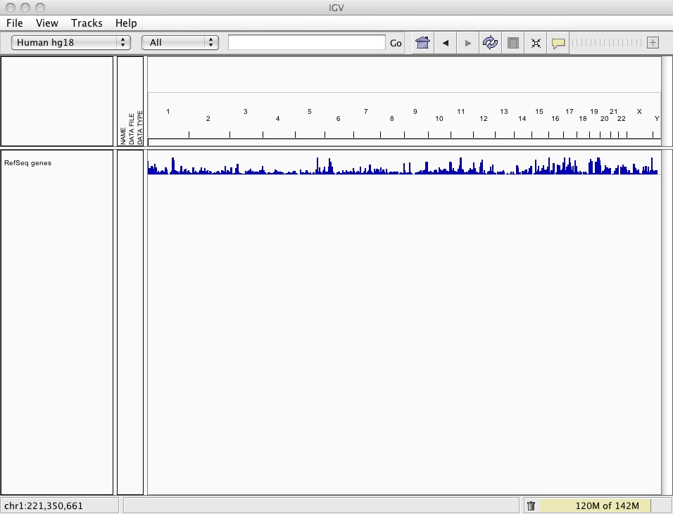
Browsing Somatic Mutations In IGV

Slide 9
Browsing Somatic Mutations In IGV
Download from wiki (if not done on Monday)
HCC1143.normal.21.19M-20M.bam
HCC1143.normal.21.19M-20M.bam.bai
HCC1143.tumour.21.19M-20M.bam
HCC1143.tumour.21.19M-20M.bam.bai
4. File → Load from File…

Slide 10
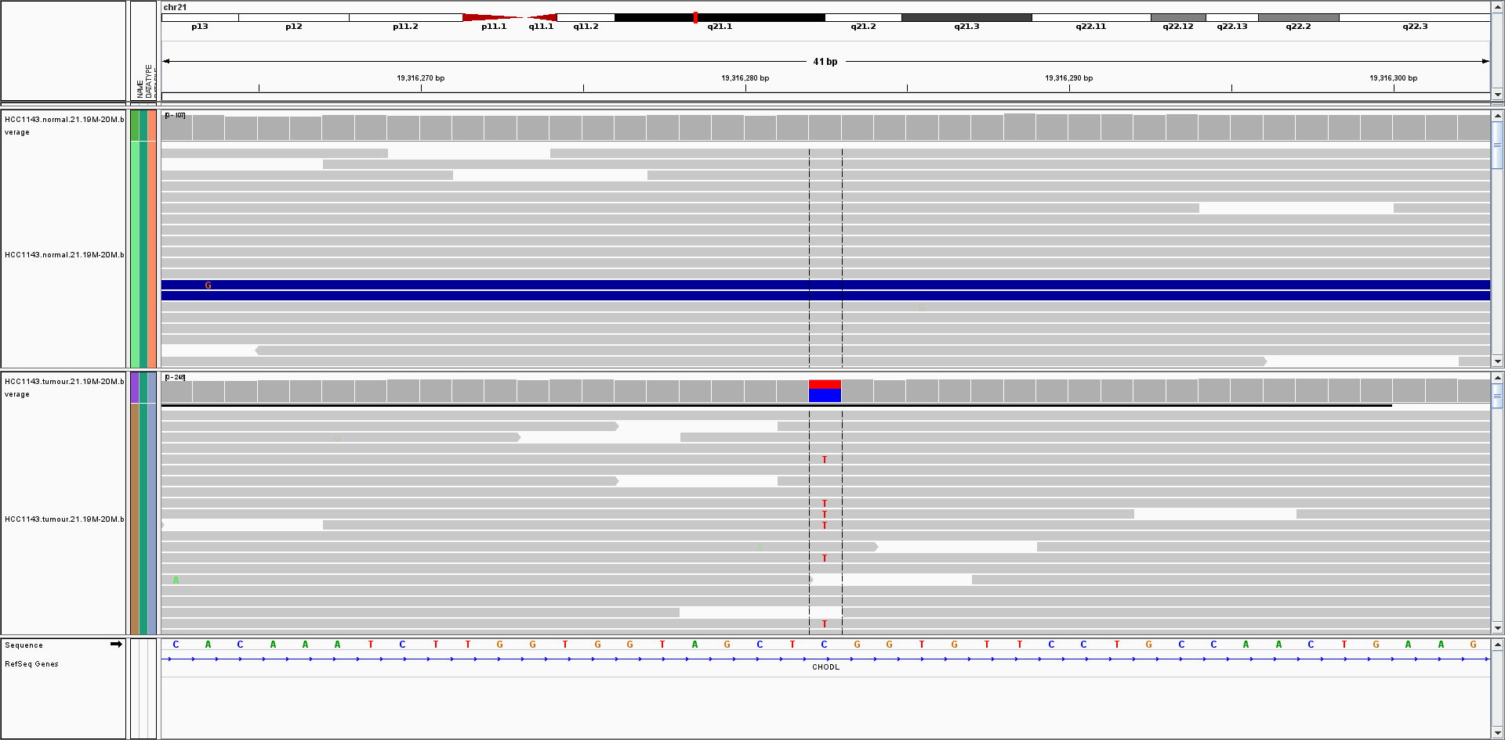
Browsing Somatic Mutations In IGV
Likely somatic mutations found by GATK, Strelka and MutationSeq
chr21:19316282

Slide 11
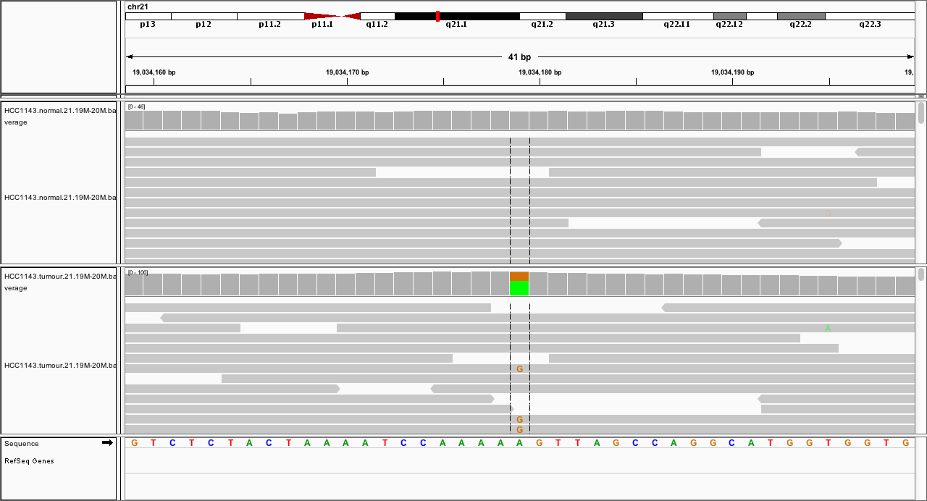
Browsing Somatic Mutations In IGV
Likely somatic mutations found by GATK, Strelka and MutationSeq
chr21:19034179

Slide 12
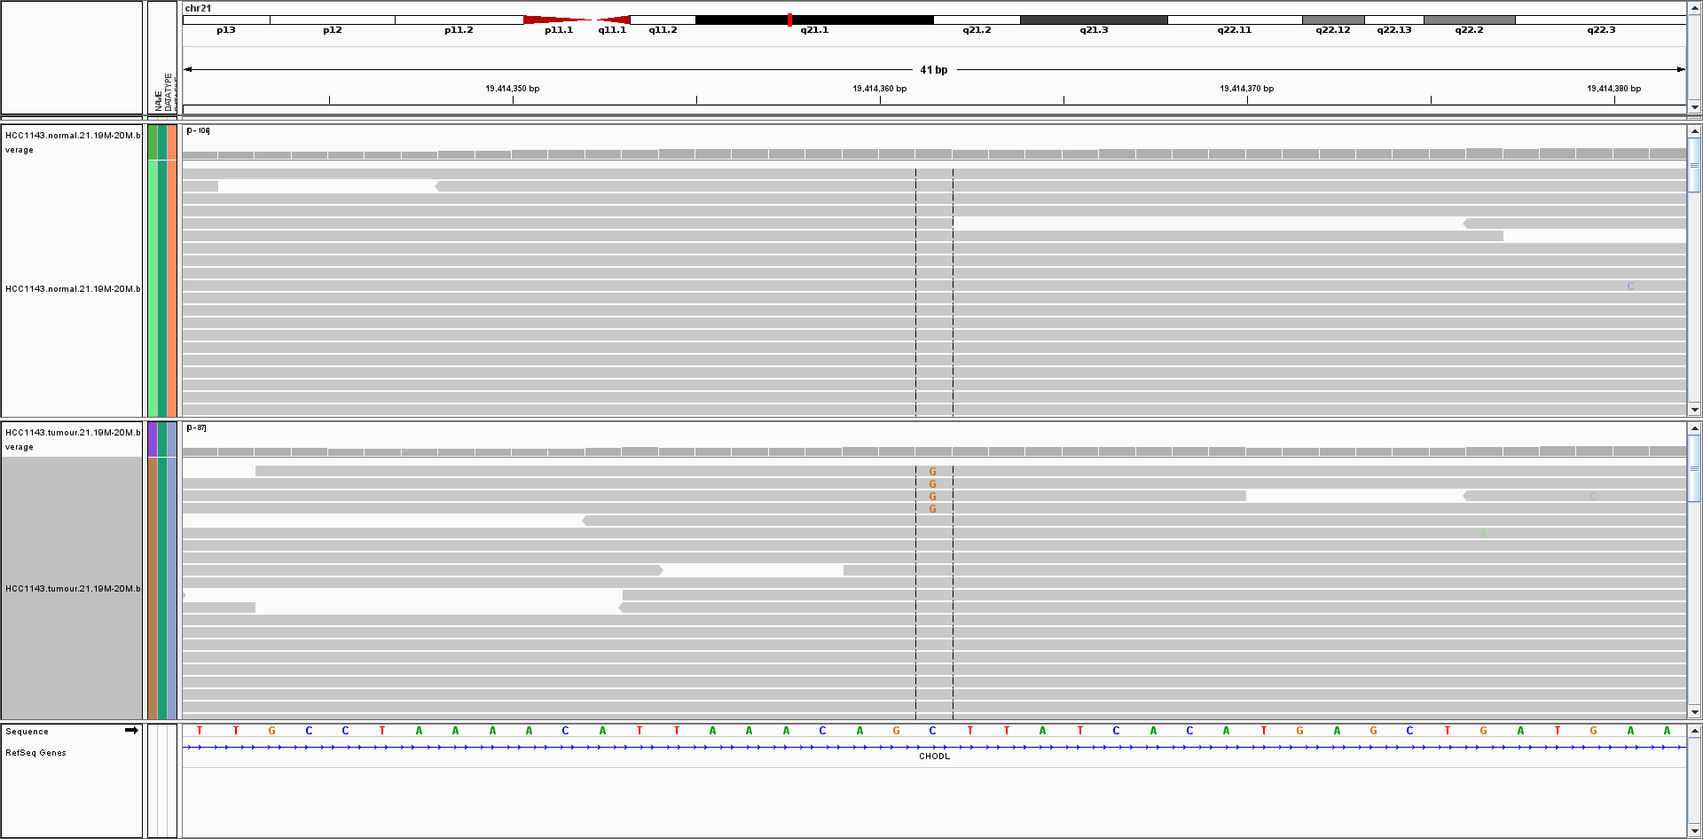
Browsing Somatic Mutations In IGV
Low prevalence somatic mutations found by GATK, Strelka (tier2) and MutationSeq
chr21:19414361

Slide 13
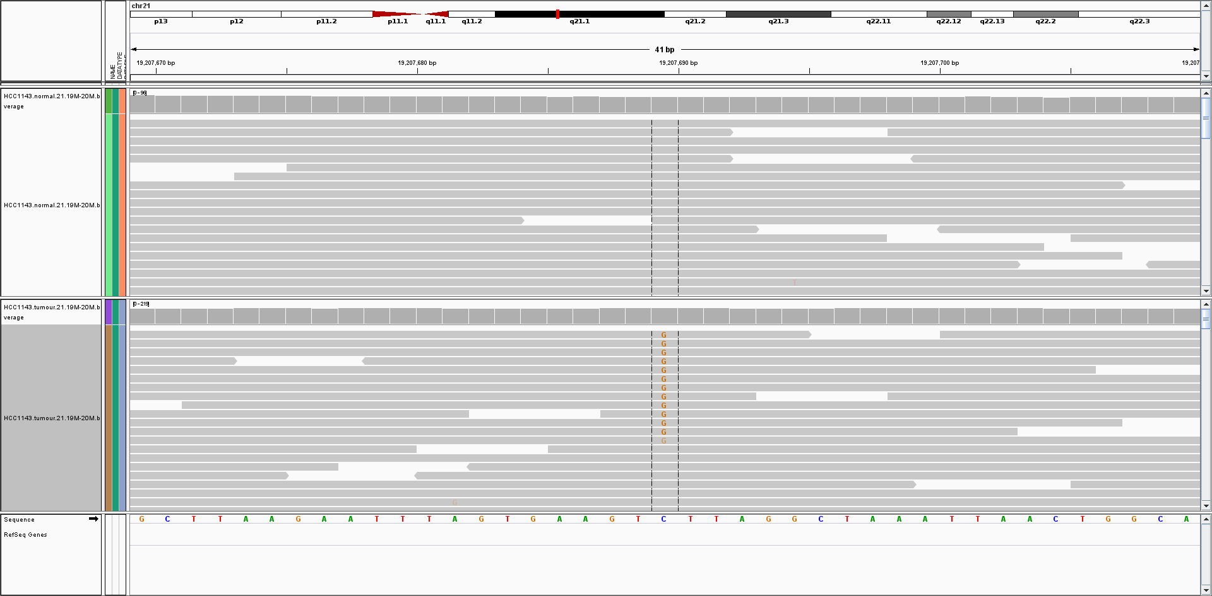
Browsing Somatic Mutations In IGV
Potential somatic found by MutationSeq and Strelka (tier1)
chr21:19207689

Slide 14
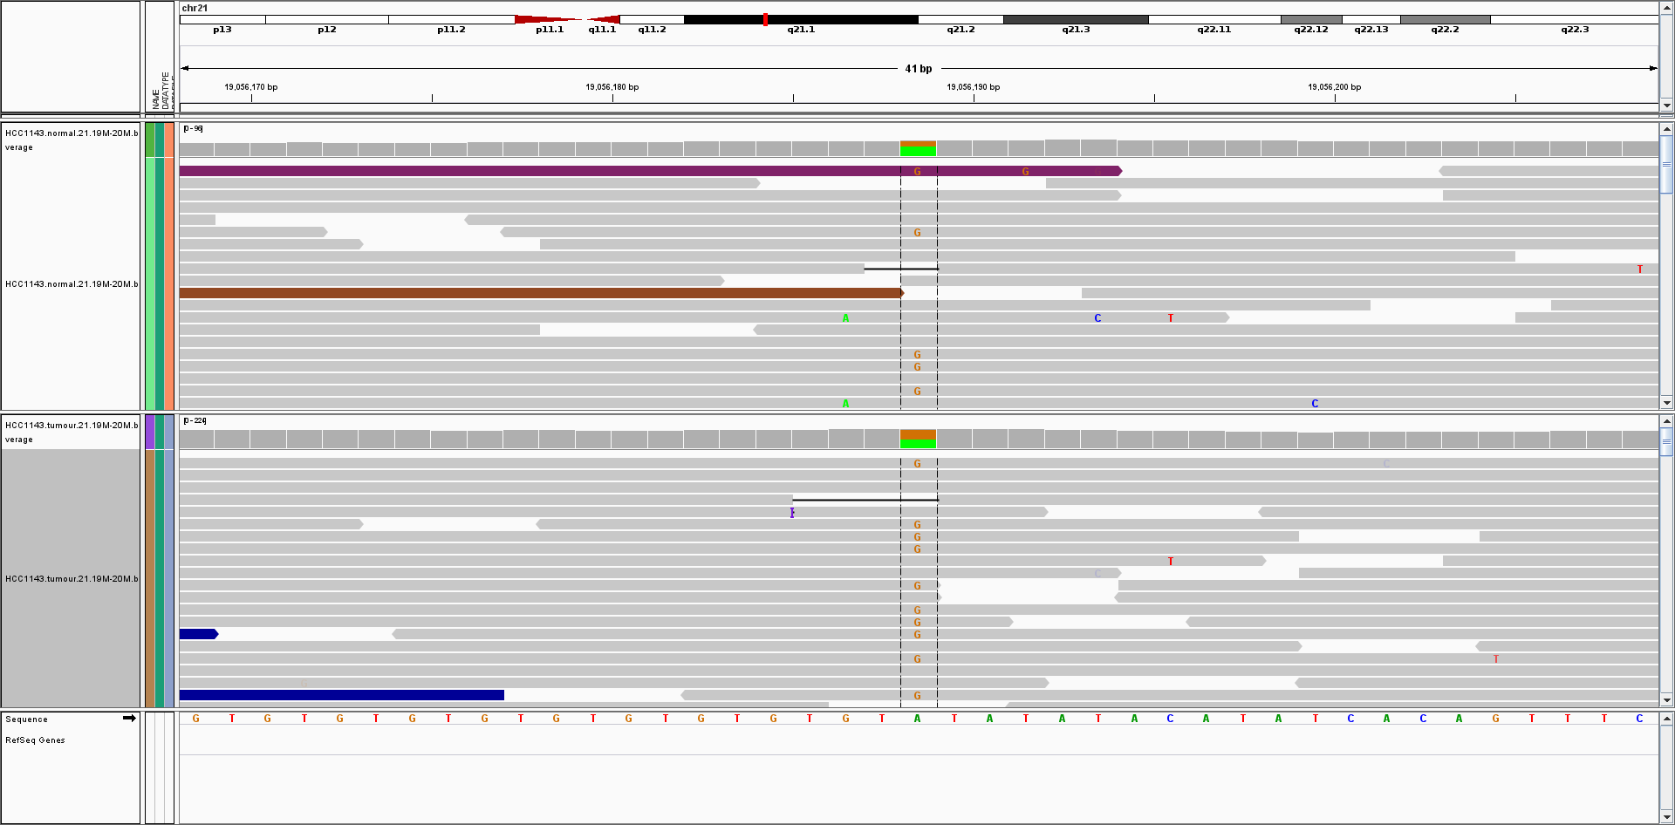
Browsing Somatic Mutations In IGV
Likely germline identified by GATK
chr21:19056188

Slide 15
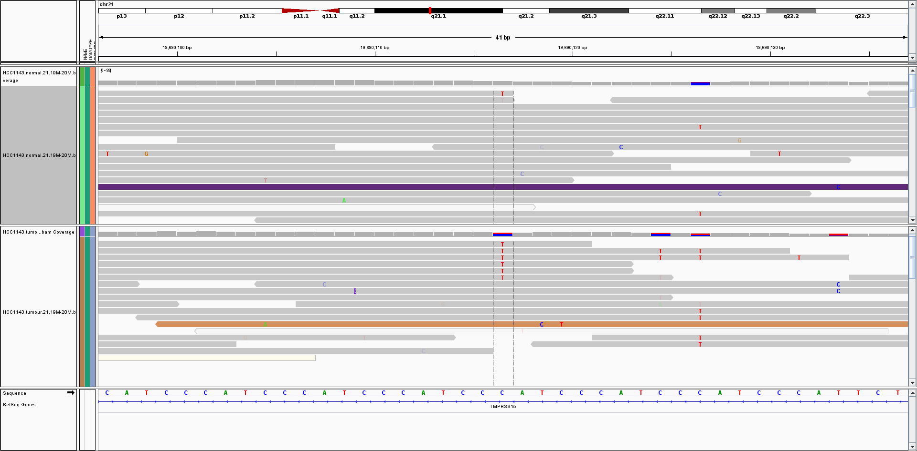
Browsing Somatic Mutations In IGV
Likely false positive identified by GATK
MutationSeq probability 0.05
chr21:19690116

Slide 16
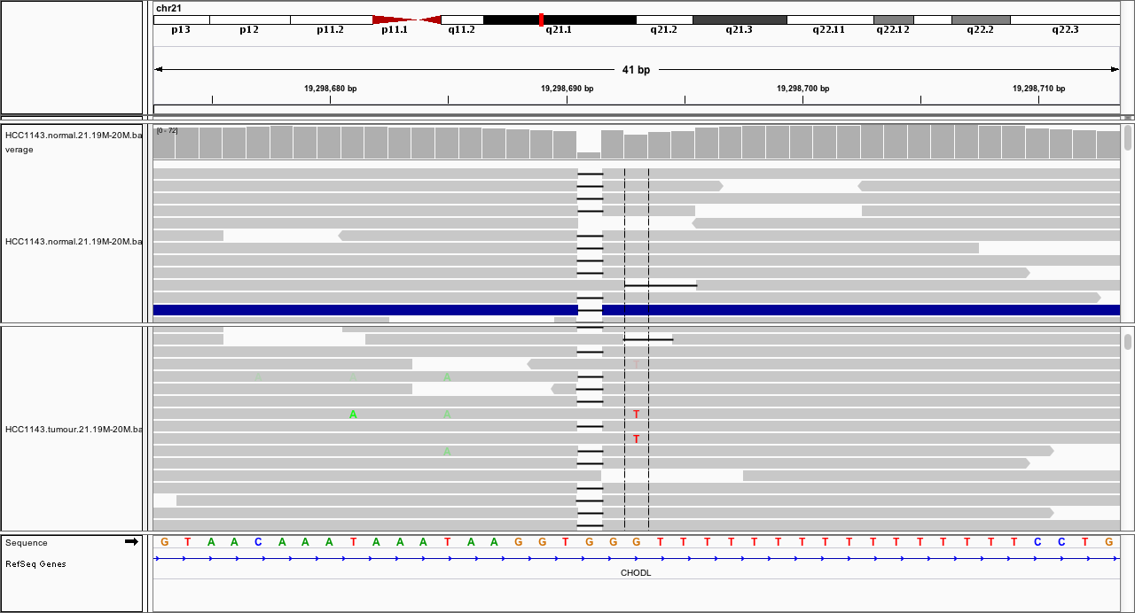
Browsing Somatic Mutations In IGV
Likely false positive identified by MutationSeq but flagged as INDL (likely indel artifact)
chr21:19298693

Slide 17
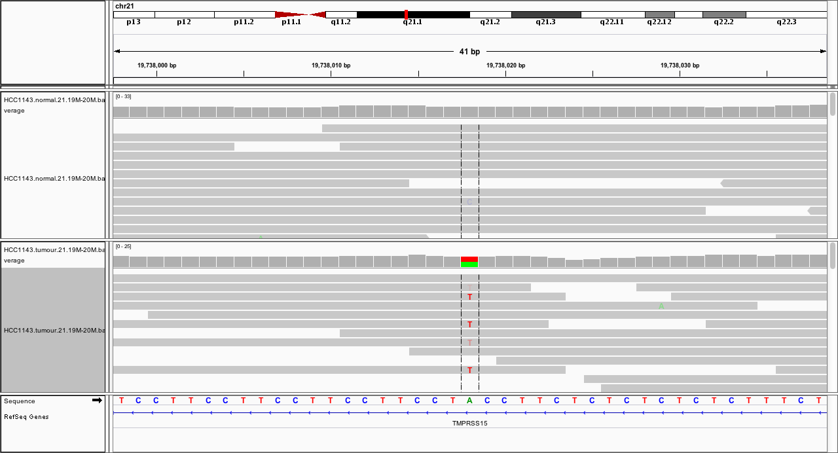
Browsing Somatic Mutations In IGV
Likely false positive identified by MutationSeq but flagged as INDL (likely indel artifact)
chr21:19738018

Slide 18
Summary Of Somatic Mutation Calling
Sources of false positives
  Germline variants
  Alignment and sequencing artifacts
Joint analysis of both genomes removes germline false positives effectively.
Filtering removes artifacts

Slide 19
Summary Of Somatic Mutation Calling
Lots of software for calling somatic mutations
JointSNVMix (http://compbio.bccrc.ca/software/)
MutationSEQ (http://compbio.bccrc.ca/software/)
Mutect (http://www.broadinstitute.org/cancer/cga/mutect)
Strelka (https://sites.google.com/site/strelkasomaticvariantcaller/)
EBCall (https://github.com/friend1ws/EBCall)
And many more...
Tools for normal tissue work poorly, some bad choices
GATK
Samtools
No matter what software you use, all predictions are just predictions. Without validation on an orthogonal platform they should never be considered true.

