Slide 1
Canadian Bioinformatics Workshops
www.bioinformatics.ca

Slide 2
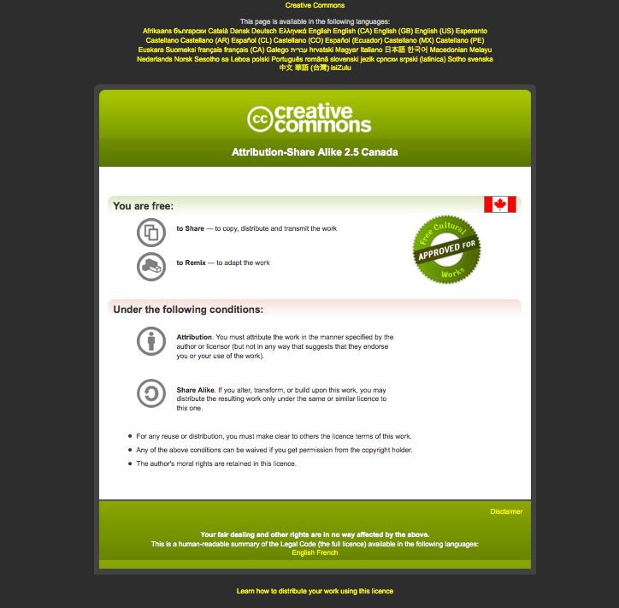
Module #: Title of Module

Slide 3
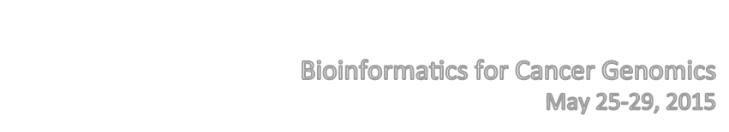
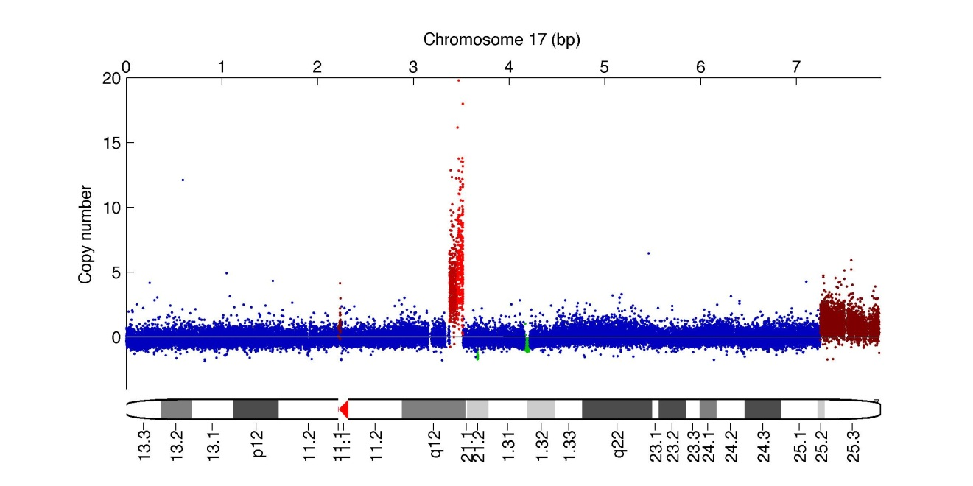


Lab Module 5
Copy Number Alterations
Many slides adapted from Gavin Ha,
Andrew Roth, and Andrew McPherson

Slide 4
Lab Module 5: Learning Objectives
Understand the basic workflow for identifying CNVs
Apply methods to identify CNAs in array and sequencing data
Visualize and interpret the results of CNA analyses

Slide 5
Getting Started
The “Installation” wiki page shows installation of tools used in this module
The “PrepData” wiki page details where we obtained the data
The “Lab” wiki page shows the steps taken in this lab
We will work through the “Lab” wiki page. You can use the “Data Preparation” wiki page as reference if interested
Notes:
- Installation wiki page...won’t go over how to install, but it is all documented in this page. Feel free to contact me if you have any issues installing these software following the workshop.

Slide 6
Analysis Of CNAs using Arrays
Normalize Data
Extract BAF & LRR
Call
CNVs
Visualize Results

Slide 7
Step 1: Normalize Data
Normalize Data
Extract BAF & LRR
Call
CNVs
Visualize Results

Slide 8
Step 1: Normalize Data
Because DNA does not hybridize with the same efficiency in all experiments, some normalization must be done
Methods for normalization depend on the platform (e.g. Affymetrix SNP 6.0, Illumina)
Software (Affymetrix SNP 6.0)
  Affymetrix Power Tools http://www.affymetrix.com/support/developer/powertools/index.affx
  Using R the AROMA package can be used http://www.aroma-project.org/_x000b_
For this tutorial we will use the Affymetrix Power Tools
  Comprehensive description of the entire normalization process can be found here: http://www.openbioinformatics.org/penncnv/penncnv_tutorial_affy_gw6.html
Notes:
In general, normalization using a batch of samples run at the same time under the same conditions should be done

Slide 9
Step 2: Extract BAF and LRR
Normalize Data
Extract BAF & LRR
Call
CNVs
Visualize Results

Slide 10
Step 2: Extract BAF and LRR
SNP genotyping arrays can measure how many copies of the A and B alleles are present
Most tools prefer to work with B allele frequencies (BAF) and Log R Ratio (LRR):
  BAF = B / (A+B)
  LRR = log(A + B) – log(x)
    x is the intensity we would expect from a probe at normal copy number
We need to convert the normalized outputs from the arrays to these values
For this tutorial we used normalize_affy_geno_cluster.pl supplied as part of the PennCNV package http://www.openbioinformatics.org/penncnv/
Notes:
- x can be estimated, but in tumours it gets difficult if the genome is heavily amplified or delete

Slide 11
Step 3: Call CNVs
Normalize Data
Extract BAF & LRR
Call
CNVs
Visualize Results

Slide 12
Step 3: Call CNVs
Calling CNVs converts the BAF and LRR measurements across the many probes (~1.8 million for Affymetrix SNP 6.0) to predictions of copy number segments
Calling CNVs in tumour genomes is challenging due to:
  Normal contamination
  Germline polymorphisms
  Genomic heterogeneity of tumour cells
  Ploidy i.e. baseline LRR
Notes:
In cancer we are generally interested in the parental copy number (PCN) i.e. the number of each the two chromosomes from the parents.
An important case is when the copy number of one parental chromosome is 0, while the other is > 0. This is called Loss Of Heterozygosity (LOH).
LOH is a very important mechanism for inactivating tumour suppressors.

Slide 13
Step 3: Call CNVs
Software (a few examples):
  OncoSNP (https://sites.google.com/site/oncosnp/)
  PICNIC (http://www.sanger.ac.uk/genetics/CGP/Software/PICNIC/)
  ASCAT (http://heim.ifi.uio.no/bioinf/Projects/ASCAT/)
  HAPSEG (https://confluence.broadinstitute.org/display/CGATools/HAPSEG)
For this tutorial we will use OncoSNP:
  It is well documented
  Handles all the confounding factors in a statistically sound framework
Notes:
The run_oncosnp.sh provides encodes the arguments to oncosnp
As you can see in the script many arguments need to be passed so using a wrapper script makes life easy
The script will only analyze chromosome 21 because we set -chr 21
The script will also sets -emiters 1, which shortens the run time but leads to a worse fit. Generally -emiters 15 is recommended.
OncoSNP is quite slow so expect up to 24 hours for a whole genome analysis.

Slide 14
Step 4: Visualize Results
Normalise Data
Extract BAF & LRR
Call
CNVs
Visualize Results

Slide 15
Step 4: Visualize Results
OncoSNP results can be found in the module package:
  content/results/oncosnp
The plot files HCC1143.*.ps.gz provide a nice summary figure of the data

Slide 16
CNV Analysis using Sequencing Data
Conceptually, CNV analysis for sequencing and array data follows the same workflow
The main difference is that we start from aligned read data (BAM) instead of raw array data (CEL, etc)
A new issue that arises with sequencing data is mappability:
  Some regions of the genome are easier to map reads to than other regions

Slide 17
CNV Analysis using Sequencing Data
Software (a few examples)
  OncoSNP-Seq (https://sites.google.com/site/oncosnpseq/)
  HMMCopy/TITAN (http://compbio.bccrc.ca/software/titan)
  SomitCA ((http://www.bioconductor.org/packages/release/bioc/html/SomatiCA.html)
  …
Today we will HMMCopy/TITAN because they are published and relatively mature

Slide 18
Browse Segment Data in IGV
Download METABRIC_DatasetI997.seg from the wiki
  997 breast cancer copy number alterations predicted from SNP6 arrays (Curtis C*, Shah SP*, et al., Nature, 2012)
Open IGV
Switch reference genome to “Human hg18”
File -> Load from File…
Tracks -> Fit Data to Window

Slide 19
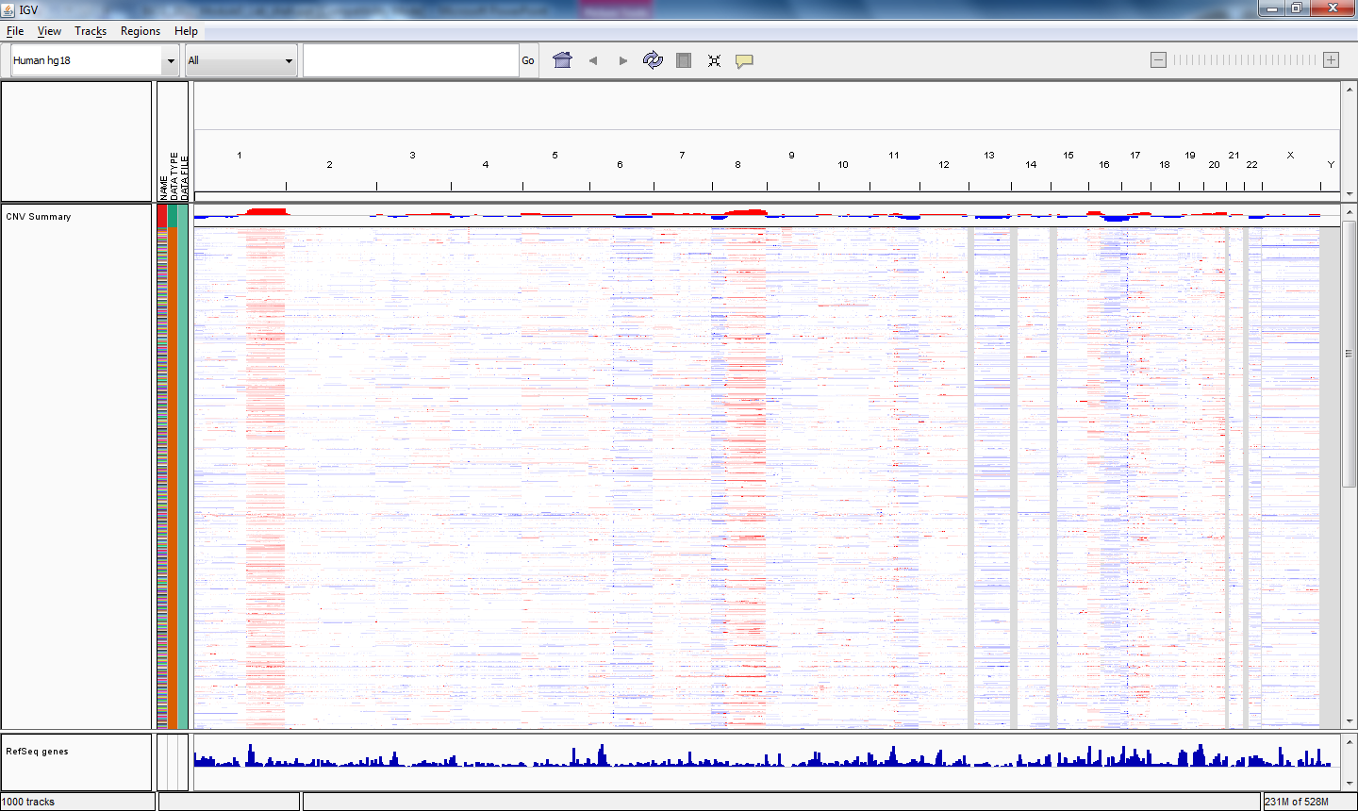
Browse Segment Data in IGV
Notes:
-highly frequent events in chr1, chr8
-mutual exclusivity

Slide 20
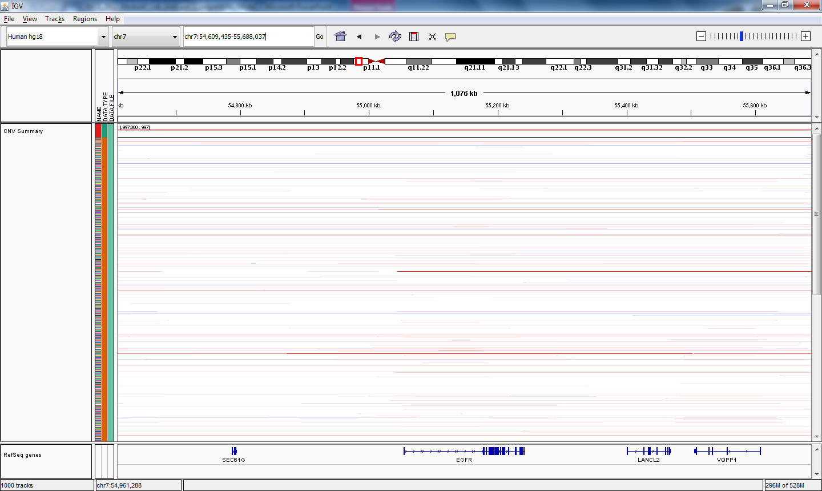
Example of Somatic High-Level Amp
Examples of EGFR somatic high-level amp
In the Search bar, type the gene:
EGFR
Press Enter, then click zoom out “-” twice.

Slide 21
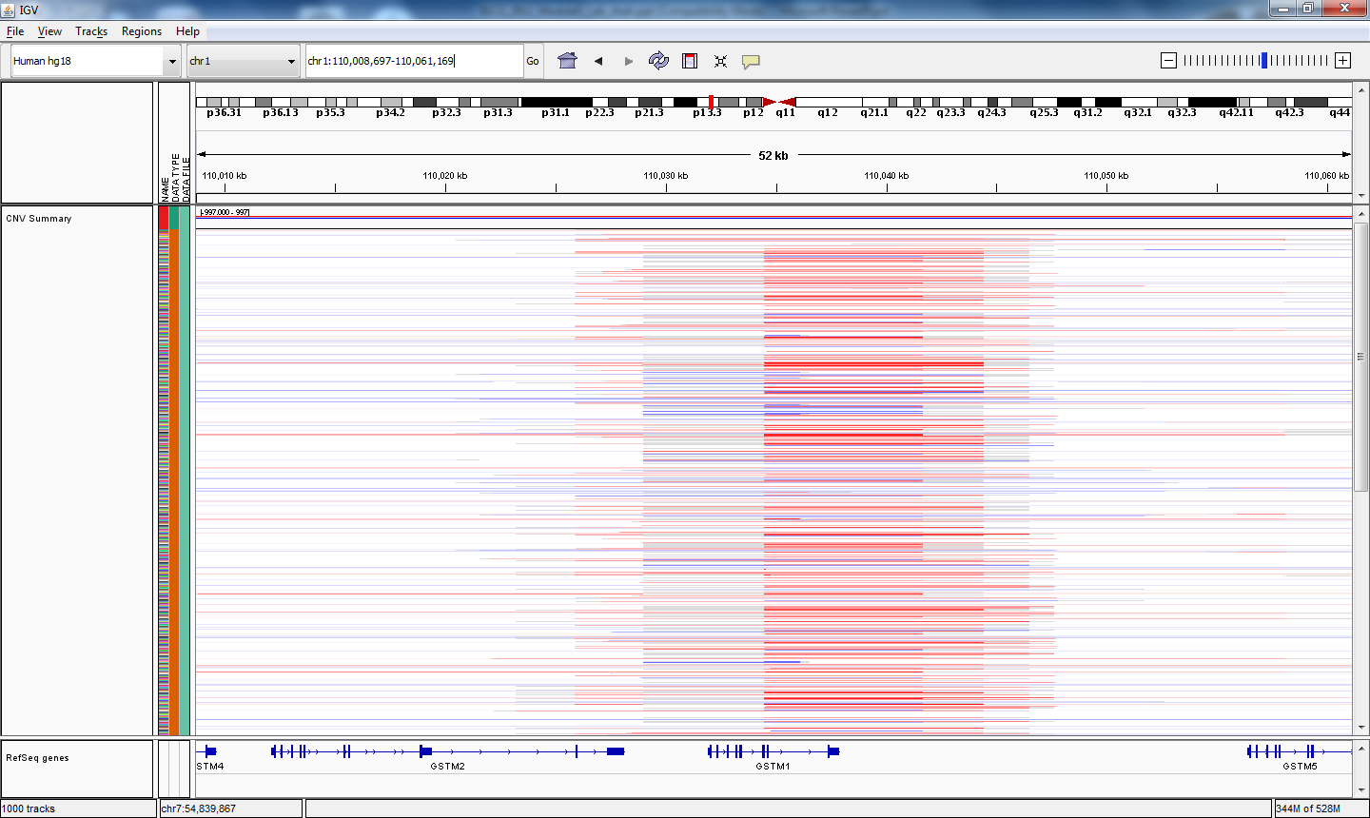
Example of Germline CNVs
Examples of germline CNVs
In the Search bar, type the gene:
GSTM1
Note the alternating gains and losses.
Note the length of the markers

