Slide 1
Canadian Bioinformatics Workshops
www.bioinformatics.ca

Slide 2
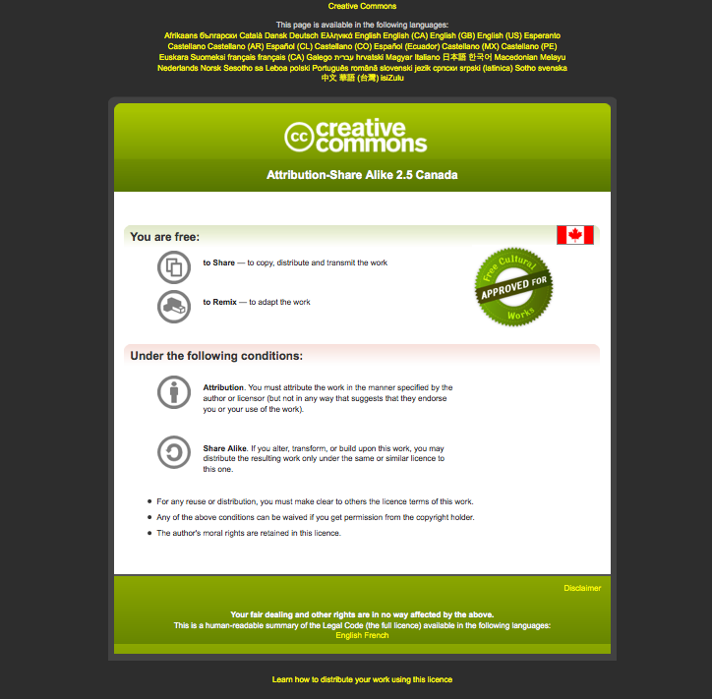
Module #: Title of Module
2

Slide 3
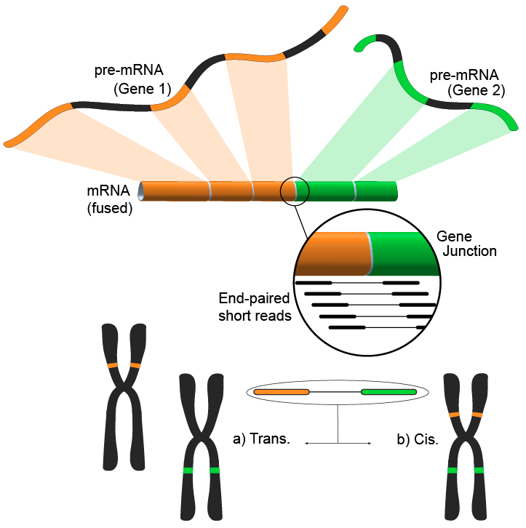
Module 4 Gene Fusion Discovery Lab
Andrew McPherson
Bioinformatics for Cancer Genomics
May 26-30, 2014
awm3@sfu.ca
http://compbio.bccrc.ca
http://compbio.cs.sfu.ca

Slide 4
Learning Objectives of Module
Explore impact of gene fusions in cancer
Learn about types of evidence for gene fusions
Understanding of the available detection methods/tools
Identify common sources of false positives
Assess a gene fusion’s potential function

Slide 5
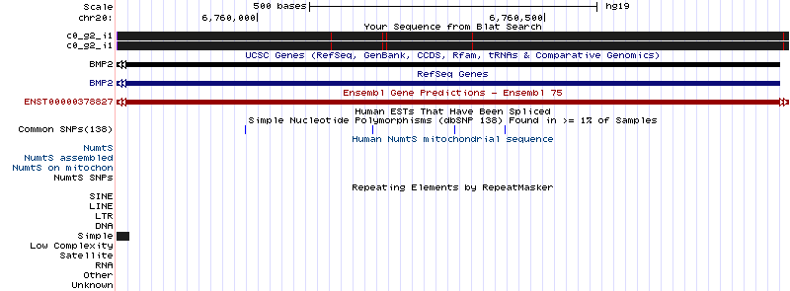
Assembly artifact chimera produced by a Simple repeat
chr20:6,759,757-6,760,925

Slide 6
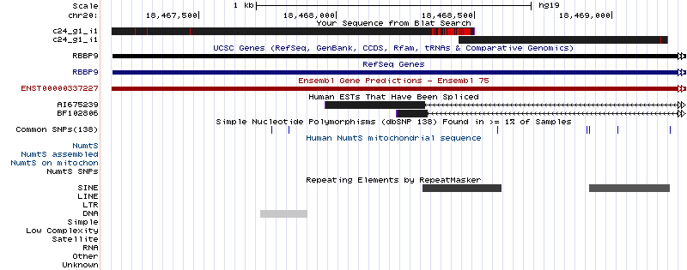
Assembly artifact chimera produced by a SINE repeat
chr20:18,467,148-18,469,269

Slide 7
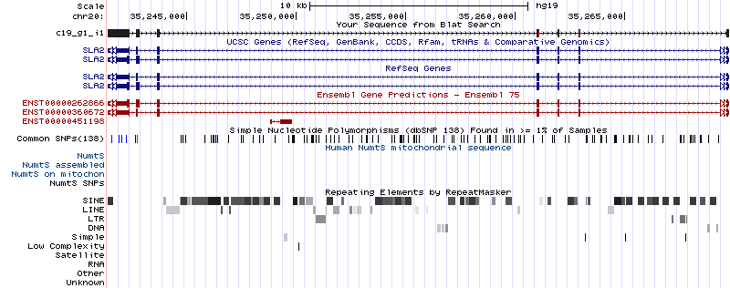
True fusion assembly identified by Trinity/gmap
chr20:35,241,397-35,269,781

Slide 8
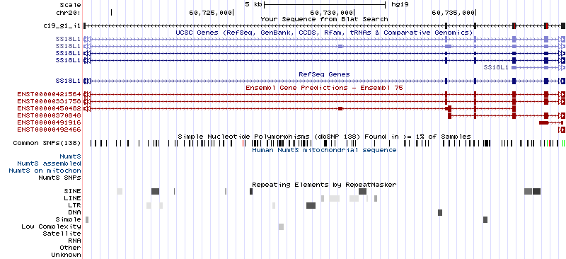
True fusion assembly identified by Trinity/gmap
chr20:60,718,853-60,738,677

