Slide 1
Canadian Bioinformatics Workshops
www.bioinformatics.ca

Slide 2
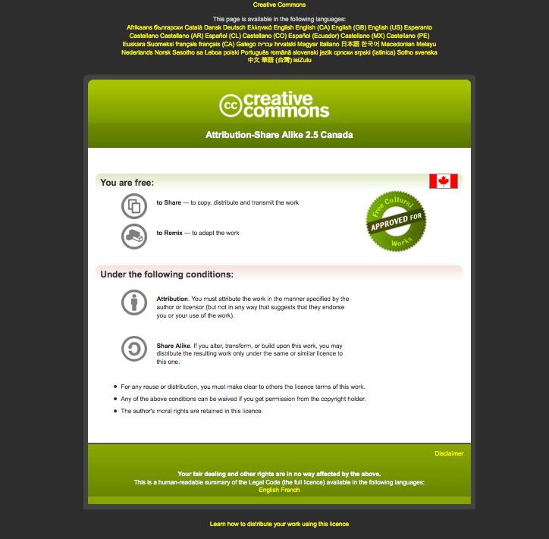
Module #: Title of Module

Slide 3
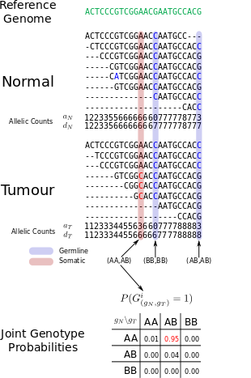


Module 6
Finding somatic mutations in cancer genome sequence data
Sohrab Shah, Andrew McPherson
compbio.bccrc.ca
Bioinformatics for Cancer Genomics
May 26 - June 1 2013
Many slides adapted from Gavin Ha,
Andrew Roth

Slide 4
Lab 6 Learning Objectives
Use SAMtools to view meta data in sequence files and prepare index files
Use GATK to call variants
Understand the variant call format (VCF)
Use JointSNVMix to call variants
Understand the benefits of jointly analysing tumour and normal genomes
Understand technical artifacts and the need to filter variants

Slide 5
Downloads And Cloud Access
> cd ~/workspace
> wget http://bioinformatics.ca/workshop_wiki/images/7/77/Module6.tar.gz
> tar -zxvf Module6.tar.gz

Slide 6
Part 1.1: View BAM Files
> cd ~/CourseData/CG_data/Module6/data/bam
> ls -lh
> samtools view -H HCC1143.normal.21.19M-20M.bam|less -S
> samtools view HCC1143.normal.21.19M-20M.bam|less -S
> samtools flagstat HCC1143.normal.21.19M-20M.bam

Slide 7
Part 1.2: Build Index Files
# Builds an index for the BAM file
> samtools index HCC1143.normal.21.19M-20M.bam
> cd ../fasta
> ls -lh
# Builds an index for the reference genome FASTA file
> samtools faidx Homo_sapiens_assembly19.fasta

Slide 8
Part 2: Call Variants With GATK
> ~/CourseData/CG_data/Module6/data/bam
> ls -lh
> samtools view -H HCC1143.normal.21.19M-20M.bam|less -S
> samtools view HCC1143.normal.21.19M-20M.bam|less -S
> samtools flagstat HCC1143.normal.21.19M-20M.bam

Slide 9
Part 2: Call Variants With GATK
GATK (McKenna et al., Genome Res, 2010)
java -jar /usr/local/GATK/GenomeAnalysisTK.jar –h
---------------------------------------------------------------------------------
The Genome Analysis Toolkit (GATK) v1.1-23-g8072bd9, Compiled 2011/08/08 17:41:57
Copyright (c) 2010 The Broad Institute
Please view our documentation at http://www.broadinstitute.org/gsa/wiki
For support, please view our support site at http://getsatisfaction.com/gsa
---------------------------------------------------------------------------------
---------------------------------------------------------------------------------
usage: java -jar GenomeAnalysisTK.jar -T <analysis_type> [-I <input_file>] [-SM <sample_metadata>] [-rbs <read_buffer_size>]
[-et <phone_home>] [-rf <read_filter>] [-L <intervals>] [-XL <excludeIntervals>] [-R <reference_sequence>] [-B
<rodBind>] [-BTI <rodToIntervalTrackName>] [-BTIMR <BTI_merge_rule>] [-ndrs] [-D <DBSNP>] [-dt <downsampling_type>]
[-dfrac <downsample_to_fraction>] [-dcov <downsample_to_coverage>] [-baq <baq>] [-baqGOP <baqGapOpenPenalty>] [-PF
<performanceLog>] [-OQ] [-DBQ <defaultBaseQualities>] [-S <validation_strictness>] [-U <unsafe>] [-nt <num_threads>]
[-im <interval_merging>] [-rgbl <read_group_black_list>] [--disable_experimental_low_memory_sharding] [-l
<logging_level>] [-log <log_to_file>] [-h]
-T,--analysis_type <analysis_type> Type of analysis to run
-I,--input_file <input_file> SAM or BAM file(s)
-SM,--sample_metadata <sample_metadata> Sample file(s) in JSON format
-rbs,--read_buffer_size <read_buffer_size> Number of reads per SAM file to buffer in memory
-et,--phone_home <phone_home> What kind of GATK run report should we generate? Standard
is the default, can be verbose or NO_ET so nothing is posted
to the run repository (NO_ET|STANDARD|STDOUT|AWS_S3)
….
Extensive documentation on using GATK is available here:
http://www.broadinstitute.org/gsa/wiki/index.php/The_Genome_Analysis_Toolkit

Slide 10
Part 2: Call Variants With GATK
> cd ~/workspace/Module6/scripts
> less -S run_gatk.sh
> mkdir ~/workspace/Module6/gatk
> ./run_gatk.sh ~/CourseData/CG_data/Module6/data/fasta/Homo_sapiens_assembly19.fasta ~/CourseData/CG_data/Module6/data/bam/HCC1143.normal.21.19M-20M.bam ~/CourseData/CG_data/Module6/data/bam/HCC1143.tumour.21.19M-20M.bam ~/workspace/Module6/gatk/results.vcf

Slide 11
Part 2: Call Variants With GATK
> less -S ../gatk/results.vcf
> less -S results.vcf
> python call_somatic_mutations.py –-help
> python call_somatic_mutations.py ../gatk/results.vcf --normal_column 1 --min_genotype_quality 30 > ../gatk/somatics.txt
> less -S ../gatk/somatics.txt

Slide 12
Part 3: Call Variants With JointSNVMix
> jsm.py --help
> jsm.py train --help
> jsm.py classify --help
> mkdir ~/workspace/Module6/jointsnvmix
> ./run_jointsnvmix.sh ~/CourseData/CG_data/Module6/data/fasta/Homo_sapiens_assembly19.fasta ~/CourseData/CG_data/Module6/data/bam/HCC1143.normal.21.19M-20M.bam ~/CourseData/CG_data/Module6/data/bam/HCC1143.tumour.21.19M-20M.bam ~/workspace/Module6/jointsnvmix

Slide 13
Part 3: Call Variants With JointSNVMix
> less -S ../jointsnvmix/
> less -S ../jointsnvmix/params.txt
> less -S ../jointsnvmix/results.txt

Slide 14
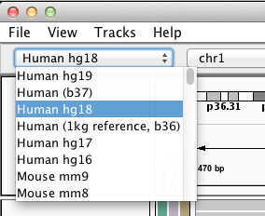
Part 4: Browsing Somatic Mutations In IGV
Open IGV
Switch reference genome to “Human hg19”

Slide 15
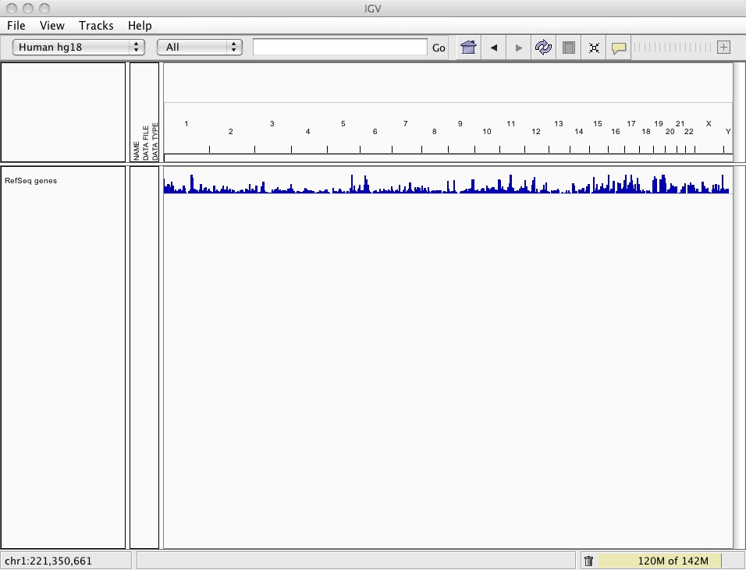
Part 4: Browsing Somatic Mutations In IGV

Slide 16
Part 4: Browsing Somatic Mutations In IGV
Download from wiki (if not done on Monday)
HCC1143.normal.21.19M-20M.bam
HCC1143.normal.21.19M-20M.bam.bai
HCC1143.tumour.21.19M-20M.bam
HCC1143.tumour.21.19M-20M.bam.bai
4. File → Load from File…

Slide 17
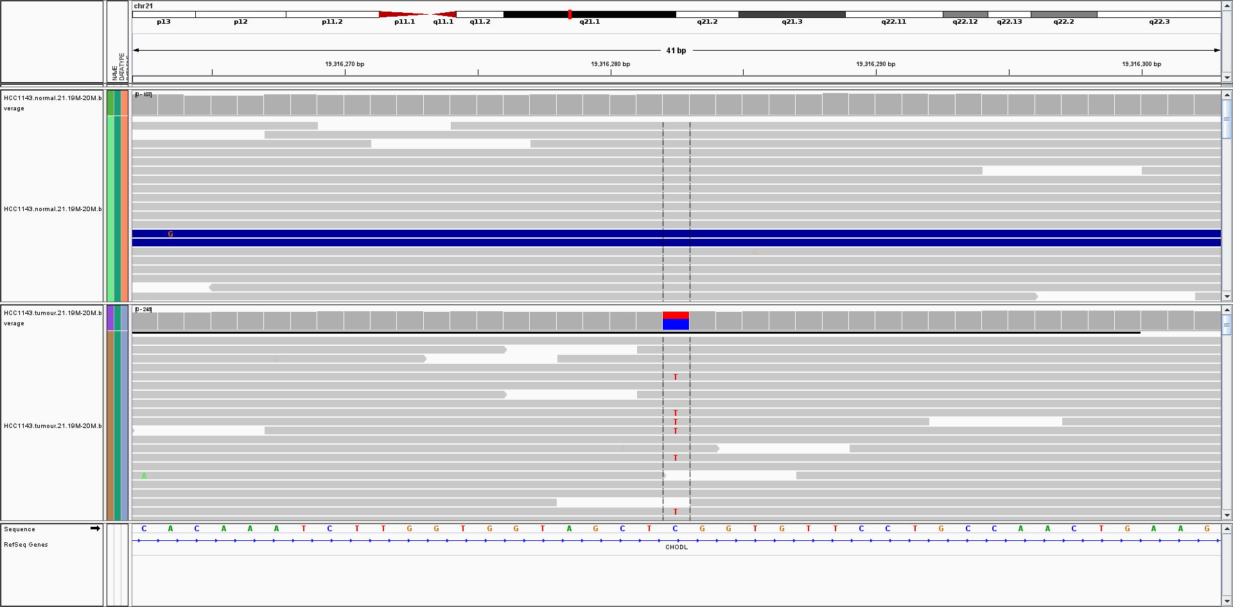
Part 4: Browsing Somatic Mutations In IGV
Likely somatic mutations found by GATK, Strelka and MutationSeq
chr21:19316282

Slide 18
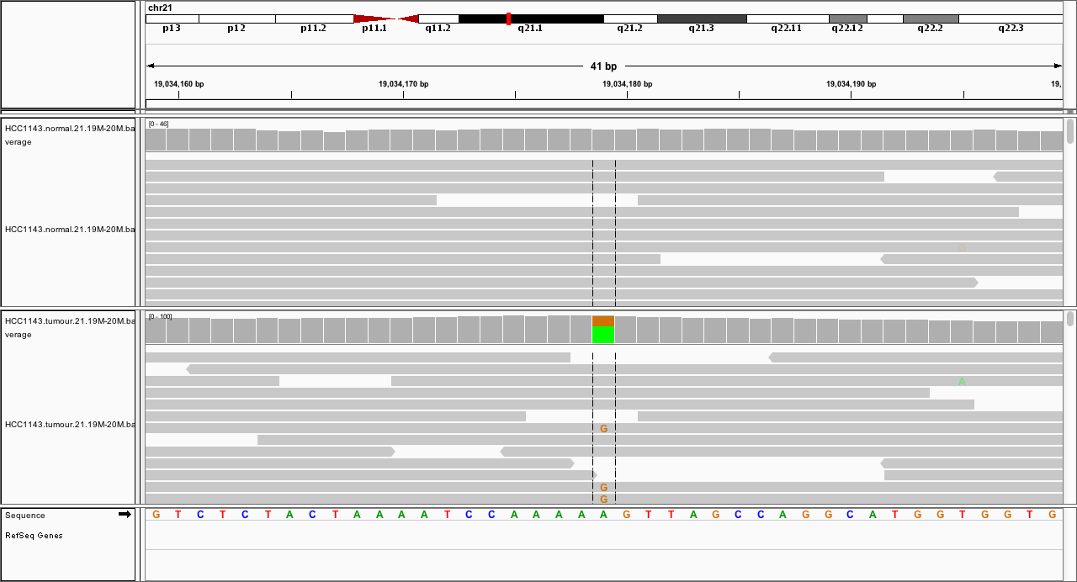
Part 4: Browsing Somatic Mutations In IGV
Likely somatic mutations found by GATK, Strelka and MutationSeq
chr21:19034179

Slide 19
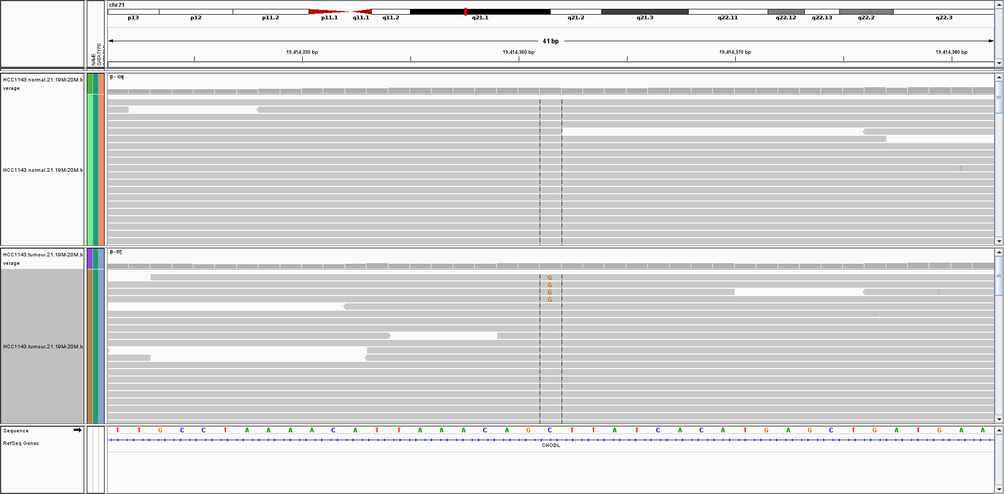
Part 4: Browsing Somatic Mutations In IGV
Low prevalence somatic mutations found by GATK, Strelka (tier2) and MutationSeq
chr21:19414361

Slide 20
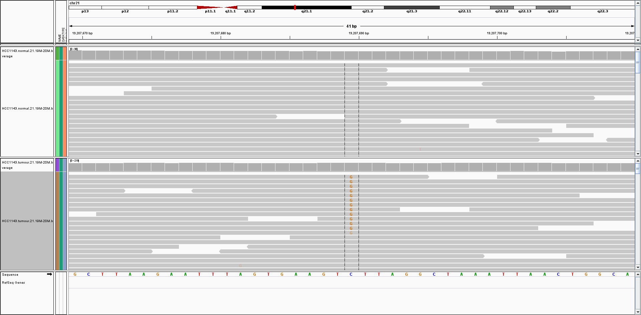
Part 4: Browsing Somatic Mutations In IGV
Potential somatic found by MutationSeq and Strelka (tier1)
chr21:19207689

Slide 21
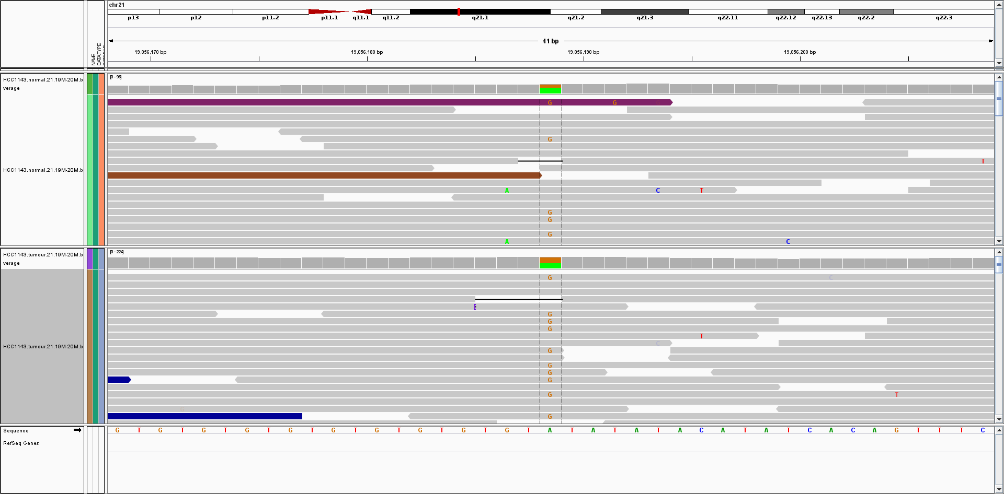
Part 4: Browsing Somatic Mutations In IGV
Likely germline identified by GATK
chr21:19056188

Slide 22
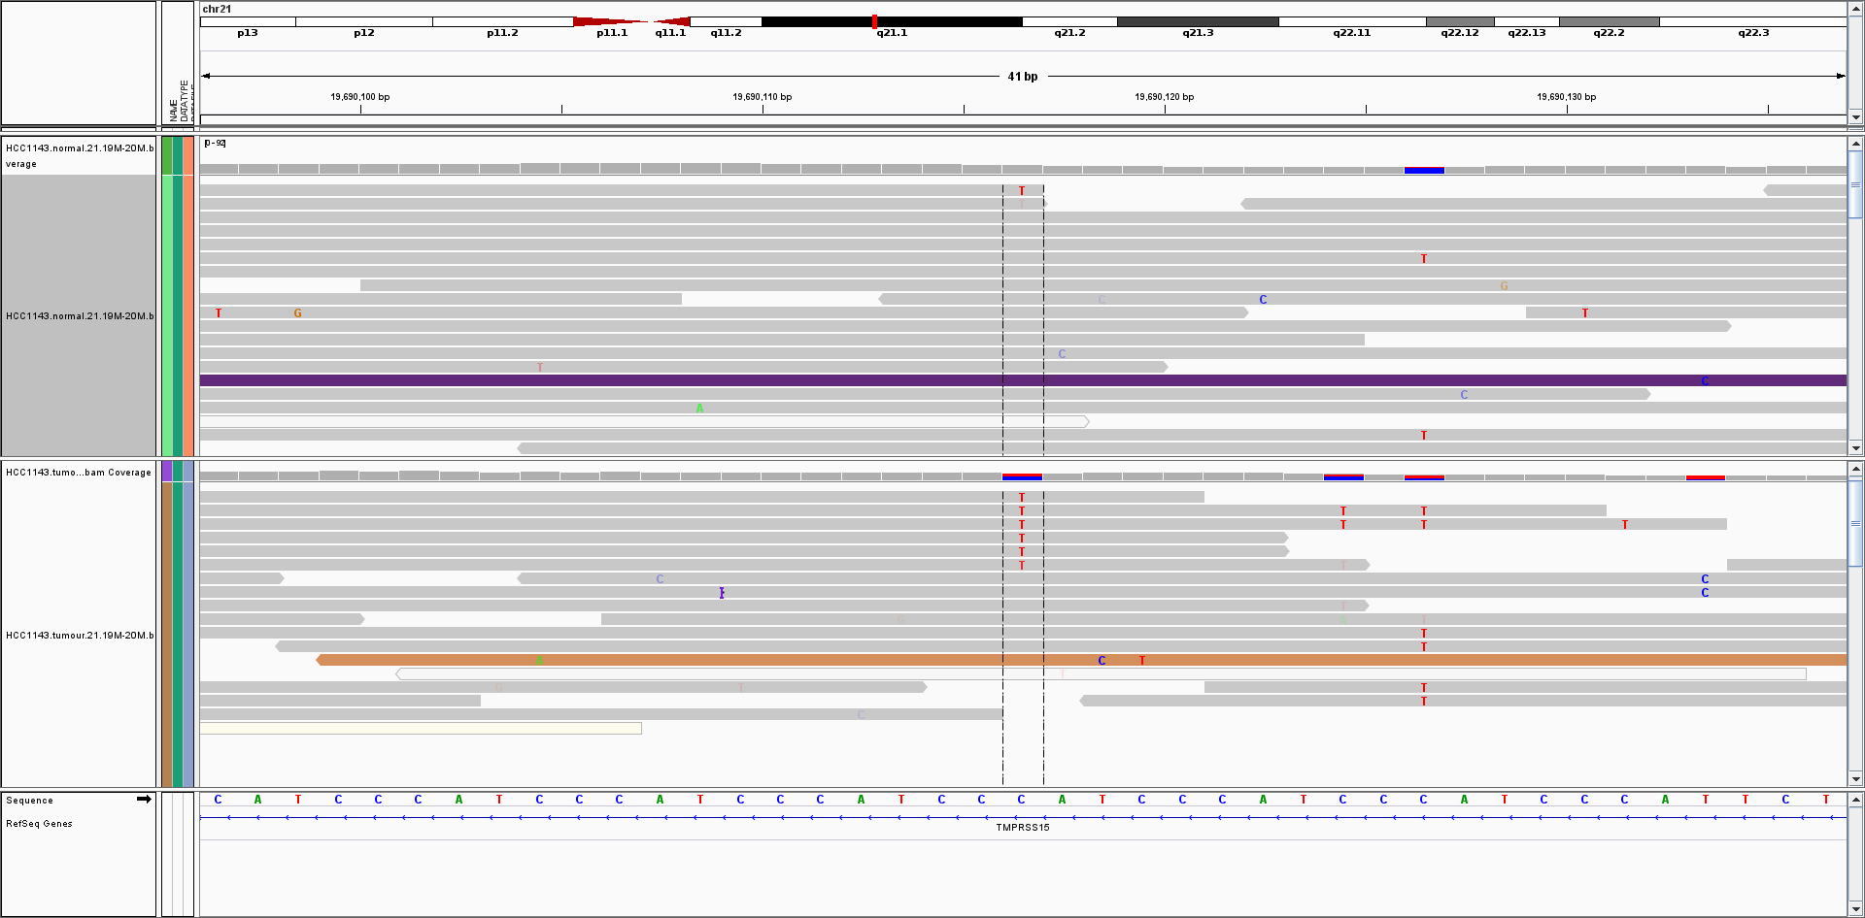
Part 4: Browsing Somatic Mutations In IGV
Likely false positive identified by GATK
MutationSeq probability 0.05
chr21:19690116

Slide 23
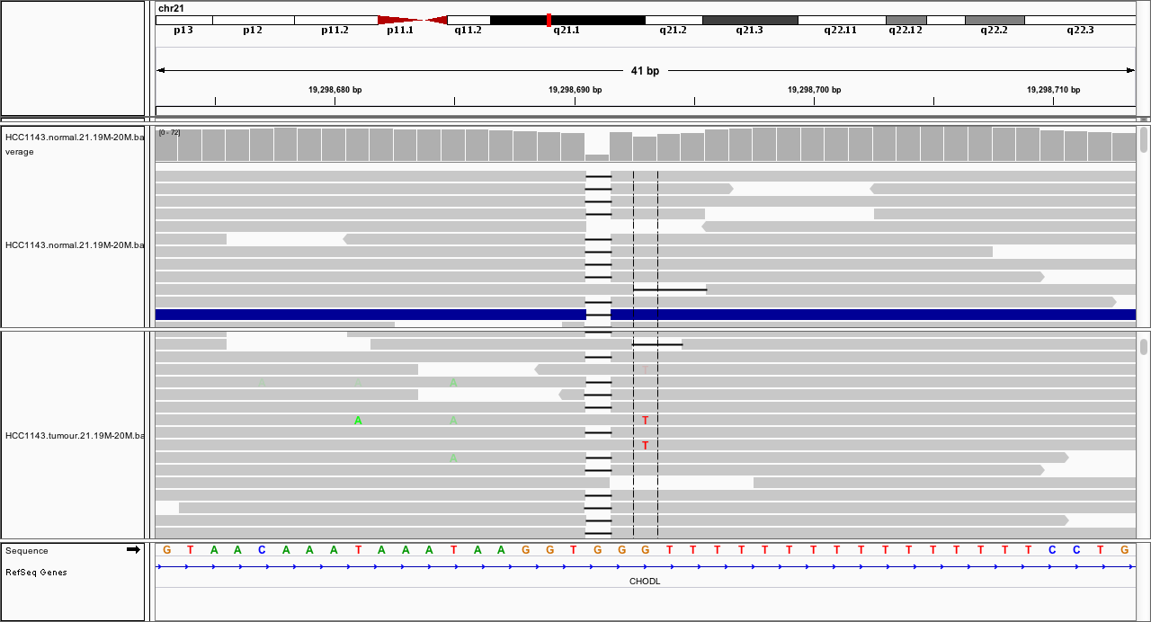
Part 4: Browsing Somatic Mutations In IGV
Likely false positive identified by MutationSeq but flagged as INDL (likely indel artifact)
chr21:19298693

Slide 24
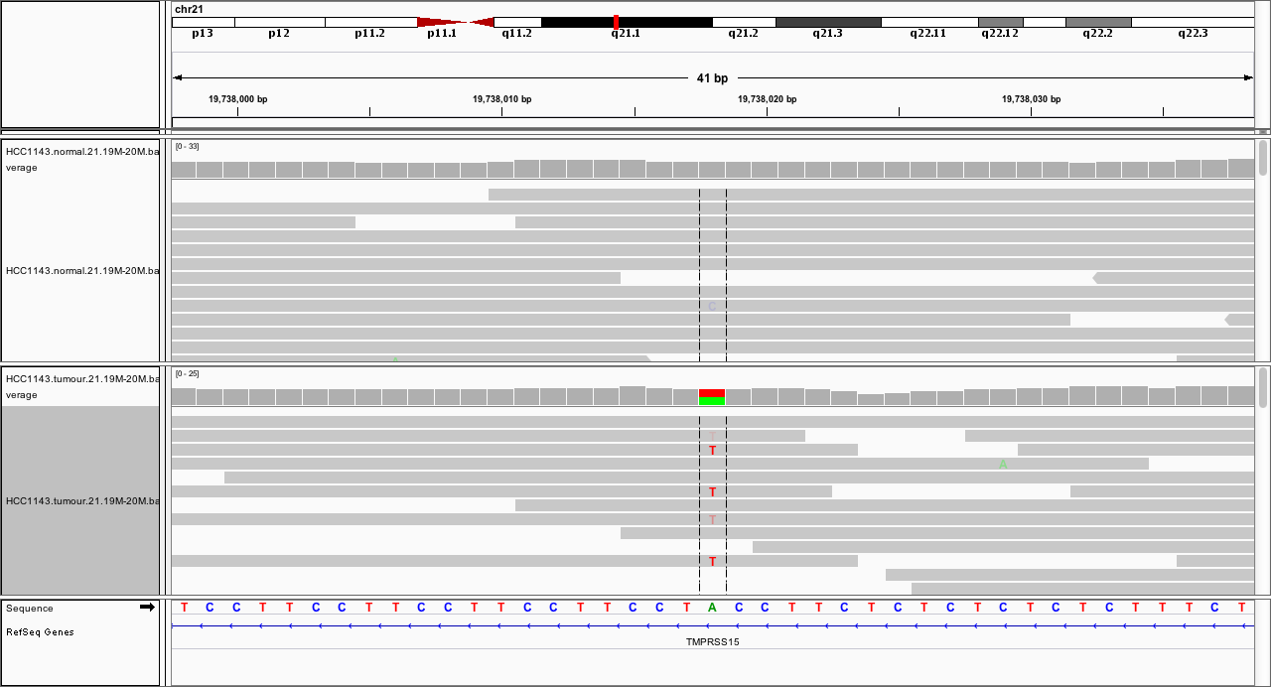
Part 4: Browsing Somatic Mutations In IGV
Likely false positive identified by MutationSeq but flagged as INDL (likely indel artifact)
chr21:19738018

Slide 25
Part 5: Summary Of Somatic Mutation Calling
Sources of false positives
  Germline variants
  Alignment and sequencing artifacts
Joint analysis of both genomes removes germline false positives effectively.
Filtering removes artifacts

Slide 26
Part 5: Summary Of Somatic Mutation Calling
Lots of software for calling somatic mutations
JointSNVMix (http://compbio.bccrc.ca/software/)
MutationSEQ (http://compbio.bccrc.ca/software/)
Mutect (http://www.broadinstitute.org/cancer/cga/mutect)
Strelka (https://sites.google.com/site/strelkasomaticvariantcaller/)
EBCall (https://github.com/friend1ws/EBCall)
And many more...
Tools for normal tissue work poorly, some bad choices
GATK
Samtools
No matter what software you use, all predictions are just predictions. Without validation on an orthogonal platform they should never be considered true.

