Slide 1
Canadian Bioinformatics Workshops
www.bioinformatics.ca

Slide 2
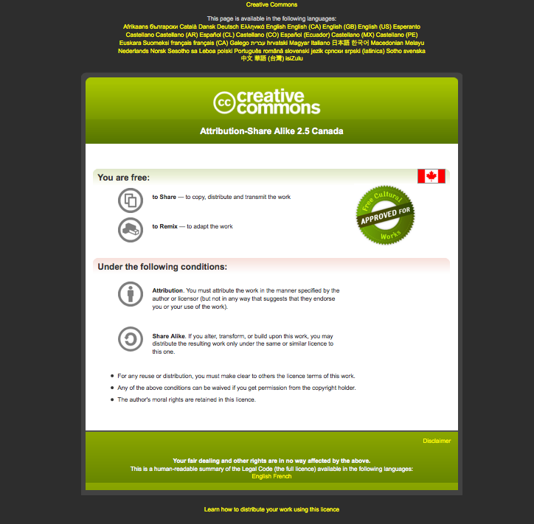
Module #: Title of Module
2

Slide 3
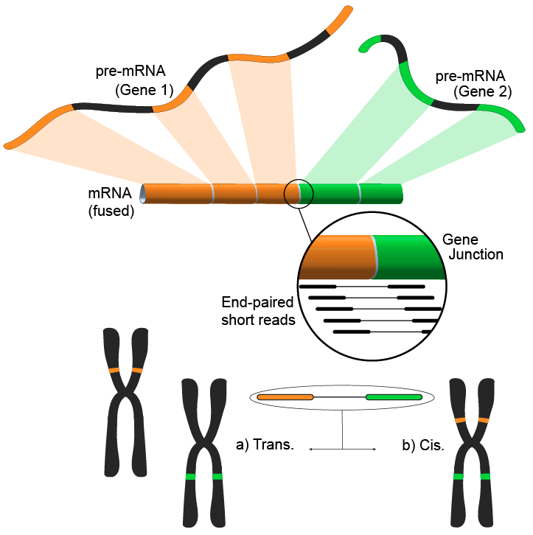
Module 4 Gene Fusion Discovery Lab
Andrew McPherson
Bioinformatics for Cancer Genomics
May 26-30, 2014
awm3@sfu.ca
http://compbio.bccrc.ca
http://compbio.cs.sfu.ca

Slide 4
Learning Objectives of the Lab
Become familiar with fusion discovery tools
Identify common sources of false positives

Slide 5
Fusion Discovery Tools
deFuse
ChimeraScan
Tophat-Fusion
Trinity / gmap / rsem
See the lab writeup for running the tools on the simulated data

Slide 6
Example 1: Artifact fusion induced by homology
Notice the best matches overlap in the query sequence
ACTIONS QUERY SCORE START END QSIZE IDENTITY CHRO STRAND START END SPAN
---------------------------------------------------------------------------------------------------
browser details YourSeq 132 1 141 171 97.2% 17 + 62499145 62499374 230
browser details YourSeq 96 2 154 171 88.8% 22 + 38890737 38890976 240
browser details YourSeq 67 104 171 171 100.0% Y - 15027123 15027592 470
browser details YourSeq 62 108 171 171 98.5% X - 73350813 73350876 64
browser details YourSeq 40 88 141 171 87.1% 6 - 74118977 74119030 54
browser details YourSeq 32 84 116 171 100.0% 22 - 49607171 49613016 5846
browser details YourSeq 22 92 114 171 100.0% 4 + 72709432 72709456 25
browser details YourSeq 21 95 116 171 100.0% 6 + 131014581 131014603 23
browser details YourSeq 20 93 112 171 100.0% 2 - 157047083 157047102 20
browser details YourSeq 20 101 122 171 95.5% 14 - 29461851 29461872 22
browser details YourSeq 20 1 20 171 100.0% 3 + 175393751 175393770 20

Slide 7
Example 2: Artifact fusion induced by repetitive genome sequence
one part of the query sequence maps to many locations in the genome
ACTIONS QUERY SCORE START END QSIZE IDENTITY CHRO STRAND START END SPAN
---------------------------------------------------------------------------------------------------
browser details YourSeq 68 40 107 107 100.0% 22 - 32435560 32435627 68
browser details YourSeq 64 40 107 107 97.1% 15 + 82824392 82824459 68
browser details YourSeq 64 40 107 107 97.1% 15 + 83208735 83208802 68
browser details YourSeq 62 40 107 107 95.6% 5 - 116052023 116052090 68
browser details YourSeq 60 40 107 107 94.2% 17 - 29158008 29158075 68
browser details YourSeq 58 40 107 107 92.7% 1 + 167131923 167131990 68
browser details YourSeq 57 44 102 107 98.4% 6 - 63257401 63257459 59
browser details YourSeq 54 44 107 107 92.2% 6 + 50825228 50825291 64
browser details YourSeq 54 41 106 107 85.8% 3 + 143574838 143574900 63
browser details YourSeq 37 44 88 107 91.2% 7 - 37156486 37156530 45
browser details YourSeq 35 1 35 107 100.0% 15 - 82824833 82824867 35
browser details YourSeq 35 1 35 107 100.0% 15 - 83209176 83209210 35
browser details YourSeq 34 40 75 107 97.3% 11 + 110976470 110976505 36
browser details YourSeq 30 8 39 107 96.9% 22 + 32435452 32435483 32
browser details YourSeq 20 1 20 107 100.0% 5 + 144765194 144765213 20

Slide 8
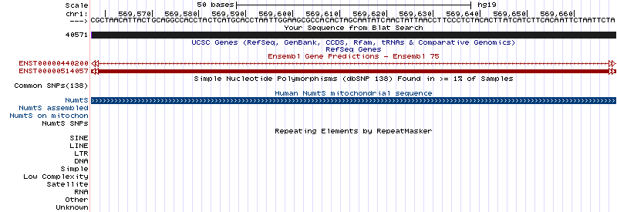
Example 3: Artifact fusion induced by a NUMT insertion
Notice the alignment is to a region annotated as NUMT

Slide 9
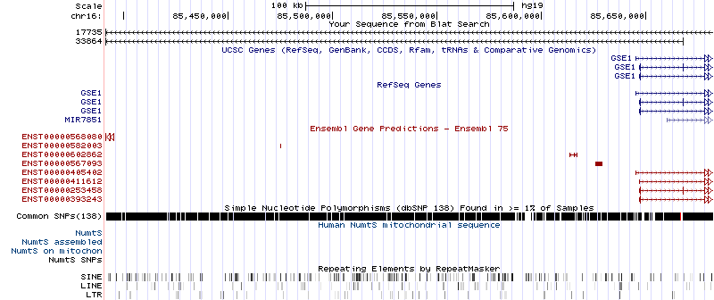
Example 4: Read-through chimera
Full alignment to a contiguous section of the genome

Slide 10
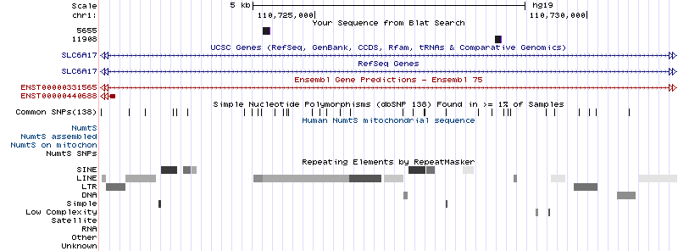
Example 5: Rearrangement inducing spurious intronic transcription
Alignments to intronic region of SLC6A17

Slide 11
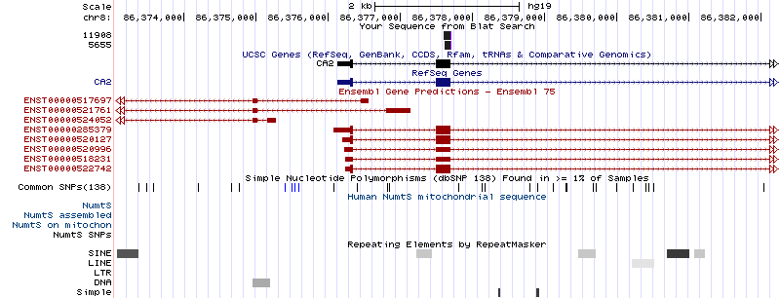
Example 5: Rearrangement inducing spurious intronic transcription
Alignment to an exon of CA2, with the fusion boundary at the boundary of an exon

Slide 12
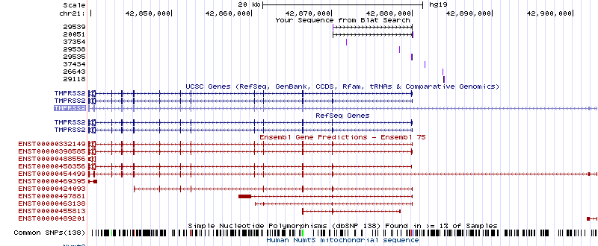
Example 6: TMPRSS2-ERG
Notice some predictions are spliced and there are many variants

Slide 13
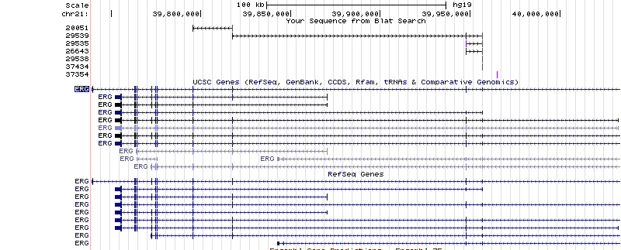
Example 6: TMPRSS2-ERG
Notice some predictions are spliced and there are many variants

Slide 14
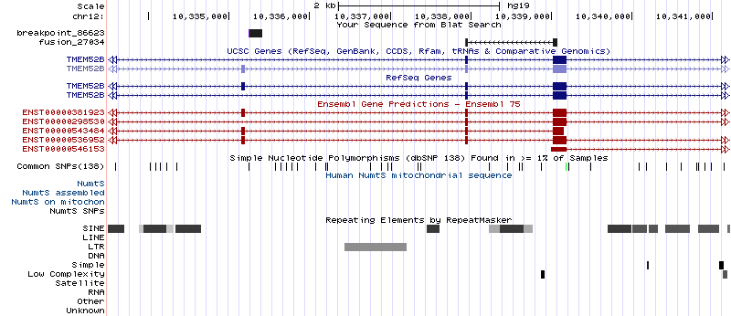
Example 7: Complex breakpoint
TMEM52B side of the fusion

Slide 15
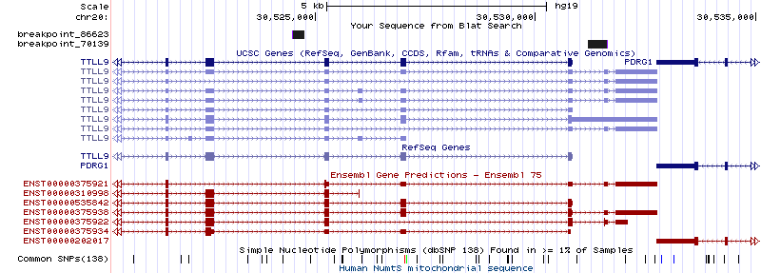
Example 7: Complex breakpoint
Interstitial segment from TTLL9

Slide 16
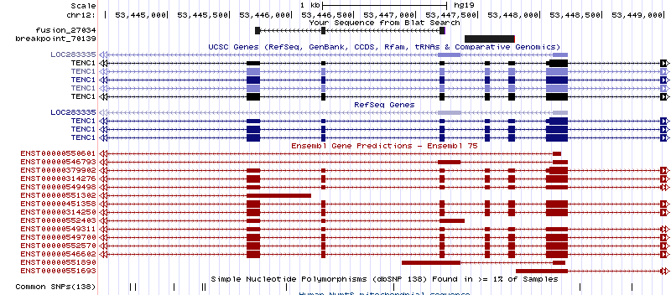
Example 7: Complex breakpoint
TENC1 side of the breakpoint

Slide 17
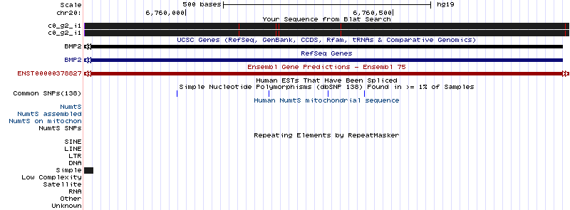
Example 8: Assembly artifact chimera produced by a Simple repeat
Notice the alignment of each end of the sequence to the same loci, ending at a simple repeat

Slide 18
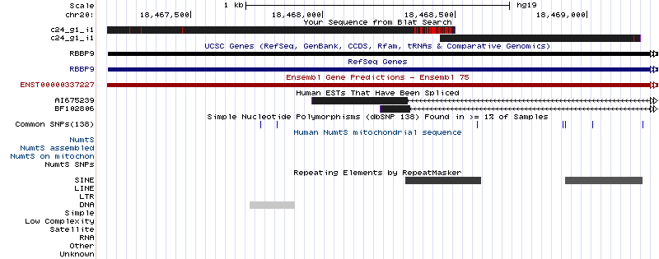
Example 9: Assembly artifact chimera produced by a SINE repeat
Notice the alignment of each end of the sequence to the same loci, ending at a SINE repeat

Slide 19
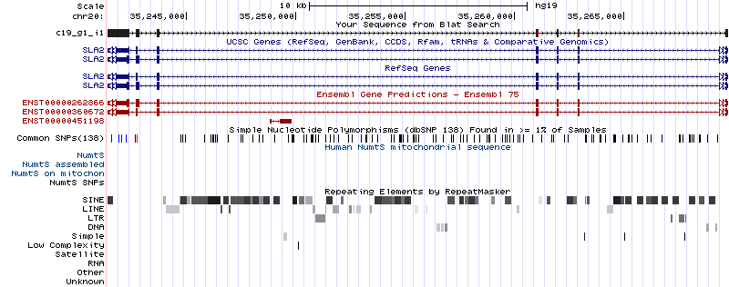
Example 10: True fusion assembly identified by Trinity/gmap
Each end includes splicing concordant with the gene model

Slide 20
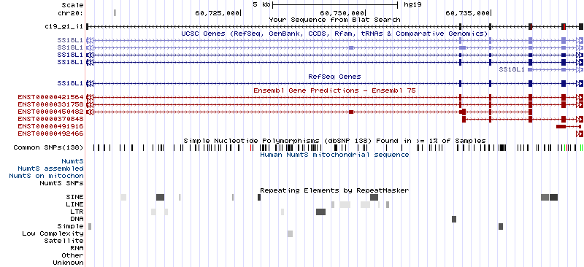
Example 10: True fusion assembly identified by Trinity/gmap
The fusion breakpoint does not overlap a repeat

