Slide 1
Graph Neural Networks on Circuit-SAT
CURE

Slide 2
Background
Deep Learning => Classical combinatorial optimization problems
E.g., SAT; Routing; TSP…
Targets: Learning how to solve them
Two main approaches:
Given a template of the solver algorithm (greedy strategy), Deep Learning is to learn the optimal heuristic within this template
E.g., How to do mutation and permutation in GA.
ATPG: Replace conventional backtracking heuristics in ATPG with artificial neural networks. (ITC 2020)
Let Deep Learning figure out the entire solution structure.
Notes:
I think I haven’t formally introduce the topic of SAT to you guys. So l will report some recent progress on gnn part. Although our project targets on learning on VLSI testing and the two tasks are ATPG and test point insertion, here I start with a more basic and fundamental problem: satisﬁability problem, SAT problem. I think it could be a good starting point, and offer an additional view to test point insertion problem. cause as you know, ATPG problem can be converted info SAT problems in some way. Also, I am building a codebase for this problem, and it would be useful for our project.
So here is the rough background for SAT problem. There are a bunch of works which focus on using deep learning to solve some combinatorial optimization problems. For example SAT here, Routing and TSP. There are two main approaches towards them. The first one is to modify a given algorithms. The role of deep learning is to lean the optimal heuristic within this template.
Two example to illustrate this approach. The first one is for genetic algorithm, how to do mutation and permutation is a problem. And we can use a deep learning model to learn it.
Another example is in the context of ATPG, we can replace the conventional backtracking heuristics in ATPG with artificial neural networks. This study is published on ITC 2020.
The second approach is to let deep learning figure out the entire solution. We are not given a template of the solver, but use deep learning to learn a complete solution.

Slide 3
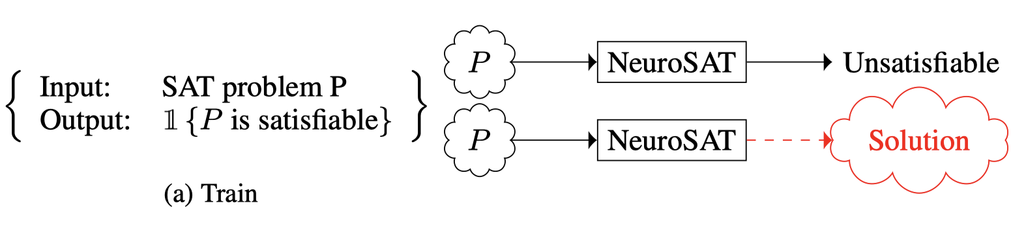
Background – Learn to solve SAT
SAT:
Given a formula of propositional logic (Boolean expression), there exists an assignment of Boolean values to its variables such that the formula evaluates to 1, then this formula is satisfiable.
The goal of a SAT problem is to determine if the formula is satisﬁable, and if so, to produce a satisfying assignment of truth values to variables.
Solver
Solver
Notes:
Next, some background for SAT problem.
The definition of SAT problem is given a a formula of Boolean expression, we should decide whether there exists an assignment of Boolean values to its variables such that the formula evaluates to 1. If so, then such formula is SAT. If not, this formula is UNSAT.
And in the case of SAT problems, we are supposed to produce a satisfying assignment of truth values to variables.

Slide 4
Background – Learn to solve SAT
SAT application
SAT-based test pattern generation
Graph coloring
Scheduling
Function fitting (NN)
…
Solver
Solver
Notes:
Here I also list some potential SAT-based applications. For example, SAT-based test pattern generation, graph coloring, scheduling, and function fitting.
As I said, I will focus on learning to solve SAT at this stage, and once we get a reasonable result, then we can try to take one step further to deal with SAT-based test pattern generation or test point insertion.

Slide 5
Background – Learn to solve SAT
Motivation
For a given class of SAT problem, the problem instances are typically drawn from a certain (unknown) distribution.
Therefore, if a sufﬁcient number of problem instances are available, then in principle, Deep Learning should be able to extract the common structures among these instances and produce meta-algorithms (or models) that would, in theory, outperform the carefully hand-crafted algorithms.
Model
A combinatorial circuit => A graph
Use graph neural networks (GNNs) to model this problem
Notes:
Here I give a motivation of why we use deep learning to solve SAT. The motivation is quite intuitive. For a given class of SAT problem, the problem instances are typically drawn form a certain yet unknown distribution. Therefore, if a sufficient number of problem instances are available, then in principle, deep learning should be able to extract the common structures among these instances and produce meta-algorithms that would, in theory, outperform the carefully hand-crafted algorithms.
Ok, this is the motivation and expectation.
And for circuit-SAT problem, how to re-formulate it as a problem, or what model can we apply to SAT? Here we take a graph-based approach to do it. A combinatorial circuit can be represented as a graph, usually a directed acyclic graph. Then we can use graph neural networks to model this problem.

Slide 6
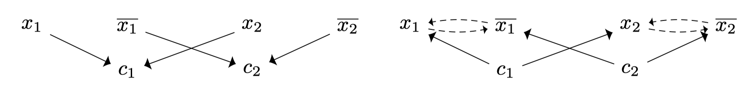
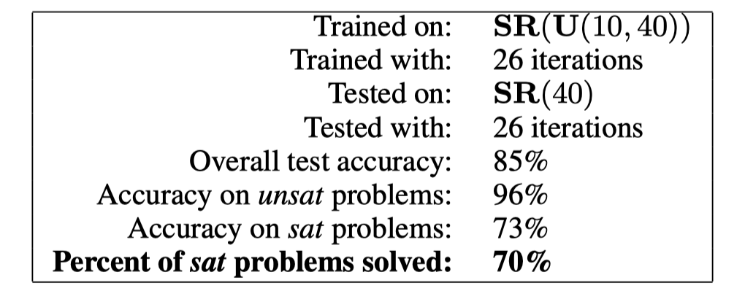
Related work – Neuron-SAT, ICLR 2019
Represent SAT as CNF (Conjunctive normal form)
E.g.,
Graph representation: literals and clauses.
Each node has its own embedding.
Aggregate as one single vector, then do the graph-level classification.
(0-UNSAT, 1-SAT)
Training
Randomly generate pairs of SAT and UNSAT.
Notes:
Here I briefly introduce two related work that use deep learning, especially GNN to solve SAT problem.
The first one is called Neuron-SAT, wherein the Boolean expressions are in the CNF format, or a product of sums.
Then they use a pretty shallow graph structure to represent the CNF expression. Here is an example. There are two variables, and if we consider their negations, then we have 4 literals
For for each literals, we know which clauses it belongs to, then we can add an edge between literals and clauses.
The final graph just looks like this.
And they use neural networks to learn such structure, and such neural network will assign one embedding vector for each node.
We can aggregate the embedding for all nodes as one single vector and feed it into a classifier to predict whether a graph is SAT or not.
Here is the results from their papers.
When testing on SR(40), which means that for each expression, there are 40 variables, the overall test accuracy is around 85%.
Because of the time, that’s all background and related work I want to introduce today.
Any problem so far?

Slide 7
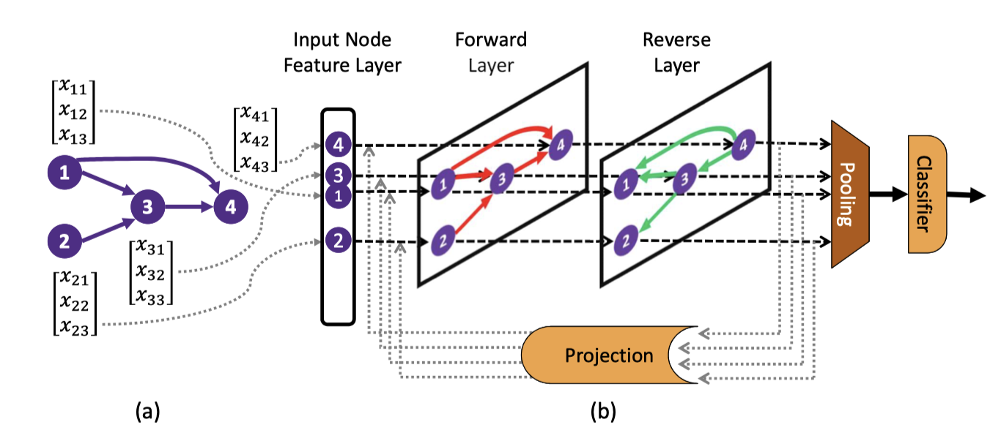
Related work – DG-DAGRNN, ICLR 2019
Graph representation
Notes:
The second work is called DG-DAGRNN.

Slide 8
What we want to do now
Problems
Circuit SAT - Poor performance (~85%)
Circuit structure is not well utilized (random SAT and CNF for now)
Knowledge about logic gates (AND, OR, NOT, implication) is not explicitly utilized
Targets
Better graph structure for circuit-sat=> Learn a better representation to solve SAT.
Based on learned representation, some applications can be explored. E.g., test point insertion, efficient and effective ATPG…
Notes:
There are a few problems in this research field. First is the performance concern. The state of the art solutions right now can only achieve around 85% accuracy.
Also, we expect that the problems we are dealing with have more structure information of circuits. Cause finally we will apply such deep learning to VLSI testing. One the other hand, if we can map SAT problem into a certain distribution that contains more informative structure, like structure embedded in the circuit design, then it can help improve the performance.
Also, the prior knowledge of logic gates is not fully utilized.
And the target is to build a better graph structure for circuit-sat, which will improve the performance of solving SAT.
The is the main objective at the initial stage. And I have to say that it’s more related to fundamental machine learning field.
And later, based on such structure and algorithm, we can explore some potential applications on VLSI testing, like test point insertion and ATPG.

Slide 9
How to Learn
Circuit Representation?
Circuit Graph Structure
GNN Learning for Circuits
Its Applications
on VLSI Testing
Test Point Insertion
Automatic Test Pattern Generation

Slide 10
Applying Logic Synthesis for SAT problem
CNF to AIG conversion
Convert CNF into AIG. (Replace OR gate of CNF as combination of AND and NOT gate). Obtained AIG is complex and redundant.
Use logic synthesis tool (ABC from UCB) to convert AIG into Optimized AIG. (Balancing, rewriting, etc)
Parse AIG and store it in IGraph data structure.
One single virtual node for each graph
Map SAT into a certain distribution: more compact and contains more informative structure.
Notes:
The main idea is to apply logic synthesis for SAT problem.
The logic synthesis here means that given a raw Boolean expression (CNF form here), some logic synthesis techniques are applied to optimize the expression. And most of the optimization are done on the AIG representation, which means that we first convert the CNF raw expression into AIG form. And use the tool to optimize the given AIG.
The reason why we do these steps is that it’s very likely that the CNF distribution contains noises and it’s difficult for GNN to learn from it. You know, CNF is a flattened expression. And it’s much more complex than the original problems.
By applying logic synthesis, we can convert the original distribution to a compact one, with more informative structure.

Slide 11
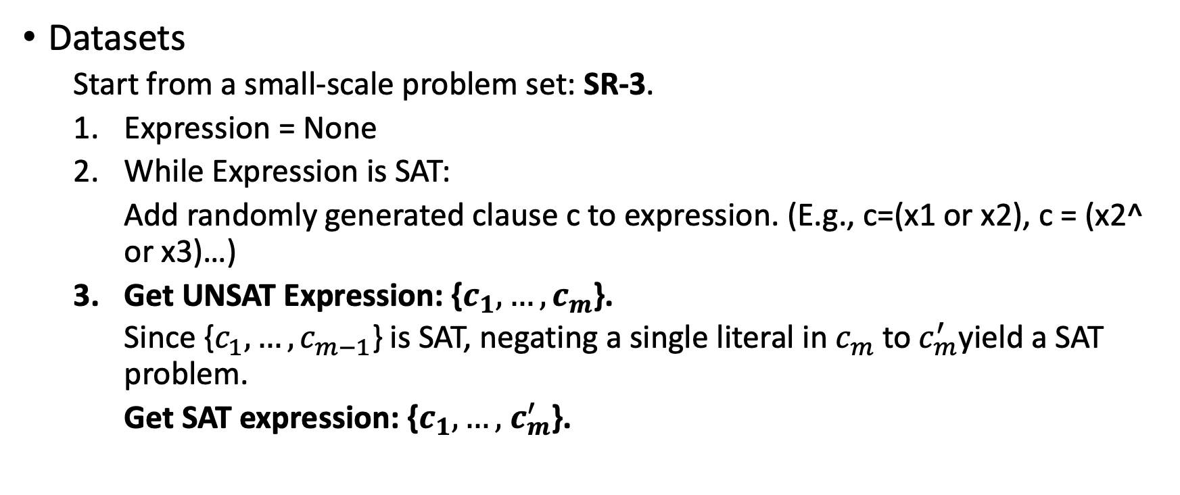
Applying Logic Synthesis for SAT problem
Datasets
Start from a small-scale problem set: SR-3.
Expression = None
While Expression is SAT:
Add randomly generated clause c to expression. (E.g., c=(x1 or x2), c = (x2^ or x3)…)
Get UNSAT Expression: {$c_{1},…,c_{m}$}.
Since {$c_{1},…,c_{m−1}$} is SAT, negating a single literal in $c_{m}$ to $c_{m}^{′}$yield a SAT problem.
Get SAT expression: {$c_{1},…,$ $c_{m}^{′}$}.
Notes:
I will skip some implementation details here. And just show
Ok. I prepare a slide to demonstrate how I build the graph and train it. To start with, let me briefly introduce the dataset generation procedure.
We create a distribution SR3, pairs of random SAT problems on 3 variables.
In the while loop, we generate a random clause on 3 variables and add it to the SAT problem, until adding the clause c_m finally makes the problem unsatifiable.
Since {c 1 , . . . , c m−1 } had a satisfying assignment, negating a single literal in c m must yield a satisﬁable. In this way, we can get a pair of SAT and UNSAT problems.

Slide 12
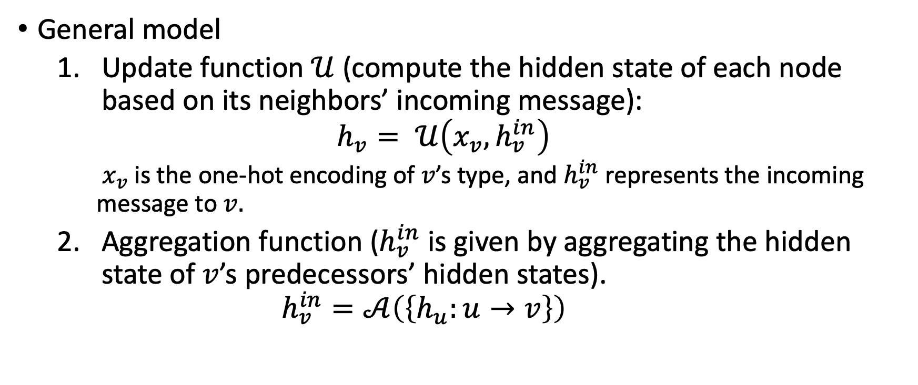
DAG (AIG) encoding using GNN
General model
Update function $𝒰$ (compute the hidden state of each node based on its neighbors’ incoming message):
$$h_{v}= 𝒰\left(x_{v}, h_{v}^{in}\right)$$
$x_{v}$ is the one-hot encoding of $v$’s type, and $h_{v}^{in}$ represents the incoming message to $v.$
Aggregation function ($h_{v}^{in}$ is given by aggregating the hidden state of $v$’s predecessors’ hidden states).
$$h_{v}^{in}=𝒜\left(\left\{h_{u}:u→v\right\}\right)$$
Notes:
Next lets step into how we encode the DAG using GNN.
Similar to standard GNNs, we use an update function U to compute the hidden state of each node. Here U is functional with the inputs x_v and h_v^in. So here, x_v is the node vector of node v. Usually, we use a one-hot encoding to encode the node v, based on the type of v. And the second input is the hv_in. So the Hv_in represents the incoming message to v. How we calculate the hv_in? That the second function we use, the aggregation function.
where u → v denotes there is a directed edge from u to v, and h u : u → v represents a multiset of v’s predecessors’ hidden states.
How to do the updating and aggregation is the main design space for the GNN.

Slide 13
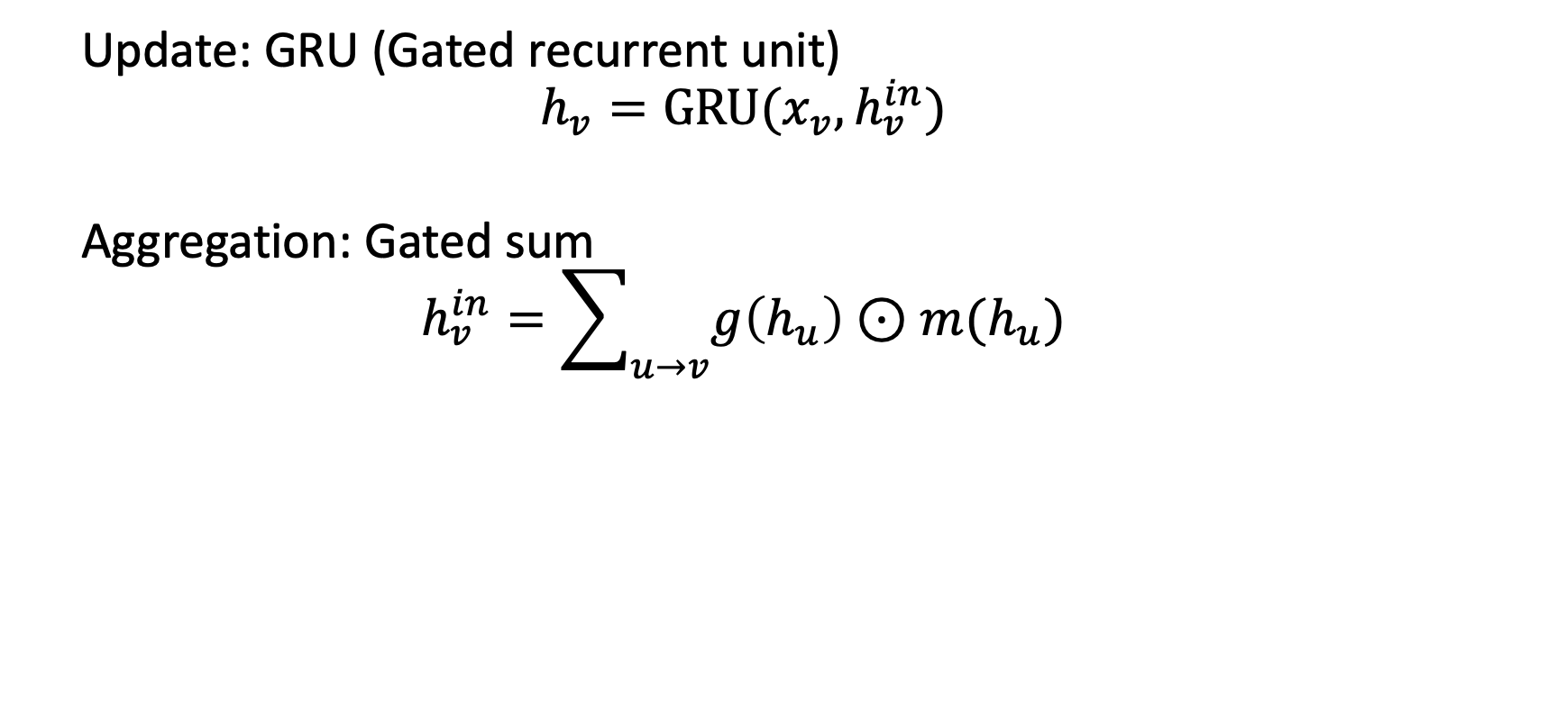
Graph neural networks for AIG
Update: GRU (Gated recurrent unit)
$$h_{v}=GRU(x_{v},h_{v}^{in})$$
Aggregation: Gated sum
$$h_{v}^{in}=\sum_{u→v}{g\left(h_{u}\right)⊙m(h_{u})}$$
Notes:
Here I first fix the update function as GRU (the gated recurrent unit). It’s just a version of sequential model, and it’s more efficient than the LSTM with smaller number of weights.
And the aggregation function is the gated sum. You can take it as the weighted sum of the incoming hidden state. But the weight are learned automatically.

Slide 14
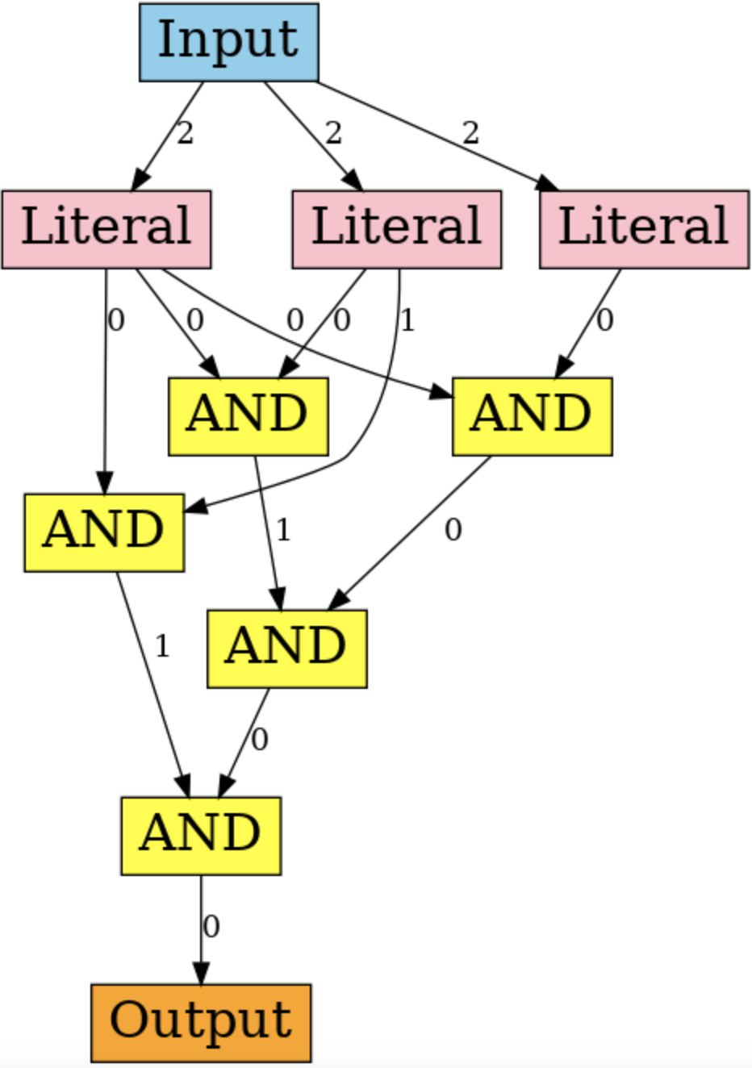
Graph neural networks for AIG
Type 1: AND gates as vertices, Invertor gates as edges.
Type 2: AND gates as vertices, Invertor gates negate hidden state.
Type 3: AND/Invertor gates as vertices.
Notes:
I have done a few trials for the gnn designs, and there are three types of GNN design. Let’s walk through them one by one.
For the type 1, the AND gates are represents as vertices, and the invertor as edges. And the second type: the AND gates are represented as vertices as well, but the behavior of invertor is defined explicitly, which is to negate the incoming hidden state.
The for the type 3, I represent both the and and invertor gates as vertices.
So lets go to a concrete example.

Slide 15
Experiments – toy dataset
Datasets: SR3. # training data: 17,600. # Test data: 1,749
Accuracy on training data: 98.68% (Type1); 84.74%(Type2); 67.64%(Type3)
Accuracy on test data: 95.61% (Type1); 82.27%(Type2); 68.27%(Type3)
Not fully-optimized yet.
Code: lee-man/circuit-rl: The representation learning for circuits and its applications to VLSI testing (github.com)
Notes:
And here I briefly report the experiments on a toy dataset I conducted.
The dataset used is SR-3, which means that the number of variables is 3 for each problem instance. And the dataset size is as follows.
The accuracy on test data is about 95%, which looks good as I haven’t started to optimize the training process at all. And the results are comparable with the SOTA.
And I update all the code on github. So far Sadaf an I can access it. If any engineers from Huawei want to check it out, I am very glad to share it with you.

Slide 16
TO DO
Training models on SR3TO10 problems (600,000 training data, 20,000 testing data). Training speed is low due to the data structure used now.
Compare with NeuronSAT.
Add more prior info.
Test point insertion (Embedding as measurements)

Slide 17
TO DO
Re-implement GCN paper and test on small-scale circuit designs
Try other GNN structures/Graph design
Apply embedding from SAT Circuit to TPI.

Slide 18
SAT problem
https://www.borealisai.com/en/blog/tutorial-9-sat-solvers-i-introduction-and-applications/

