Slide 1

BDMLA Coursework 1
Big Data and Machine Learning Application:
Predicting Airline Flight Delays with Apache Spark
Soh Chee Yong
Student ID: UP2653853
M33877 Big Data and Machine Learning Applications
November 2026
Notes:
[0:00-0:24] Hello, my name is Soh Chee Yong, and this is my Big Data and Machine Learning Applications project: predicting airline flight delays with Apache Spark. I used every U.S. domestic flight from 2025, 7,001,619 of them, to test one practical question: can we tell, before a plane even leaves the gate, that it is going to arrive late?

Slide 2
BACKGROUND
Costly. Flight delays cost the U.S. economy an estimated $32.9 billion in 2007, shared between airlines, passengers and lost demand (Ball et al., 2010).
Clearly defined. The Bureau of Transportation Statistics (BTS) counts a flight as delayed when it arrives 15 or more minutes late.
Big data. BTS publishes a record for every domestic flight of the larger U.S. carriers: millions of labelled rows every year.
Useful if predicted early. Airlines can re-plan crews, gates and spare aircraft; passengers with tight connections can be warned.
$32.9B
cost of U.S. delays in 2007
15 min
BTS delay threshold
7,001,619
flights in 2025
Notes:
[0:24-0:58] Delays matter because they are expensive: a major U.S. study estimated around 33 billion dollars in 2007 alone. The industry uses a simple rule: a flight that arrives 15 minutes or more after schedule counts as delayed. The Bureau of Transportation Statistics publishes a record for every domestic flight, which gives us millions of labelled examples. If risky flights can be flagged early, airlines can re-plan crews and spare aircraft, and passengers with tight connections can be warned.

Slide 3
PROJECT PROPOSAL
Using only information known before departure, will this flight arrive 15+ minutes late?
Target: DELAYED = 1 when ARR_DELAY ≥ 15 minutes, otherwise 0.
Prediction point: before scheduled departure, using schedule-derived inputs.
Departure delay is excluded because it is unavailable at that prediction point.
Method: process 12 monthly files in Spark and compare three MLlib classifiers.
Notes:
[0:58-1:36] So the problem statement is: using only information known before departure, will this flight arrive 15 or more minutes late? That makes it a binary classification problem. The 'before departure' condition is the important part. Many online examples use the departure delay as an input, but you only know that once the plane has left, so the model looks accurate but is useless in practice. My approach is to process the whole year with Spark, build features from the schedule only, and compare three Spark MLlib classifiers fairly.

Slide 4
OBJECTIVES AND SCOPE
Objectives
Scope
O1
Ingest, union and clean all 12 monthly files in Spark
U.S. domestic flights, January–December 2025
Arrival delay ≥ 15 min as the target
Schedule information only: no departure delay, no weather
Google Colab (2 cores, ~12 GB RAM) with PySpark
O2
Engineer features from schedule information only
O3
Train LR, Random Forest and GBT in Spark MLlib
O4
Evaluate with imbalance-aware metrics + training time
O5
Show how the pipeline scales out
Notes:
[1:36-2:05] I set five objectives: ingest and clean all twelve monthly files in Spark; engineer features with no target leakage; train Logistic Regression, Random Forest and Gradient-Boosted Trees; evaluate them with metrics that suit an imbalanced problem, plus training time; and show how the pipeline scales out. The scope is all 2025 U.S. domestic flights, using schedule information only, running on a free Google Colab machine.

Slide 5
PROCESS MODEL
CRISP-DM (Wirth & Hipp, 2000): an iterative data-science process
Business
understanding
Business understanding: flag flights likely to arrive 15+ min late, before departure
Data understanding: 12 BTS files, data-quality profile, exploratory charts
Data preparation: cleaning funnel, leakage control, 39 features
Modelling: LR, Random Forest, GBT with 3-fold CV tuning
Evaluation: test metrics, temporal test, feature importance
Deployment (proposed): weather, Dataproc cluster, streaming
Deployment
(proposed)
Data
understanding
BTS
2025 data
Evaluation
Data
preparation
Iterations in this project
Modelling
trial run → feature-label fix → full run → resume after disconnect → revision after review
Notes:
[2:05-2:20] I followed CRISP-DM, the standard process model for data-science projects. It is a cycle rather than a straight line, which matched reality: a trial run, a fix, the full run, and a resume after Colab disconnected.

Slide 6
DATA SET USED
Source: BTS Reporting Carrier On-Time Performance, Jan–Dec 2025 (12 monthly CSVs, 3.17 GB, ~110 columns each).
Size: 7,001,619 flights; 6,879,483 after cleaning.
Imbalanced: 22.31% of flights are delayed, so always predicting 'on time' already scores 77.70% accuracy.
Class balance after cleaning
12
3.17 GB
monthly files
raw CSV
17 / 110
25.1x
columns kept
faster on Parquet
Source: Bureau of Transportation Statistics (2026), Reporting Carrier On-Time Performance.
Notes:
[2:20-2:55] The data is the official BTS on-time performance table: twelve monthly CSV files, 3.17 gigabytes, and 7,001,619 flights. Each file has about 110 columns, but I only load 17 of them, for leakage reasons I'll come back to. After cleaning, 22.31% of flights are delayed. So the classes are imbalanced: a model that always says 'on time' would already score 77.70% accuracy. One early optimisation was converting the CSVs to Parquet once; after that, the same query ran 25.1x faster.

Slide 7
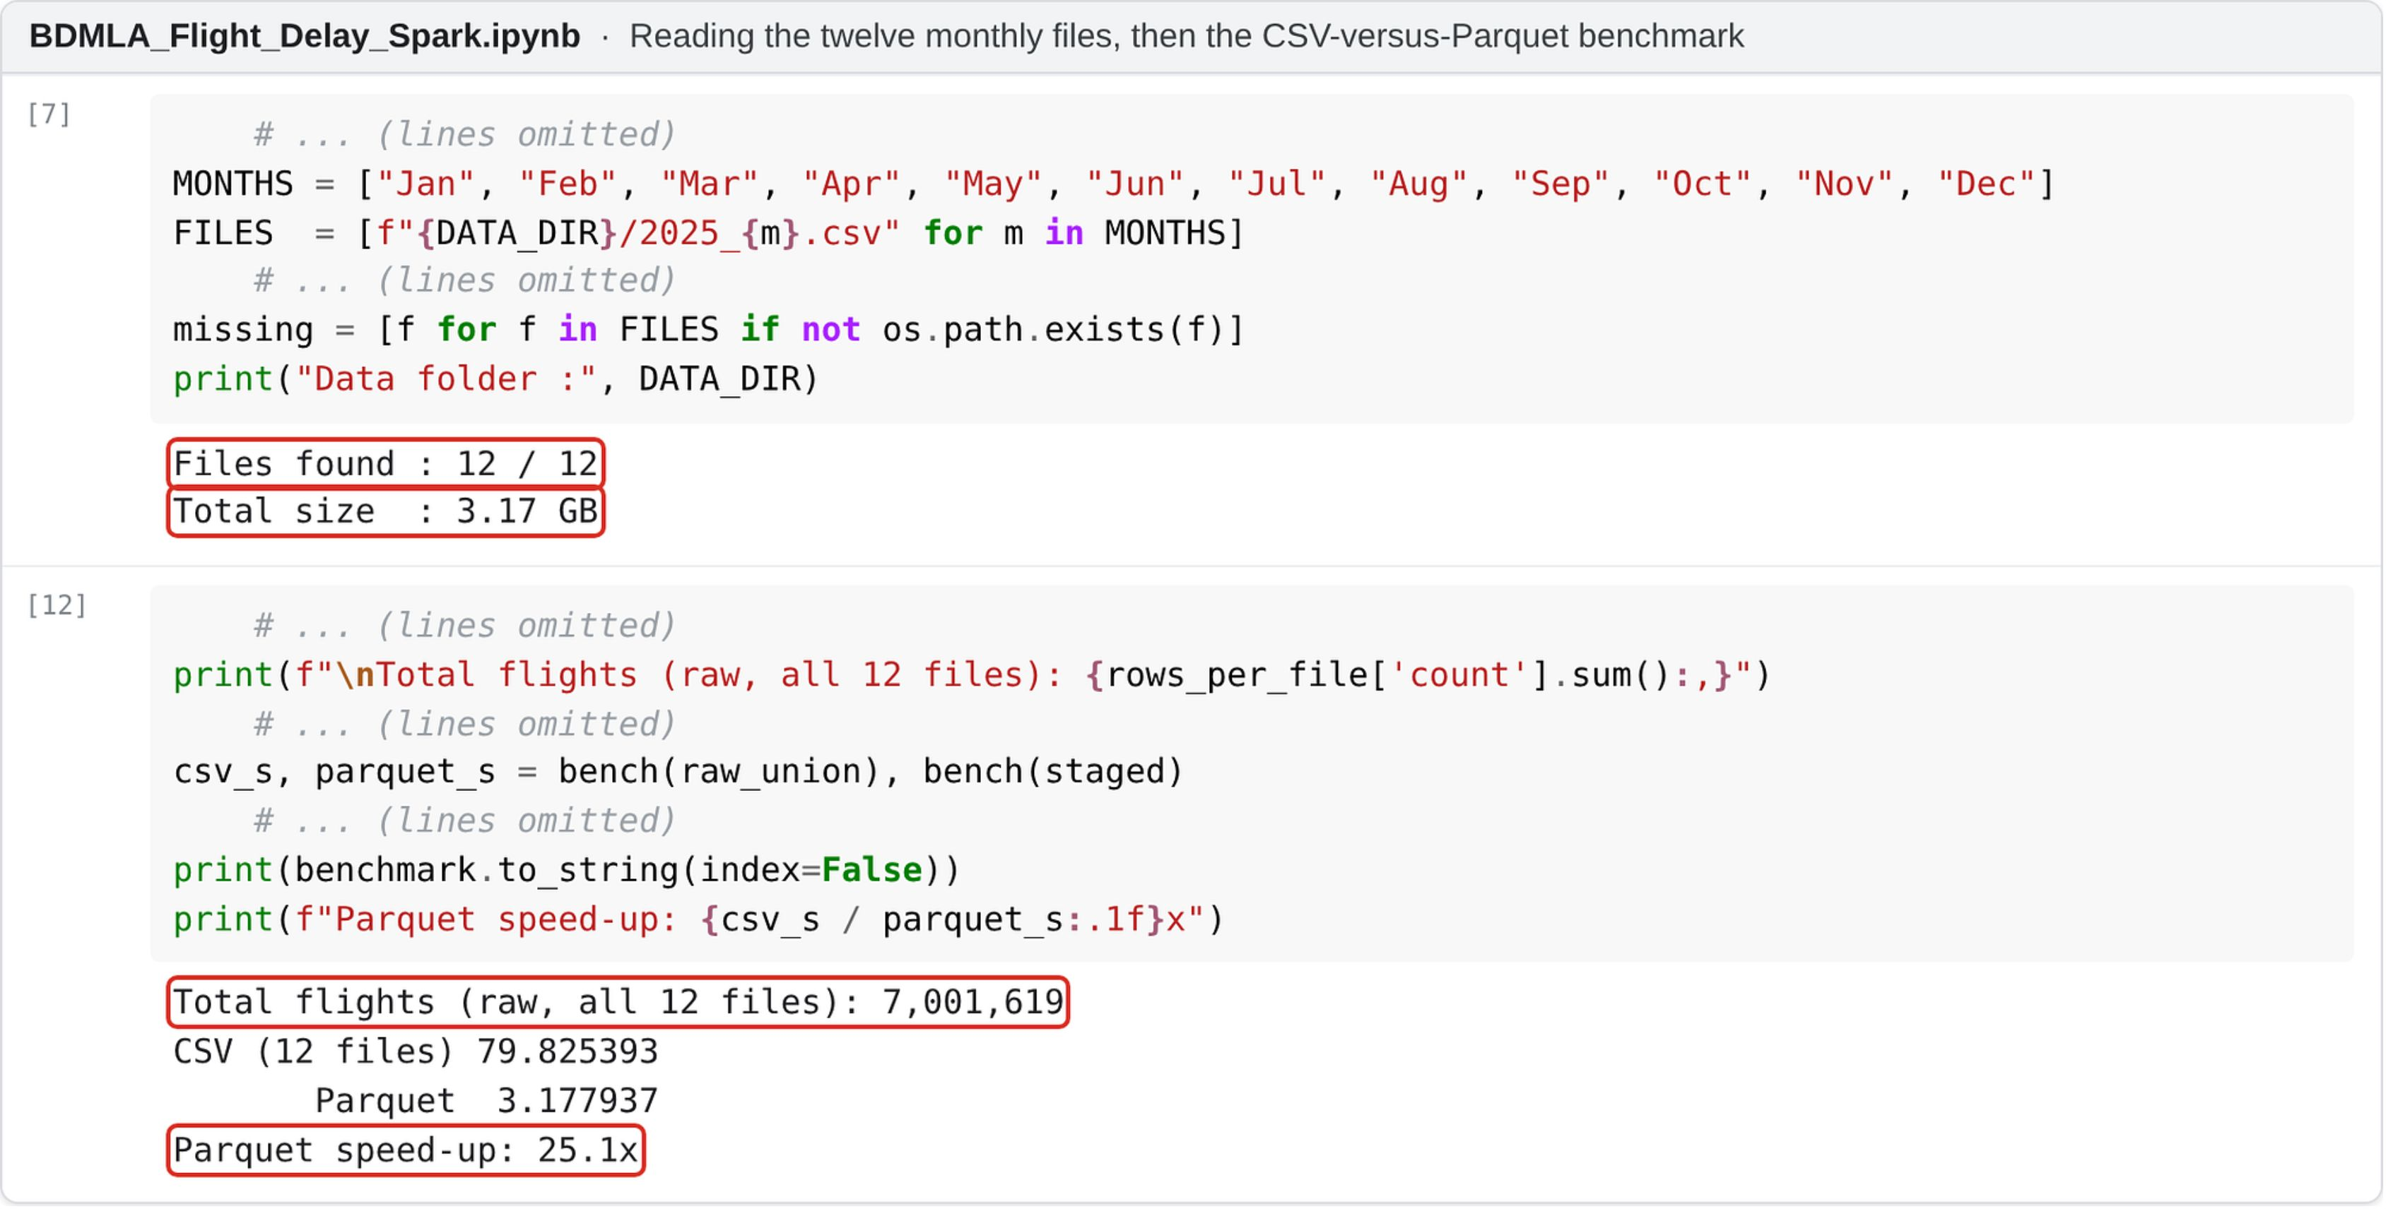
SPARK INGESTION
All 12 files found · 7,001,619 raw flights · same query: 25.1x faster on Parquet vs CSV
Notes:
[2:55-3:23] Here is what that step looks like in the notebook. The first cell checks that all twelve files are in Drive, 3.17 gigabytes in total. After the union there are 7,001,619 flights. The bottom box is the benchmark: the same aggregation took about 80 seconds on the CSV files and about 3 seconds on Parquet, a 25.1x speed-up, so everything after this reads from Parquet.

Slide 8
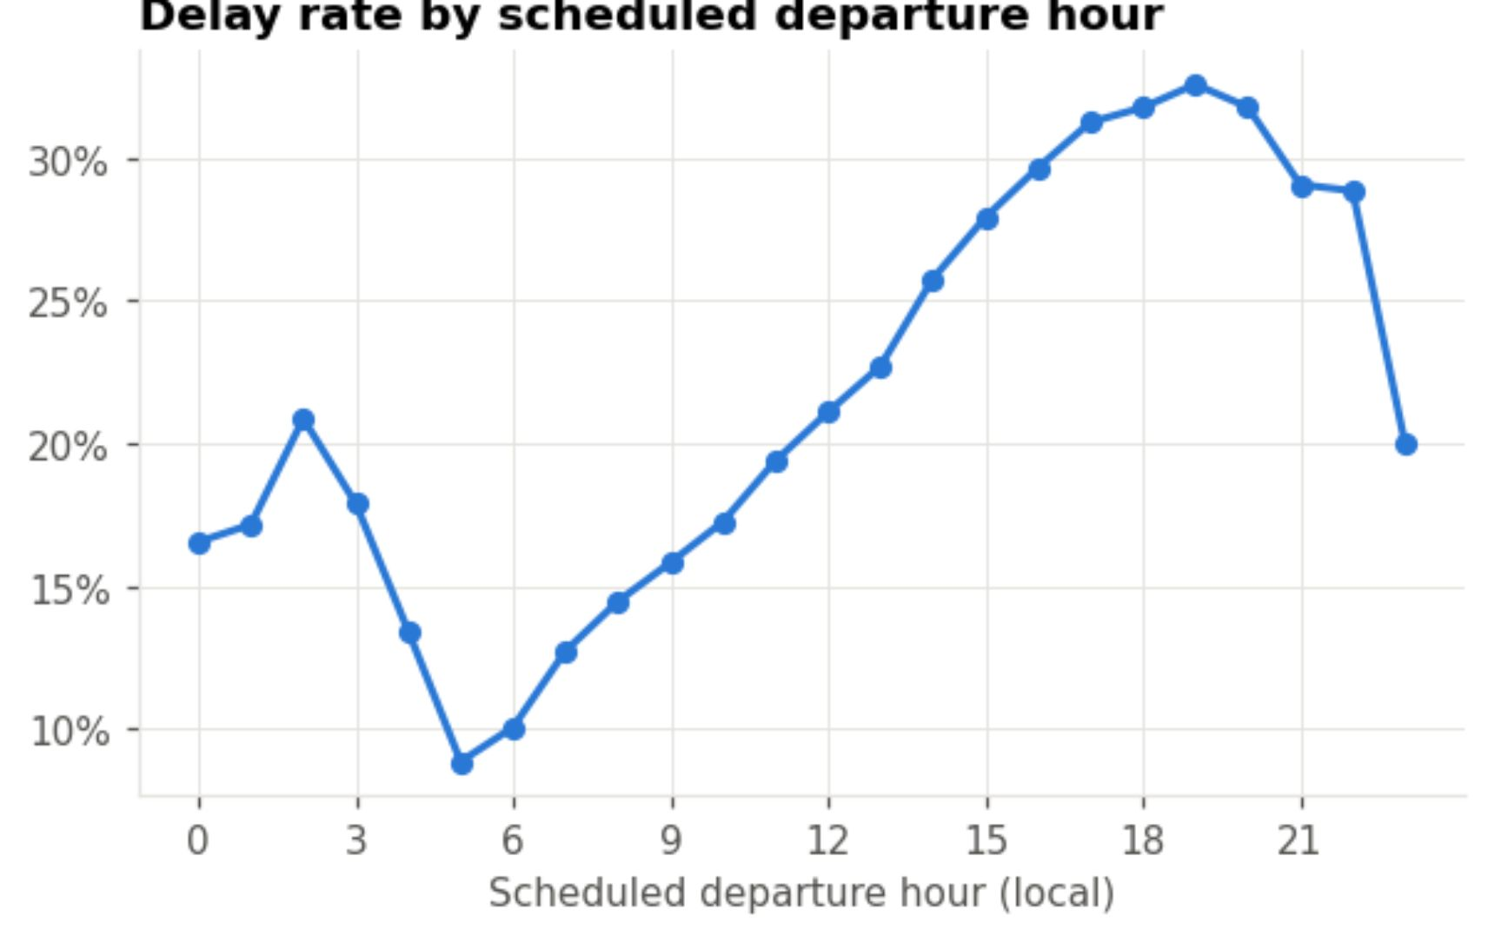
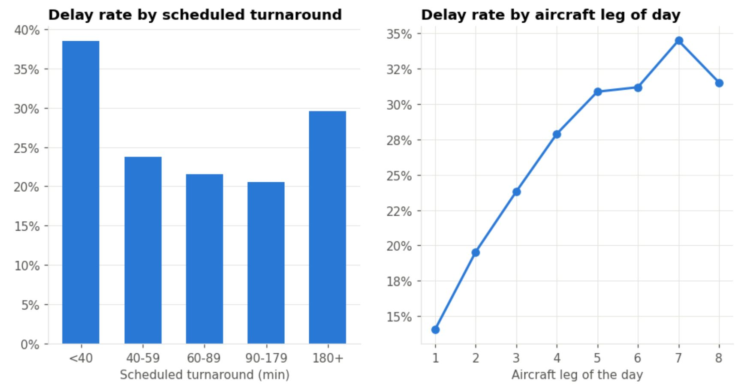
EXPLORATORY ANALYSIS
Delays build through the day: about 9% of 5am departures arrive late, rising to about 33% at 7pm.
Delays propagate along the aircraft: an aircraft's 1st leg is late ~15% of the time, its 7th ~34%; turnarounds under 40 minutes give a 38% delay rate.
Notes:
[3:23-4:00] Exploring the data showed two patterns that shaped my features. On the left, the delay rate by scheduled departure hour: only about 9 percent of 5am departures arrive late, but by 7pm it's around a third. On the right, the later the leg of the day for an aircraft, the more likely it is to be late, and very tight turnarounds under 40 minutes have a 38 percent delay rate. Delays roll forward through an aircraft's day, so I built features that capture exactly that.

Slide 9
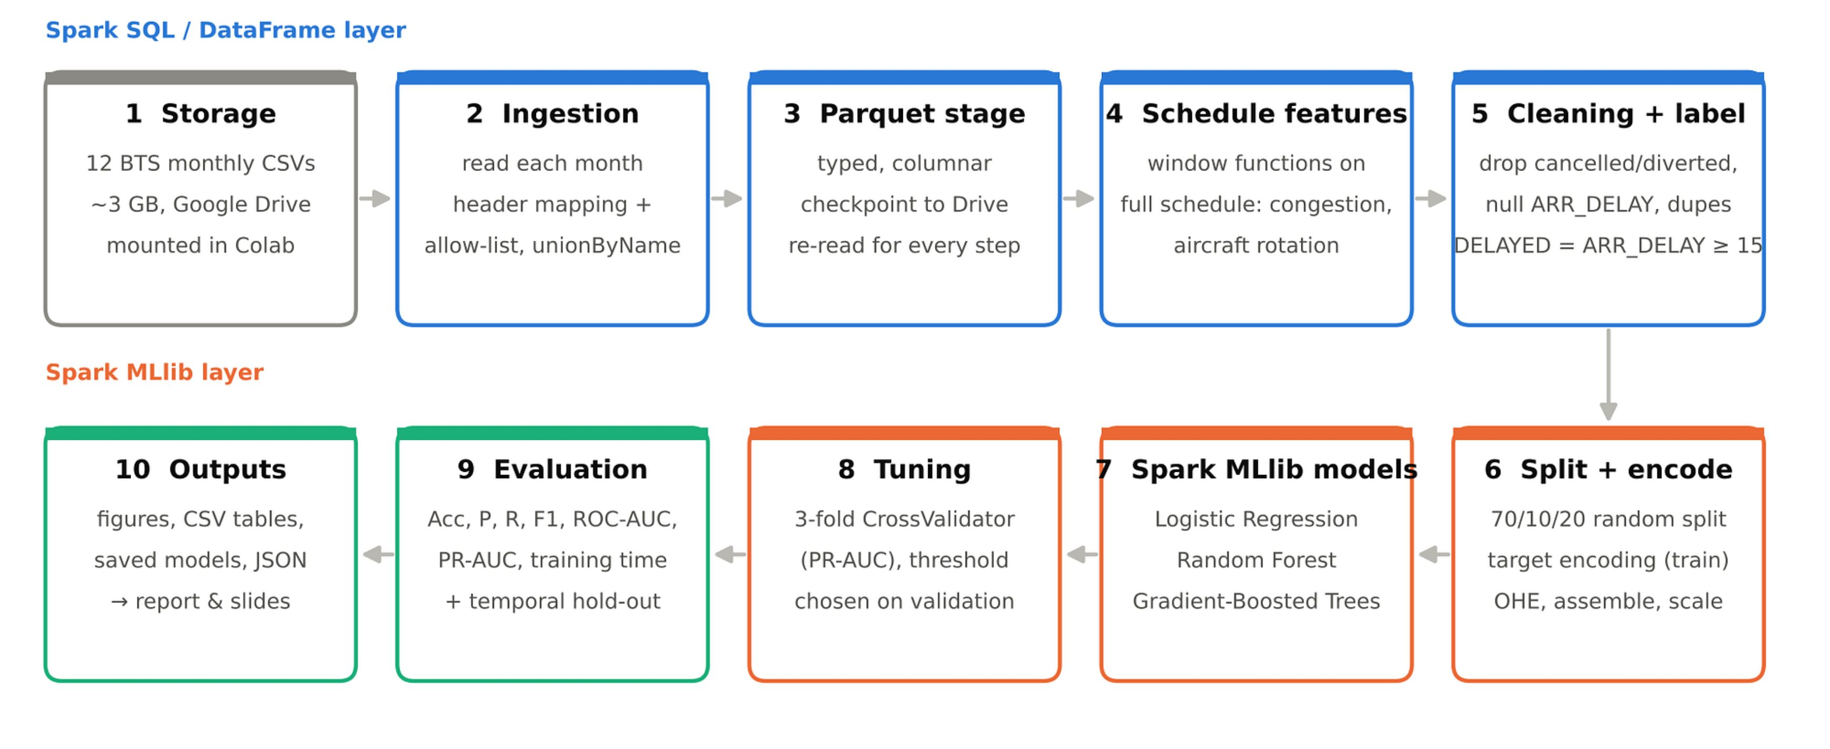
ARCHITECTURE DESIGN
Google Colab · PySpark 4.0.4 · Spark SQL / DataFrames for processing · Spark MLlib for modelling · Parquet checkpoint in Google Drive
Notes:
[4:00-4:34] This is the whole pipeline. The twelve files sit in Google Drive. Spark reads each month, maps the column names, keeps only the allowed columns and unions them into one DataFrame. That is written once to Parquet, which also acts as a checkpoint. Then come the schedule features, cleaning and the label. The second row is the machine learning layer: split, encode, train, tune and evaluate, and finally export every chart and table used in my report.

Slide 10
TECHNOLOGY USED
01
02
03
Apache Spark
Spark MLlib
Spark SQL
PySpark 4.0.4
LR · RF · GBT
+ Parquet
04
05
06
Python
Google Colab
Google Drive
pandas · matplotlib
2 vCPU · ~12 GB
data + checkpoints
Notes:
[4:34-4:41] The stack: Spark through PySpark, MLlib, Spark SQL with Parquet, Python, and Google Colab with Google Drive.

Slide 11
CLEANING AND LEAKAGE
Cleaning funnel (rows remaining)
Leakage guard
Allow-list at ingestion: post-flight columns are never loaded
Also excluded: DEP_DELAY, DEP_TIME, TAXI_OUT, DEP_DEL15
ARR_DELAY only builds the label, then it is dropped
Schedule counts use the full schedule, before cancelled flights are removed
An assertion stops the run if a forbidden column reaches the features
Remaining risks: same-day aircraft swaps, in-sample target encoding
Notes:
[4:41-5:21] Cleaning followed the brief: remove cancelled and diverted flights and rows with no arrival delay, then duplicates and impossible values, which leaves 6,879,483 flights. The bigger issue is leakage. Columns such as wheels-on time or the delay-cause minutes are only known after landing, so they are never loaded. I also excluded departure delay and taxi-out time. There's a subtle trap too: if you count flights per hour after removing cancellations, a stormy day looks quiet, and the feature leaks the outcome. So those counts are calculated on the full schedule first.

Slide 12
FEATURE ENGINEERING
39 features, built from the published schedule
Calendar and time
Flight and airline
Month, day, weekday, departure/arrival hour (with sin/cos), days to the nearest federal holiday
Scheduled duration, distance, airline (one-hot)
Airport congestion
Aircraft rotation
Scheduled departures/arrivals at the airport that hour; daily airport and carrier volume
Leg of the day for the tail number; scheduled turnaround since its last flight (window function)
High-cardinality categories → smoothed target encoding.
Origin, destination, route, origin×hour and carrier×origin become their historical delay rate, fitted on the training split only.
Notes:
[5:21-6:02] I ended up with 39 features in four groups, all built from the published schedule: calendar and time, including how close the date is to a public holiday; basic flight details; airport congestion, meaning how many flights are scheduled at the same airport in the same hour; and aircraft rotation, built with a Spark window function over each tail number. Airports and routes have thousands of values, which would explode the feature space and break Spark's tree limits, so I replaced each with its smoothed historical delay rate, fitted on the training data only.

Slide 13
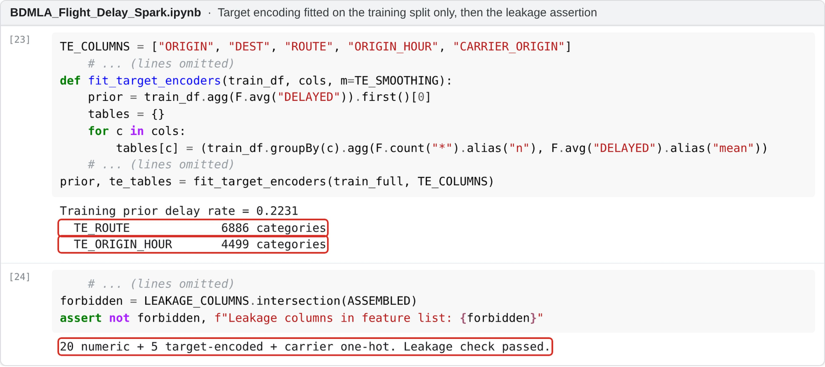
TARGET ENCODING
Training-only fit · 6,886 routes · 4,499 airport-hours · stops on leakage
Notes:
[6:02-6:33] This is the target-encoding code. The encoders are fitted on the training split only, so the validation and test flights never influence them. The output shows why one-hot encoding was not an option: there are 6,886 routes and 4,499 airport-and-hour combinations. The second cell is the leakage guard: an assertion compares the feature list with the forbidden columns, and the run stops if any of them is there. In my run it passed.

Slide 14
MODEL TRAINING PIPELINE
Split 70/10/20
train · valid · test
Target-encode
(train only)
Assemble +
standardise
Class weights
N / (2·N_class)
Evaluate on test
+ temporal test
Tune threshold
on validation
Train LR · RF · GBT
(Spark MLlib)
3-fold CV
(PR-AUC)
Logistic Regression: interpretable linear baseline.
Random Forest: many independent trees, easy to parallelise.
Gradient-Boosted Trees: trees added in sequence, each fixing the last; sequential rounds make it hardest to scale.
Notes:
[6:33-7:12] Here is the training pipeline. The data is split 70, 10 and 20 percent into train, validation and test sets. Because Colab only has two cores, models were trained on a 30% sample of the training set, but validation and test were always scored in full. Every model gets class weights, so delayed flights count as much as on-time ones. Each model is tuned with three-fold cross-validation on PR-AUC, the decision threshold is chosen on the validation set, and the test set is used once, at the end.

Slide 15
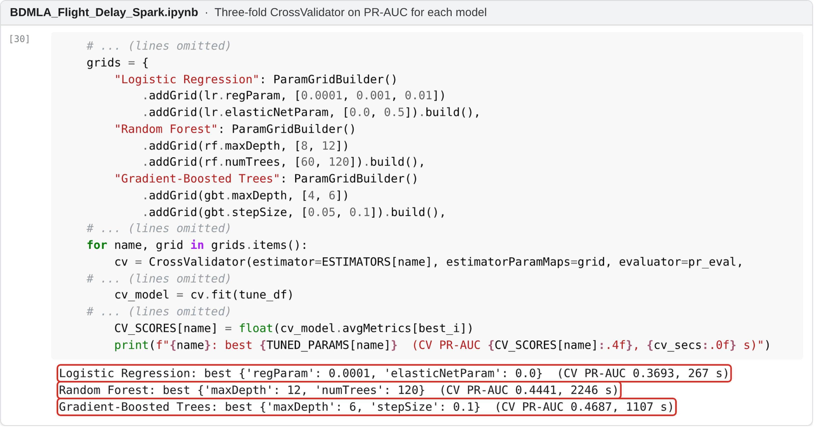
TUNING WITH CV
3-fold CrossValidator on PR-AUC · best CV PR-AUC: LR 0.369, RF 0.444, GBT 0.469
Notes:
[7:12-7:45] And this is the tuning step in Spark MLlib. Each model has a small parameter grid, and CrossValidator runs three-fold cross-validation scored on PR-AUC. The boxed lines are the winners: Random Forest with depth 12 and 120 trees, and boosting with depth 6 and a step size of 0.1, which had the best cross-validated PR-AUC, 0.469. Tuning Random Forest alone took about 37 minutes on Colab, which shows how expensive a grid search is on two cores.

Slide 16
RESULTS ON THE TEST SET
Test-set metrics (delayed = positive class)
 | Acc. | F1 | AUC | Train
Logistic Regression | 0.624 | 0.431 | 0.676 | 47 s
Random Forest | 0.669 | 0.460 | 0.715 | 2115 s
GBT | 0.710 | 0.479 | 0.735 | 465 s
Always 'on time' | 77.70% | 0.000 | 0.500 | -
Best (random split): Gradient-Boosted Trees, F1 0.479, ROC-AUC 0.735
In plain terms: GBT catches ~60% of delays, but ~6 in 10 of its alerts are false alarms
Accuracy trap: doing nothing scores higher accuracy than every model
Notes:
[7:45-8:25] These are the results on the random test split. Gradient-Boosted Trees came out best, with an F1 of 0.479 and a ROC-AUC of 0.735. In plain terms, it catches about 60 percent of delayed flights, but about six in ten of its delay alerts are false alarms. Notice the last row: a 'model' that always says on time gets 77.70% accuracy and catches zero delays, which is why accuracy alone is misleading here. Both tree models achieved a higher ROC-AUC than Logistic Regression, which suggests that interactions between the features help.

Slide 17
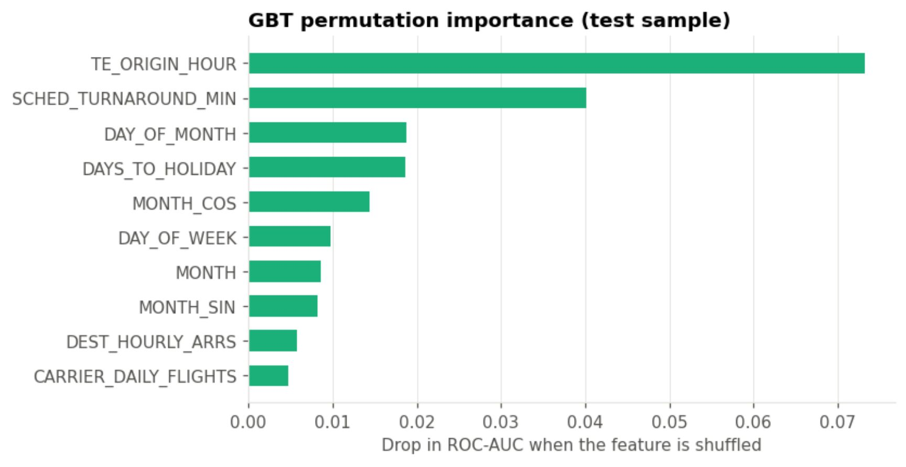
WHAT DRIVES DELAYS
Random split vs Oct–Dec test
 | ROC-AUC random | ROC-AUC Oct–Dec | F1 random | F1 Oct–Dec
LR | 0.676 | 0.603 | 0.431 | 0.130
RF | 0.715 | 0.672 | 0.460 | 0.402
GBT | 0.735 | 0.679 | 0.479 | 0.377
Strongest GBT features: airport-hour delay history and scheduled turnaround.
Trained on Jan–Sep, tested on Oct–Dec: RF has the higher F1 (0.402); GBT a slightly higher ROC-AUC (0.679).
Thresholds used some Oct–Dec validation flights, so this is a preliminary temporal comparison.
Notes:
[8:25-9:12] What is the model using? Permutation importance, on the left, shows the two features that matter most: the historical delay rate of that airport at that hour, and the scheduled turnaround time. On the right is a stricter test: train on January to September, then predict October to December. All models drop, and the ranking changes: Random Forest has the higher F1, while boosting keeps a slightly higher ROC-AUC. So the preferred model depends on the metric and on how it is evaluated. I consider this temporal test more relevant to practical use, with one caveat: the thresholds came from a validation set that includes some autumn flights.

Slide 18
CHALLENGES
First full run stopped after 3+ hours
1
Most likely a Colab session limit; added Parquet checkpoints, saved results after every model, and a resume option
Feature labels shifted between Spark versions
2
My code assumed Spark 3.5's metadata order; Colab's Spark 4.0 orders it differently. Spotted when a chart made no sense; fixed by sorting on vector index plus an assertion
Target leakage
3
Allow-list ingestion and schedule counts computed before cancellations are removed
Class imbalance (22% delayed)
4
Class weights plus a validation-tuned threshold instead of chasing accuracy
3 GB of CSV on a 12 GB machine
5
Only 17 columns loaded, then columnar Parquet: same query 25× faster
Notes:
[9:12-9:50] There were some practical challenges. My first full run stopped after more than three hours, most likely because of a Colab session limit, so I added checkpoints and a resume option. Feature-importance labels were also shifted: my code assumed the metadata order used by Spark 3.5, but Colab ran Spark 4.0, which orders it differently. It was spotted because one chart ranked day-of-week as the strongest feature, which made no sense, and it is now fixed with an explicit check. Leakage, imbalance and memory limits also needed care.

Slide 19
FUTURE SCOPE
Weather
Cleaner validation
Add hourly NOAA forecasts; prior work found weather improves accuracy
OOF target encoding in CV pipeline; temporal thresholds on separate month
Ablations
Real cluster
Compare runs with and without class weights and threshold tuning
Full data on Google Dataproc, with repeated timing runs
Stronger models
XGBoost or LightGBM on Spark with GPU acceleration
Notes:
[9:50-10:01] Next, I would add weather forecasts, use out-of-fold target encoding inside cross-validation, measure the effect of class weights, and repeat the training on a real cluster.

Slide 20
WHAT I LEARNT
Accuracy can mislead
Predicting 'on time' for every flight beats every model on accuracy; recall, precision and PR-AUC tell the real story
Leakage is subtle
Dropping post-flight columns was easy; counting flights after cancellations or encoding before CV were not
Evaluate on the future
The temporal test changed which model looks best
Engineering matters
Checkpointing, version differences and memory limits took as much effort as modelling
Notes:
[10:01-10:32] So what did I learn? First, accuracy can be misleading on imbalanced data. Second, leakage is subtle: removing post-flight columns was easy, but problems like counting flights after cancellations, or encoding categories before cross-validation, only showed up on closer inspection. Third, evaluating on future months changed my view of which model is best. And finally, the engineering side, checkpointing, version differences and memory, took as much effort as the modelling.

Slide 21
CONCLUSION
Built an Apache Spark pipeline over 7,001,619 U.S. domestic flights of 2025 that excludes post-flight information.
On the random test split, Gradient-Boosted Trees performed best (F1 0.479, ROC-AUC 0.735); on later, unseen months Random Forest had the higher F1, so the best model depends on how it is used.
Accuracy is misleading on imbalanced data; recall, precision, PR-AUC and a temporal test give a fairer picture.
Big data tooling made it feasible on free Colab: Parquet, broadcast joins and keeping evaluation inside Spark.
Before extending the model: audit the rotation features, use out-of-fold encoding and chronological validation.
Notes:
[10:32-10:59] To conclude: I built a Spark pipeline over every U.S. domestic flight in 2025 that excludes post-flight information. On the random split, Gradient-Boosted Trees performed best; on later months, Random Forest had the higher F1. Schedule-only prediction works, but it has a ceiling, and before extending it I would first validate the method itself: the rotation features, the encoding and the chronological validation.

Slide 22
REFERENCES
Ball, M., et al. (2010). Total delay impact study. NEXTOR.
Belcastro, L., Marozzo, F., Talia, D., & Trunfio, P. (2016). Using scalable data mining for predicting flight delays. ACM TIST, 8(1), 5.
Breiman, L. (2001). Random forests. Machine Learning, 45(1), 5–32.
Bureau of Transportation Statistics. (2026). Reporting carrier on-time performance (1987–present) [Data set]. U.S. DOT.
Friedman, J. H. (2001). Greedy function approximation: A gradient boosting machine. Annals of Statistics, 29(5), 1189–1232.
Kaufman, S., Rosset, S., Perlich, C., & Stitelman, O. (2012). Leakage in data mining. ACM TKDD, 6(4), 15.
Meng, X., et al. (2016). MLlib: Machine learning in Apache Spark. JMLR, 17(34), 1–7.
Micci-Barreca, D. (2001). A preprocessing scheme for high-cardinality categorical attributes. SIGKDD Explorations, 3(1), 27–32.
Saito, T., & Rehmsmeier, M. (2015). The precision-recall plot is more informative than the ROC plot. PLoS ONE, 10(3), e0118432.
Wirth, R., & Hipp, J. (2000). CRISP-DM: Towards a standard process model for data mining. Proc. 4th Int. Conf. on the Practical Applications of Knowledge Discovery and Data Mining, 29–39.
Zaharia, M., et al. (2016). Apache Spark: A unified engine for big data processing. CACM, 59(11), 56–65.
Notes:
[10:59-11:03] The main references I used are listed here.

Slide 23


Thank you
Notes:
[11:03-11:10] Thank you very much for watching. The full code, results and report are included in my submission.

