Slide 1
– BDMLA Coursework 1
Big Data and Machine Learning Application:
Face Mask Detection

Slide 2
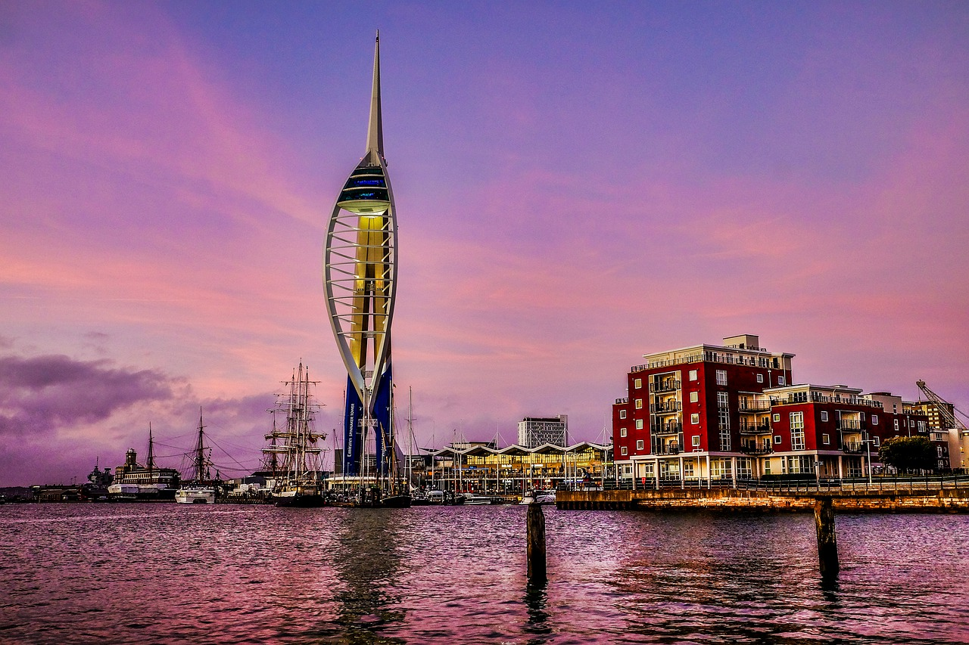
Thank you

