Slide 1
– BDMLA Coursework 1
Big Data and Machine Learning Application:
Predicting Airline Flight Delays with Apache Spark
[Your name] · [Student ID] · M33877 · November 2026
Notes:
[0:00-0:24] Hello, my name is [your name], and this is my Big Data and Machine Learning Applications project: predicting airline flight delays with Apache Spark. I used every U.S. domestic flight from 2025, 7,001,619 of them, to test one practical question: can we tell, before a plane even leaves the gate, that it is going to arrive late?

Slide 2
BACKGROUND
Costly. Flight delays cost the U.S. economy an estimated $32.9 billion in 2007, shared between airlines, passengers and lost demand (Ball et al., 2010).
Clearly defined. The Bureau of Transportation Statistics (BTS) counts a flight as delayed when it arrives 15 or more minutes late.
Big data. BTS publishes a record for every domestic flight of the larger U.S. carriers: millions of labelled rows every year.
Useful if predicted early. Airlines can re-plan crews, gates and spare aircraft; passengers with tight connections can be warned.
$32.9B
cost of U.S. delays in 2007
15 min
BTS delay threshold
7,001,619
flights in 2025
Notes:
[0:24-1:03] Delays matter because they are expensive. A major U.S. study estimated the cost at around 33 billion dollars in 2007 alone, shared between airlines, passengers and lost demand. The industry uses a simple rule: a flight that arrives 15 minutes or more after schedule counts as delayed. The Bureau of Transportation Statistics publishes a record for every domestic flight, which gives us millions of labelled examples. If risky flights can be flagged early, airlines can re-plan crews and spare aircraft, and passengers with tight connections can be warned.

Slide 3
PROJECT PROPOSAL
Using only information known before departure, will this flight arrive 15+ minutes late?
Binary classification: DELAYED = 1 if ARR_DELAY ≥ 15 minutes, otherwise 0.
Before departure only: many public notebooks use departure delay as an input, which is only known once the plane has left. That inflates accuracy and makes the model useless in practice (Kaufman et al., 2012).
Approach: ingest all twelve 2025 monthly files with Apache Spark, engineer schedule-based features, and compare three Spark MLlib classifiers.
Notes:
[1:03-1:41] So the problem statement is: using only information known before departure, will this flight arrive 15 or more minutes late? That makes it a binary classification problem. The 'before departure' condition is the important part. Many online examples use the departure delay as an input, but you only know that once the plane has left, so the model looks accurate but is useless in practice. My approach is to process the whole year with Spark, build features from the schedule only, and compare three Spark MLlib classifiers fairly.

Slide 4
OBJECTIVES AND SCOPE
Objectives
Scope
O1
Ingest, union and clean all 12 monthly files in Spark
U.S. domestic flights, January–December 2025
Arrival delay ≥ 15 min as the target
Schedule information only: no departure delay, no weather
Google Colab (2 cores, ~12 GB RAM) with PySpark
O2
Engineer leakage-free, pre-departure features
O3
Train LR, Random Forest and GBT in Spark MLlib
O4
Evaluate with imbalance-aware metrics + training time
O5
Show how the pipeline scales out
Notes:
[1:41-2:09] I set five objectives: ingest and clean all twelve monthly files in Spark; engineer features with no target leakage; train Logistic Regression, Random Forest and Gradient-Boosted Trees; evaluate them with metrics that suit an imbalanced problem, plus training time; and show how the pipeline scales out. The scope is all 2025 U.S. domestic flights, using schedule information only, running on a free Google Colab machine.

Slide 5
DATA SET USED
Source: BTS Reporting Carrier On-Time Performance, Jan–Dec 2025 (12 monthly CSVs, 3.17 GB, ~110 columns each).
Size: 7,001,619 flights; 6,879,483 after cleaning.
Imbalanced: 22.31% of flights are delayed, so always predicting 'on time' already scores 77.70% accuracy.
12
3.17 GB
monthly files
raw CSV
17 / 110
25.1x
columns kept
faster on Parquet
Source: Bureau of Transportation Statistics (2026), Reporting Carrier On-Time Performance.
Notes:
[2:09-2:44] The data is the official BTS on-time performance table: twelve monthly CSV files, 3.17 gigabytes, and 7,001,619 flights. Each file has about 110 columns, but I only load 17 of them, for leakage reasons I'll come back to. After cleaning, 22.31% of flights are delayed. So the classes are imbalanced: a model that always says 'on time' would already score 77.70% accuracy. One early optimisation was converting the CSVs to Parquet once; after that, the same query ran 25.1x faster.

Slide 6
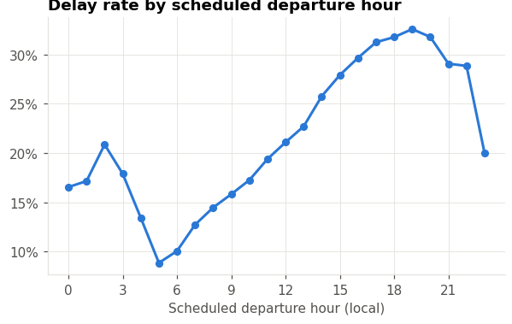
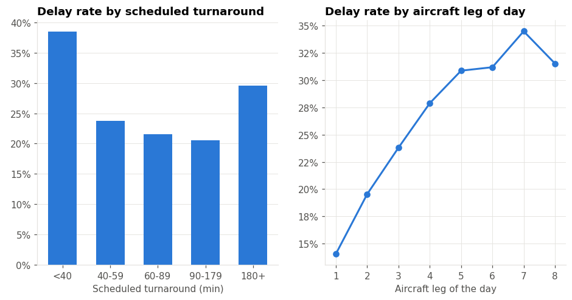
EXPLORATORY ANALYSIS
Delays build through the day: about 9% of 5am departures arrive late, rising to about 33% at 7pm.
Delays propagate along the aircraft: an aircraft's 1st leg is late ~15% of the time, its 7th ~34%; turnarounds under 40 minutes give a 38% delay rate.
Notes:
[2:44-3:21] Exploring the data showed two patterns that shaped my features. On the left, the delay rate by scheduled departure hour: only about 9 percent of 5am departures arrive late, but by 7pm it's around a third. On the right, the later the leg of the day for an aircraft, the more likely it is to be late, and very tight turnarounds under 40 minutes have a 38 percent delay rate. Delays roll forward through an aircraft's day, so I built features that capture exactly that.

Slide 7
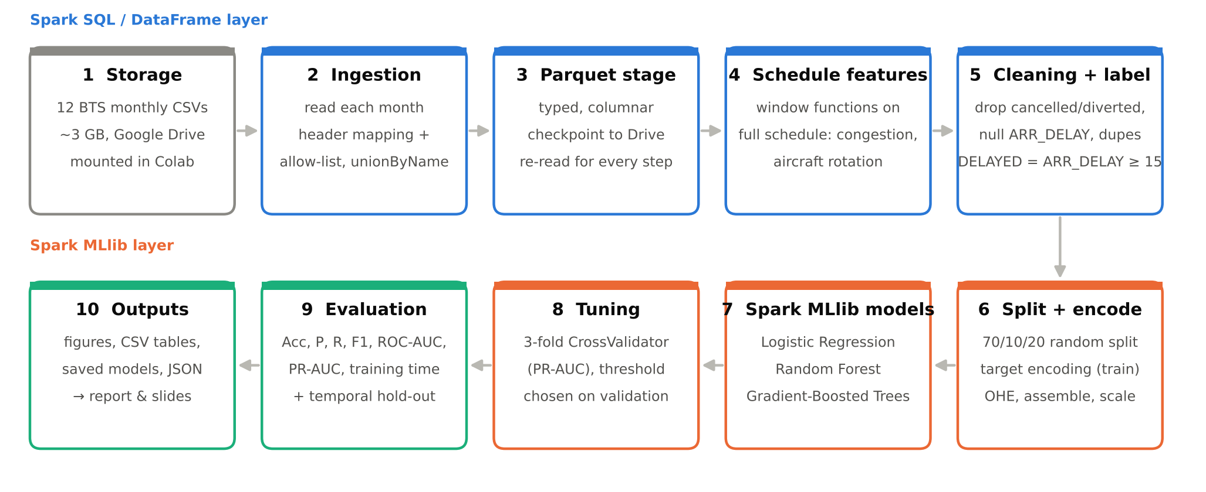
ARCHITECTURE DESIGN
Google Colab · PySpark 4.0.4 · Spark SQL / DataFrames for processing · Spark MLlib for modelling · Parquet checkpoint in Google Drive
Notes:
[3:21-3:54] This is the whole pipeline. The twelve files sit in Google Drive. Spark reads each month, maps the column names, keeps only the allowed columns and unions them into one DataFrame. That is written once to Parquet, which also acts as a checkpoint. Then come the schedule features, cleaning and the label. The second row is the machine learning layer: split, encode, train, tune and evaluate, and finally export every chart and table used in my report.

Slide 8
TECHNOLOGY USED
01
02
03
Apache Spark
Spark MLlib
Spark SQL
PySpark 4.0.4
LR · RF · GBT
+ Parquet
04
05
06
Python
Google Colab
Google Drive
pandas · matplotlib
2 vCPU · ~12 GB
data + checkpoints
Notes:
[3:54-4:11] The technology stack is Apache Spark through PySpark, with MLlib for the models and Spark SQL with Parquet for the data processing, Python for plotting, and Google Colab for compute, with the data and checkpoints stored in Google Drive.

Slide 9
CLEANING AND LEAKAGE
Leakage guard
Allow-list at ingestion: post-flight columns are never loaded
Also excluded: DEP_DELAY, DEP_TIME, TAXI_OUT, DEP_DEL15
ARR_DELAY only builds the label, then it is dropped
Schedule counts use the full schedule, before cancelled flights are removed
An assertion stops the run if a forbidden column reaches the features
Notes:
[4:11-4:51] Cleaning followed the brief: remove cancelled and diverted flights and rows with no arrival delay, then duplicates and impossible values, which leaves 6,879,483 flights. The bigger issue is leakage. Columns such as wheels-on time or the delay-cause minutes are only known after landing, so they are never loaded. I also excluded departure delay and taxi-out time. There's a subtle trap too: if you count flights per hour after removing cancellations, a stormy day looks quiet, and the feature leaks the outcome. So those counts are calculated on the full schedule first.

Slide 10
FEATURE ENGINEERING
39 features, all known before departure
Calendar and time
Flight and airline
Month, day, weekday, departure/arrival hour (with sin/cos), days to the nearest federal holiday
Scheduled duration, distance, airline (one-hot)
Airport congestion
Aircraft rotation
Scheduled departures/arrivals at the airport that hour; daily airport and carrier volume
Leg of the day for the tail number; scheduled turnaround since its last flight (window function)
High-cardinality categories → smoothed target encoding.
Origin, destination, route, origin×hour and carrier×origin become their historical delay rate, fitted on the training split only.
Notes:
[4:51-5:31] I ended up with 39 features in four groups, all known in advance: calendar and time, including how close the date is to a public holiday; basic flight details; airport congestion, meaning how many flights are scheduled at the same airport in the same hour; and aircraft rotation, built with a Spark window function over each tail number. Airports and routes have thousands of values, which would explode the feature space and break Spark's tree limits, so I replaced each with its smoothed historical delay rate, fitted on the training data only.

Slide 11
MODEL TRAINING PIPELINE
Split 70/10/20
train · valid · test
Target-encode
(train only)
Assemble +
standardise
Class weights
N / (2·N_class)
Evaluate on test
+ temporal test
Tune threshold
on validation
Train LR · RF · GBT
(Spark MLlib)
3-fold CV
(PR-AUC)
Logistic Regression: interpretable linear baseline.
Random Forest: many independent trees, easy to parallelise.
Gradient-Boosted Trees: trees added in sequence, each fixing the last; sequential rounds make it hardest to scale.
Notes:
[5:31-6:10] Here is the training pipeline. The data is split 70, 10 and 20 percent into train, validation and test sets. Because Colab only has two cores, models were trained on a 30% sample of the training set, but validation and test were always scored in full. Every model gets class weights, so delayed flights count as much as on-time ones. Each model is tuned with three-fold cross-validation on PR-AUC, the decision threshold is chosen on the validation set, and the test set is used only once, at the end.

Slide 12
RESULTS ON THE TEST SET
 | Acc. | F1 | AUC | Train
Logistic Regression | 0.624 | 0.431 | 0.676 | 47 s
Random Forest | 0.669 | 0.460 | 0.715 | 2115 s
GBT | 0.710 | 0.479 | 0.735 | 465 s
Always 'on time' | 77.70% | 0.000 | 0.500 | -
Best: Gradient-Boosted Trees (F1 0.479, ROC-AUC 0.735)
Tuning: Random Forest 0.705 → 0.715 ROC-AUC, but twice the training time
Accuracy trap: doing nothing scores higher accuracy than every model
Notes:
[6:10-6:51] These are the test results. Gradient-Boosted Trees came out best, with an F1 of 0.479 and a ROC-AUC of 0.735. Notice the last row of the table: a 'model' that always says on time gets 77.70% accuracy and catches zero delays. That's why accuracy on its own is misleading here, and why I focus on recall, F1 and PR-AUC instead. Both tree models clearly beat Logistic Regression, so the non-linear interactions matter. Tuning improved Random Forest, but doubled its training time, and boosting still beat it while training in less than a quarter of the time.

Slide 13
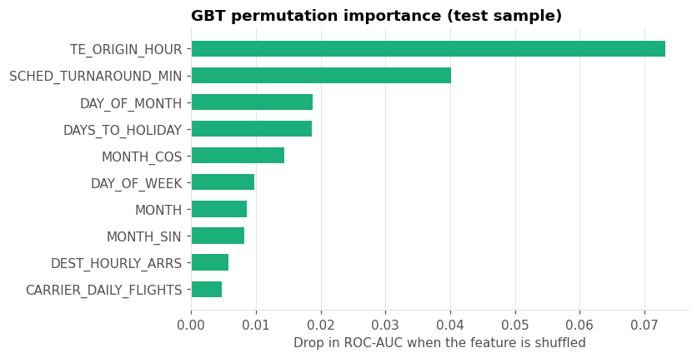
WHAT DRIVES DELAYS
Top drivers: the airport's historical delay rate at that hour, and the scheduled turnaround time.
Honest test: trained on Jan–Sep, tested on Oct–Dec, GBT ROC-AUC drops 0.735 → 0.679; the random split let trees memorise specific bad days.
Notes:
[6:51-7:35] What is the model actually using? The left chart shows permutation importance: how much accuracy drops when one feature is shuffled. The two that matter most are the historical delay rate of that airport at that hour, and the scheduled turnaround time, which is the delay-propagation story again. On the right is my strictest test: train on January to September, then predict October to December. ROC-AUC drops from 0.735 to 0.679 for boosting. A random split lets the model learn specific storm days that also appear in the test set, so this temporal figure is the honest estimate for real use.

Slide 14
CHALLENGES
1
Colab disconnected after 3+ hours
Parquet checkpoint in Drive, results saved after every model, and a resume option that reuses tuned settings
2
A silent bug on Spark 4
Feature-importance labels were shifted on Colab's Spark 4.0; a sanity check on the chart caught it, now fixed with an assertion
3
Target leakage
Allow-list ingestion and schedule counts computed before cancellations are removed
4
Class imbalance (22% delayed)
Class weights plus a validation-tuned threshold instead of chasing accuracy
5
3 GB of CSV on a 12 GB machine
Only 17 columns loaded, then columnar Parquet: same query 25× faster
Notes:
[7:35-8:14] The project had some real challenges. My first full run was disconnected by Colab after more than three hours, so I added Parquet checkpoints, saved results after every model, and a resume option that reuses the tuned settings. On Colab's Spark 4, the feature-importance labels were silently shifted; I only caught it because Logistic Regression claimed day-of-week was its strongest feature, which made no sense. I fixed it and added an assertion. And throughout, I had to control leakage, handle the imbalance, and fit three gigabytes into a twelve-gigabyte machine.

Slide 15
FUTURE SCOPE
Weather
Stronger models
Join hourly NOAA weather forecasts: the biggest missing signal
XGBoost or LightGBM on Spark, with GPU acceleration (RAPIDS)
Real cluster
Streaming
Full training data on Google Dataproc, wider tuning grids
Spark Structured Streaming to update predictions on the day
Cleaner encoding
Out-of-fold target encoding to avoid in-sample bias
Notes:
[8:14-8:42] For future work, weather forecasts are the biggest missing signal, so joining NOAA data would come first. I'd also try XGBoost or LightGBM on Spark with GPU acceleration, train on the full data on a real Dataproc cluster, where the same code simply runs on more executors, and use Spark Structured Streaming to update predictions on the day as earlier flights report delays.

Slide 16
CONCLUSION
Built a leakage-free Apache Spark pipeline over all 7,001,619 U.S. domestic flights of 2025.
Gradient-Boosted Trees performed best (F1 0.479, ROC-AUC 0.735), clearly ahead of Logistic Regression, and far cheaper to train than a tuned Random Forest.
Accuracy is misleading on imbalanced data: class weights, a tuned threshold, PR-AUC and an honest temporal test matter more.
Big data tooling made it feasible on free Colab: Parquet, broadcast joins and keeping evaluation inside Spark.
Schedule-only prediction is possible but limited: weather and on-the-day updates are the way forward.
Notes:
[8:42-9:11] To conclude: I built a complete, leakage-free Spark pipeline over every U.S. domestic flight in 2025, and Gradient-Boosted Trees performed best. The biggest lessons were about evaluation rather than algorithms: handling the imbalance, choosing the threshold for the business need, and testing honestly on future months. Schedule-only prediction works, but it has a ceiling, so weather data and on-the-day updates are where the next gains will come from.

Slide 17

Thank you
Notes:
[9:11-9:19] Thank you very much for watching. The full code, results and report are included in my submission.

