Slide 1
Logistic Regression
Week 6 Project

Slide 2
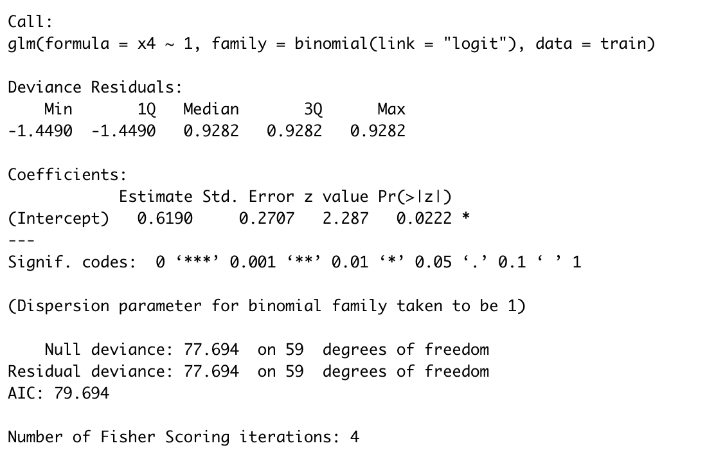

Estimating base model
Initial base model for analysis sample
-2LL is 77.6936

Slide 3
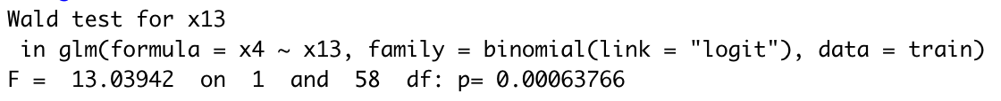

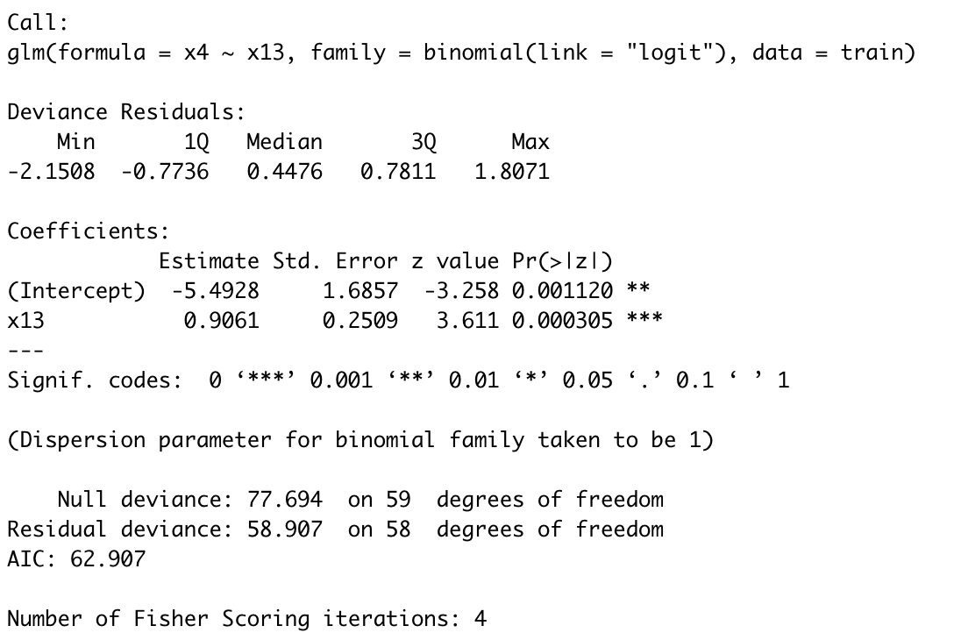
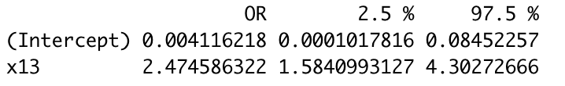
Adding x13
-2LL dropped significantly to 58.90741
Overall p-value with Wald statistic < 0.05
P-value for x13 within model < 0.05
Confidence intervals for x13 does not contain 0
Odds ratio is statistically significant

Slide 4
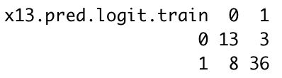
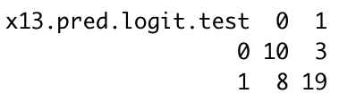
Classification matrix for adding x13
Analysis sample
Holdout sample
Cut off score is 0.5
13/16 or 81.25% predicted correctly for ”USA/North America” region
36/44 or 81.81% predicted correctly for “Outside North America” region
49/60 or 81.667% predicted correctly overall
Cut off score is 0.5
10/13 or 76.92% predicted correctly for ”USA/North America” region
19/27 or 70.37% predicted correctly for “Outside North America” region
29/40 or 72.5% predicted correctly overall

Slide 5
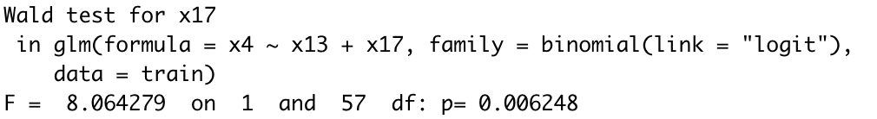

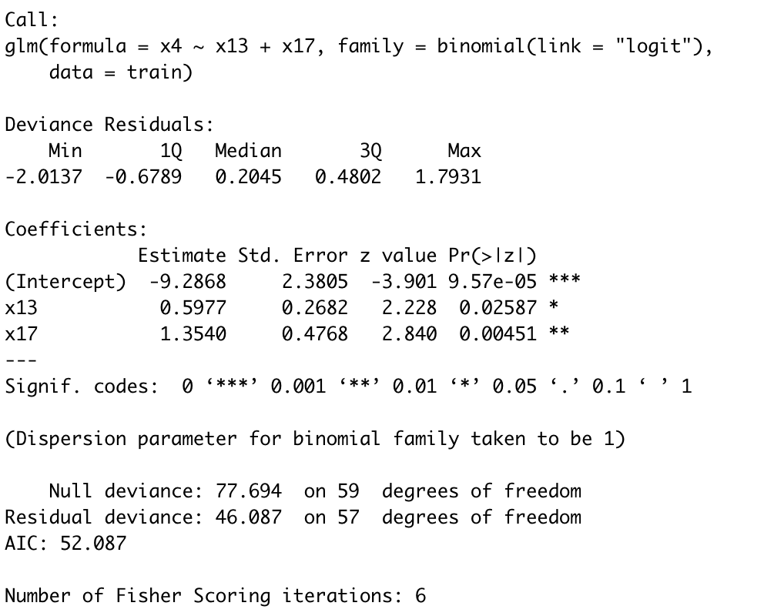
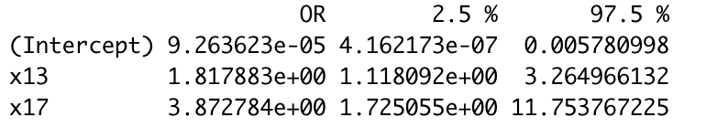
Final model
-2LL dropped again to 46.0866
Overall p-value with Wald statistic still < 0.05
P-value for both independent variables within model still < 0.05
Confidence intervals for both independent variables does not contain 0
Odds ratio is statistically significant

Slide 6
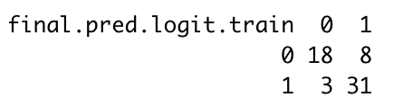
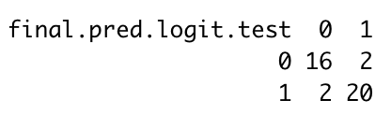
Classification matrix for final model
Analysis sample
Holdout sample
Cut off score is 0.5
18/26 or 69.23% predicted correctly for ”USA/North America” region
31/34 or 91.18% predicted correctly for “Outside North America” region
49/60 or 81.667% predicted correctly overall
Cut off score is 0.5
16/18 or 88.89% predicted correctly for ”USA/North America” region
20/22 or 90.91% predicted correctly for “Outside North America” region
36/40 or 90% predicted correctly overall

Slide 7
Appendix: R code

Slide 8
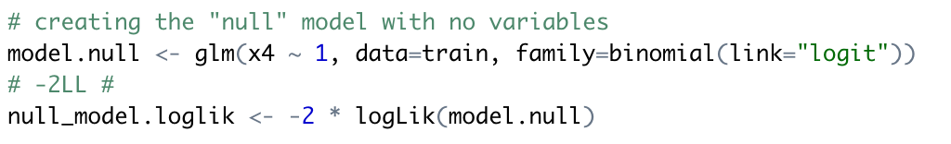
Null model and -2ll

Slide 9
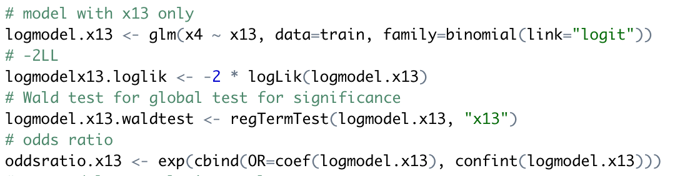
Model with x13, -2ll, wald test, and odds ratio

Slide 10
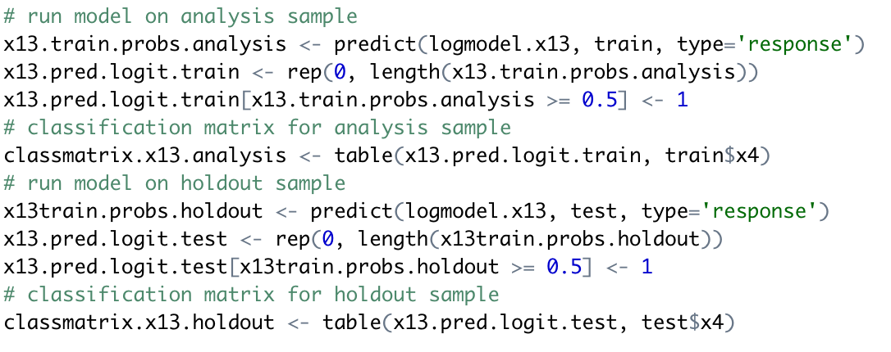
Classification matrix with x13 model for analysis and holdout sample

Slide 11
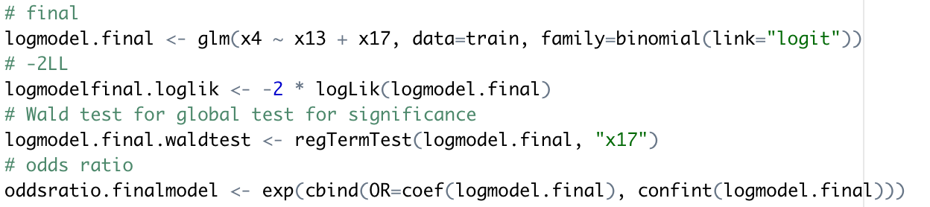
Final model, -2ll, wald test, and odds ratio

Slide 12
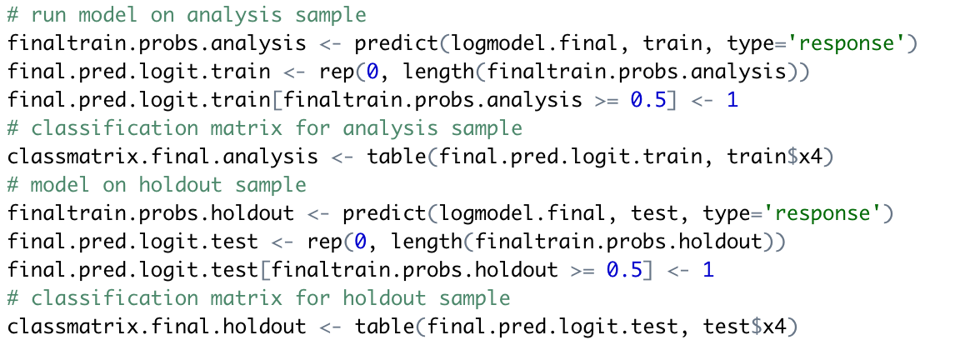
Classification matrix with final model for analysis and holdout sample

