Slide 1
Multiple Discriminant Analysis
Week 5 project

Slide 2
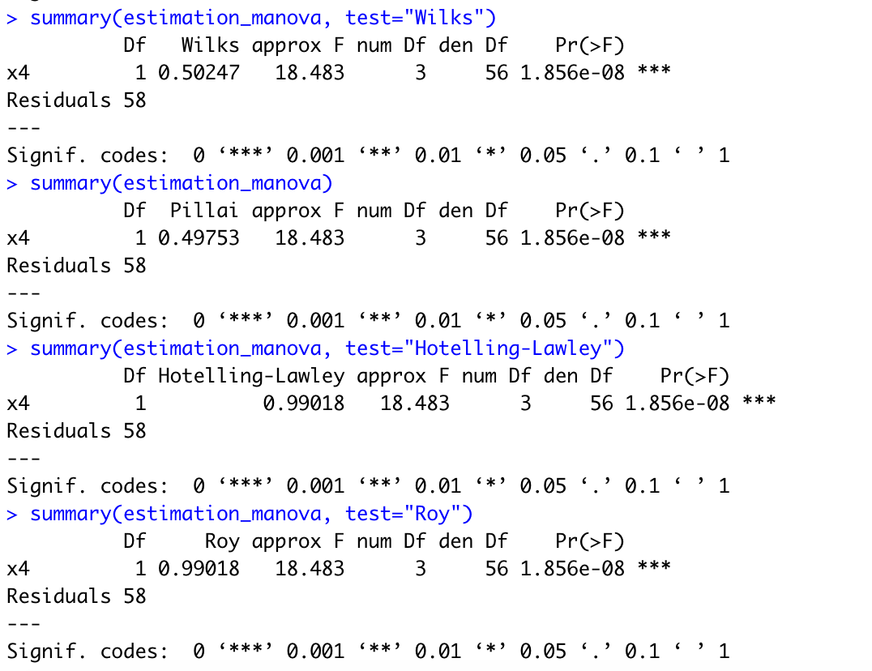
Adding x11 to discriminant function
Discriminant function on estimation sample (60 records randomly chosen)
Overall test of model is statistically significant for Wilks’ Lambda with p-value <= 0.05
Also statistically significant with p-value for other measures:
Pillai
Hotelling-Lawley
Roy

Slide 3
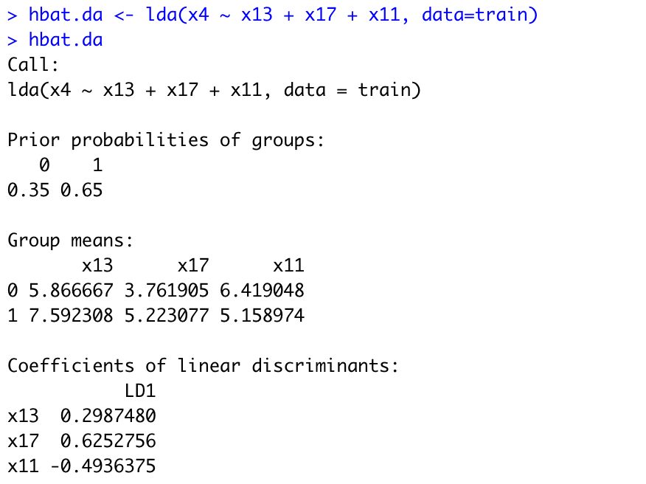
Summary statistics of overall Model
Prior probabilities of 0.35 for USA/North America and 0.65 of Outside North America
Coefficients of Discriminant function variables
X13 = 0.2987
X17 = 0.6253
X11 = -0.4936

Slide 4
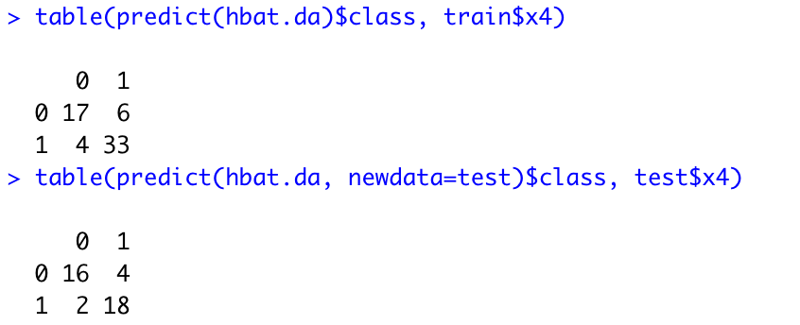
Classification matrix
Estimation Sample
17/23 correctly classified for USA/North America = 73.91%
33/37 correctly classified for Outside North America = 89.19%
50/60 total correctly classified = 83.33%
Holdout sample
16/20 correctly classified for USA/North America = 80%
18/20 correctly classified for Outside North America = 90%
34/40 total correctly classified = 85%

Slide 5
Group prediction of analysis sample
id | x4 | descr_z_score | predicted_group |  | id | x4 | descr_z_score | predicted_group
1 | 1 | 0.5320974 | 1 |  | 57 | 1 | 1.1086114 | 1
2 | 0 | -1.8971575 | 0 |  | 58 | 0 | -1.7744122 | 0
3 | 1 | -2.0769198 | 0 |  | 59 | 0 | -1.2987684 | 0
4 | 1 | 0.6030452 | 1 |  | 61 | 0 | -2.2174031 | 0
5 | 0 | -1.0113448 | 0 |  | 62 | 1 | 0.5384225 | 1
8 | 1 | 1.9540316 | 1 |  | 63 | 0 | -0.543309 | 1
9 | 1 | 1.4106055 | 1 |  | 64 | 1 | -0.7989751 | 0
10 | 1 | 1.0528771 | 1 |  | 65 | 1 | -0.1875894 | 1
11 | 0 | -1.2811997 | 0 |  | 68 | 1 | 0.5958645 | 1
12 | 1 | 1.3189269 | 1 |  | 69 | 1 | 1.3535884 | 1
15 | 1 | 0.8794853 | 1 |  | 70 | 1 | 2.0532727 | 1
17 | 1 | 0.7444693 | 1 |  | 74 | 1 | -1.5675098 | 0
19 | 1 | 1.3870558 | 1 |  | 76 | 0 | -1.0293817 | 0
25 | 1 | 0.8181951 | 1 |  | 77 | 1 | 1.2971303 | 1
26 | 1 | 2.0532727 | 1 |  | 78 | 0 | -0.1250164 | 1
27 | 0 | -2.211078 | 0 |  | 80 | 1 | -0.4690696 | 1
29 | 0 | -2.211078 | 0 |  | 81 | 0 | -1.0293817 | 0
30 | 1 | 1.396627 | 1 |  | 82 | 0 | -1.2811997 | 0
31 | 0 | -2.187017 | 0 |  | 86 | 1 | 1.3535884 | 1
32 | 1 | -0.6268207 | 0 |  | 87 | 1 | 1.1083081 | 1
34 | 1 | 2.1857232 | 1 |  | 89 | 0 | -0.1617299 | 1
35 | 1 | 0.2630549 | 1 |  | 90 | 1 | 0.9882544 | 1
36 | 0 | -1.7943715 | 0 |  | 91 | 0 | -1.3226999 | 0
37 | 0 | -1.0113448 | 0 |  | 92 | 1 | 1.5602329 | 1
42 | 0 | -0.1250164 | 1 |  | 94 | 1 | -2.0338812 | 0
46 | 1 | 0.7073309 | 1 |  | 97 | 1 | 1.2110531 | 1
47 | 0 | -1.2987684 | 0 |  | 99 | 1 | 0.53821 | 1
48 | 1 | 1.9310409 | 1 |  | 100 | 1 | 1.9315954 | 1
51 | 1 | -0.1875894 | 1
53 | 1 | -1.1146443 | 0
54 | 0 | -2.187017 | 0
55 | 1 | 2.1857232 | 1
Group predictions per individual case
Id is record id
X4 is actual group
Descr_z_score is the discriminant Z score
Predicted_group is the predicted group of the record

Slide 6
Group prediction of holdout sample
id | x4 | descr_z_score | predicted_group |  | id | x4 | descr_z_score | predicted_group
6 | 1 | 1.0860412 | 1 |  | 50 | 0 | -1.6452963 | 0
7 | 1 | 1.8801775 | 1 |  | 52 | 0 | -1.8971575 | 0
13 | 0 | -0.5913445 | 1 |  | 56 | 0 | -1.2171337 | 0
14 | 0 | -2.6691984 | 0 |  | 60 | 1 | -0.4554786 | 1
16 | 0 | -2.2174031 | 0 |  | 66 | 1 | 1.9310409 | 1
18 | 1 | 0.7073309 | 1 |  | 67 | 1 | 0.7444693 | 1
20 | 1 | 1.4379148 | 1 |  | 71 | 1 | 1.4379148 | 1
21 | 1 | 1.1812215 | 1 |  | 72 | 0 | -2.2599305 | 0
22 | 1 | -3.1464691 | 0 |  | 73 | 1 | 0.7212639 | 1
23 | 0 | -2.6417198 | 0 |  | 75 | 1 | 0.5320974 | 1
24 | 1 | -1.2202105 | 0 |  | 79 | 0 | -2.0338812 | 0
28 | 1 | 1.3012342 | 1 |  | 83 | 0 | -1.2759016 | 0
33 | 1 | 0.7751997 | 1 |  | 84 | 1 | 1.1219832 | 1
38 | 1 | -0.8938521 | 0 |  | 85 | 0 | -1.6224727 | 0
39 | 1 | 2.314839 | 1 |  | 88 | 0 | -1.6224727 | 0
40 | 1 | 1.3189269 | 1 |  | 93 | 0 | -2.6691984 | 0
41 | 1 | 1.8050019 | 1 |  | 95 | 0 | -1.2171337 | 0
43 | 0 | -0.4404753 | 1 |  | 96 | 0 | -0.9786921 | 0
44 | 1 | 0.7667362 | 1 |  | 98 | 0 | -1.7943715 | 0
45 | 0 | -1.8908323 | 0
49 | 1 | -1.5675098 | 0
Group predictions per individual case
Id is record id
X4 is actual group
Descr_z_score is the discriminant Z score
Predicted_group is the predicted group of the record

Slide 7
Appendix: r code

Slide 8
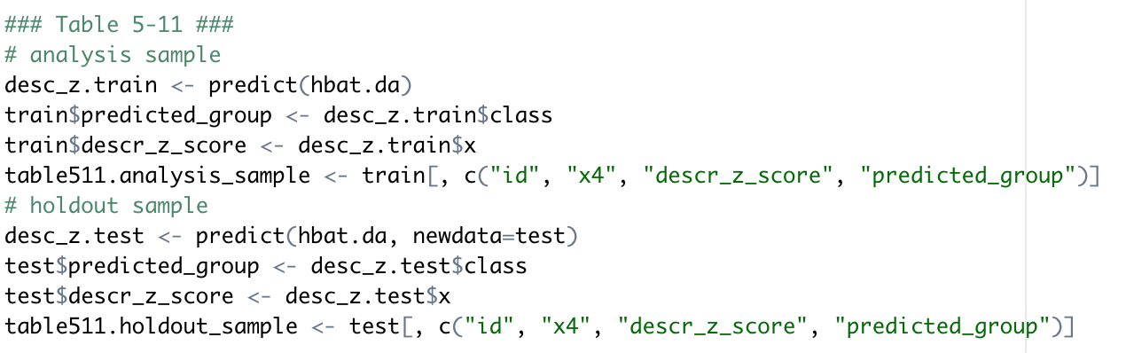
Group predictions of analysis sample and holdout sample

