Slide 1
Examining Your Data
Week 2 project

Slide 2
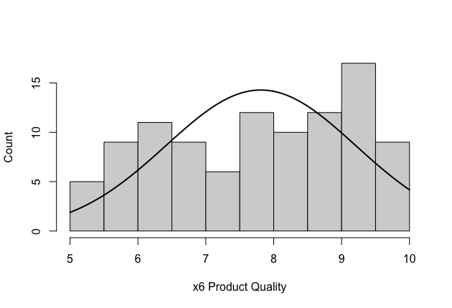
Distribution of x6 Product Quality
Frequency of x6 Product Quality represented through histogram
Normal curve is superimposed on the distribution
Middle of distribution falls below normal curve but no skewness to left or right of distribution
Mode of distribution falls between 9 to 9.5

Slide 3
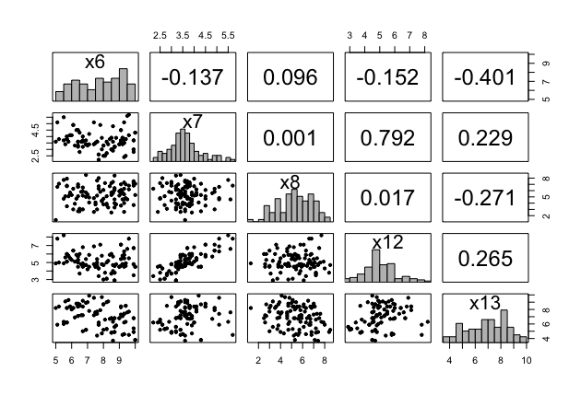
Scatterplot matrix of metric variables x6, x7, x8, x12, and x13
Diagonal of matrix represents frequency distribution of data values as a histogram for the respective variable
Scatterplots below diagonal represents bivariate relationships for the variables in their respective column and row.
For example, the scatter plot in row 2, column 1 is for relationship between x7 (row) and x6 (column)
Pearson correlation for bivariate relationships represented in boxes above the diagonal in their respective column and row (like scatter plots below diagonal)
Highest correlation between x7 and x12; Lowest correlation between x7 and x8
Negative relationships between x6 and x7, x6 and x12, x6 and x13, and x8 and x13. Highest negative relationship is between x6 and x13

Slide 4
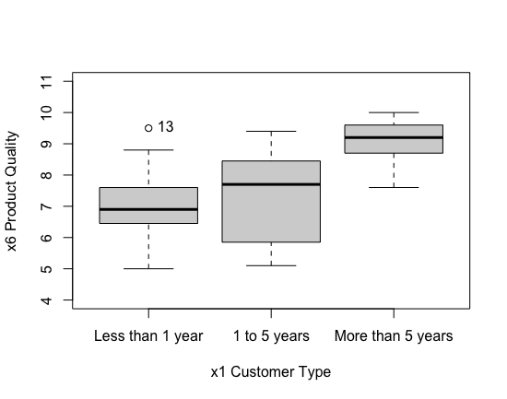
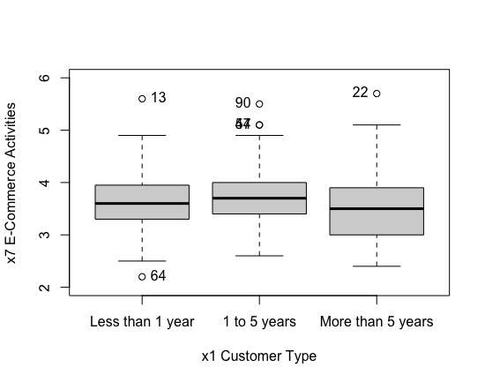
Boxplots for data distribution between metric variables x6 and x7 with each category for nonmetric variable x1
Boxplot for x1 and x6:
Significant difference among three groups
Only one outlier above box for group “Less than 1 year”
Group “1 to 5 years” has high standard deviation between values, with skewness below median
Boxplot for x1 and x7:
No significant difference among groups
Several outliers within groups: one above and below box for group “Less than 1 year”; three outliers (two similar outliers) above box for “1 to 5 years”; one outlier above box for “More than 5 years”
Median is almost alike among groups

