Slide 1
Factor analysis
Week 3 Project

Slide 2
Stage 3: Designing a factor analysis

Slide 3
Correlation among variables
Pearson Correlation Matrix of 13 metric variables from dataset
29 out of 78 correlations are statistically significant at .01 (represented in bold)
As a result, good to move forward and examine adequacy
X15 has 0 significant correlations
X17 has the most significant correlations with 9

Slide 4
Measures of Sampling Adequacy and partial correlations
Kaiser-Meyer-Olkin Measure of Sampling Adequacy with a matrix of the partial correlations
Overall MSA is above .50 at .609
X11, x15, and x17 have MSA values below .50
x15 and x17 had the lowest and highest number of significant correlations

Slide 5
Stage 4: Deriving factors and assessing overall fit

Slide 6
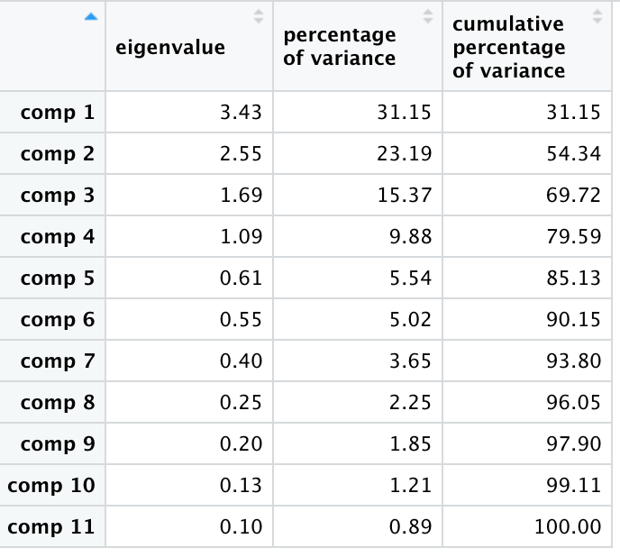
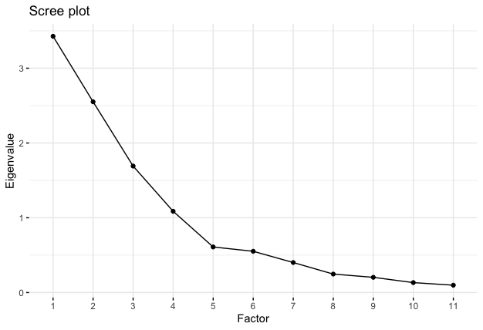
Eigenvalues and scree plot of eleven possible factors
Latent root criterion
Four factors have eigen values greater than 1.0
Therefore, we can retain four factors
Scree test
Factor at 4 stays above 1.0
Other factors below 1.0
Therefore, agrees with latent root criterion to retain four factors

Slide 7
Stage 5: Interpreting the factors

Slide 8
Unrotated component analysis factor matrix
Matrix represents unrotated factor loading matrix
Four columns 1, 2, 3, and 4 represent factor loadings per variable
Communality column represents sum of squared factor loadings. Represents communality with other variables
X10 has lowest communality, less in common with other variables
X18 has highest communality, more in common with other variables
Sum of squares shows relative importance of each factor for variance associated with variables
Factor 1 has highest order of importance and Factor 4 has lowest order of importance
Percentage of trace is high at 79.59% so variables are highly related to each other

Slide 9
VARIMAX-Rotated Loadings for full and a reduced set of variables
Matrix represents varimax rotated loadings for all variables and reduced variables (no x11)
Both matrices have high communality within all variables
Both matrices have high trace percentage showing variables are in fact highly related to each other
Getting rid of x11 in reduced matrix improved trace percentage

Slide 10
Stage 6: Validation of factor analysis

Slide 11
VARIMAX-Rotated Loadings for split samples
Split sample analysis to validate factor analysis results
Both varimax rotations are similar in terms of loadings and communalities
Therefore, results are reliable

Slide 12
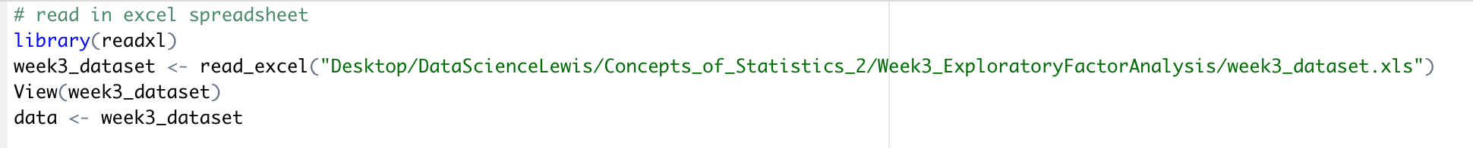
Appendix: R code
(Outputs were extracted to spreadsheet for better formatting)
Reading in dataset:

Slide 13
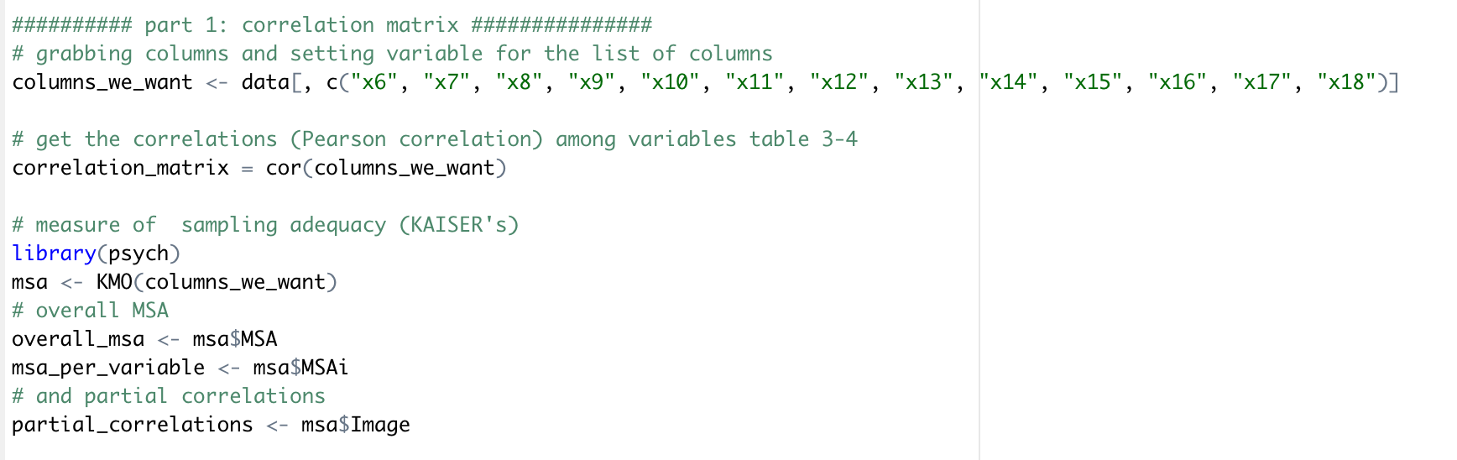
Table 3-4

Slide 14
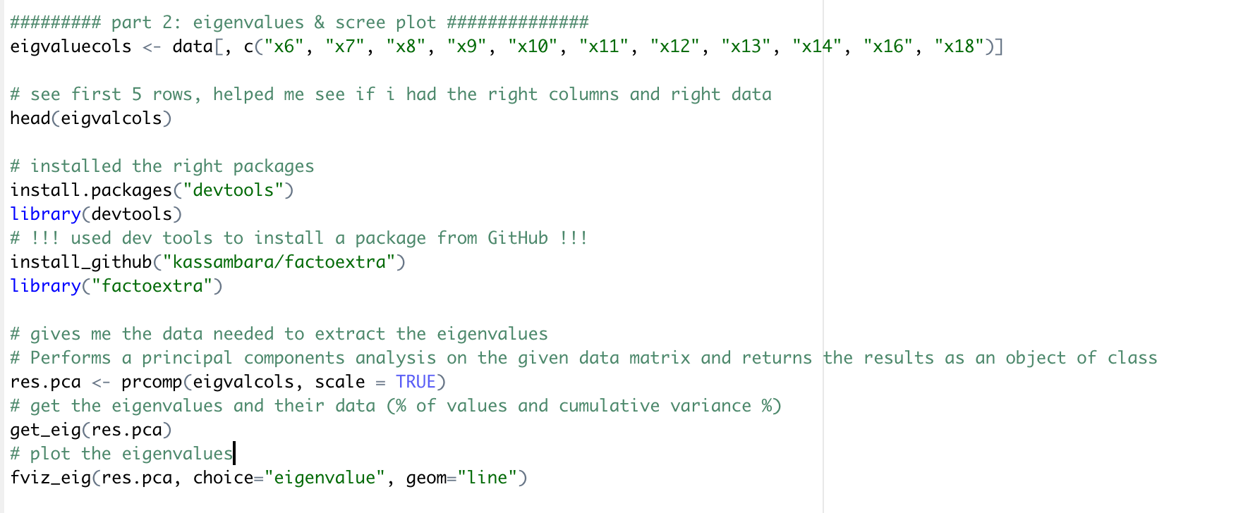
Table 3-6 and figure 3-9

Slide 15
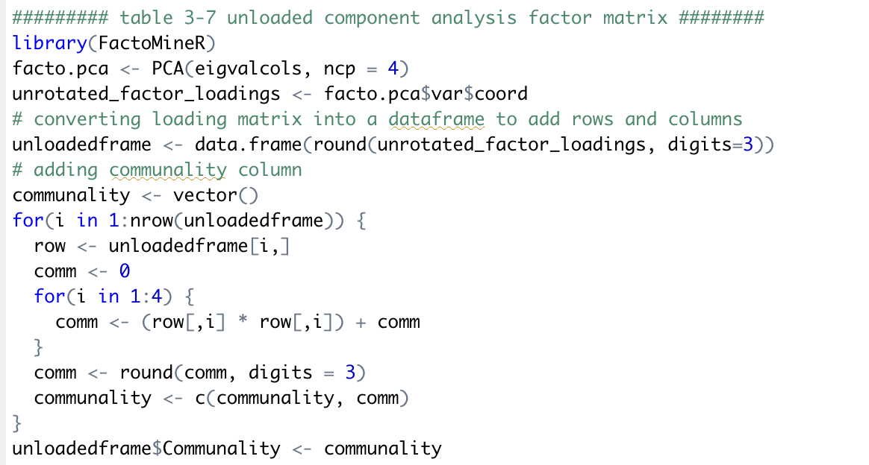
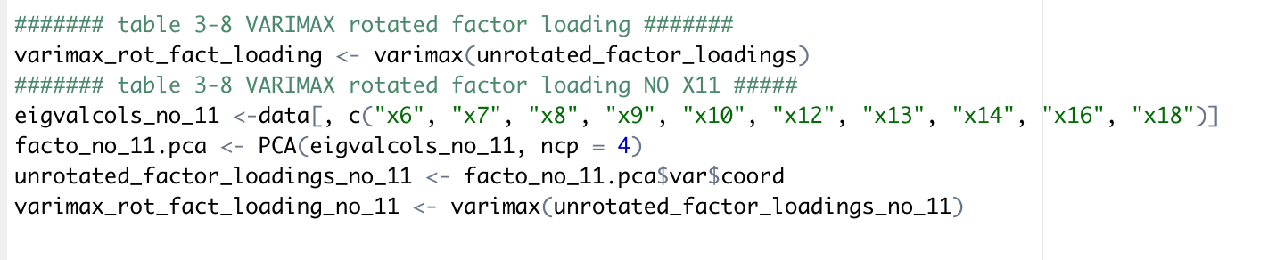
Table 3-7 and table 3-8

Slide 16
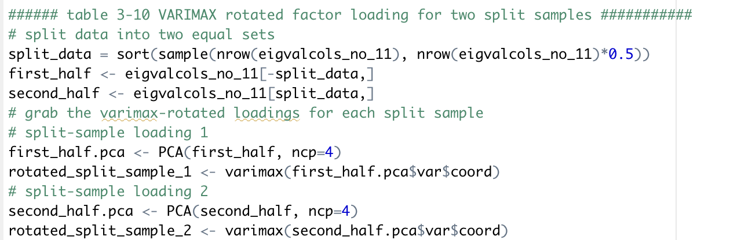
Table 3-10

