Slide 1
Multiple Regression Analysis
Week 4 Project

Slide 2
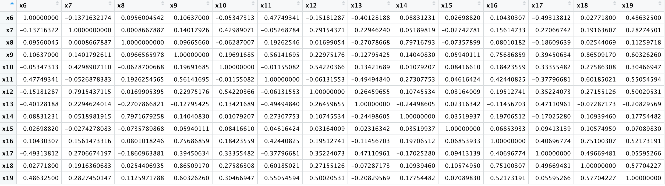
Correlation Matrix

Slide 3
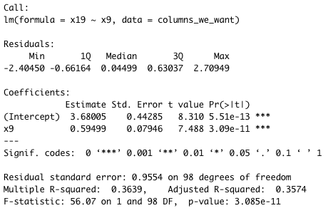
Table 4.8: Selecting the First Variable x9 (Extra Credit)
From correlation matrix, variable x9 has highest correlation with dependent variable x19 (.603)
P-value: 3.085e-11
Global hypothesis test is good
Adjusted R-squared: 0.3754
Low adjusted R-squared, model could be better
Regression Coefficient: 0.595

Slide 4
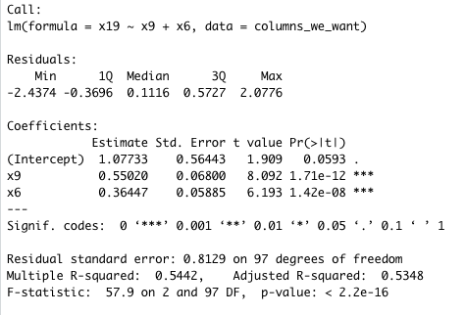
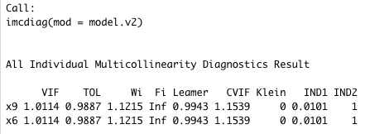
Table 4.9: Adding x6 (Extra Credit)
P-value: 2.2e-16
Global hypothesis test is good
Adjusted R-squared: 0.5348
Significant improvement from adding x6
P-value for individual variables
X9 = 1.71e-12
X6 = 1.42e-08
Test for all independent variables is good
VIF for each is 1.0114, Tolerance for each is 0.9887
No sign of multicollinearity

Slide 5
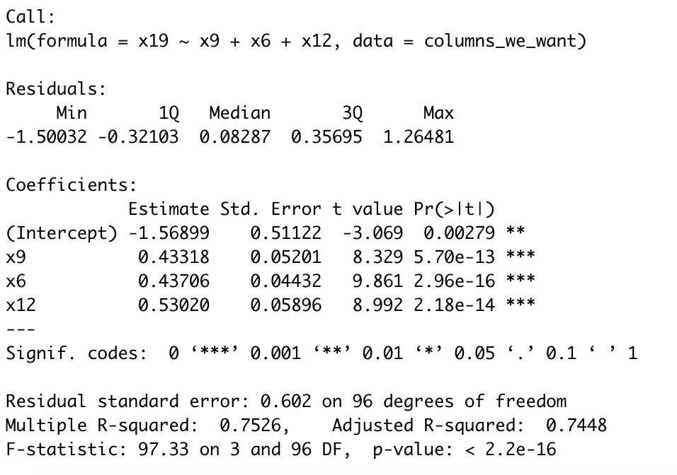
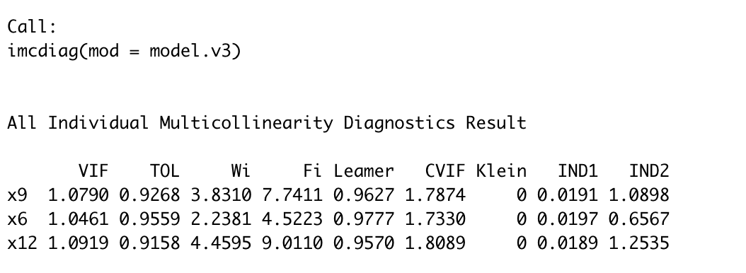
Table 4.10: Adding x12 (Extra Credit)
P-value: 2.2e-16
Global hypothesis test is good
Adjusted R-squared: 0.7448
Significant improvement from adding x12, closer to 1
P-value for individual variables
X9 = 5.70e-13
X6 = 2.96e-16
X12 = 2.18e-14
Test for all independent variables is good
No high VIF score
No sign of multicollinearity

Slide 6
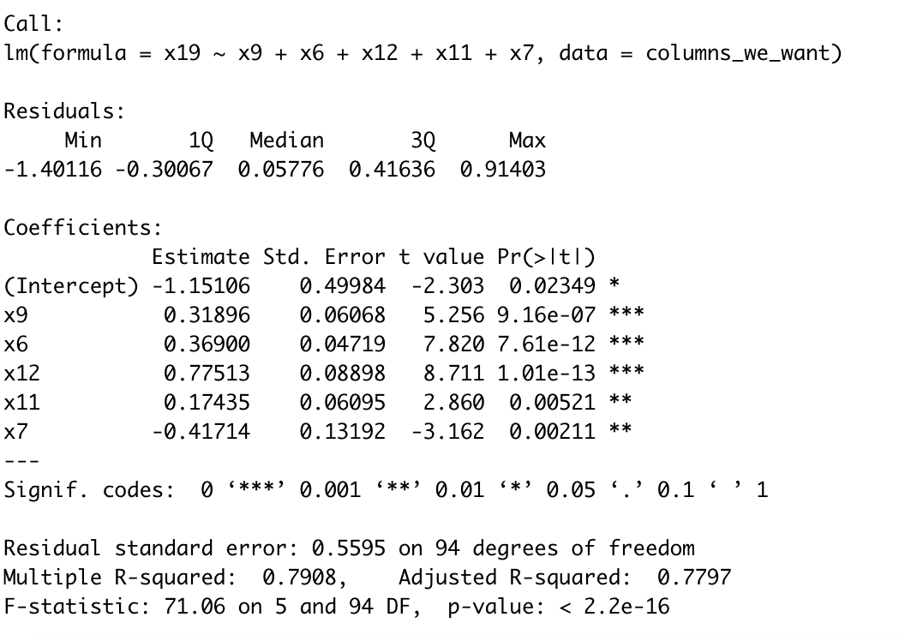
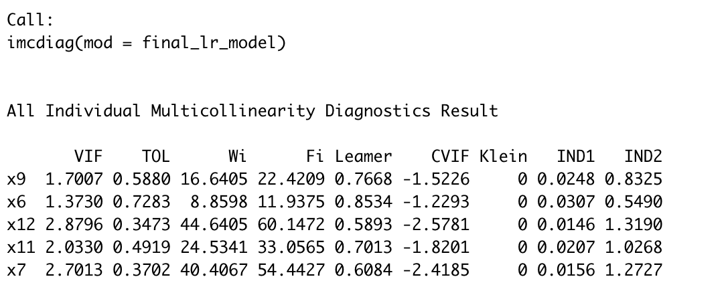
Final Multiple Regression Model
P-value: 2.2e-16
Global hypothesis test is good
Adjusted R-squared: 0.7797
Moved closer to 1
P-value for individual variables
X9 = 9.16e-07
X6 = 7.61e-12
X12 = 1.01e-13
X11 = 0.00521
X7 = 0.00211
Test for all independent variables is good
All VIF scores below 5
No sign of multicollinearity

Slide 7
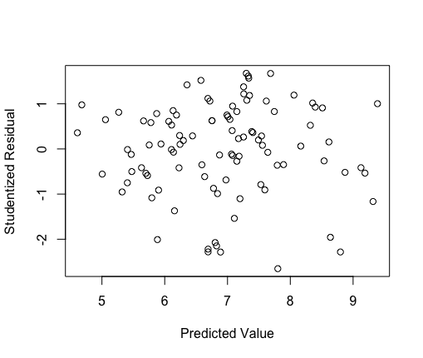
Analysis of Studentized Residuals with Predicted Values
No nonlinear pattern to residual
Overall equation is linear

Slide 8
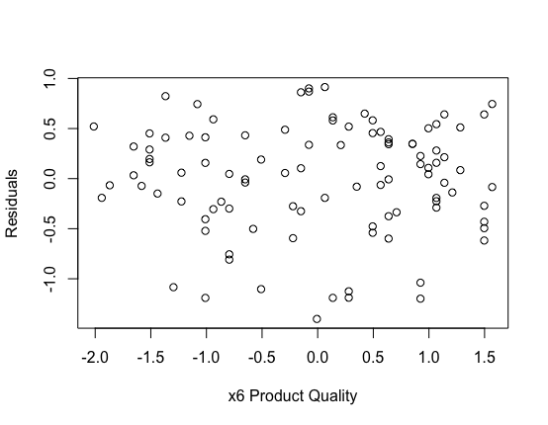
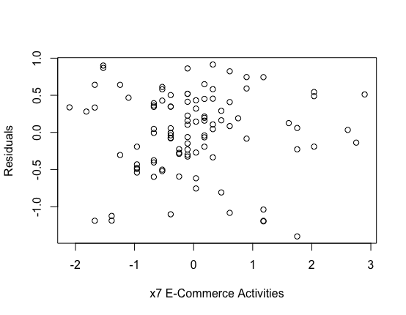
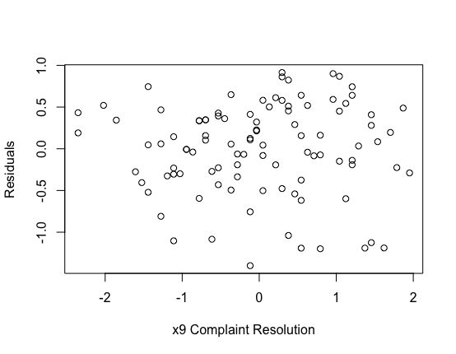
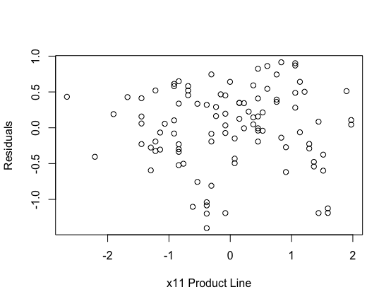
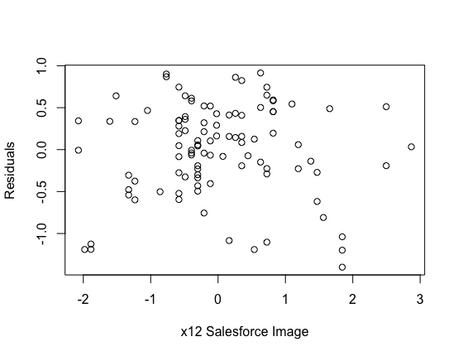
Standardized Partial Regression Plots
No nonlinear pattern for all 5 plots
Meets assumption of linearity for all independent variables

Slide 9
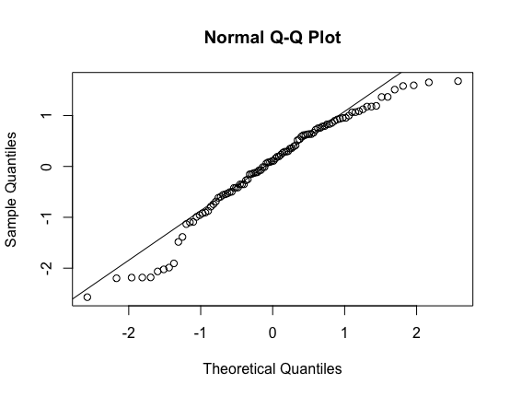
Normal Probability Plot of Standardized Residuals
Most values fall along diagonal
Residuals represent normal distribution
Regression variate meets assumption of normality

Slide 10
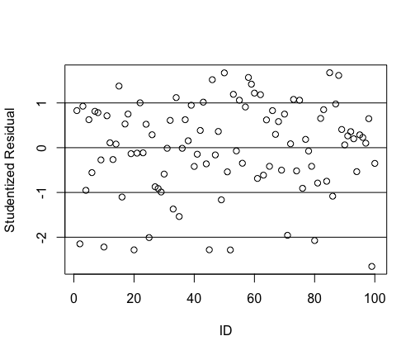
Plot of Studentized Residuals
7 observations lower than -1.96
Those 7 observations have significant residuals
Those 7 observations can be deemed as outliers

Slide 11
Appendix: R Code

Slide 12
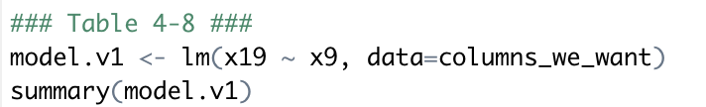
Table 4.8

Slide 13
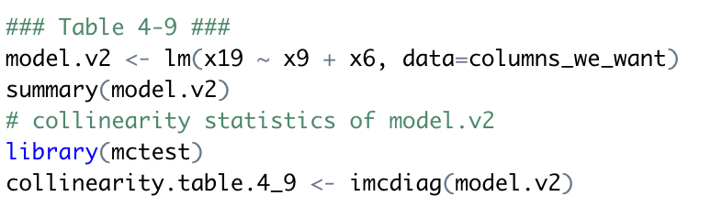
Table 4.9

Slide 14
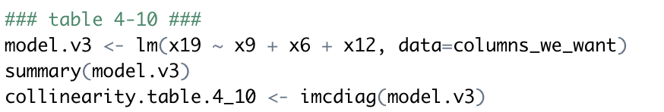
Table 4.10

Slide 15
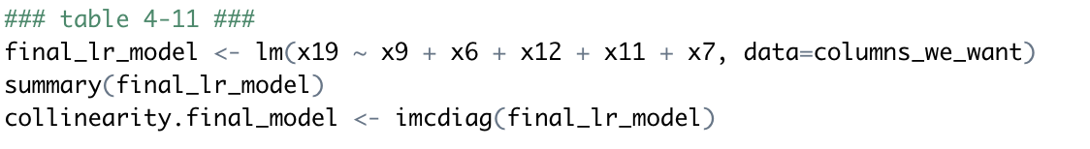
Final Model

Slide 16
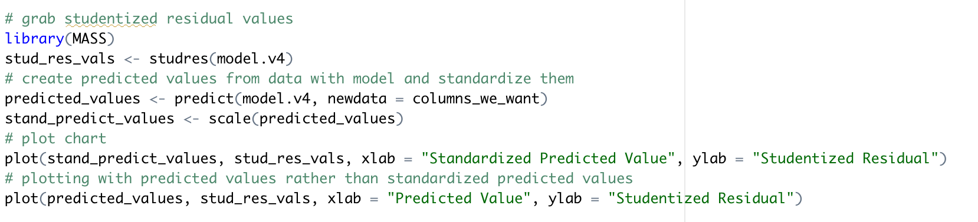
Figure 4-10

Slide 17
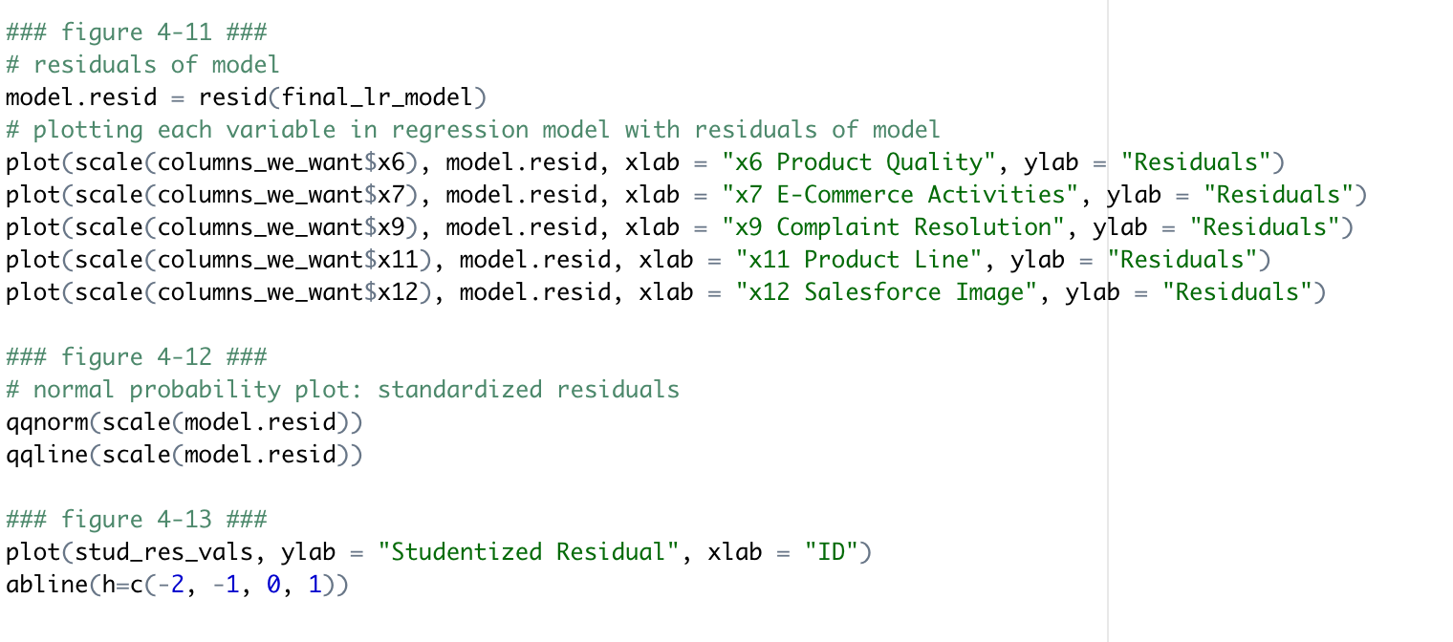
Figure 4.11, Figure 4.12, Figure 4.13

