Slide 1
manova
Week 7 Project

Slide 2
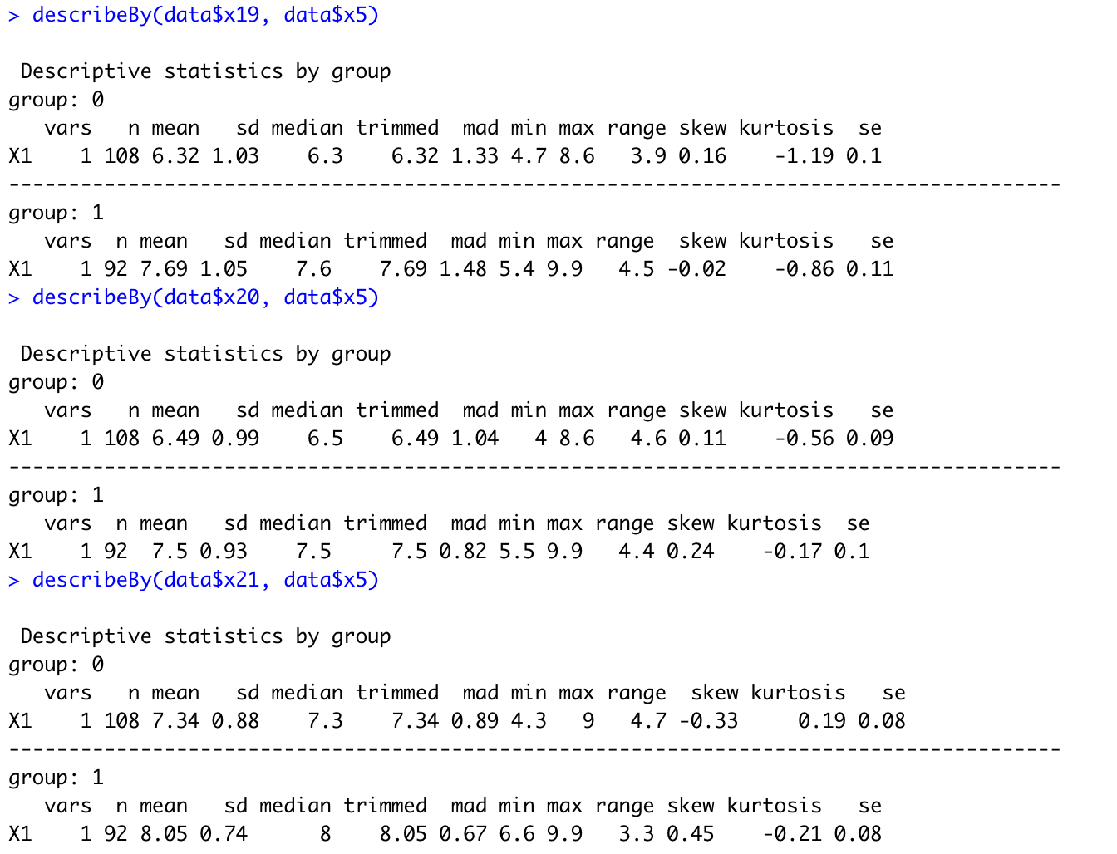
Descriptive Statistics for groups of x5
Group 0 is ”Indirect through broker”
Group 1 is “Direct to customer”
Group 1, “Direct to customer” distribution channel shows higher mean scores for each x19, x20, and x21

Slide 3
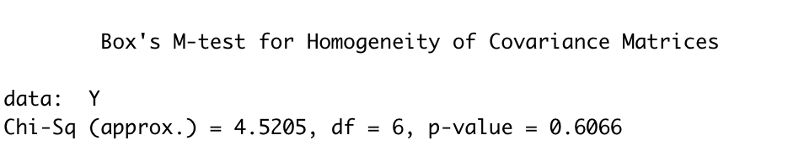
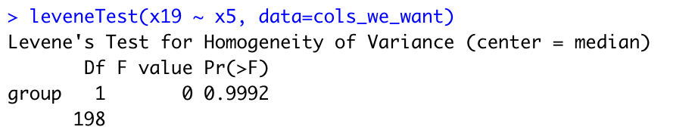
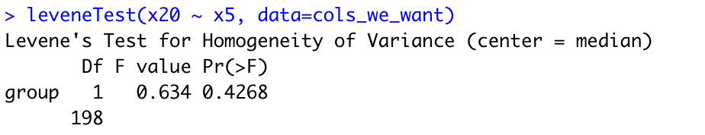
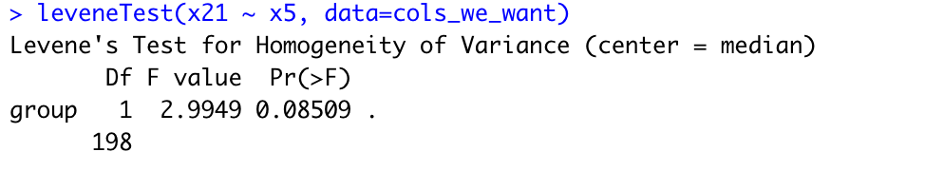

Multivariate and univariate measures for testing homoscedasticity of x5
Box’s M test shows nonsignificant value at 0.607
Indicates no significant difference between the two groups on three dependent variables
Levene’s test shows all three variables are nonsignificant
Bartlett’s test shows significant intercorrelation

Slide 4
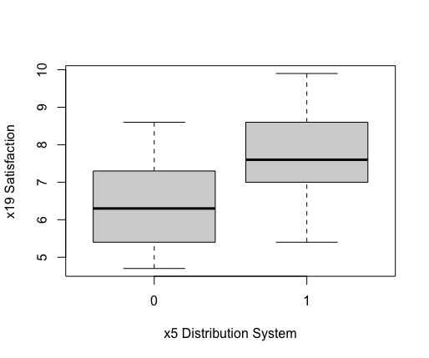
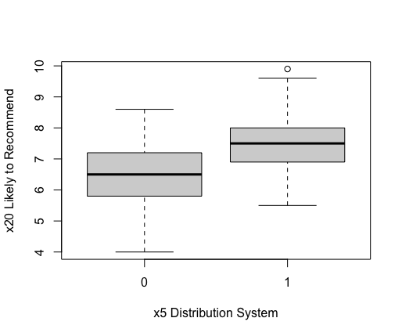
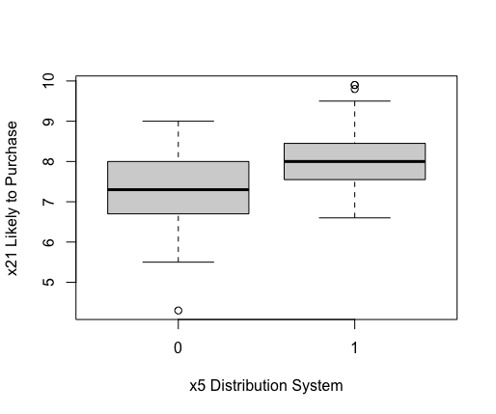
Boxplots of x19, x20, x21 for groups of x5
Small amount of outliers among groups

Slide 5
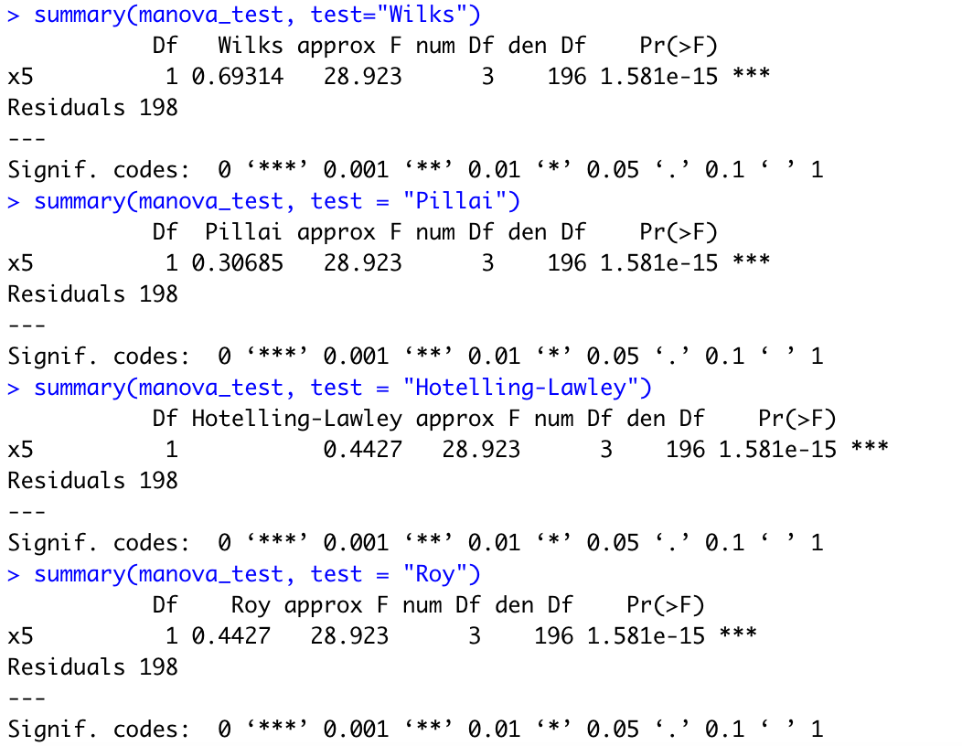
Multivariate tests for group differences
Wilks’ Lambda, Pillai’s Criterion, Hotelling’s ^{T2} and Roy’s greatest each have p-values < 0.05
Shows that x19, x20, x21 have significant difference between the two types of distribution systems

Slide 6
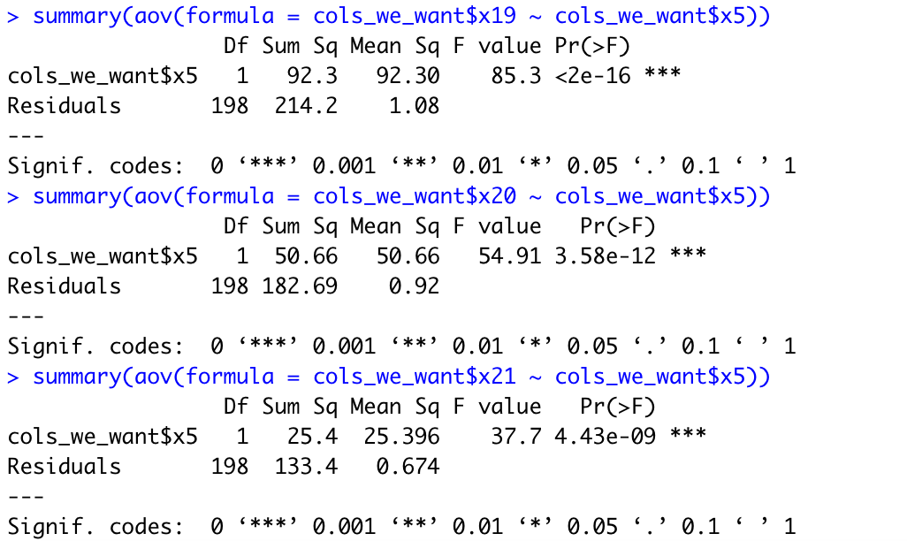
Univariate tests for group differences
All individual tests have p-value < 0.05 denoting high significance
Each variable follows same pattern of higher purchase outcomes for direct distribution system

Slide 7
Appendix: r code

Slide 8
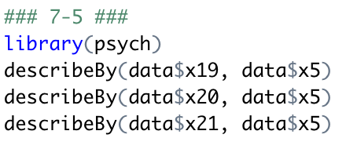
Descriptive statistics

Slide 9
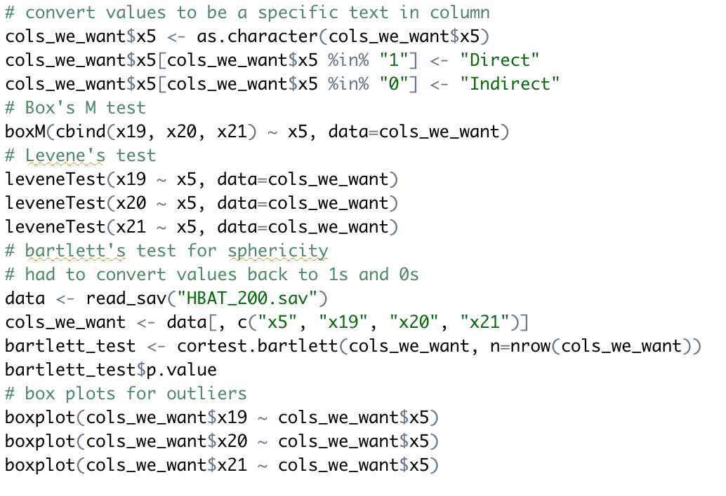
Box M’s Test Levene’s test Bartlett’s test for sphericity outlier box plots

Slide 10
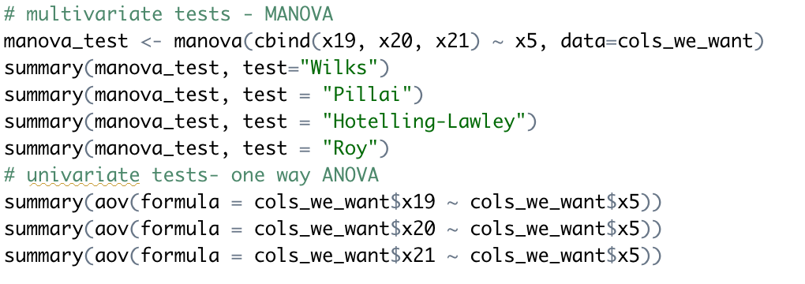
Multivariate and univariate tests

