Slide 1
WiFi Authentication [Beacon Manipulation]
2023.06.19.
GyeongHeon Jeong(ghjeong@mmlab.snu.ac.kr),
SangWi Kang(swkang@mmlab.snu.ac.kr)

Slide 2


WiFi authentication
Beacon Frame
Server
Cert.
Raspi
Signature
Generate key-pair
&
Get Cert.
Validate signature
Continue connection
AP
Mobile
Terminal

Slide 3
Contents to do
AP make private key and public key pair, and get certificate
2 ways to give cert+signature
1. Cert+signature in beacon frame
2. Give user cert+signature packet after connection request
User validate signature with AP’s public key
User can figure out REAL AP
Raspi
Origin beacon frame
Cert.
Signature
Mobile
Terminal
AP

Slide 4
Project Progress
AP의 key-pair 및 인증서 생성
RSA 512, 1024, 2048
ECDSA 256, 384, 521
AP 동작 핵심 프로그램인 hostapd 분석 (Raspberry Pi OS)
Beacon interval, SSID 등 primitive type 위주 수정
Hostapd beacon logic 분석 지연으로 구현 방향 변경
Beacon manipulation with Python Scapy
Signature parsing by client kernel modification

Slide 5
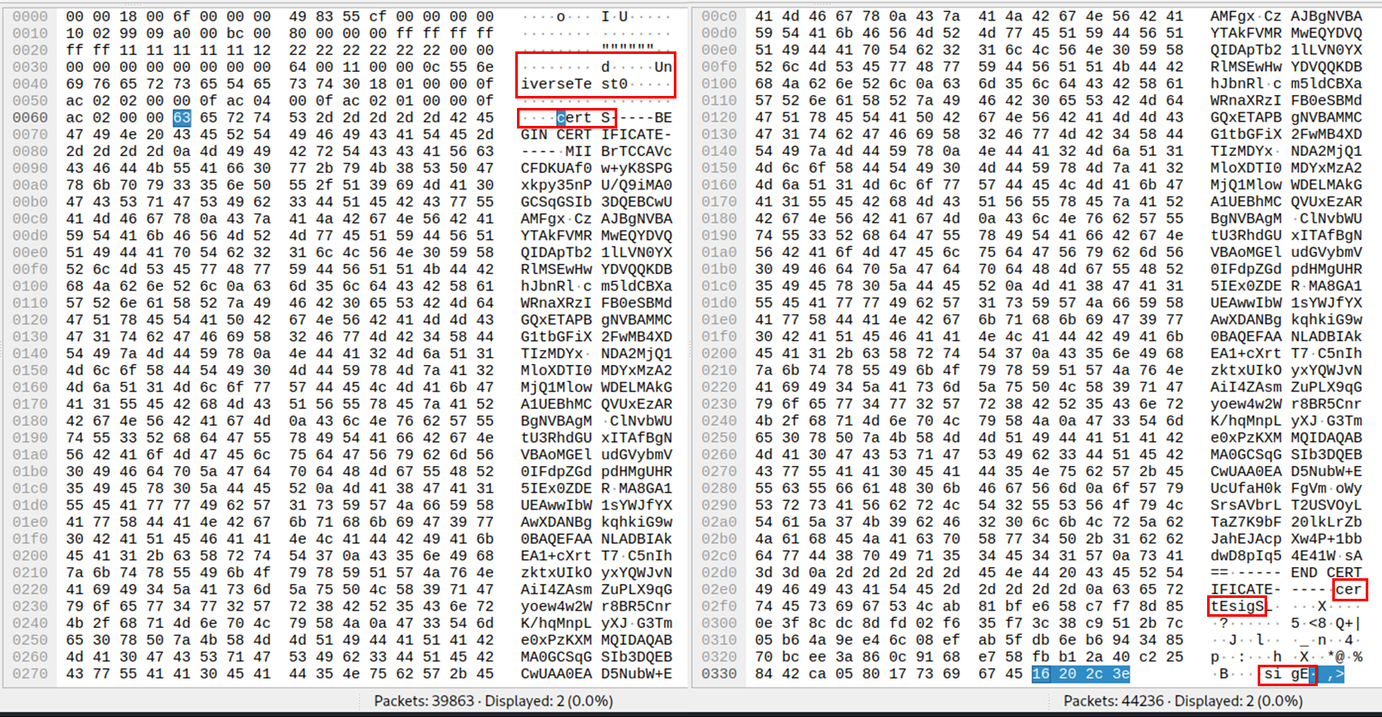
Beacon Manipulation

Slide 6
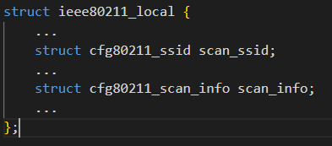
Signature Parsing
Packet arrival
ieee80211_rx_handlers()
ieee80211_rx_h_mgmt_check
Beacon frame access method
ieee80211_scan_rx()
ieee80211_bss_info_update()
ieee80211_update_bss_from_elems()

Slide 7
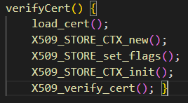
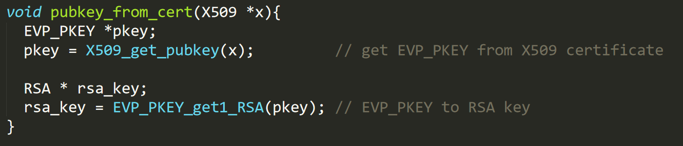

Signature Verification
Cert. verification
Get Public key in cert.
&
Signature Verification

Slide 8
Experiment & Result (Frame Size)
(bytes)

Slide 9
Experiment & Result (Delay)
(ms)
Beacon tx delay – From signature generation to beacon sending

Slide 10
Thank you for listening

