Slide 1
Lab 17

Slide 2
Goal
Understanding and applying inheritance using the example of money

Slide 3
Prep
Create a project for lab17 and import Bill, Coin, Money, Money Main and Quarter

Slide 4
Review Given Code
Open up all the files and take a look at the relationships between the classes, Money is the superclass to which Bill and Coin are children of Money
Quarter is a child class of Coin
Looking at Money main you can see that we have an array of strings and an array wallet of type Money which has the same length as the array of strings
Each string represents a type of legal tender [B5 = 5 dollar bill, Q = quarter, B20 = 20 dollar bill, Q = quarter]
Within the main method we have a loop that processes that array of strings and uses it to build our array of Money
Finally we have a method to go through our array of Money and print all the Bills and cents line by line

Slide 5
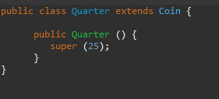
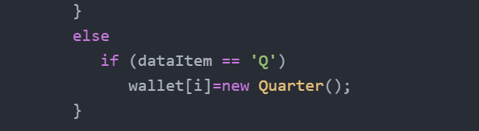
Create All the Coins
To start off you want to create classes for the coins that aren’t implement yet that is the Penny, Nickel and Dime classes and you want to do them following the example from the Quarter class
You also need to update the for loop in the main method for MoneyMain, adding conditions to check for ‘D’, ‘N’ and ‘P’
Add some of the new coins to the data source and run MoneyMain to make sure everything checks out

Slide 6
Create a toString method for Bills
Similar to how in the main method be can easily print out the values for the Coins we want to be able to do the same for the Bills so we need to implement a toString method in the Bills class that prints “$ dd.00” in this format
Also the toString method for Coins needs a little improvement because the given method prints $ 0.1 for pennies and $ 0.5 for nickels instead of $ 0.01 and $ 0.05

Slide 7
sumWallet
Finally we want to create a method sumWallet which adds up all the dollars and coins in the wallet and prints out the value of the money in the wallet in $ dd.cc format
Using a loop similar to the one given for printWallet will be useful using instance of to separate bills from coins
Once you have the sum value of all the bills and the coins you will need to adjust the dollar and cents values similar to how we did with the add function from lab 15 using the modulus operator and integer division.

