Slide 1
Risk Adjustment Calculation

Slide 2
CMS Medicare Risk Adjustment
A retroactive payment system that takes data from the previous year to predict costs in the current year
Additive model based on the enrollees health status and demographics
Utilizes a Hierarchical Condition Category (HCC) model to determine health status

Slide 3
I DON”T KNOW WHAT GOES INTO RISK SCORE
Risk Adjustment Type Code
Demographic Data
Age
Sex
Institutionalization
Special Status Data
Disability
Original Reason for Entitlement (OREC)
Medicaid Status (will be calculated differently in 2017 PY)
Disease Data
Hierarchical Condition Category (HCC)
Hierarchy
Disability Interactions
Disease Interactions

Slide 4
Risk Adjustment Factor Type
RAF Type Code can be found on the Monthly Membership Report (MMR)
RAF Type Code determines which model to use and coefficients when calculating the RAF Score for an individual member.
Additional RAF Types will be included in 2017 PY for the new, Dual-eligible Model.
RAF Type Code | Description | Notes
E | New Enrollee | Members score is only based on Demographic and Special Status
C or I | Community/Institutional | Most common type code, utilizing the basic model v22
D, C1, C2, I1, I2 | ESRD/Transplant Recipient | Utilizes the v21 model

Slide 5
Demographic Information
Age/Gender | Community RAF | Institutional RAF
Male 70-74 | 0.356 | 1.431
Female 70-74 | 0.348 | 1.145
Male 60-64 | 0.311 | 1.081
Female 60-64 | 0.392 | 0.986

Slide 6
Special Status Information
Status Type | Community RAF | Institutional RAF
Medicaid Male Over 64 | 0.177 | 0.067

Slide 7
Risk Adjustment Data Flow
Physician or Facility
Medicare Advantage Organization
Front-End Risk Adjustment System
Risk Adjustment Processing System
Risk Adjustment System

Slide 8
RAPS Submission
Currently it is up to the submitter to determine what encounters risk adjust (inpatient hospital, provider visit)
Only claims that risk adjust are submitted

Slide 9
EDPS Submission
All encounters are submitted
CMS will flag those encounters that risk adjust
100’s of more fields are submitted in the 837 form
MAO-002 shows what is accepted
MAO-004 shows what encounters risk adjust

Slide 10
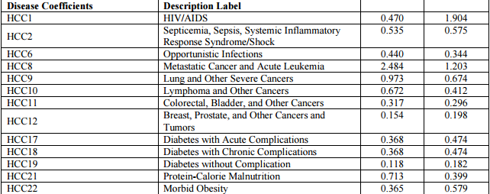
Hierarchical Condition Categories
There are 8,667 ICD-10 codes that map to 79 unique HCCs
An individual can have multiple HCCs but only one HCC per category

Slide 11
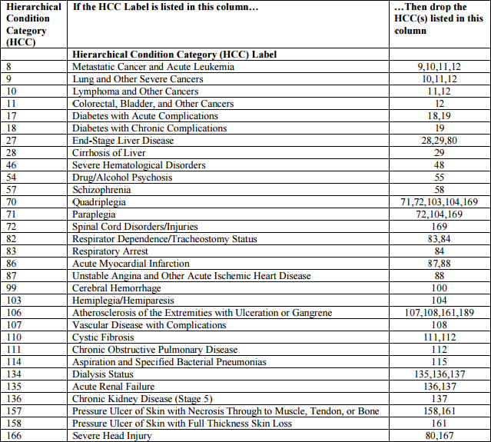
Hierarchy

Slide 12
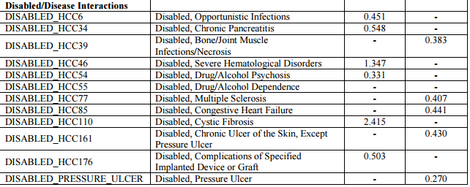
Disable Interactions
If a member is diagnosed with a particular condition and is under the age of 65, a disabled interaction is applied to the RAF.

Slide 13
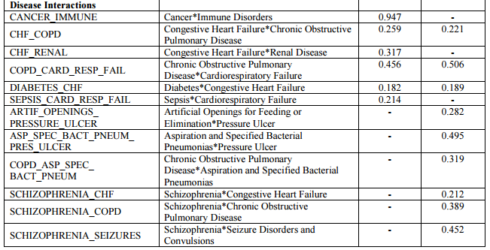
Disease Interaction
Some diseases in combination with one another create a unique circumstance that can cause the individual to need more medical attention. These are known as disease interactions

Slide 14
Adding It All Together
Demographic Risk Score
RAF Type
Special Status Risk Score
Add Risk Scores
Normalize
Disease Data Risk Score

Slide 15
Normalizing for payment
( (Risk Score) * (1 – Coding Intensity))/(Normalization Factor)
The RAF score goes through an equation that applies a coding intensity and normalization factor to be used for payments to Medicare Advantage Organization.
The “raw” risk scores rarely change and as such CMS use the normalization factor and coding intensity to adjust the average risk score between model calibration years.
The normalization factor is used to adjust beneficiaries’ risk scores so that the average risk score is 1.
Coding Intensity is an adjustment that reflects the differences in coding patterns between MAO’s and Fee-for-service providers.

Slide 16
Adding It All Together Member A
Example with 72 year old male who has Medicaid and was diagnosed with diabetes and congestive heart failure.
RAF Type Code = C
2016 Coding Intensity = 4.91%
2016 Normalization Factor = 1.026

Slide 17
Member A RAF How did it get there?
The RAF type does not change throughout the year with few exceptions
The Demographic and Special Status info does not change throughout the year
Disease Data is calculated at three different periods after what is known as a “Sweeps” deadline.
The submission date is determined by the Transaction Date or date Submitted to CMS.

Slide 18
CMS Sweeps Calendar and Payment System

Slide 19
RAPS for Member A July 2014 – Dec 2015 DOS

Slide 20
Initial Data Member A

Slide 21
Mid-Year Data Member A

Slide 22
Final Data Member A

Slide 23
Breaking out Member A Net RAPS

Slide 24
Member A Sweeps RAF HCC

Slide 25
Member A Sweeps RAF Lift
True-Ups/Retroactive payments are calculate taking the difference from the New Sweeps Risk Score – The Prior Sweeps Risk Score
After – Before = RAF Lift

Slide 26
Member A Chart Lift
If HCC 18 came from a chart what is the RAF lift?

Slide 27
2017 RAF Type Changes
Community Type | Age | MMR RAF Type
Full Benefit Dual Aged | 65+ | CF
Full Benefit Dual Disabled | 0-64 | CF
Partial Benefit Dual Aged | 65+ | CP
Partial Benefit Dual Disabled | 0-64 | CP
Non Dual Aged | 65+ | CN
Non Dual Disabled | 0-64 | CN
The (C)ommunity RAF Type will be split into 6 RAF Types dependent on Medicaid status and age.
Member A Example: MMR will show CF in the RAF Type and as member is 72, this means that Member A is a “Full Benefit Dual Aged” RAF Type.

Slide 28
v12 vs v21 vs v22
Each “v” is a version change of the model.
V12 is the old model that was in use prior to 2016 Payment Year
V21 was a new model implemented for the 2012 Payment Year that only applied to the ESRD members
V22 is the new model that was been slowly transitioned to since the 2014 Payment Year forward and is in full for 2016 Payment Year
The logic for calculating a risk score is the same for all of the models, the only differences are the HCCs and their values.

