Slide 1

GitLab Issue

Slide 2
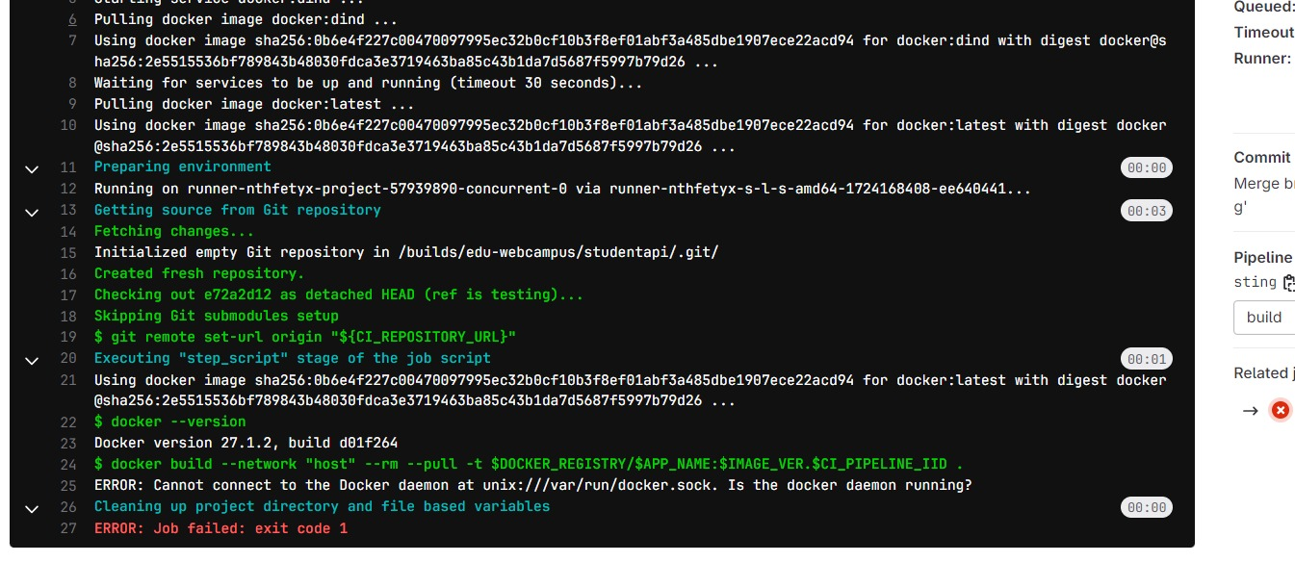
If anyone Facing Above Issue, please run below commands in Gitlab runner server
chmod 666 /var/run/docker.sock
systemctl restart docker

Slide 3
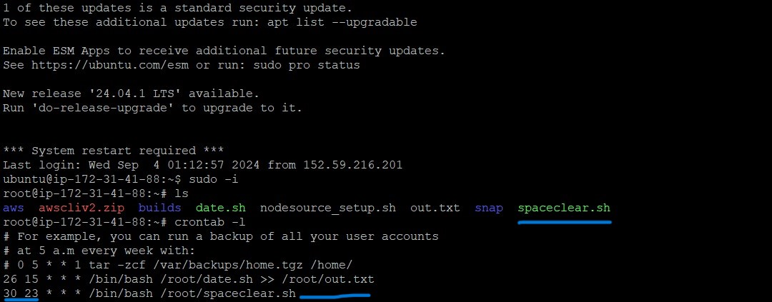
We already scheduled cronjob in Gitlab runner Server, Everyday Nite at 11.30 Spaceclear script is running Automatically

Slide 4
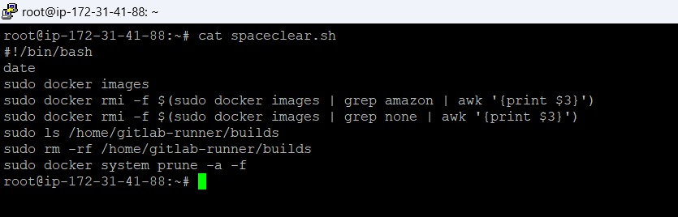
In bashscript commands

