Slide 1
Srinitish D
Final Project
3/21/2024 Annual Review

Slide 2
Sign Language Detection
This is a Python Project employing a Convolutional Neural Network, sklearn to identify the sign language alphabets for universal accessibility.
3/21/2024 Annual Review

Slide 3


AGENDA
Problem Statement
Project Overview
Who Are The End Users
Your Solution And Its Value Proposition
Wow Factor
Modelling
Result
3/21/2024 Annual Review

Slide 4

PROBLEM STATEMENT
Design and Develop a neural Python project to detect the American sign language which is expressed by finger and hand position. It is the primary language of many who are deaf and hard of hearing. Utilize Neural Network models to address the problem is an effective and efficient method. The objective is to create a detection system to enable people with disabilities.
3/21/2024 Annual Review

Slide 5

PROJECT OVERVIEW
Objective: Develop a Convolutional Neural Network (CNN) model for accurate and real-time recognition of sign language gestures.
Scope: The scope involves designing, training, and implementing a CNN-based sign language recognition system with high accuracy.
Technologies: Utilizing Python libraries such as Keras, TensorFlow, and scikit-learn for building, training, and evaluating the CNN model.
Testing & Improvement: Employing rigorous testing methodologies and iterative optimization strategies to enhance the CNN model's performance.
Dataset Preprocessing: Implementing preprocessing techniques including normalization, augmentation, and noise reduction
Outcome: The development of a robust and efficient sign language recognition system capable of accurately translating gestures into text
3/21/2024 Annual Review

Slide 6

WHO ARE THE END USERS?
Deaf and Hard of Hearing Individuals: The primary end users of the system are individuals who are deaf or hard of hearing.
Sign Language Interpreters: Professional sign language interpreters can use the system as a tool to support their work.
Educational Institutions: Schools and universities catering to deaf or hard-of-hearing students can integrate the system into their educational programs.
3/21/2024 Annual Review

Slide 7
YOUR SOLUTION AND ITS VALUE PROPOSITION
Solution: The solution is to implement a Convolutional Neural Network (CNN) model for sign language recognition. The code is structured to train the CNN model using a dataset containing sign language images, split into training and testing sets. Key components of the solution include data preprocessing, model architecture definition, training, evaluation, and performance visualization.
Value Proposition:
Accuracy: The CNN model achieves a certain level of accuracy in recognizing sign language gestures, as indicated by the evaluation metrics such as accuracy and loss plotted in the graphs.
Real-time Recognition: The trained model is capable of real-time recognition of sign language gestures, enabling seamless communication for the deaf and hard-of-hearing community.
3/21/2024 Annual Review

Slide 8

THE WOW IN YOUR SOLUTION
Real-Time Recognition: The system's capability for real-time recognition of sign language gestures is well developed. It enables instantaneous communication between individuals using sign language and those who may not understand sign language
Advanced Technology: Leveraging Convolutional Neural Networks (CNNs), a state-of-the-art deep learning technique, demonstrates the use of advanced technology to solve real-world problems.
Potential Impact: The potential impact of the solution is significant, as it can improve the quality of life for a substantial portion of the population.
3/21/2024 Annual Review

Slide 9
MODELLING
Sequential model: allows us to specify a neural network, precisely, sequential. From input to output, passing through a series of neural layers, one after the other.
Model Architecture:
Input Layer
Convolutional Layers
Batch Normalization
Max Pooling Layers
Dropout Regularization
Dense Layers
Output Layer
Compilation
3/21/2024 Annual Review

Slide 10
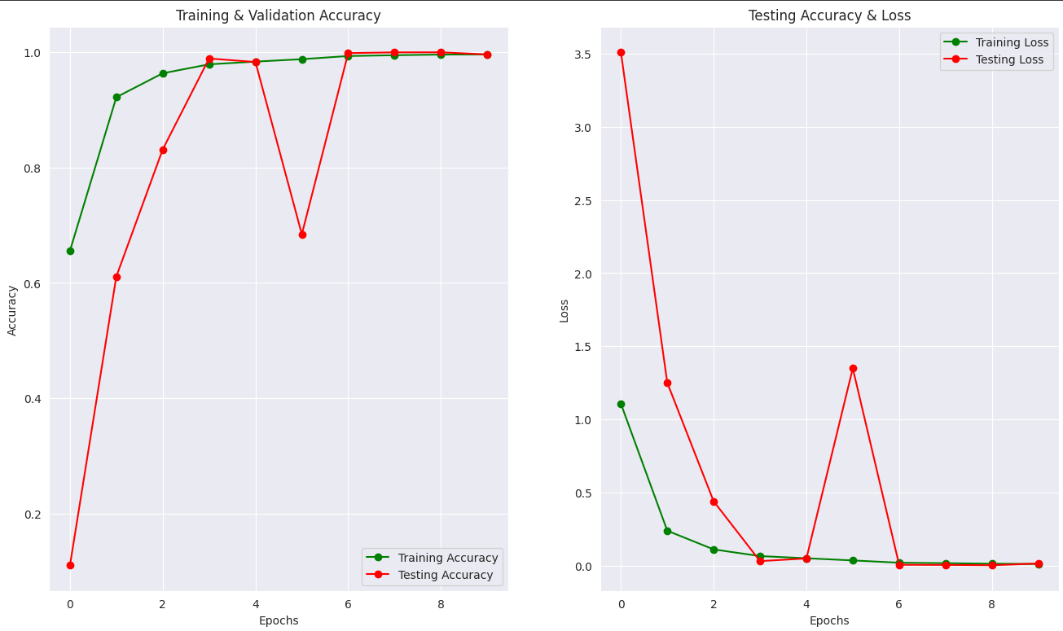
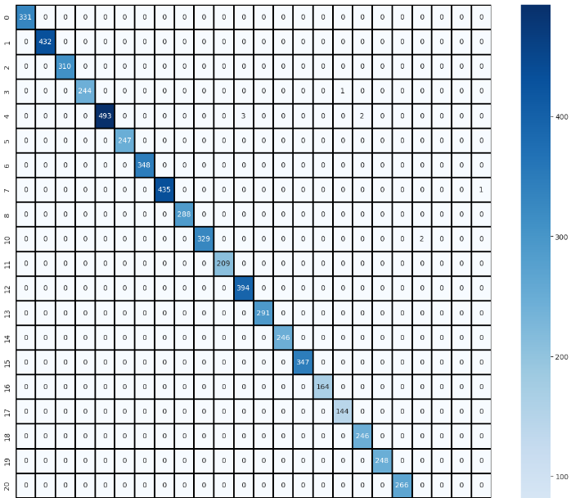
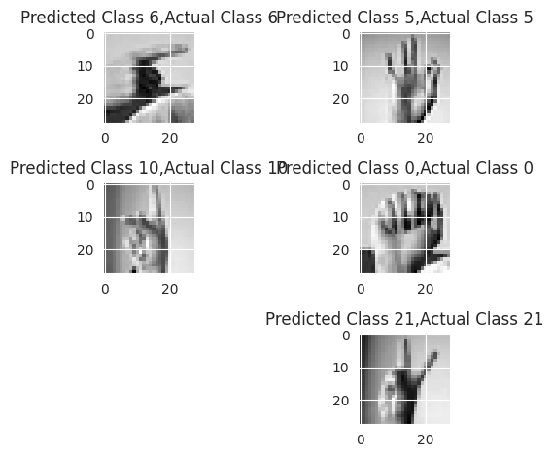
RESULTS
3/21/2024 Annual Review

