Slide 1
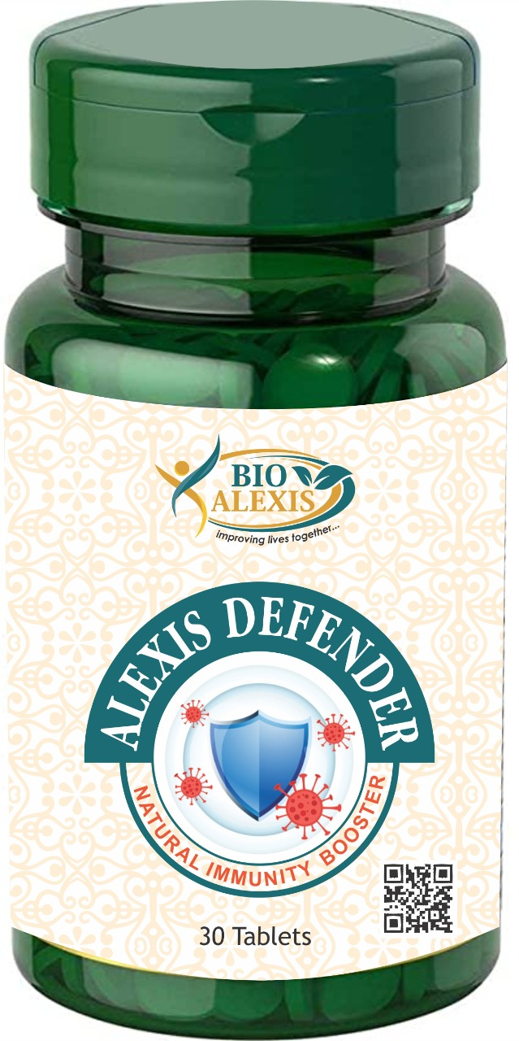

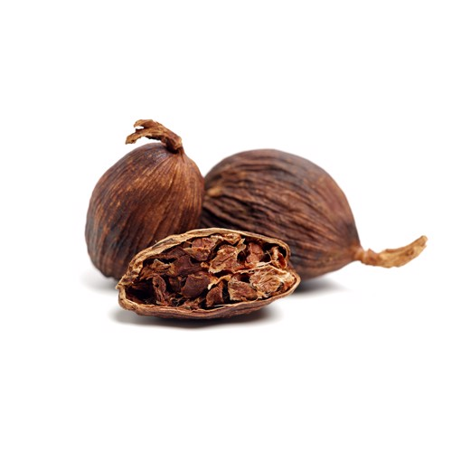
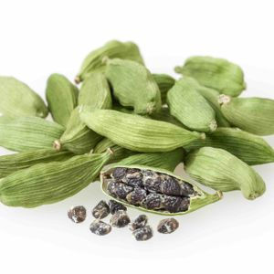

Alexis Defender

Slide 2
Benefits of Alexis Defender
Help in Cold & Cough
Sore throat
Week Immunity
Loss of appetite
Low Energy
Dull skin
Stress and Sleep disorder
Frequent Infection

Slide 3

Very Effective in Asthma

Slide 4


Slide 5


Slide 6


Slide 7


Slide 8


Slide 9
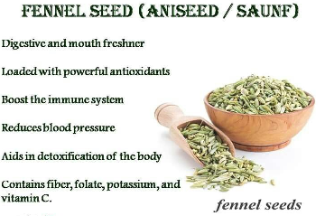

Slide 10


