Slide 1

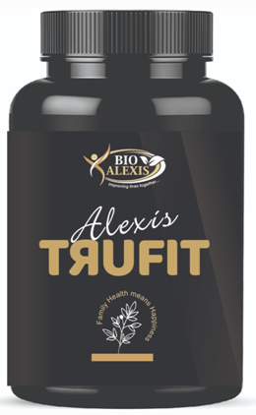
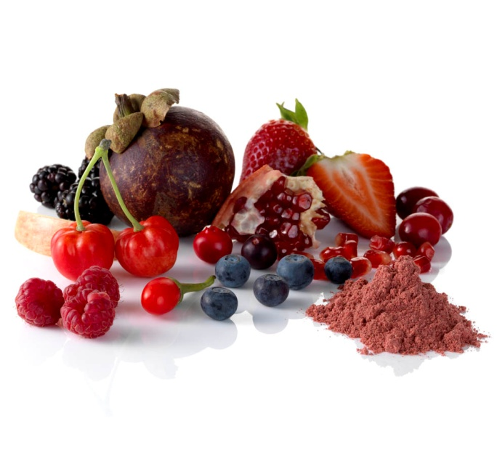

Bio Alexis Presents,
The Powerful Nourishment for Physical & Mental Health

Slide 2

Because Family Health Means Happiness

Slide 3

Scientifically and clinically proven ingredients
18.6 % improvement in
working memory capacity
(WMC)

Slide 4
What is working memory capacity ?
Working Memory Capacity (WMC) is the small amount of information that can be held in mind and used in the execution of cognitive tasks.
For examples ?
Holding a person's address in mind while listening to instructions about how to get there.

Slide 5

Ask to your self
1. What is BioAlexis office No. ?
2. What is your school prayer ?
3. What is your school address (10^{th Class}) ?
4. What is your Down Line
Leader Mobile no.?
5. What is your Aadhar No.?

Slide 6
How to improve working Memory Capacity
Break big chunks of information into small, bite-sized pieces
(remember mobile no. like this 891 305 1195)
Add exercise to your daily routine
Experiment with various ways of remembering information
Regularly use TRUFIT
*

Slide 7


12.9% improvement of memory reaction time (MRT)

Slide 8
Natural Beta Carotenes
Healthy Skin &
Hair Growth
Beta carotene is a red and orange pigment found in many fresh fruits and vegetables, Essential for healthy skin and hair growth.

Slide 9


Natural Vitamins for Physical & Mental Growth and Bone Health
Alexis Trufit contains all essential Vitamins and minerals that Promotes healthy growth and development.
Vitamin A - Brain development and protects against colds
Vitamin C & E - Powerful antioxidant, immune protecting properties
Vitamin D - for healthy bones and teeth
Vitamin B6 – for building antibodies for the immune system and helps the nervous system in brain function

Slide 10
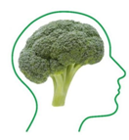
Sulforaphane: Memory & Brain
Sulforaphane is natural substance extracted from broccoli improves processing speed and working memory

Slide 11

Lutin & Zeaxanthin : Eye & Vision Health
As powerful natural antioxidants, Lutein and Zeaxanthin may protect your eyes in numerous ways.
Reduces eye irritation
Defend against free radicals and oxidative stress
Enhance the sharpness of your vision
Improve your visual contrast sensitivity
Protect eye tissue from sunlight damage & harmful light
Helps freedom from eyeglasses in children.

Slide 12
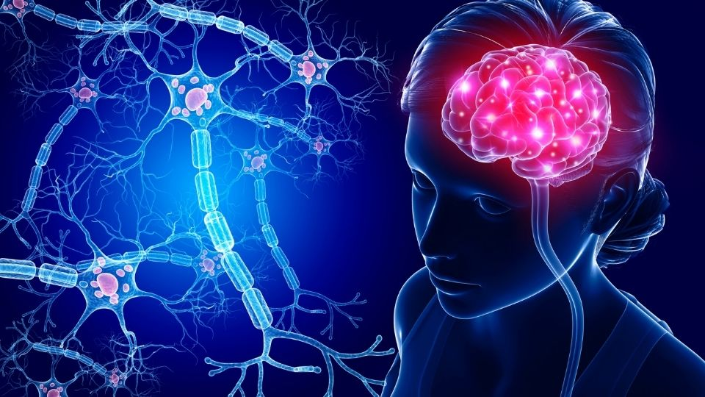
Withanolides: Improve brain function and Intelligence
Withanolides obtained from Ashwagandha and this increases Acetylcholine level in the brain and improve brain function and intelligence.

Slide 13

Fenugreek Saponins and Flavonoids:
Stop Hair Thinning & Hair loss, and Anti-dandruff
Lecithin in Alexis Trufit acts as a natural emollient that conditions and moisturizes scalp and hair deeply and it makes your hair stronger from the roots by providing rich nourishment.

Slide 14

Best Nutrition for Senior Citizens
Natural Vitamin D & E, Iron and Beta Carotenes are essential for elder people health.

Slide 15
The Powerful Nourishment for Physical & Mental Health Family Health Means Happiness

