Slide 1
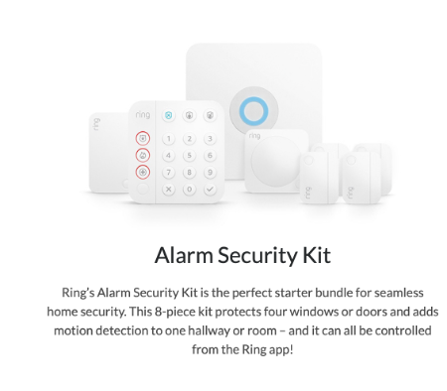

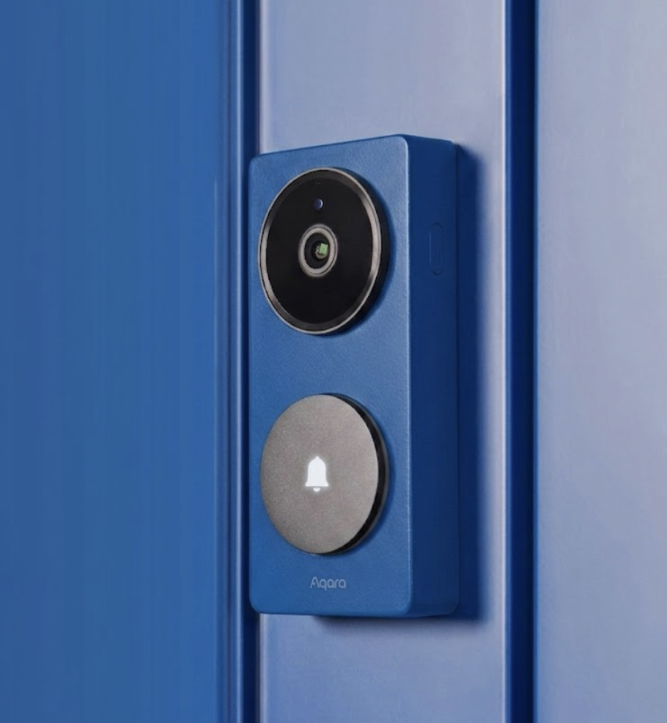
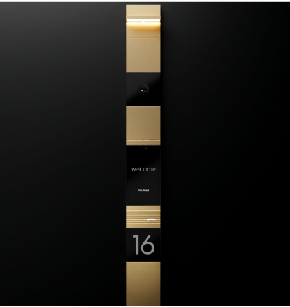
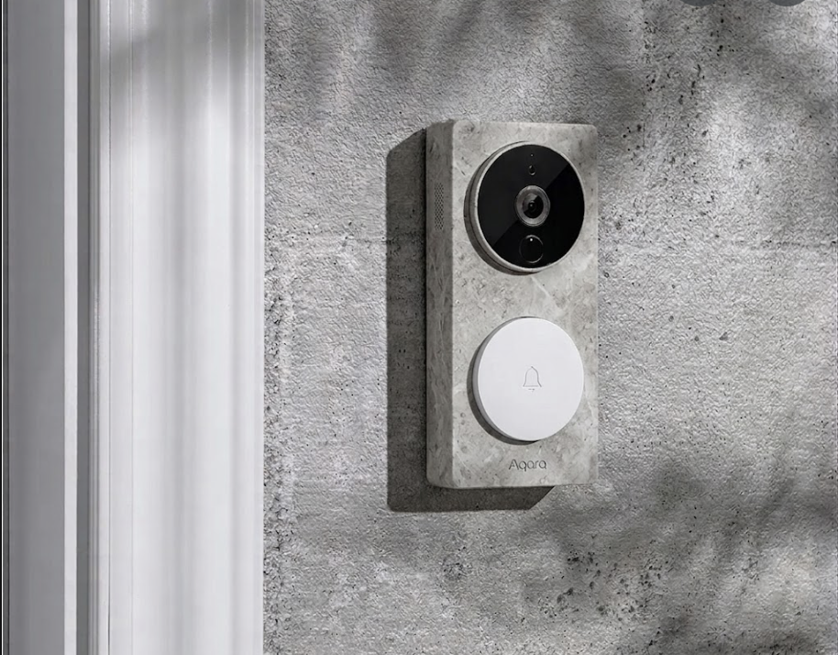
US CI Doorbell and Security Systems
Entry Level
Design Focused
Luxury
[ Notes / description ]
[ Notes / description ]
[ Notes / description ]

