Slide 1
Self Balancing Robot With Encoder Motor
Presented By :
Mohammad Tipu Sultan (15101036)
Md. Eyaseen Arafat Khan (15101038)
Md. Asif Khan (15101040)

Slide 2
Contents
Introduction
Components
Functions of all Components
Connection Diagram
Arduino Code
How does it work
Screenshots
Problems Faced
Future Plan

Slide 3
Introduction
The self-balancing robot is similar to an upside down pendulum.
This inverted pendulum cannot stay balanced on its own.
We balance the robot by driving its wheels in the direction in which it is falling.
What we are trying to do here is to keep the center of gravity of the robot exactly above the pivot point.

Slide 4
Components
Arduino Uno R3
MPU 6050
6V 210RPM Gear Motor Set
L298N Motor Drive
Switch Button
Screw Nut Set

Slide 5
Components (Continued)
Jumper Wires
Acrylic Sheet
Li-ion Battery and Charger
9V Battery
Hot Glue Gun

Slide 6
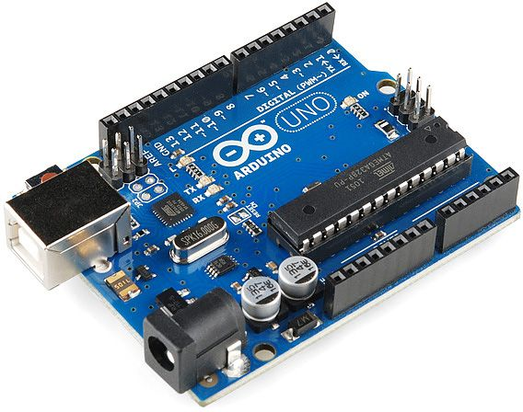
Function of Components
Arduino Uno R3
The Arduino Uno R3 is a microcontroller board based on a removable, dual-inline-package (DIP) ATmega328 AVR microcontroller.
It has 20 digital input/output pins.

Slide 7
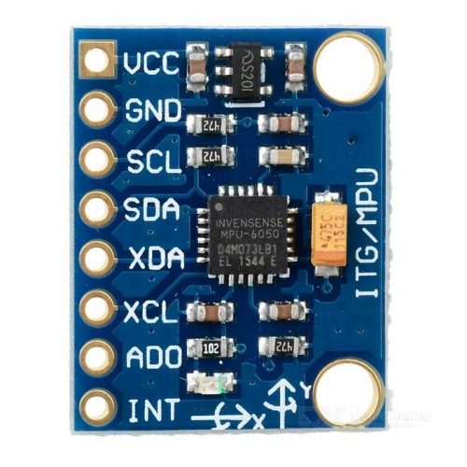
Function of Components
MPU 6050
The MPU 6050 is a 6 DOF (degrees of freedom) or a six-axis IMU sensor, which means that it gives six values as output: three values from the accelerometer and three from the gyroscope.
It is a sensor based on MEMS (micro electro mechanical systems) technology.

Slide 8
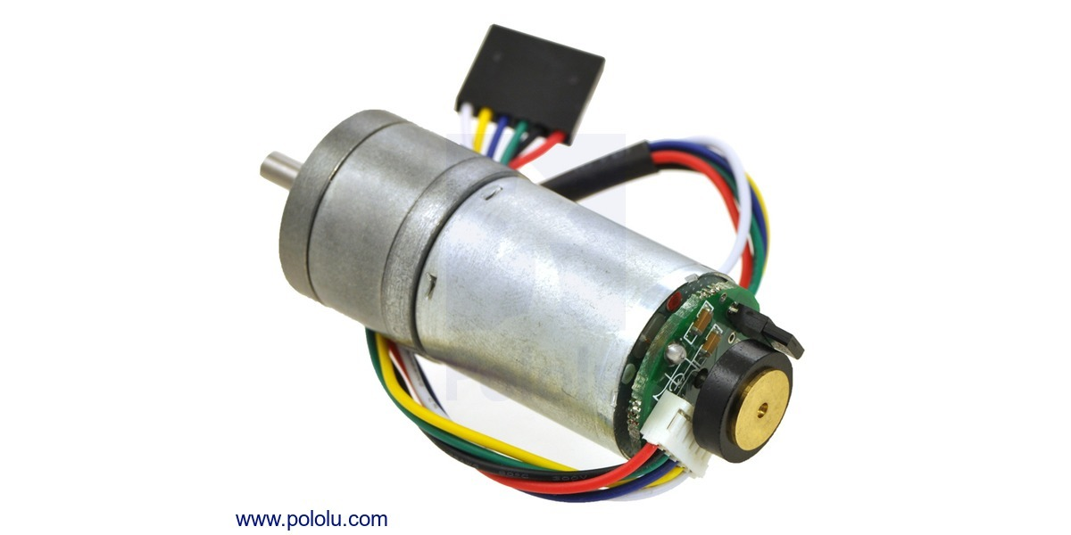
Function of Components
RPM Encoder Gear Motor
The versions of these gear motors with encoders use a two-channel Hall effect sensor to detect the rotation of a magnetic disk on a rear protrusion of the motor shaft.
The quadrature encoder provides a resolution of 48 counts per revolution of the motor shaft when counting both edges of both channels.

Slide 9
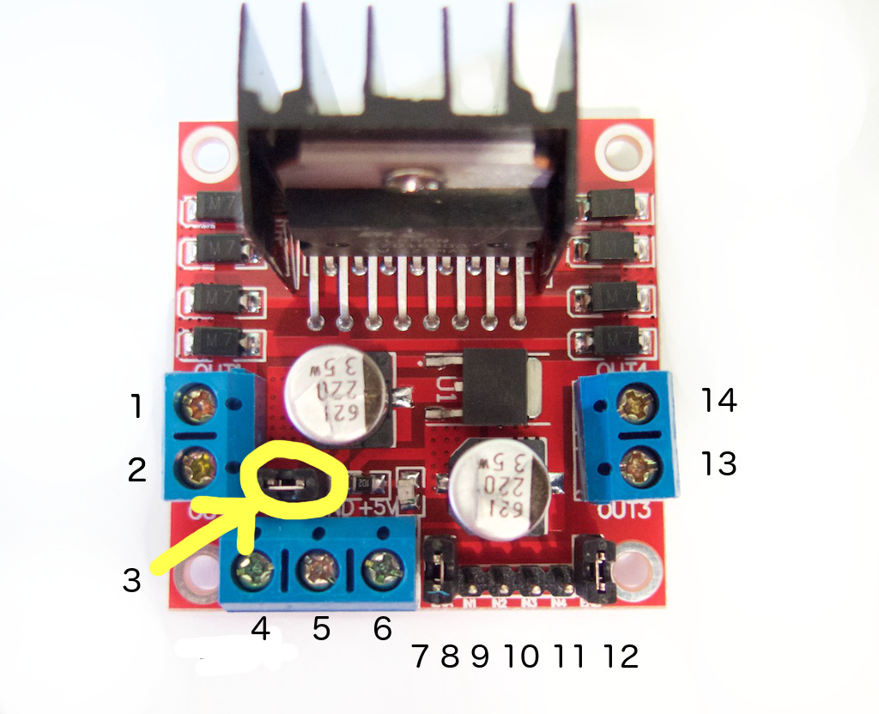
Function of Components
L298N Motor Driver
The L298N Motor Driver Module is a high voltage Dual H-Bridge
H-bridge drivers are used to drive inductive loads that requires forward and reverse function with speed control such as DC Motors, and Stepper Motors.

Slide 10
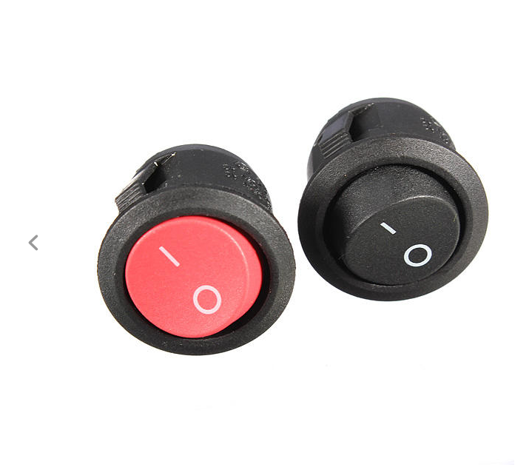
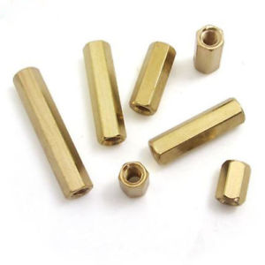
Function of Components
Switch Button
Screw Nut Set

Slide 11
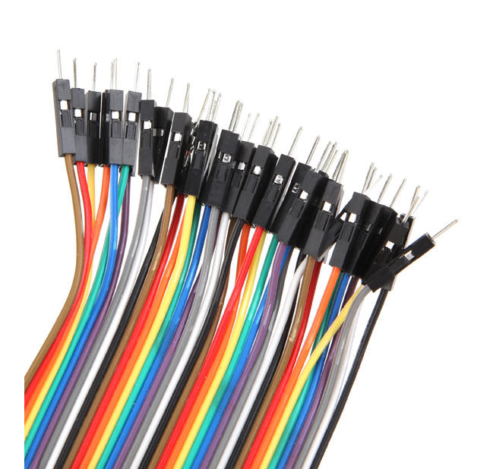
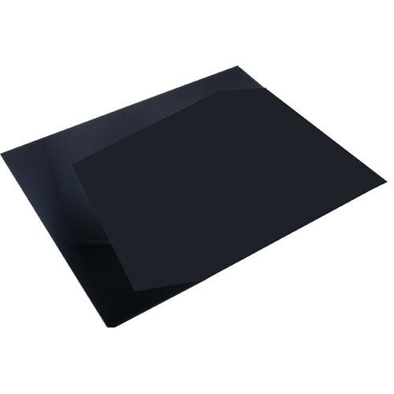
Function of Components
Jumper Wires
Acrylic Sheet

Slide 12
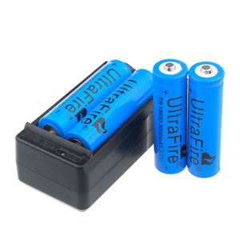
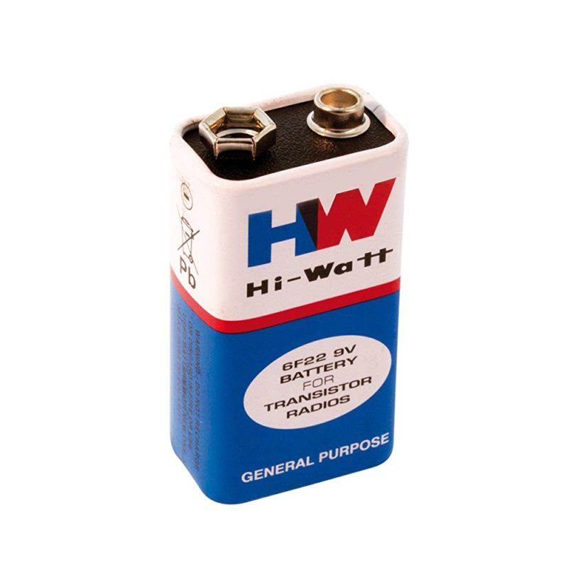
Function of Components
Li-ion Battery and Charger
9V Battery

Slide 13
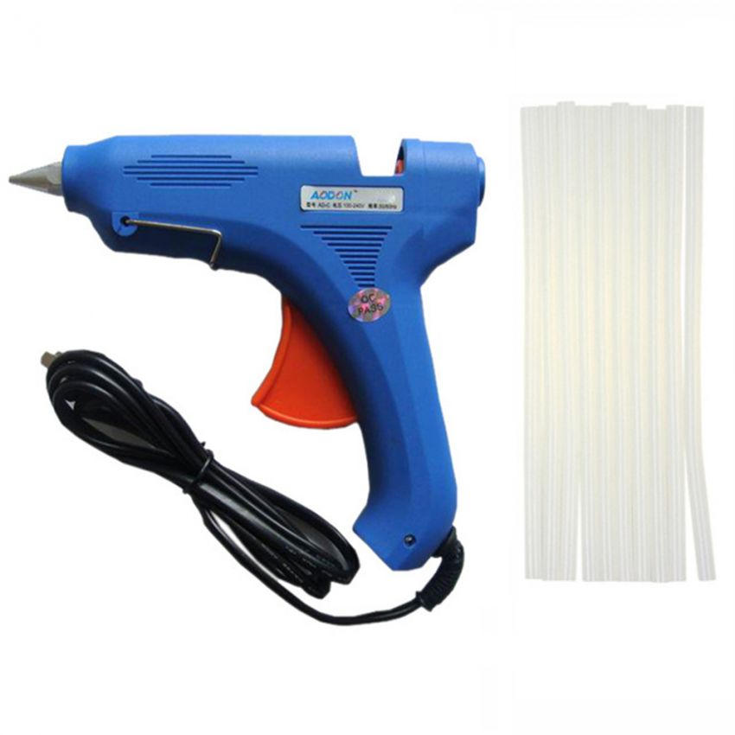
Function of Components
Hot Glue Gun

Slide 14
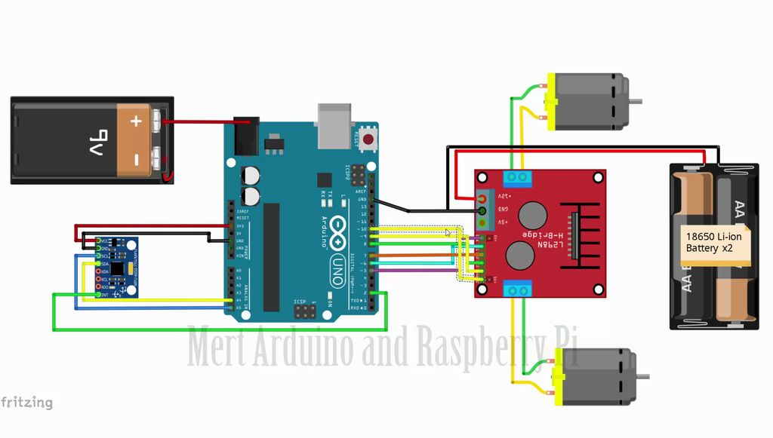
Connection Diagram

Slide 15
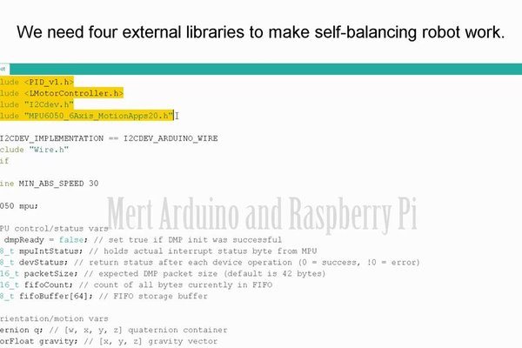
Arduino Code

Slide 16
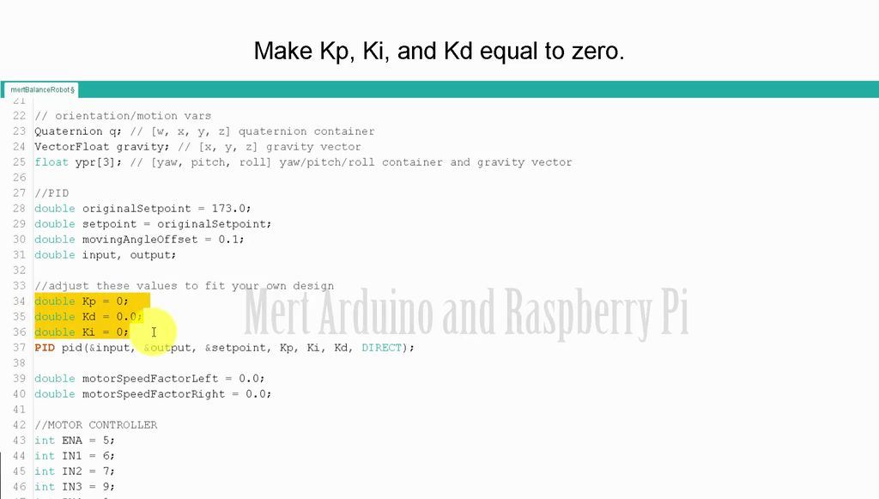
Arduino Code (Cont.)

Slide 17
How does it work
To keep the robot balanced, the robot must counter-act the fall of the robot.
This action requires a feedback and a correcting element.
The feedback element is MPU6050 which gives both rotation and acceleration in all 3 axis which is used by the Arduino to know the current orientation of the robot.
The correcting element is motor and wheel combination.

Slide 18
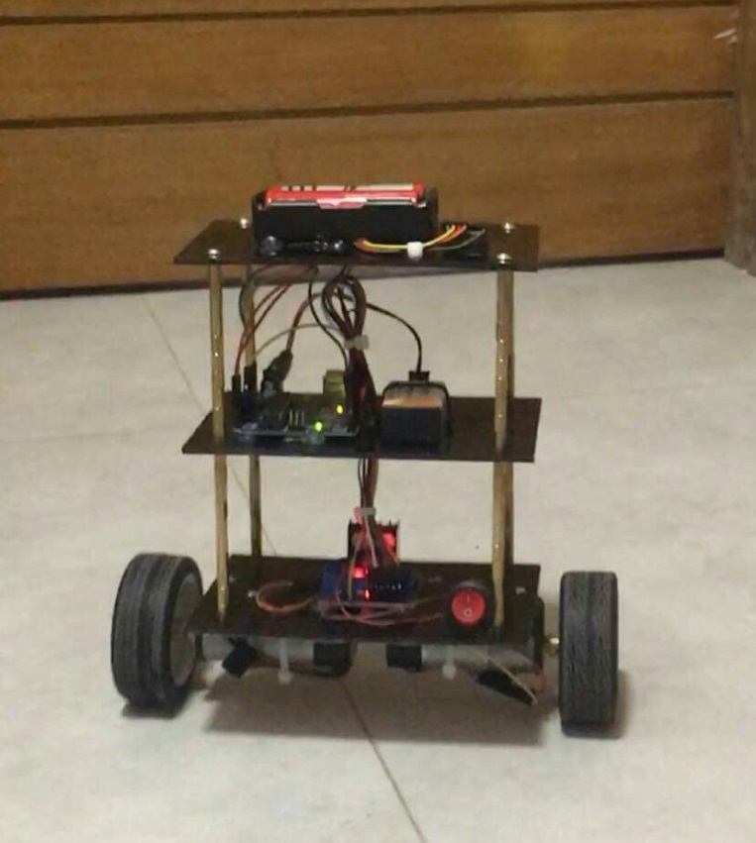
Screenshots

Slide 19
Problems faced
Motor Driver and sensor
Defect of DC motor
Adjusting the value of Kp, kd and ki

Slide 20
Future plan
Our plan is to make this robot more alert by adding sonar sensor and Bluetooth.
It will be able to response and come to the user if he/she calls it by it’s name.

Slide 21


