Slide 1

Drools & Workbench

Slide 2
Drools & Workbench
Drools(JBoos Rules)
一个具有易于访问企业策略、易于调整以及易于管理的开源业务规则引擎。
Drools Workbench
Drools的一个工作台，是对drl规则，Fact、元数据等进行编辑、编译、部署的一个管理平台。

Slide 3
Fact对象
在Drools 规则应用当中，将一个普通的JavaBean 插入到规则的WorkingMemory当中后的对象。
规则可以对Fact 对象进行任意的读写操作。
一个Fact 对象通常是一个具有get和set方法的POJO对象，通过这些get和set方法实现对Fact 对象的读写操作。
当 Fact 对象插入到WorkingMemory 当中后，会与当前WorkingMemory 当中所有的规则进行匹配。

Slide 4
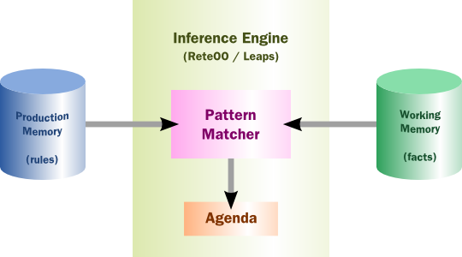
Drools工作方式
规则系统实际上是一个推理引擎，用于匹配facts和rules
当匹配被找到，rule actions被fire
Actions
改变facts的状态，或者新增一些facts
在应用上执行一些“外部”action
重要的几个概念
Rule
Production Memory
Inference Engine
Pattern Matcher
Working Memory
Fact
Agenda
基于Rete算法，模式匹配
规则保存在规则库
Fact事实
条件满足的规则称为具有冲突性，通过Agenda来管理冲突（管理冲突规则的执行顺序）

Slide 5
Drools工作方式
5. Fire All Rules
Agenda
Rule
Activation
Rule
1.Parse DRL
RuleBase
Rule
Rule
Fact
Rule
Rule
Activation
Fact
Rule
Fact
2. Create
Fact
Fact
Fact
Fact
3. Assert Facts
WorkingMemory
Fact
Fact
Fact
Fact
Fact
Fact
Rule
(5) activation -> consequence
Rule
Rule
Rule
Rule
Notes:
It is important to bear in mind that, in a real-world system, there will be many rules (potentially tens of thousands) and many facts (possibly even hundreds of thousands). Let us look at the steps required to get JBoss Rules up and running and see how the system works to process our rules.
First of all, we obtain our list of rules (specified in one or more DRL, DSL or XML files) and tell JBoss Rules to parse them into memory.
<animate id=“1”/> This uses an instance of the org.drools.compiler.PackageBuilder class. A java.io.InputStream is passed to the addPackageFromDrl(…) method and then the getPackage() method is called to obtain an in-memory representation of the parsed rules. Then we can pick an implementation of org.drools.RuleBase depending on the algorithm we wish to apply (org.drools.reteoo.RuleBaseImpl for the Object Oriented Rete implementation) and load the package into a RuleBase with the RuleBase.addPackage(…) method. Now we have an in-memory definition of the Rules suitable for algorithmic processing.
<animate id=“2”/>Now we have the RuleBase defined, we need to obtain a construct that can do the work of combining rules and facts, this is known as the “Working Memory” and is created using the org.drools.WorkingMemory RuleBase.newWorkingMemory() method.
<animate id=“3”/> So the next step is to make JBoss Rules “aware” of the world in which it is operating. Each fact is asserted into the Working Memory ( WorkingMemory.assert(…) ). As the facts are asserted, JBoss Rules is actually doing a lot of the work required to understand how the facts relate to the rules and to build up the optimised Rete network that describes this relationship.
<animate id=“4”/> If we “look inside” the implementation of the WorkingMemory we can see that it is holding a reference to the Facts and a copy of the parsed Rules, we are ready to go
<animate id=“5”/> Now we ask the call the fire all rules method on the WorkingMemory (WorkingMemory.fireAllRules()) to actually trigger all the interactions between facts and rules. It is helpful and instructive at this point to consider a naïve, brute force approach. The rules engine behaves as if it has exhaustively evaluated all of the rules against all of the facts and looked to see which rules should be fired against which facts.
<animate id=“6”/> The black lines represent all the possible interactions and the red lines the ones when a particular rule matches against one or more sets of facts. Each such red line, represents an activation object in JBoss rules terminlogy and is a pair of a rules consquence and the tuple of objects on which the rule has been activated.
<animate id=“7”/> All of the activations are queued within a data construct known as an agenda. In general, the order which this activations are stacked will not be formally defined. The constructs such as salience allow some more control over how they are defined.
<animate id=“8”/> Finally, activations are processed one-by-one from the agenda, calling the consequence of the rule on the facts that activated it.
One final complication to note is that the processing of the consequence from one rule may change facts on which other activations’s on the agenda rules and facts were calculated. Thus this is actually an iterative process where the firing of one activation on the agenda can actually affect the contents of the agenda before the next activation is fired!
As you can imagine, once you have tens of thousand rules and potential hundreds of thousands of facts, a “brute force” approach which mindelessly evaluates all facts against all rules becomes unworkable. The Rete algorithm’s purpose is to provide an efficient way of handling such as situation.
<senote>To complete this overview, I would really like to add a single slide after this one that shows the basics of what the Rete algorithm is doing – pending inspiration</senote>

Slide 6
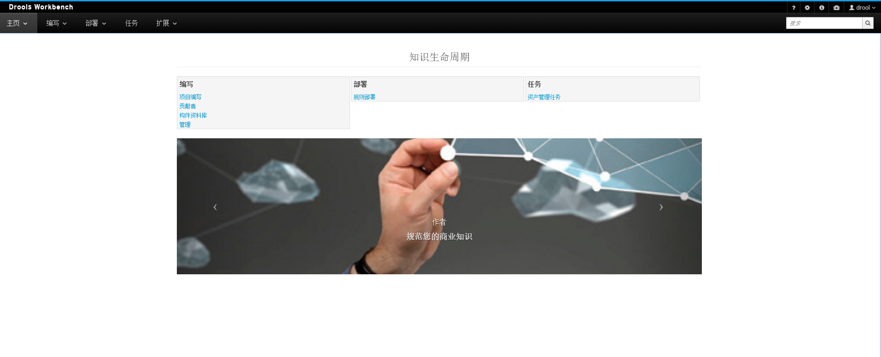
Workbench

Slide 7
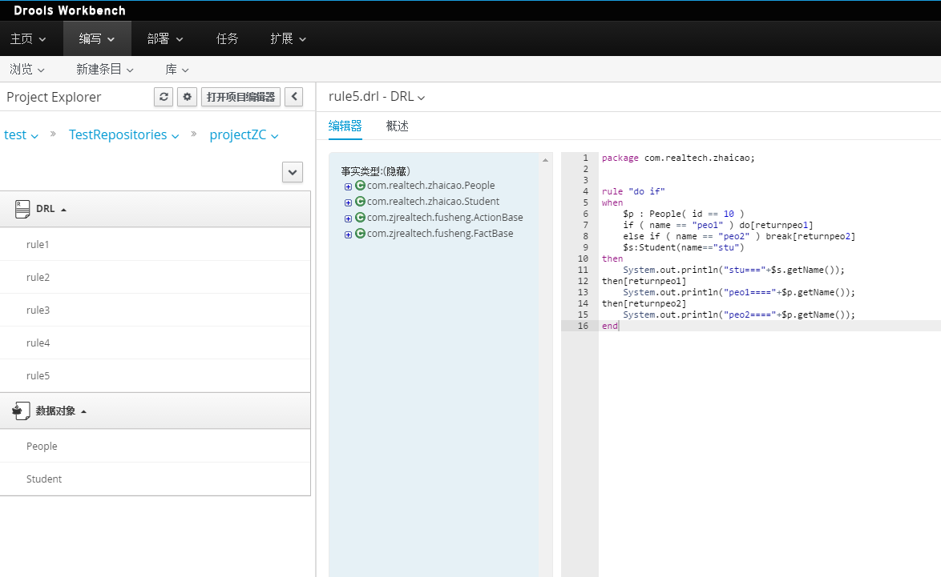
Workbench-项目编写

Slide 8
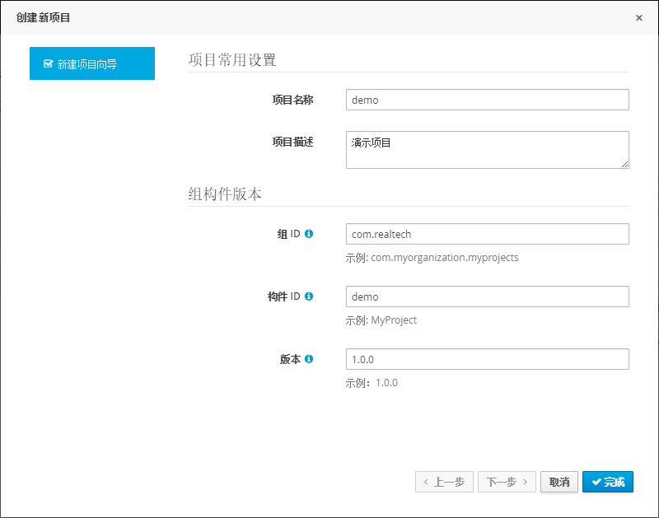
Workbench-新建项目

Slide 9
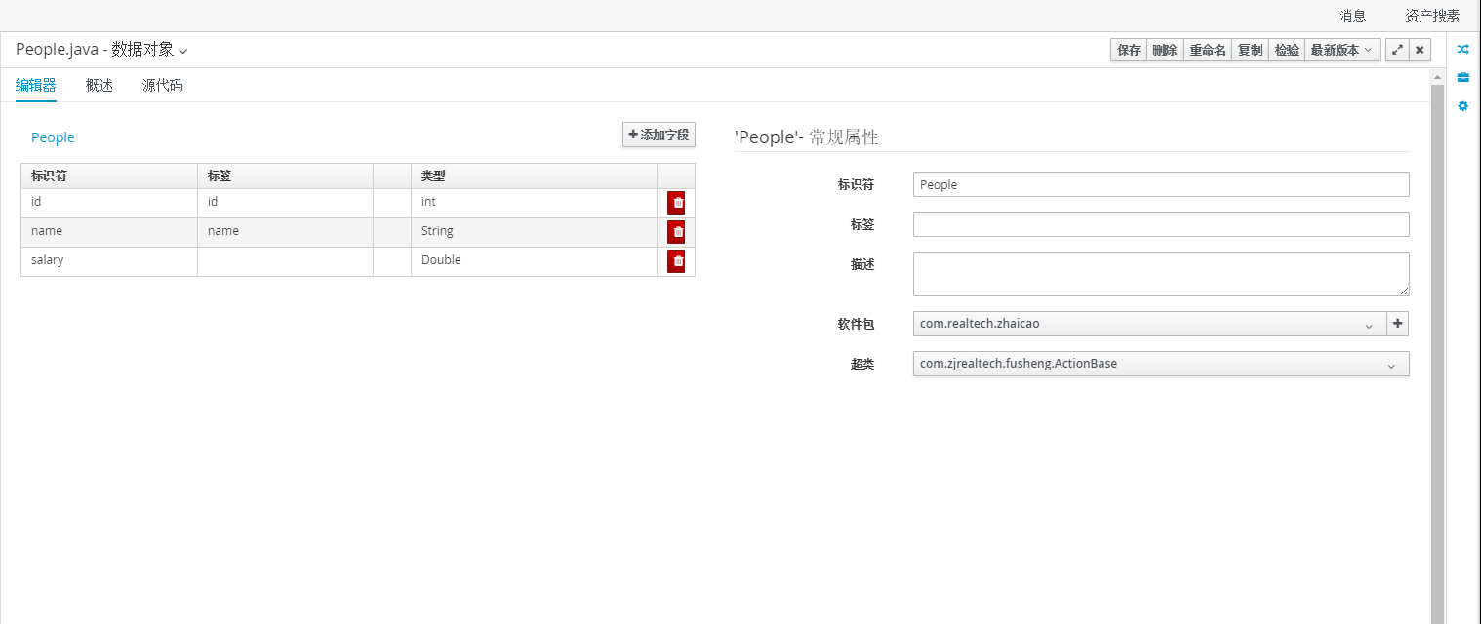
Workbench-数据对象（Fact）

Slide 10
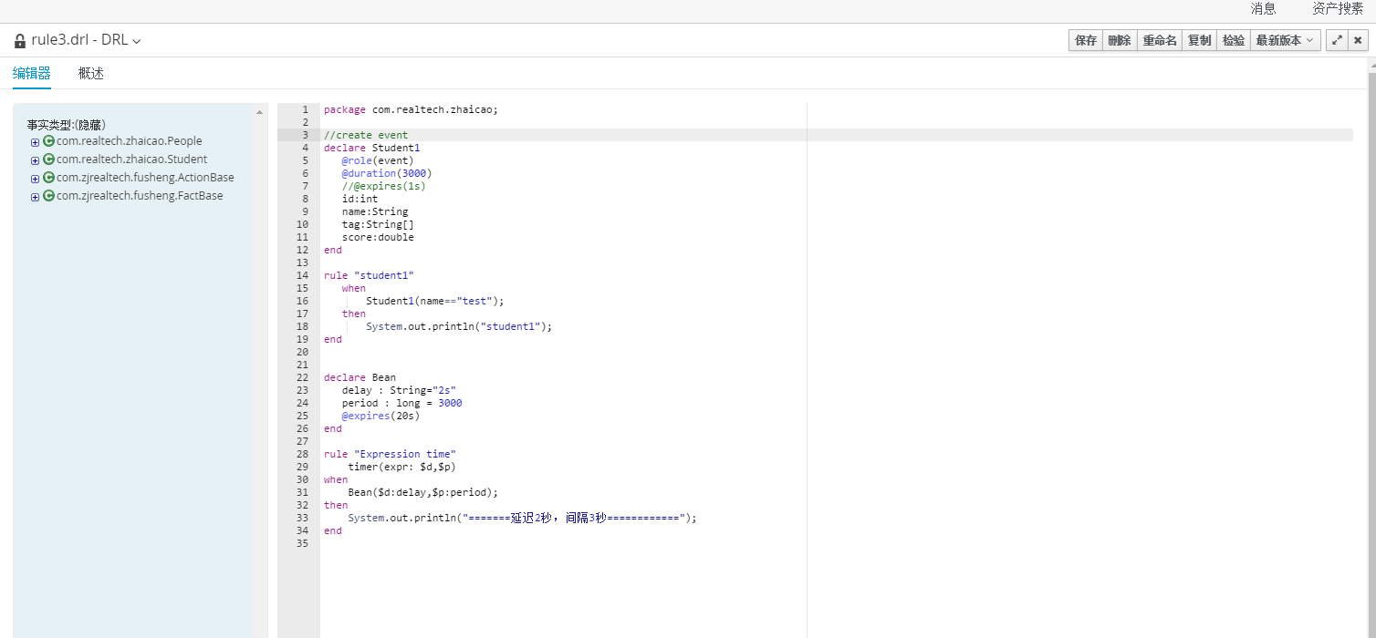
Workbench-规则文件

Slide 11
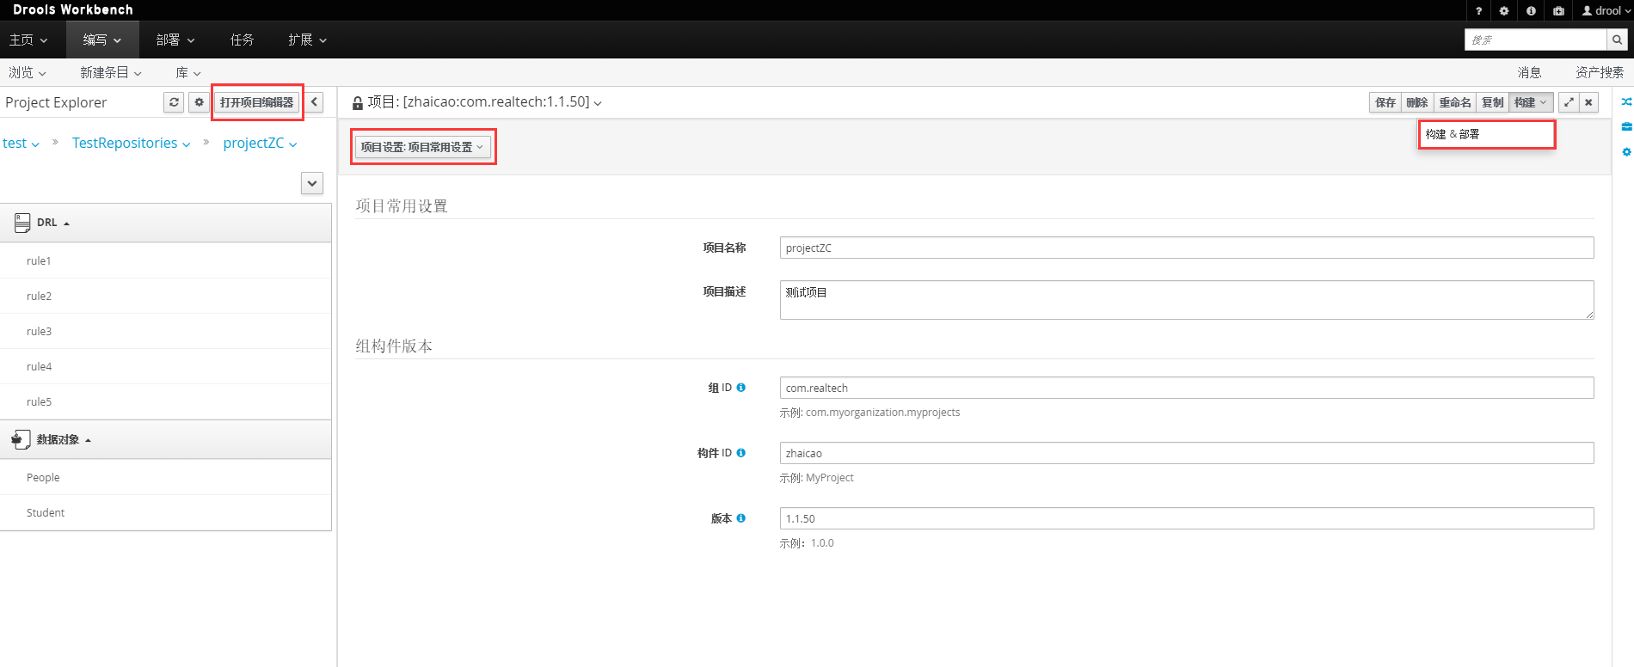
Workbench-项目构建

Slide 12
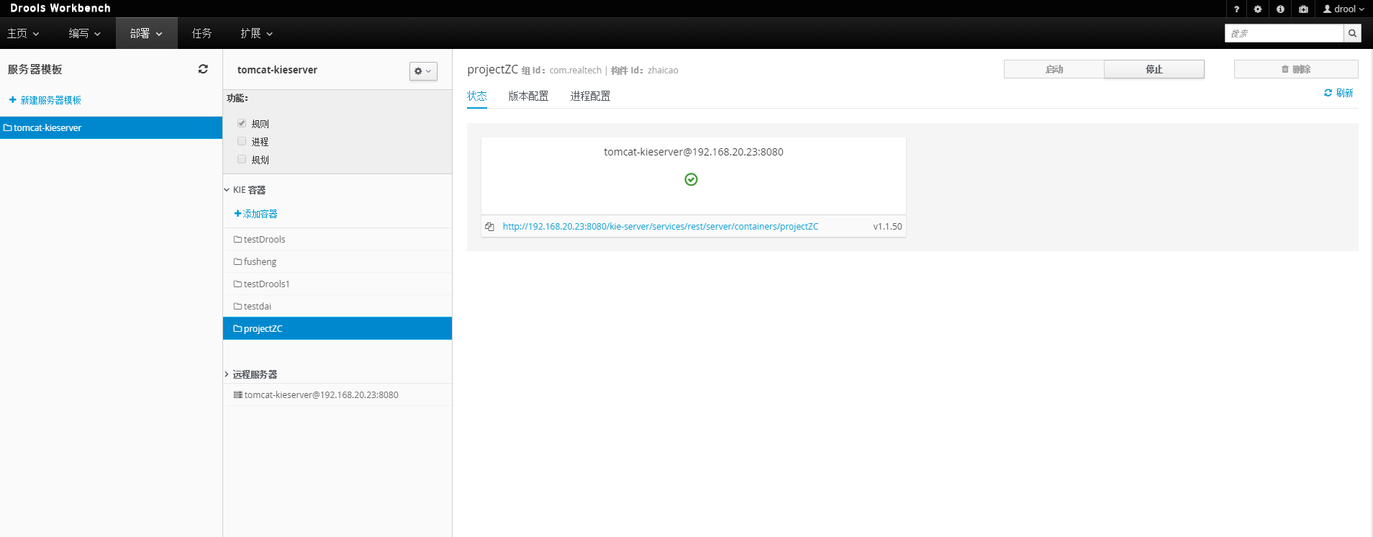
Workbench-规则部署

Slide 13
规则文件DRL
规则文件
一般为.drl后缀
支持多种规则语言（目前为Java和mvel）
包声明
package ...
放在规则文件的最开头
函数定义
function T fn(){...}

Slide 14
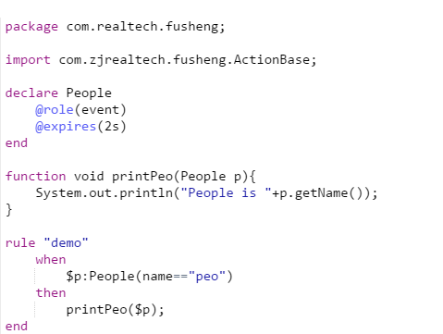
规则文件
类型声明
declare
查询
query
规则
rule
注释
单行：//
多行：/* ... */

Slide 15
规则属性
salience
优先级，数值越大越优先执行。默认为0
no-loop
如果当前规则修改了fact，会导致当前规则再次被触发，no-loop避免了这种情况。避免当前规则进入无限循环
date-effective
规则生效日期
date-effective "09-sep-2009"
date-expires
规则失效日期
date-expires "1-sep-2020"

Slide 16
规则属性
enabled
定义一个规则是否可用的，该属性的值是一个布尔值， 默认该属性的值为 true
dialect
规则语言。当前只有Java和mvel，默认为Java
duration
规则延迟触发。单位为毫秒
duration 3000
默认不会自动触发，程序中ksession需设置TimeRuleExectionOption.YES，Workbench中暂无法设置。
lock-on-active
避免同一个agenda-group中的规则被循环触发，可以理解为no-loop增强版

Slide 17
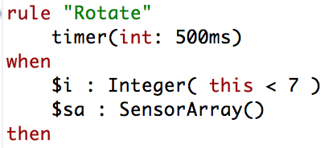
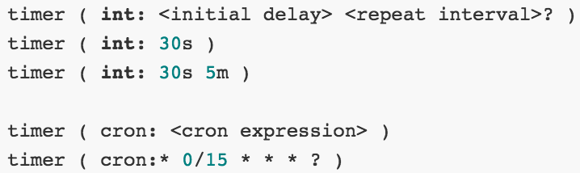
定时器、日历
定时器
设置延时
设置重复间隔。timer（ int ：延迟时间 重复间隔时间）
可以带start/end/repeat-limit三个可选参数（;分隔）
默认不会自动触发，程序中ksession需设置TimeRuleExectionOption.YES，Workbench中暂无法设置。

Slide 18
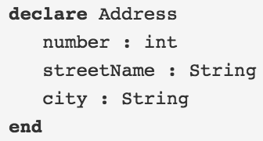
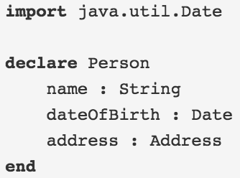
类型定义
declare ... end

Slide 19
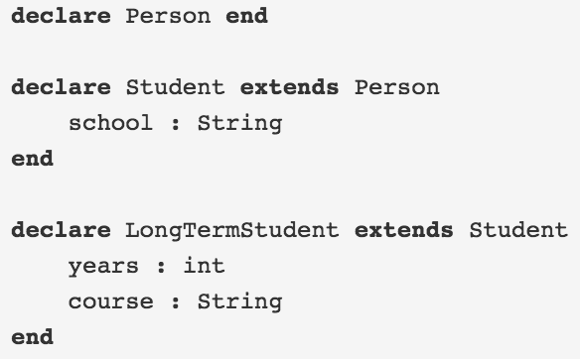
类型定义
extends

Slide 20
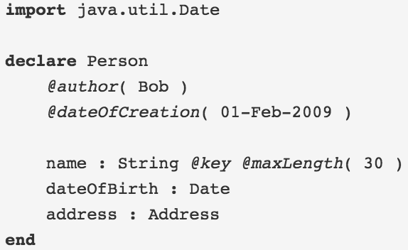
元数据
用来描述数据的数据
可以为 Fact 对象、Fact对象的属性或者是规则来定义元数据，元数据定义采用的是“@”符号开头，后面是元数据的属性名（属性名可以是任意的），括号当中是该元数据属性对应的具体值（值是任意的）
@metadata_key( metadata_value )
可对已有的类型声明元数据

Slide 21
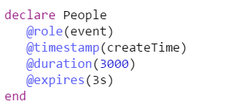
预定义的类级元数据
@Role( <fact | event> )
指明是常规Fact还是Event
Event（事件）是一种特殊类型的Fact，有时间的概念。Event需要在流模式（ Stream ）下，默认为云模式（Cloud）
@timestamp( <attribute name> )
事件的时间戳属性
参数为Date类型属性
@duration( <attribute name> )
事件的持续时间属性
参数为整数，单位毫秒
@expires( <time interval> )
Fact的失效时间间隔（仅当引擎运行于STREAM模式时）
参数为整数，单位秒
元数据可以在DRL或Workbench中定义

Slide 22
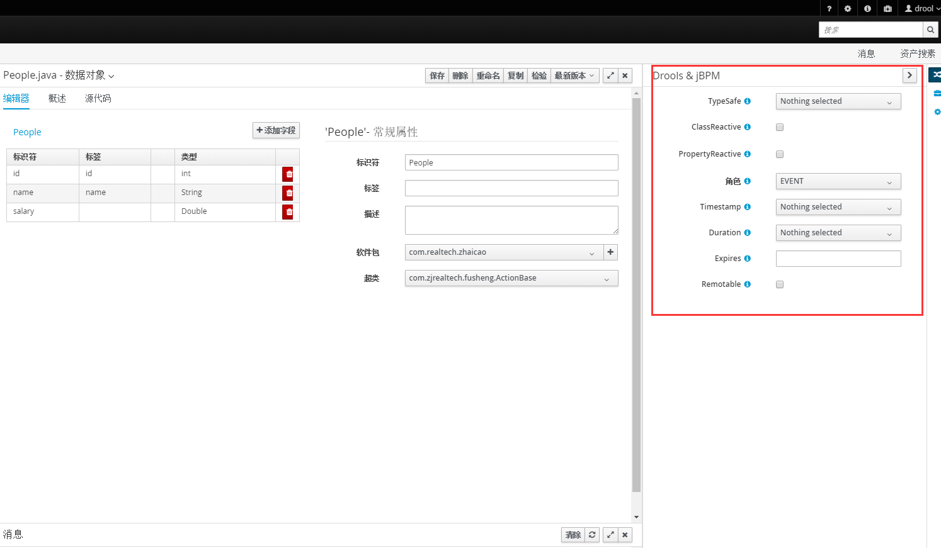
Workbench-定义元数据

Slide 23
规则语言
LHS(Left Hand Side)
模式部分、when部分
RHS(Right Hand Side)
Action部分、then部分

Slide 24
LHS
模式（Pattern）
条件元素，可以匹配工作内存中的一条fact
$order : Order( grossTotal >= 10 && < 20 )
绑定
绑定变量以便随后使用
变量以$开头只是约定
约束（模式的一部分）
返回true或false的表达式
Person( age > 50, weight > 80, height > 2 )等价于等价于Person( age > 50 && weight > 80 && height > 2 )
属性可以绑定变量，Person( $firstAge : age )

Slide 25
LHS-比较操作符
同一属性连续约束
grossTotal >= 10 && < 20 等价于：grossTotal >= 10 && grossTotal < 20
Person( age ( (> 30 && < 40) || (> 20 && < 25) ) )
嵌套属性
Person( name== “mark”, address.( city == “london”, country == “uk”) ) 等价于
Person( name == "mark", address.city == "london", address.country == "uk" )
空引用安全
Person( $streetName : address!.street ) 相当于：
Person( address != null, $streetName : address.street )
日期
Cheese( bestBefore < “27-Oct-2009” ) //可设置系统属性drools.dateformat来指定默认日期格式
List
Person( childList[0].age == 18 )
Map
Person( credentialMap["jsmith"].valid )

Slide 26
LHS-操作符
matches/not matches
对某个 Fact 的字段与标准的 Java 正则表达式进行相似匹配，被比较的字符串可以是一个标准的 Java 正则表达式
Cheese( type matches "(Buffalo)?\\S*Mozarella" )
contains/not contains
检查一个 Fact 对象的某个字段（该字段要是一个 Collection或是一个 Array 类型的对象）是否包含一个指定的对象
CheeseCounter( cheeses contains "stilton" )
memberOf/not memberOf
判断某个 Fact 对象的某个字段是否在一个集合（Collection/Array）当中
CheeseCounter( cheese memberOf $matureCheeses )

Slide 27
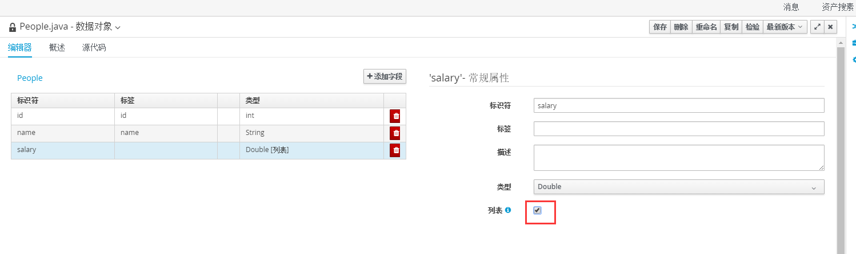
Workbench-列表

Slide 28
LHS-操作符
str
检查一个字符串类型的字段
Message( routingValue str[startsWith] "R1" )
in/not in
相当于多个==或!=条件
Person( $cheese : favouriteCheese )
Cheese( type in ( "stilton", "cheddar", $cheese ) )
and/or
Cheese( cheeseType : type ) and Person( favouriteCheese == cheeseType )
( Cheese( cheeseType : type ) and ( Person( favouriteCheese == cheeseType ) or Person( favouriteCheese == cheeseType ) )
not
检查工作内存中的某类fact的不存在性
not Bus() //工作内存中不存在Bus类型的对象
not Bus(color == “red”) //工作内存中不存在color为red的Bus类型的对象
exists
存在性检查
exists Bus()
exists Bus(color == “red”)

Slide 29
LHS-操作符
forall
匹配满足第一个模式的对象同时也满足后续的模式
所有汽车都是红色的
forall( Bus( color == ‘red’ ) )
所有type == ‘english’的汽车都是红色的
forall( $bus : Bus( type == 'english') Bus( this == $bus, color = 'red' ) )
嵌套其他条件
not ( forall( $emp : Employee()
HealthCare( employee == $emp )
DentalCare( employee == $emp ) )
)
from
指定参与匹配的数据源
Person( $personAddress : address )
Address( zipcode == "23920W") from $personAddress
等价于
$p : Person( )
$a : Address( zipcode == "23920W") from $p.address

Slide 30
LHS-操作符
collect
从满足模式的对象组合成一个对象集合
$system : System()
$alarms : Array List( size >= 3 )
from collect( Alarm( system == $system, status == 'pending' ) )
accumulate
可对集合执行累计运算。是collect更强的形式
rule "Raise alarm"
when
$s : Sensor()
accumulate( Reading( sensor == $s, $temp : temperature );
$min : min( $temp ),
$max : max( $temp ),
$avg : average( $temp );
$min < 20, $avg > 70 )
then
// raise the alarm
End
内建的累计函数
average min max count sum collectList collectSet

Slide 31
RHS
RHS部分执行相应的Action
操作工作内存的关键字
update(object)
在工作内存中更新该对象
$car.setSpeed($car.getSpeed()+1);
update($car);
insert(object)
向工作内存插入一个对象
Car car=new Car();
car.setSpeed(10);
insert (car);
insertLogical(object)
类似insert()。但当已满足当前规则的对象不再能让当前规则触发时，此对象会被引擎自动删除
delete(handle)
从工作内存删除一个对象

Slide 32
RHS
modify
用于对象的多个属性处理
rule "modify stilton"
when
$stilton : Cheese(type == "stilton")
then
modify( $stilton ){
setPrice( 20 ),
setAge( "overripe" )
}
end

Slide 33
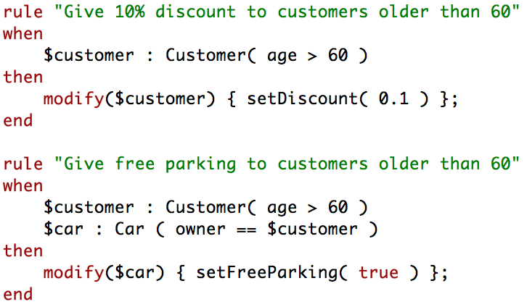
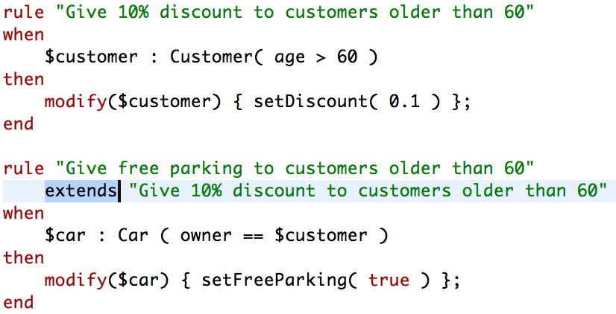
RHS
规则继承

Slide 34
Query Command
Query定义
查询工作内存对象
不带参数的查询
query “query peo 30"
person : Person( age > 30 )
end
带参数的查询
query “query people by x" (int x, String y)
person : Person( age > x, location == y )
end
Query Command
<query out-identifier="persons" name=" query people by x ">
<int>25</int>
<string>wuhan</string>
</query>

Slide 35
复杂事件
事件
通常不可修改
强时间性约束
受管理的生命周期
使用滑动窗口
事件处理模式：Cloud模式
默认模式
引擎不区分普通fact和event
没有时间的概念，不需要时钟同步
无顺序
事件处理模式：Stream模式
事件有时间顺序
引擎对多个事件流进行同步
需要会话时钟
增加了一些特性使得Stream事件处理更简单
滑动窗口支持
自动生命周期管理
自动规则延迟

Slide 36

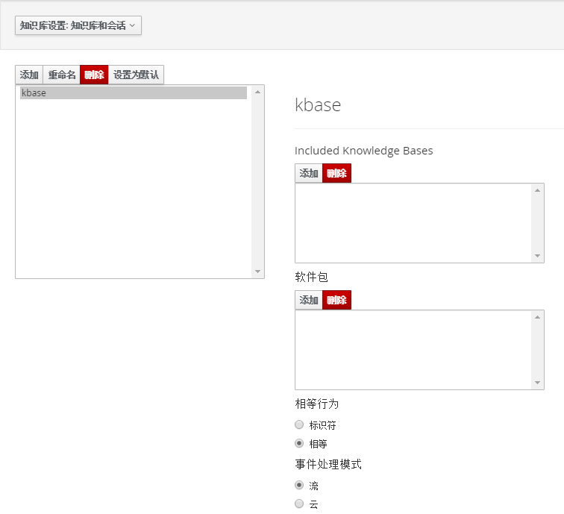
Workbench-流模式（Stream）
规则引擎默认为云模式
修改kmodule.xml
Workbench知识库
kbase
ksession

Slide 37
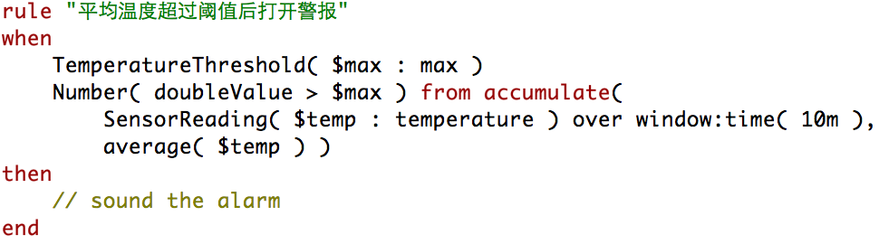
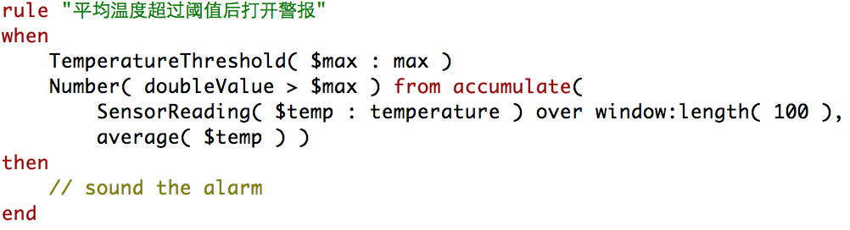
复杂事件滑动窗口
滑动窗口over window
允许仅匹配在最近一段时间发生的事件（事件时间窗口），超过窗口期的对象将自动删除
StockTick() over window:time( 2m )
允许仅匹配最近若干次发生的事件（事件长度窗口），超过窗口期的对象不会自动删除
StockTick( company == "RHT" ) over window:length( 10 )

Slide 38
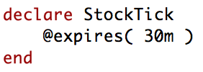
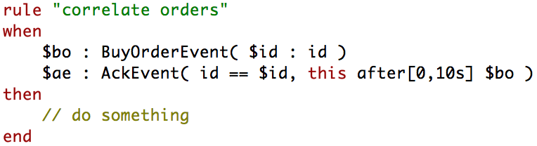
复杂事件内存管理
Stream下，引擎可以检测一个事件什么时候不再匹配任何规则
两种方式
显式，使用过期策略
隐式，分析事件上的时间性约束

Slide 39
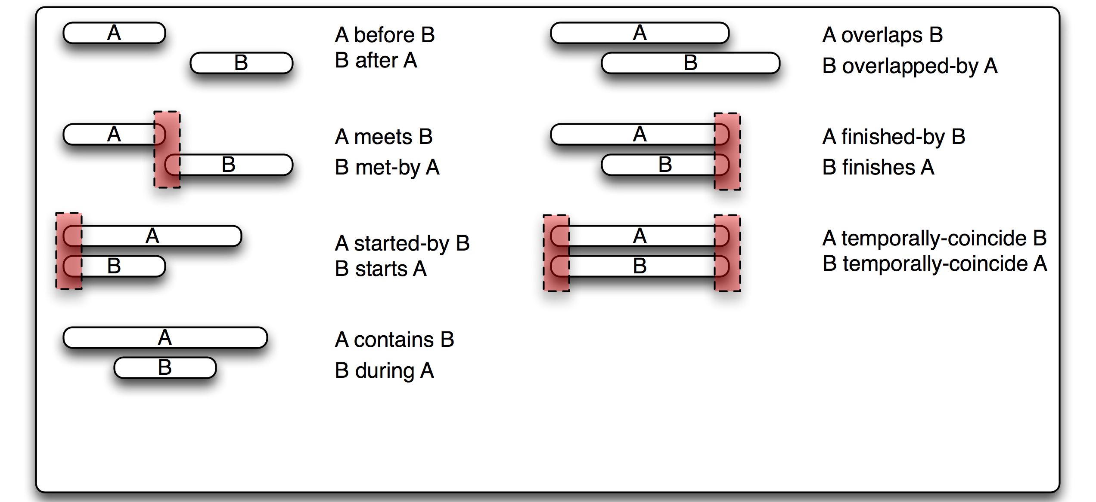
时间推理—13种时间运算

Slide 40
时间性操作符
after
$eventA : EventA( this after[ 3m30s, 4m ] $eventB )
相当于
3m30s <= $eventA.startTimestamp - $eventB.endTimeStamp <= 4m
before
$eventA : EventA( this before[ 3m30s, 4m ] $eventB )
相当于
3m30s <= $eventB.startTimestamp - $eventA.endTimeStamp <= 4m
coincides
同时发生（同时开始、同时结束）
$eventA : EventA( this coincides $eventB )
可加两个参数，分别表示开始和结束的最大时间差
$eventA : EventA( this coincides[15s, 10s] $eventB )
相当于
abs( $eventA.startTimestamp - $eventB.startTimestamp ) <= 15s && abs( $eventA.endTimestamp - $eventB.endTimestamp ) <= 10s

Slide 41
时间性操作符
during
A在B中间发生和结束，A是短事件。
$eventA : EventA( this during $eventB ) 可加1、2、4个参数
相当于
$eventB.startTimestamp < $eventA.startTimestamp <= $eventA.endTimestamp < $eventB.endTimestamp
includes
与during类似，但A、B互换。B是短事件
$eventA : EventA( this includes $eventB ) 可加1、2、4个参数
相当于
$eventA.startTimestamp < $eventB.startTimestamp <= $eventB.endTimestamp < $eventA.endTimestamp
finishes
A开始的时候B结束，A是短事件（或瞬时事件）
$eventA : EventA( this finishes $eventB ) 可加1个参数
相当于
$eventB.startTimestamp < $eventA.startTimestamp && $eventA.endTimestamp == $eventB.endTimestamp
finishedby
$eventA : EventA( this finishedby $eventB )
与finishes类似，但B是短事件

Slide 42
时间性操作符
meets
A结束的时候B开始
$eventA : EventA( this meets $eventB )
abs( $eventB.startTimestamp - $eventA.endTimestamp ) == 0
$eventA : EventA( this meets[ 5s ] $eventB )
abs( $eventB.startTimestamp - $eventA.endTimestamp) <= 5s
metby
A开始的时候B结束
$eventA : EventA( this metby $eventB )
overlaps
发生时间重叠，A先开始
$eventA : EventA( this overlaps $eventB ) 可加1,2个参数
$eventA.startTimestamp < $eventB.startTimestamp < $eventA.endTimestamp < $eventB.endTimestamp
overlappedby
与overlaps类似，发生时间重叠，但B先开始
$eventA : EventA( this overlappedby $eventB )

Slide 43
时间性操作符
start
A、B同时开始，A是短事件
$eventA : EventA( this starts $eventB ) 可加1个参数
$eventA.startTimestamp == $eventB.startTimestamp && $eventA.endTimestamp < $eventB.endTimestamp
startedby
与start类似，但B是短事件
$eventA : EventA( this startedby $eventB )

Slide 44
谢 谢

Slide 45


