Slide 1
Hadoop 基础
By 李律

Slide 2
Hadoop 历史
Hadoop was created by Doug Cutting, the creator of Apache Lucene, the widely used text search library. Hadoop has its origins in Apache Nutch, an open source web search engine, itself a part of the Lucene project.
In January 2008, Hadoop was made its own top-level project at Apache, confirming its success and its diverse, active community. By this time, Hadoop was being used by many other companies besides Yahoo!, such as Last.fm, Facebook, and the New York Times.
Today, Hadoop is widely used in mainstream enterprises. Hadoop’s role as a general purpose storage and analysis platform for big data has been recognized by the industry, and this fact is reflected in the number of products that use or incorporate Hadoop in some way.

Slide 3
Hadoop 基础模块
Hadoop Common: The common utilities that support the other Hadoop modules.
Hadoop Distributed File System (HDFS™): A distributed file system that provides high-throughput access to application data.
Hadoop YARN: A framework for job scheduling and cluster resource management.
Hadoop MapReduce: A YARN-based system for parallel processing of large data sets.

Slide 4
MapReduce
Hadoop MapReduce is a software framework for easily writing applications which process vast amounts of data (multi-terabyte data-sets) in-parallel on large clusters (thousands of nodes) of commodity hardware in a reliable, fault-tolerant manner.

Slide 5
MapReduce 编程模型
The MapReduce framework operates exclusively on <key, value> pairs, that is, the framework views the input to the job as a set of <key, value> pairs and produces a set of <key, value> pairs as the output of the job, conceivably of different types.
Input and Output types of a MapReduce job:
<k1, v1> -> map -> <k2, v2> -> combine -> <k2, v2> -> reduce -> <k3, v3>

Slide 6
WordCount ——job输入
$ bin/hadoop fs -cat /user/joe/wordcount/input/file01
Hello World Bye World
$ bin/hadoop fs -cat /user/joe/wordcount/input/file02
Hello Hadoop Goodbye Hadoop

Slide 7
WordCount——map输出
The Mapper implementation, via the map method, processes one line at a time, as provided by the specified TextInputFormat. It then splits the line into tokens separated by whitespaces, via the StringTokenizer, and emits a key-value pair of < <word>, 1>.
For the given sample input the first map emits:
< Hello, 1>
< World, 1>
< Bye, 1>
< World, 1>
The second map emits:
< Hello, 1>
< Hadoop, 1>
< Goodbye, 1>
< Hadoop, 1>

Slide 8
WordCount——combiner输出
WordCount also specifies a combiner. Hence, the output of each map is passed through the local combiner (which is same as the Reducer as per the job configuration) for local aggregation, after being sorted on the *key*s.
The output of the first map:
< Bye, 1>
< Hello, 1>
< World, 2>
The output of the second map:
< Goodbye, 1>
< Hadoop, 2>
< Hello, 1>

Slide 9
WordCount——reduce输出
The Reducer implementation, via the reduce method just sums up the values, which are the occurence counts for each key (i.e. words in this example).
Thus the output of the job is:
< Bye, 1>
< Goodbye, 1>
< Hadoop, 2>
< Hello, 2>
< World, 2>

Slide 10
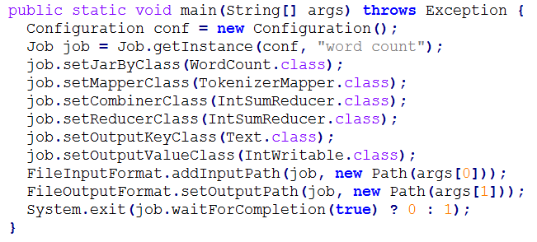
WordCount ——job configuration实现

Slide 11
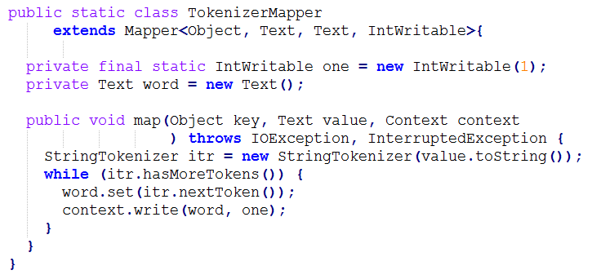
WordCount——map实现

Slide 12
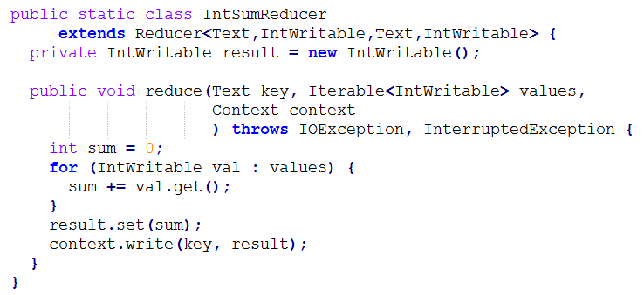
WordCount ——reduce实现

Slide 13
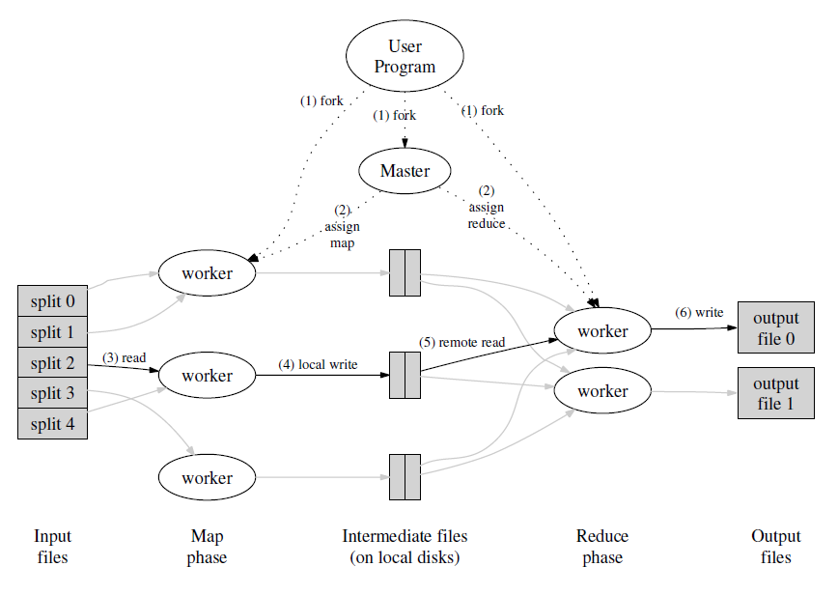
MapReduce 概览

Slide 14
HDFS
The Hadoop Distributed File System (HDFS) is a distributed file system designed to run on commodity hardware. HDFS is highly fault-tolerant and is designed to be deployed on low-cost hardware. HDFS provides high throughput access to application data and is suitable for applications that have large data sets.

Slide 15
HDFS设计
适用场景：
Very large files
Streaming data access
Commodity hardware
不适用场景：
Low-latency data access
Lots of small files
Multiple writers, arbitrary file modifications

Slide 16
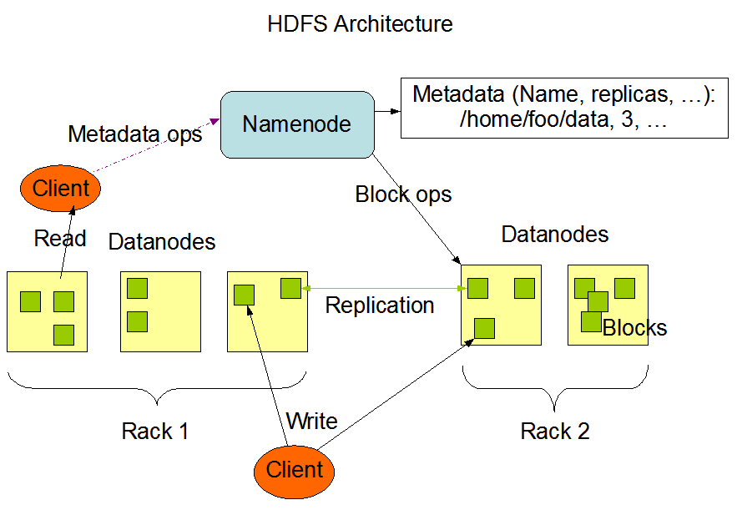
HDFS 架构

Slide 17
HDFS 主要概念
Blocks
Namenodes and Datanodes
Block Caching
Federation
High Availability
HDFS Short-Circuit Local Reads
Rack Awareness

Slide 18
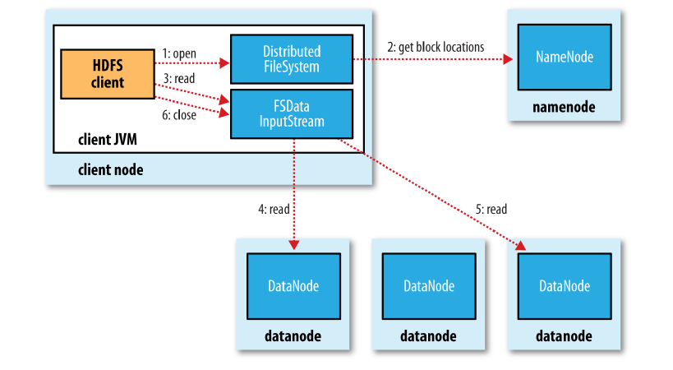
HDFS 读文件流程

Slide 19
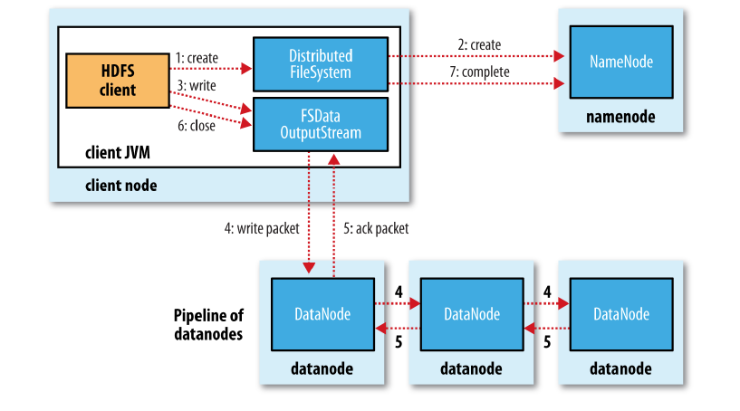
HDFS 写文件流程

Slide 20
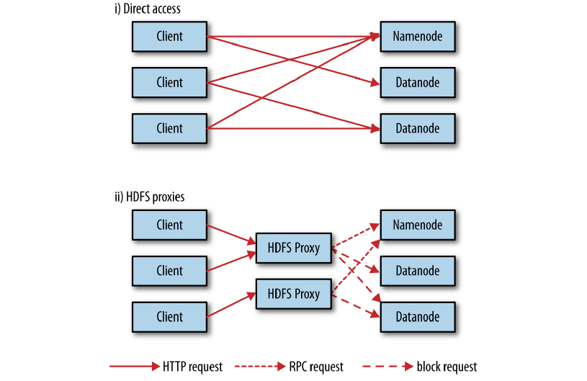
HDFS http接口

Slide 21
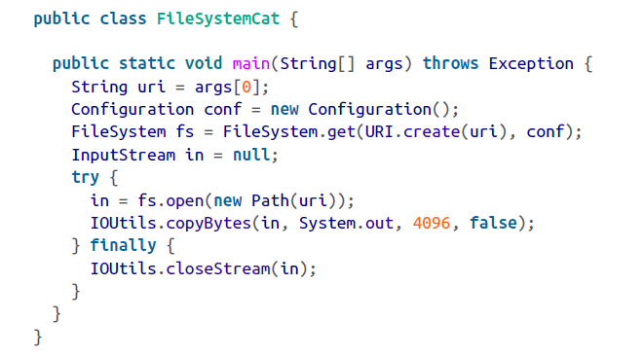
HDFS java接口

Slide 22
YARN
The fundamental idea of YARN is to split up the two major functionalities of the JobTracker, resource management and job scheduling/monitoring, into separate daemons. The idea is to have a global ResourceManager (RM) and per-application ApplicationMaster (AM). An application is either a single job in the classical sense of Map-Reduce jobs or a DAG of jobs.

Slide 23
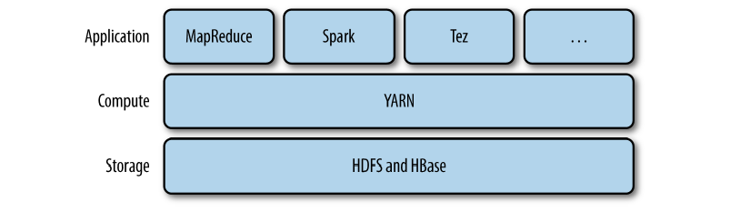
YARN 在平台中的位置

Slide 24
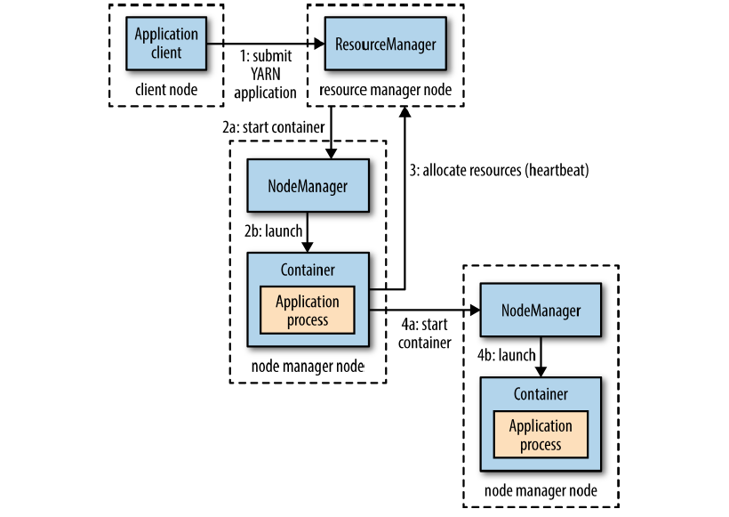
YARN 架构

Slide 25
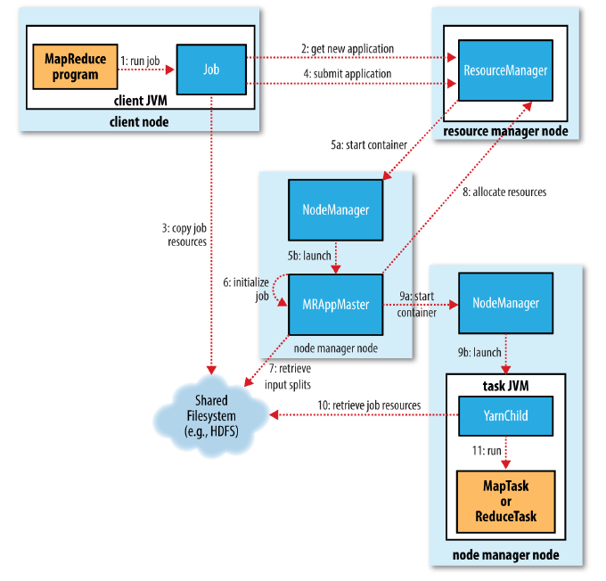
基于YARN实现MapReduce

Slide 26
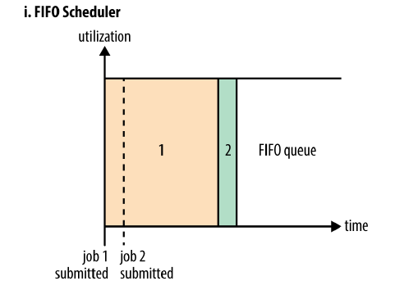
调度器——FIFO

Slide 27
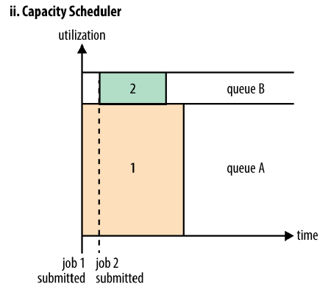
调度器——Capacity

Slide 28
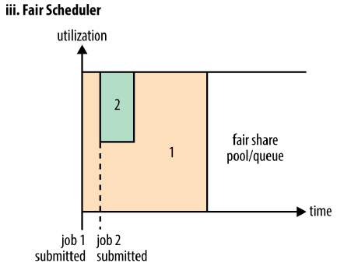
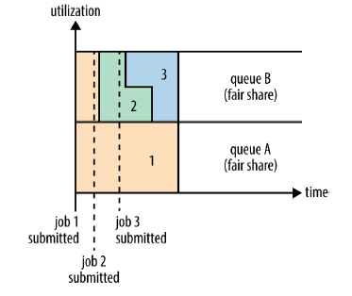
调度器——Fair

Slide 29
YARN 编程模型
Client<-->ResourceManager
ApplicationMaster<-->ResourceManager
ApplicationMaster<-->NodeManager

Slide 30
参考资料
Hadoop The Definitive Guide 以及参考文献
http://hadoop.apache.org/docs/r2.7.1/
git://git.apache.org/hadoop.git

