Slide 1
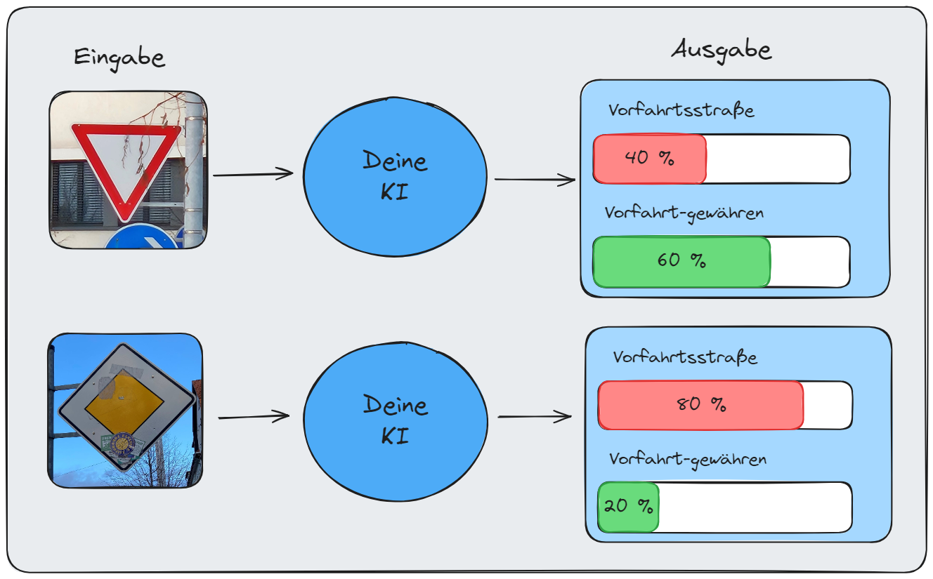






Training
Datensatz
Testen

